Slide 1
Chemistry (0620) Grade 10 Stoichiometry part one Moles in gases in solutions

Slide 2
Define the Avogadro constant?
* The number of particles in one mole of a substance.
This is 6.02 × 10²³ particles (counting atoms, molecules,ions).
*Unit = Mol.
1 mol of any sample = Avogadro’s number.
1 mol of atom/ion/molecule = 6.02 × 10²³

Slide 3
What is the equation that relates moles with the Avogadro constant?
1 Mol
Molar mass
6.02 × 10²³

Slide 4
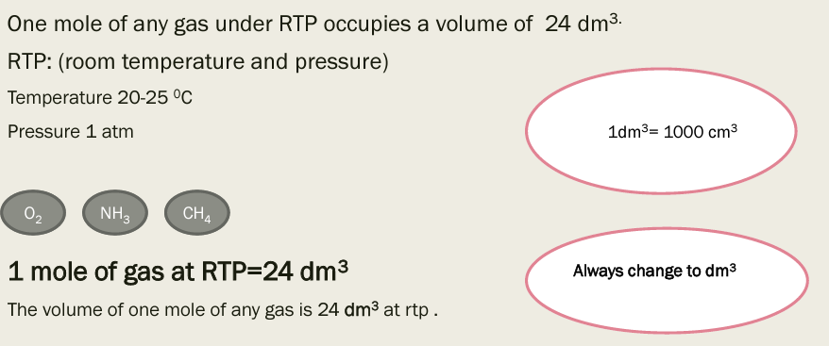
Moles of gases

Slide 5
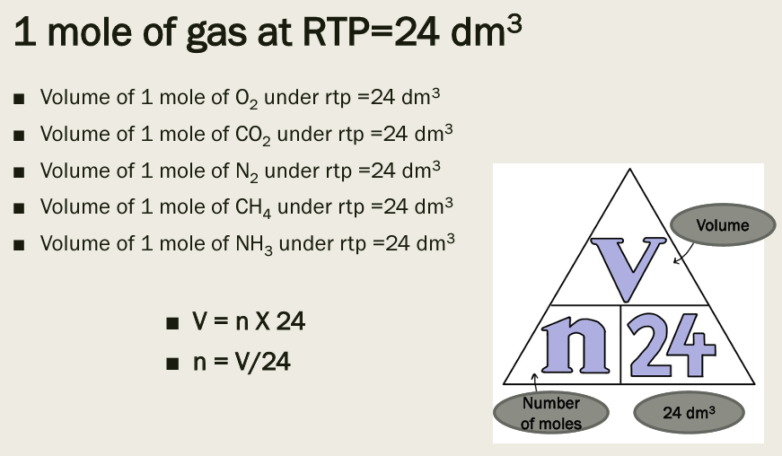

Slide 7


Slide 8
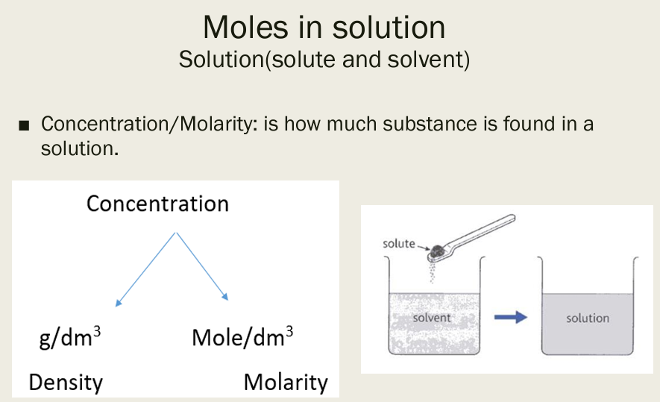

Slide 9
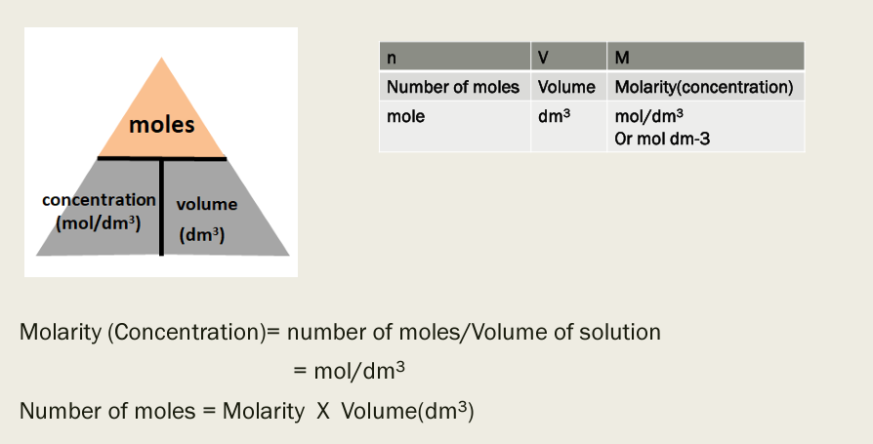

Slide 10


Slide 12
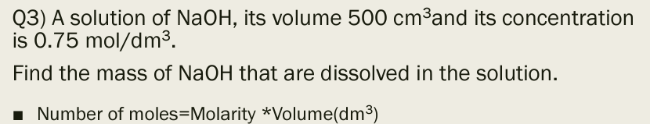

Slide 13
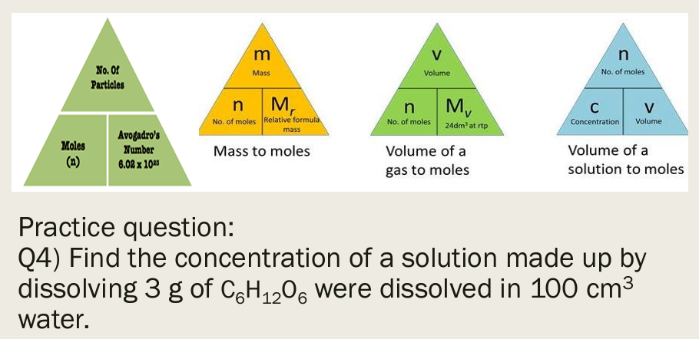

Slide 14
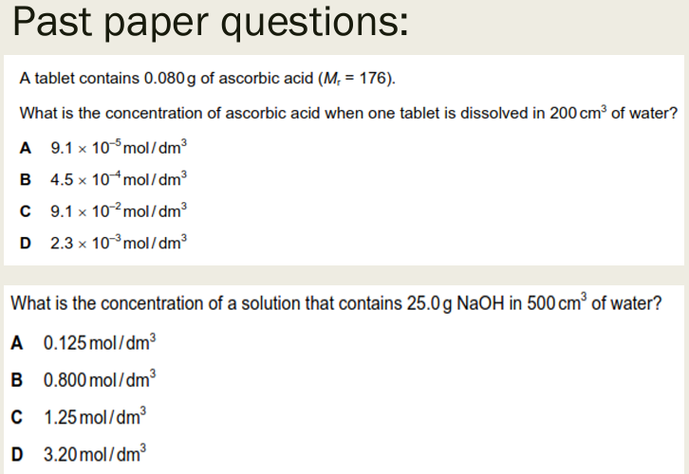

Slide 15
