Slide 1
Chemistry (0620) Grade 10 Stoichiometry part one Moles in gases in solutions

Slide 2
Define the Avogadro constant?
* The number of particles in one mole of a substance.
This is 6.02 × 10²³ particles (counting atoms, molecules, ions).
*Unit = Mol.
1 mol of any sample = Avogadro’s number.
1 mol of atom/ion/molecule = 6.02 × 10²³

Slide 3
What is the equation that relates moles with the Avogadro constant?
1 Mol
Molar mass
6.02 × 10²³

Slide 4
What is the molar mass?
The molar mass is the mass of 1 mole of the substance. It is the same as the Ar / Mr of the substance but the molar mass has a unit g/mol.
From the periodic table.

Slide 5
Questions:
Question (1):
How many atoms of Na are in 2 g Na?
Question (2):
What is the mass of 10⁶ atoms of Na?

Slide 6
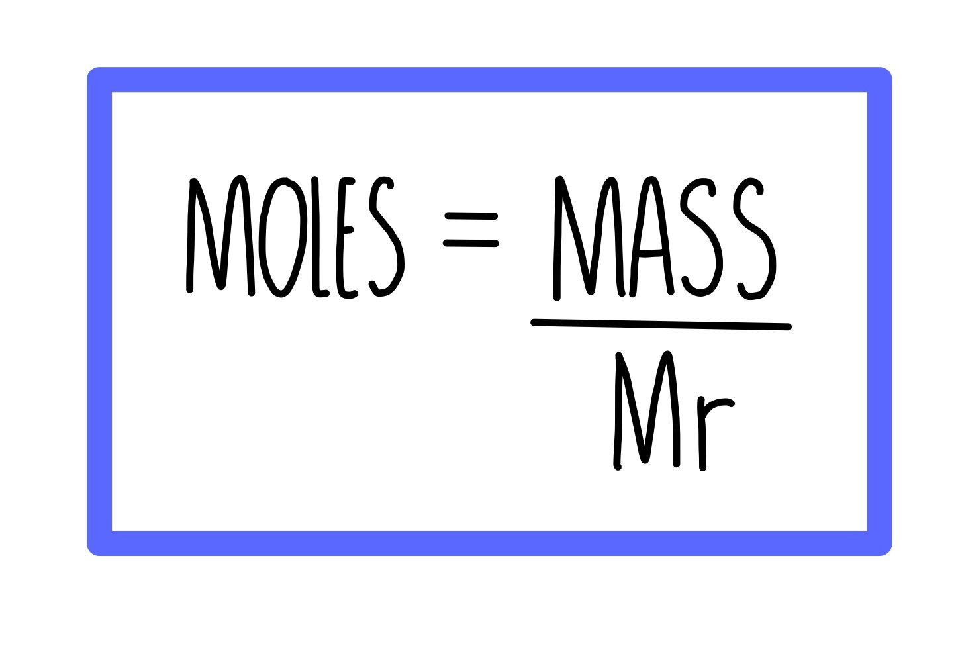
What is the equation that relates amount of substance, mass and molar mass?

Slide 7
Question(1):
Calculate the amount of substance (no. of mol) in 300 g of calcium carbonate (CaCO3)

Slide 8
Question (2)
Calculate the mass of 0.75 mol of calcium (Ca).

Slide 9
Question (3)
How many moles are in 5.44 g of sodium chloride?

Slide 10
Question (4)
Calculate the molar mass of AlCl3
(Moles = 4 and mass =534 g).

Slide 11
Question (5)
Calculate the number of carbon dioxide molecules in 1.5 moles of CO2 using Avogadro constant

Slide 12
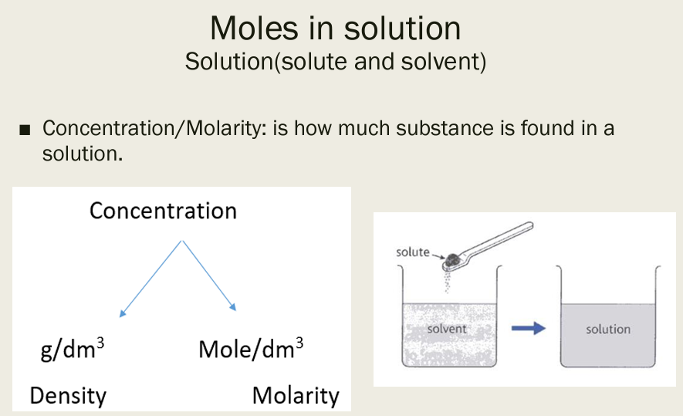

Slide 13
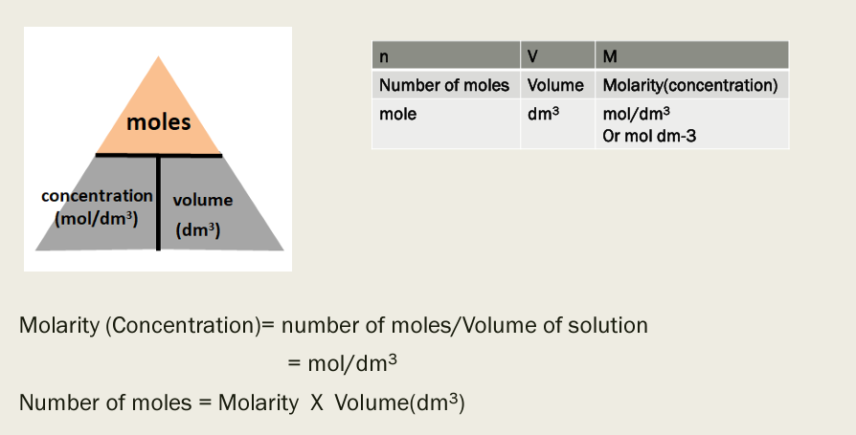
1 dm3 = 1000 cm3

Slide 14


Slide 16
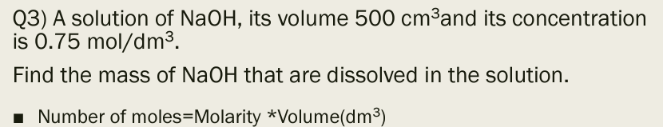

Slide 17
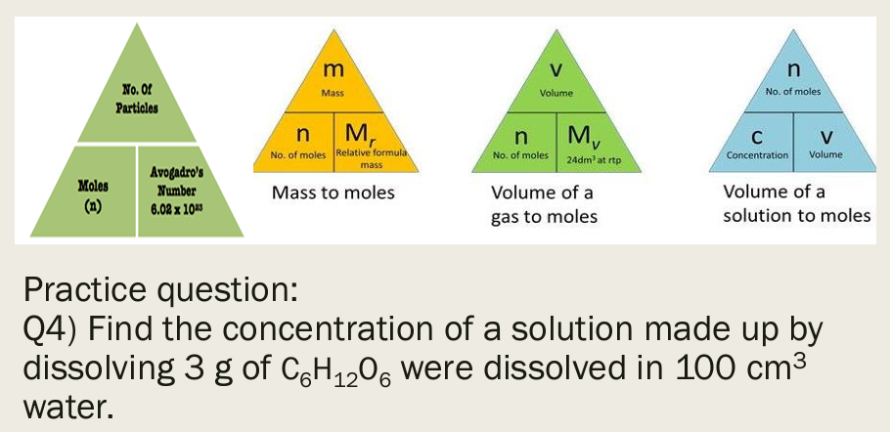

Slide 18
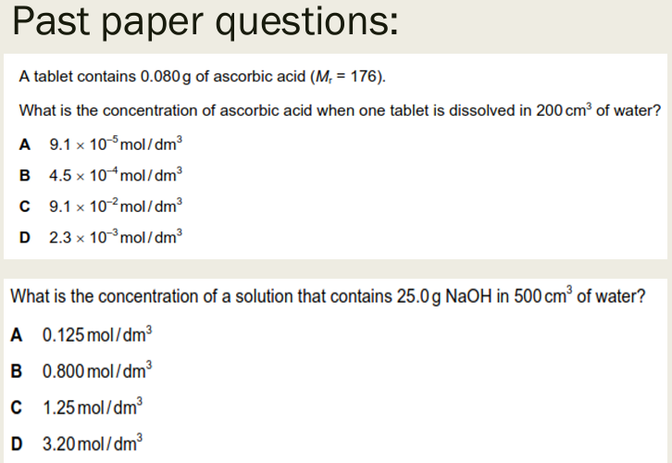

Slide 19
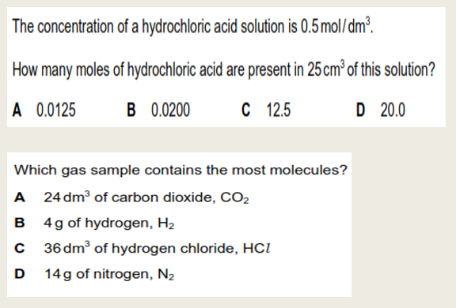

Slide 20
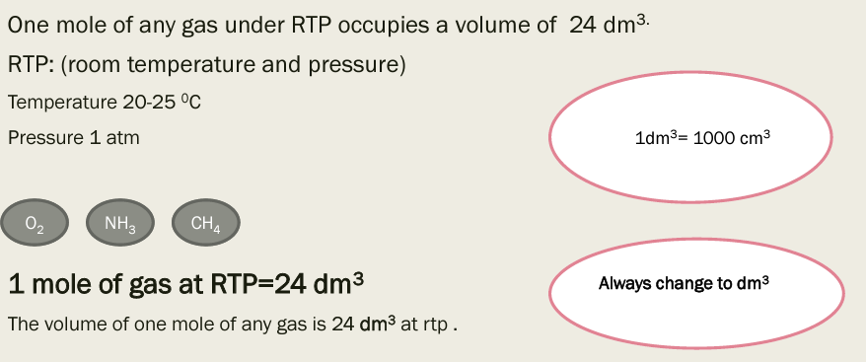
Moles of gases

Slide 21
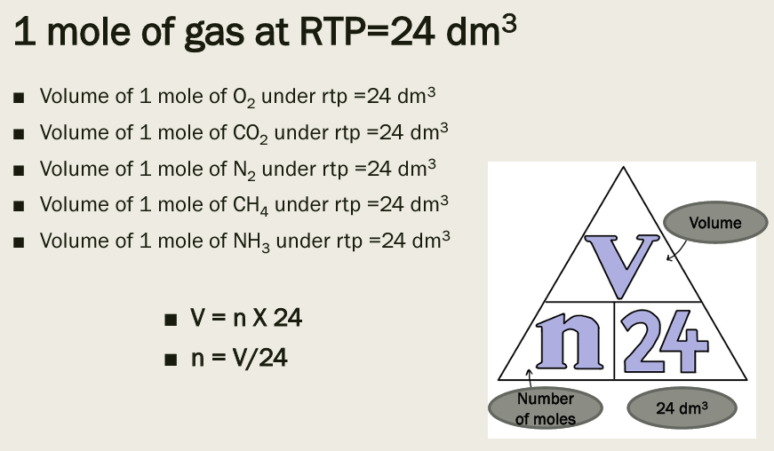

Slide 23


