Slide 1
Unit three / Grade 10
Rate of reaction
Chemistry 0620

Slide 2
Rate of reaction
• The rate of a chemical reaction is a measure of the ‘speed’ of the
reaction.
• Different reactions take place at different speeds or rates.
• The rate of reaction can be defined as the change in amount of one
of the reactant or one of the product per unit of time.
• Rate of reaction is the speed at which reactants are used up or
products are formed.
• Rate= change in quantity / change in time

Slide 3
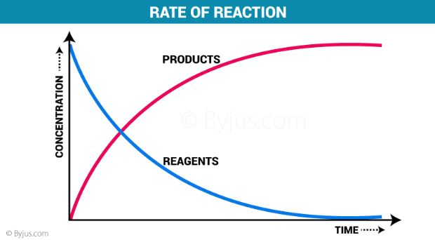
How can we measure the rate of chemical reaction?
Experimentally, we can follow the progress of a reaction by either
measuring the decrease in the amount of a reactant or the increase in
the amount of a product per unit of time.
• How fast the reactant is consumed per unit time.
• How fast the product is produced per unit time.

Slide 4
* Graphs are a way of visualising the changes in reactant or product concentration that take place during a reaction.

Slide 5
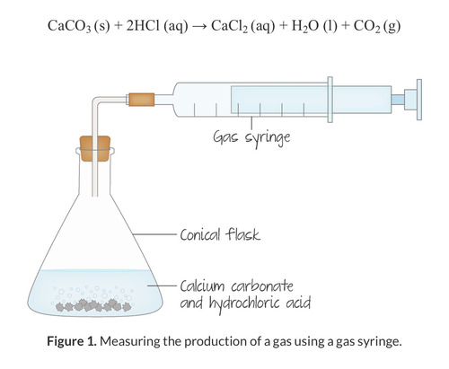
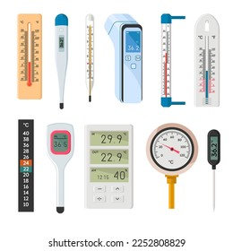
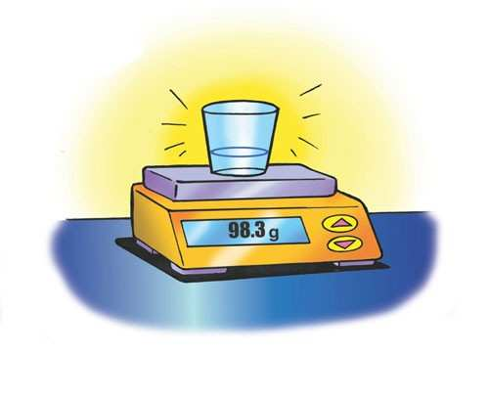
Experiments to measure the rate of reaction between calcium carbonate and hydrochloric acid
CaCO3 (s) + 2HCl (aq) → CaCl2 (aq) + H2O (l) + CO2 (g)
1 Measuring the volume of CO2 produced per unit time .
2 Measuring the change in mass(mass loss) per unit time.
3 Measuring the temperature per unit time.

Slide 6
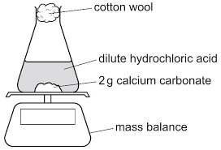
Measurement of the rate at which the mass decreases
Cotton wool allows the
CO2 gas to escape and
prevent splashing.
• The mass will decrease
since CO2 escapes

Slide 7
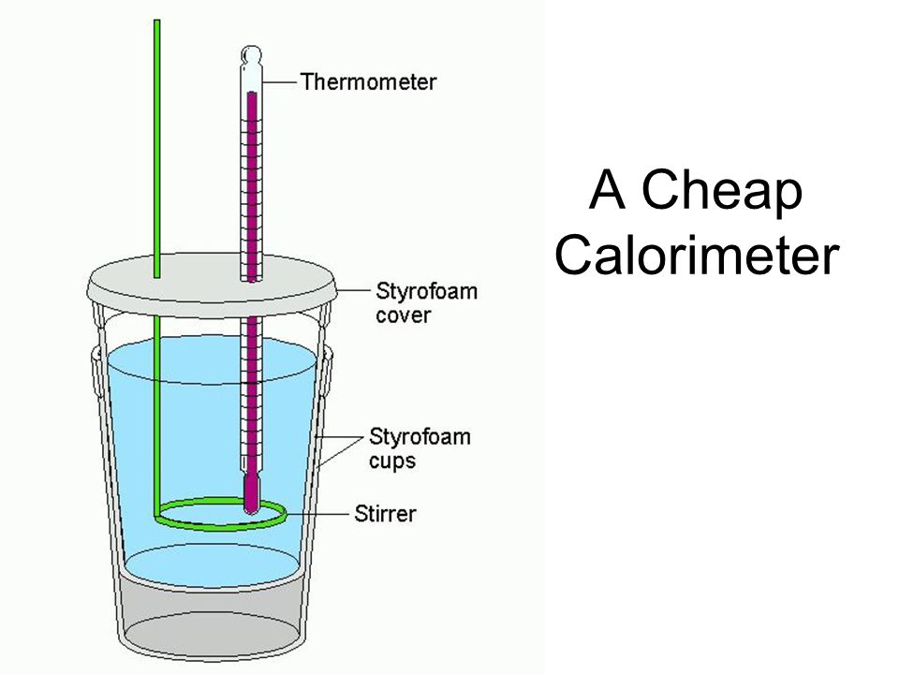
Measuring the temperature per unit time.
Polystyrene cup works
as insulator .
• Stirrer to insure equal
distribution .

Slide 8
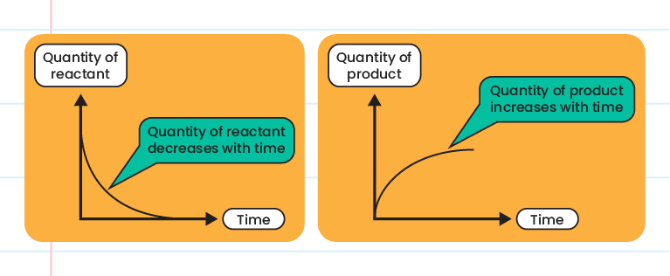
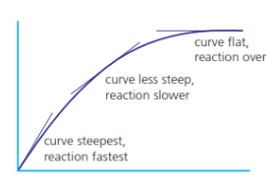
Quantity of reactants decrease, and the quantity of the products increase
At the beginning of the reaction , the
rate is very high. Curve is steep because
the concentration of the reactants is
very high, so more particles and more
effective collisions so faster rate of
reaction.
After a while , the rate decreases, the
curve is less steep because the
concentration of the reactants decreases
so less particles less effective collisions
and slower rate.
When the reaction is over the curve
becomes constant because no more
particles. The reactants are finished.

Slide 9
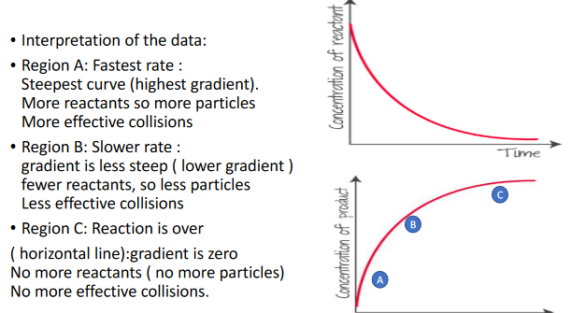
Time

Slide 10
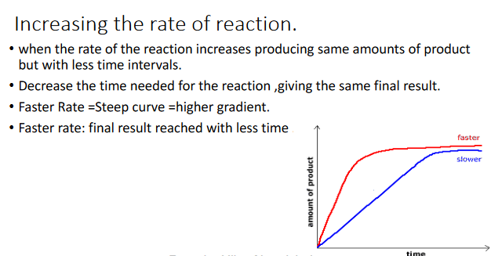

Slide 11
Collision theory
Collision theory is based on the idea that in order for a chemical reaction
to occur between two or more reactant particles, they must collide.
Not every single collision between reactant particles results in a chemical
reaction; this only happens when the following requirements are
satisfied:
Reactants must be suitable .
Reactant particles must collide.
Particles must have minimum amount of energy to start the reaction
(activation energy)
A collision that results in a reaction is called an effective collision.

Slide 12
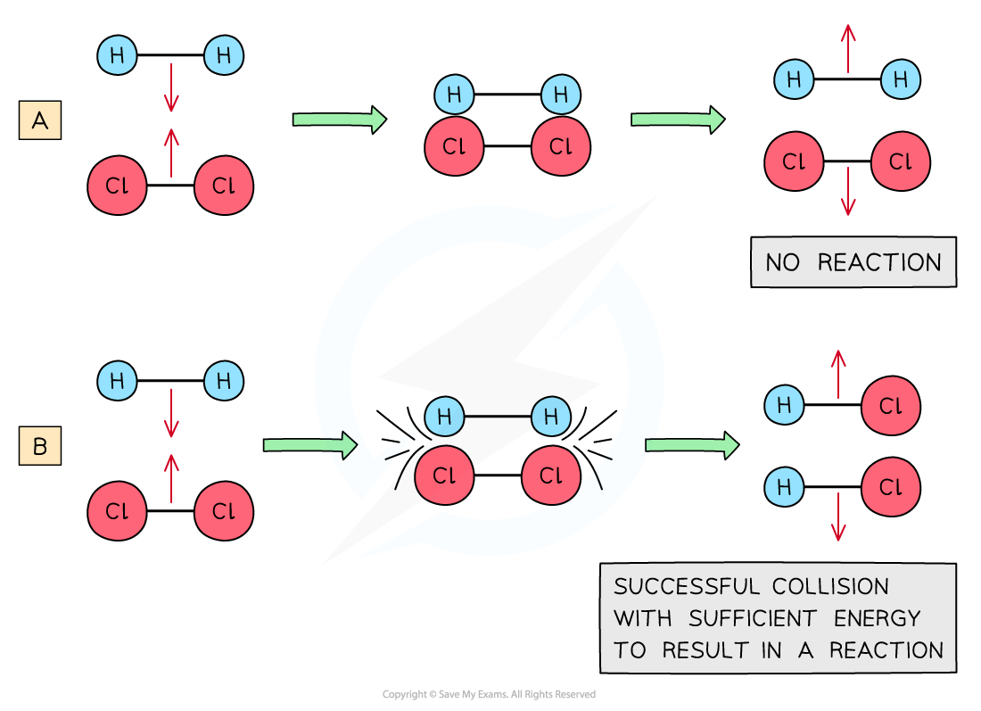
Activation energy (Ea)
The activation energy (Ea) of a reaction is the minimum amount of kinetic energy that colliding particles must have for a chemical reaction to occur.
If the reactant particles do not have sufficient kinetic energy, the collision will not be successful and a chemical reaction will not take place.

Slide 13
Experimental measurements of reaction rates
change in concentration
change in mass or volume (for reactions involving solids or gases)
change in pH (for acid base reactions)
change in conductivity (for reactions involving electrolytes)
change in colour (for reactions involving colored compounds). Difference in light absorbed by an aqueous solution if the reactants and
products are of different colors

Slide 14
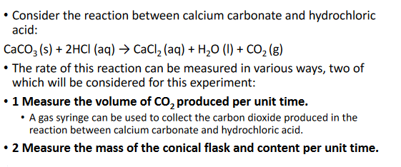
Experiments to measure the rate of reaction

Slide 15
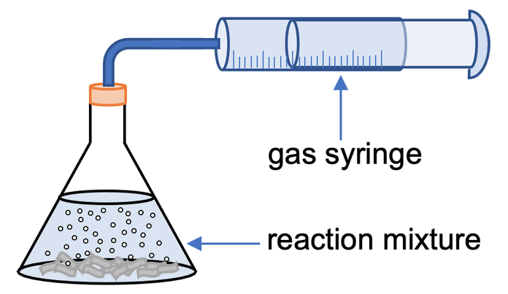
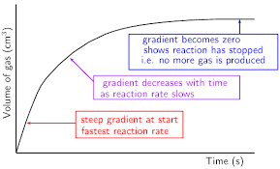
Change in gas volume
The volume of gas produced in this reaction can be measured using the apparatus .
• The hydrochloric acid is put into conical flask , the marble chips are added , the plug is quickly
fixed into the neck of the flask and the stopcock is started .
• The reaction will start immediately , bubbling (effervescence ) will occur in the flask as the carbon
dioxide gas is produced and the plunge on the syringe will start to move .
• Measuring the volume of gas in the syringe every 10 seconds will indicate how the total amount of
gas produced changes as the reaction proceeds.
• The change in the rate of the reaction with time can be shown on a graph of the results.
Change in gas volume.

Slide 16
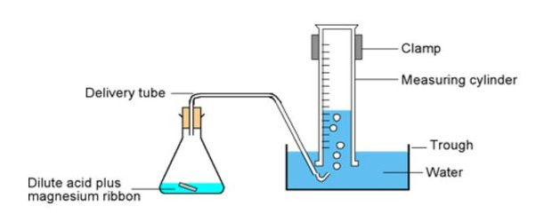
Inverted measuring cylinder method cannot e used for gases that are soluble in water because they will dissolve in the water.

Slide 17
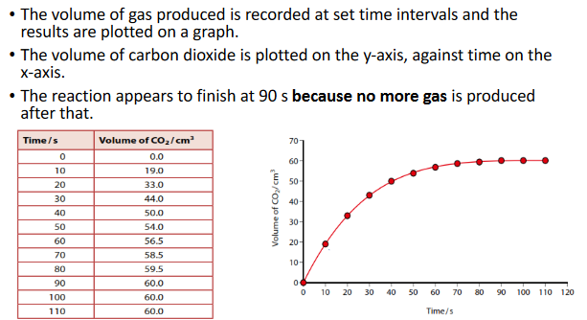

Slide 18
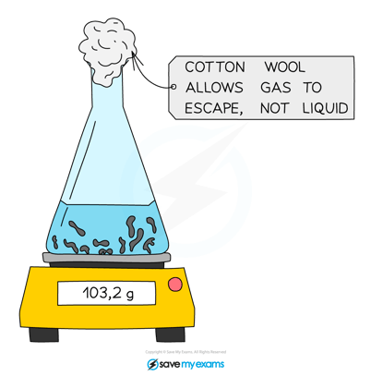
Measurement of the rate at which the mass decreases
The rate of this reaction can also
be determined by measuring the
speed at which the mass
decreases.
• The mass decreases as carbon
dioxide is given off.
• This method is not suitable for
investigating reaction where
hydrogen gas is released, because
of its low density, so the change
in mass is too small.

Slide 19
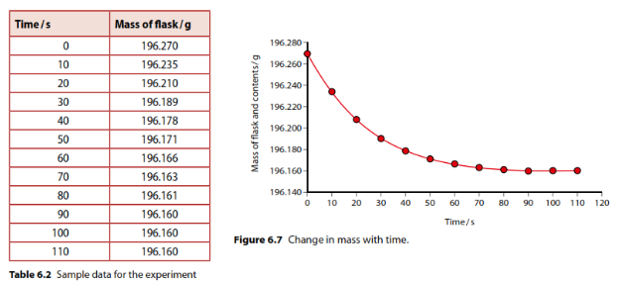

Slide 20
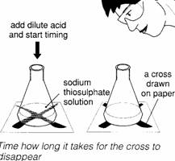
Measuring the time taken for the formation of a precipitate
The reaction between hydrochloric acid and sodium thiosulfate is an
example of a clock reaction in which the time taken for a reaction to
reach a certain point is measured.
• In this reaction, it is the formation of a precipitate of yellow sulfur in
which a cross drawn under the reaction mixture will disappear.
• By varying either the concentration or temperature of the acid or
sodium thiosulfate solution, the effect of the change can be
measured by recording the time taken for the cross to be obscured.

Slide 21
Factors affecting reaction rate
1.Temperature
2. Concentration of reactants
3. Surface area of solid reactants
4. Pressure for (reactions involving gases)
5. Catalyst
6. Light intensity

Slide 22
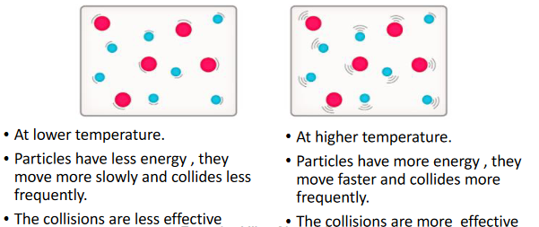
1- Temperature

Slide 23
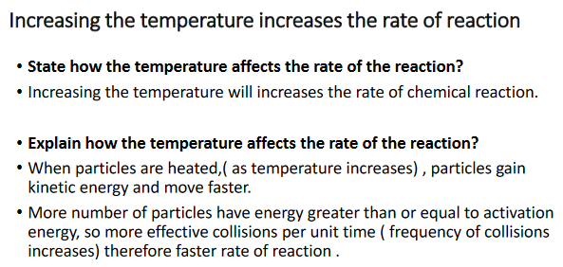

Slide 24
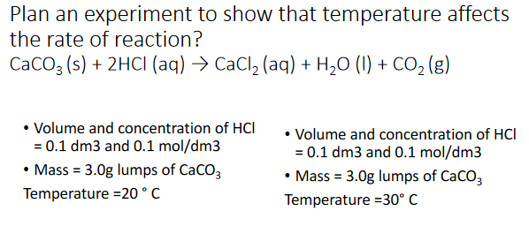

Slide 25
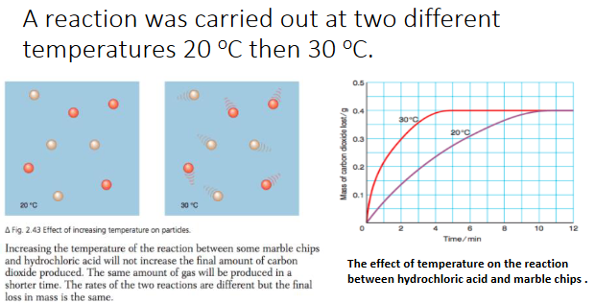

Slide 26
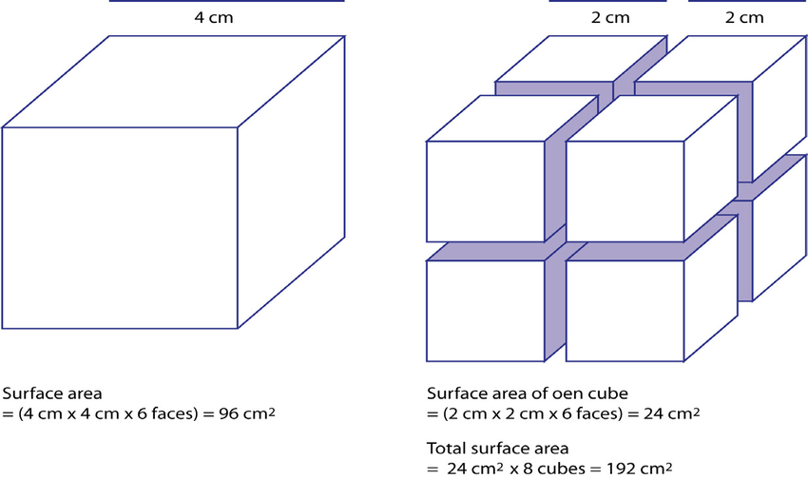
2- Surface area (particle size)
Crushing a solid into smaller pieces using a mortar and pestle increases the
surface area per unit volume and causes an increase in the rate of reaction.
• The rate of reaction would get faster as the surface area per unit volume
increases.
• Reducing the particle size will increase the surface area

Slide 27
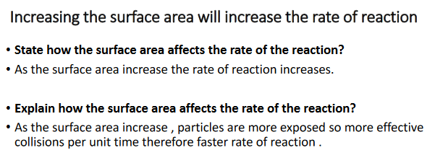

Slide 28
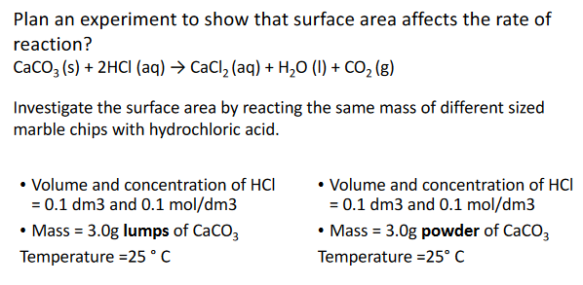

Slide 29
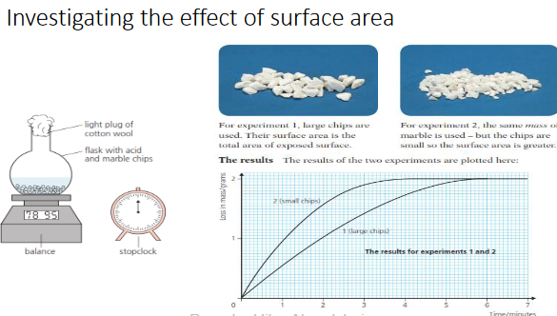

Slide 30
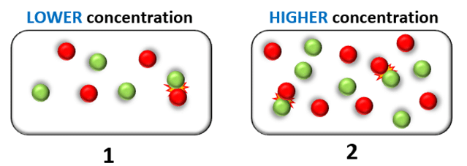
3- Concentration
Increasing the concentration of a solution increases the rate of reaction.
• the reaction of zinc with both diluted and concentrated solutions of
hydrochloric acid.
• The rate of reaction is greater in the concentrated solution because of the
increased frequency of collisions between the hydrogen ions and the zinc.
• An increase of collisions results in a greater probability of successful
collisions between the reactant particles and consequently an increase in
the rate of reaction

Slide 31
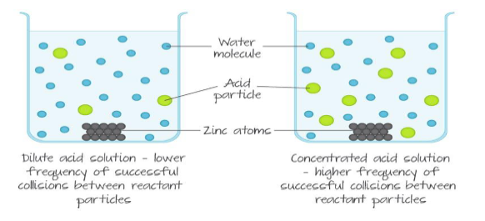

Slide 32
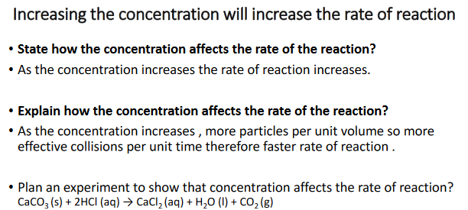

Slide 33
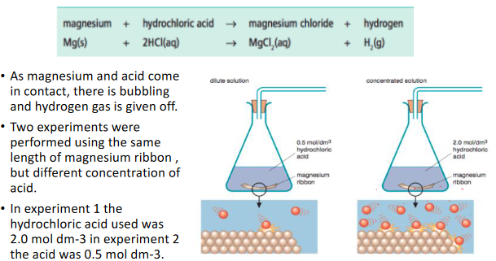

Slide 34
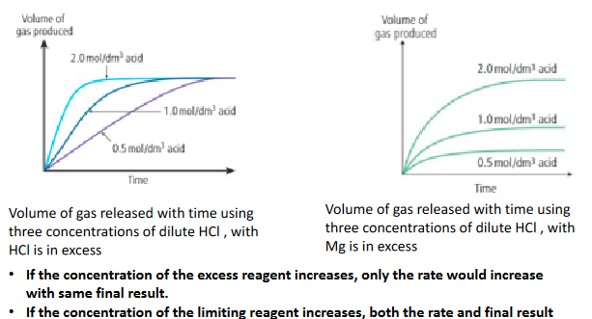
Would increase

Slide 35
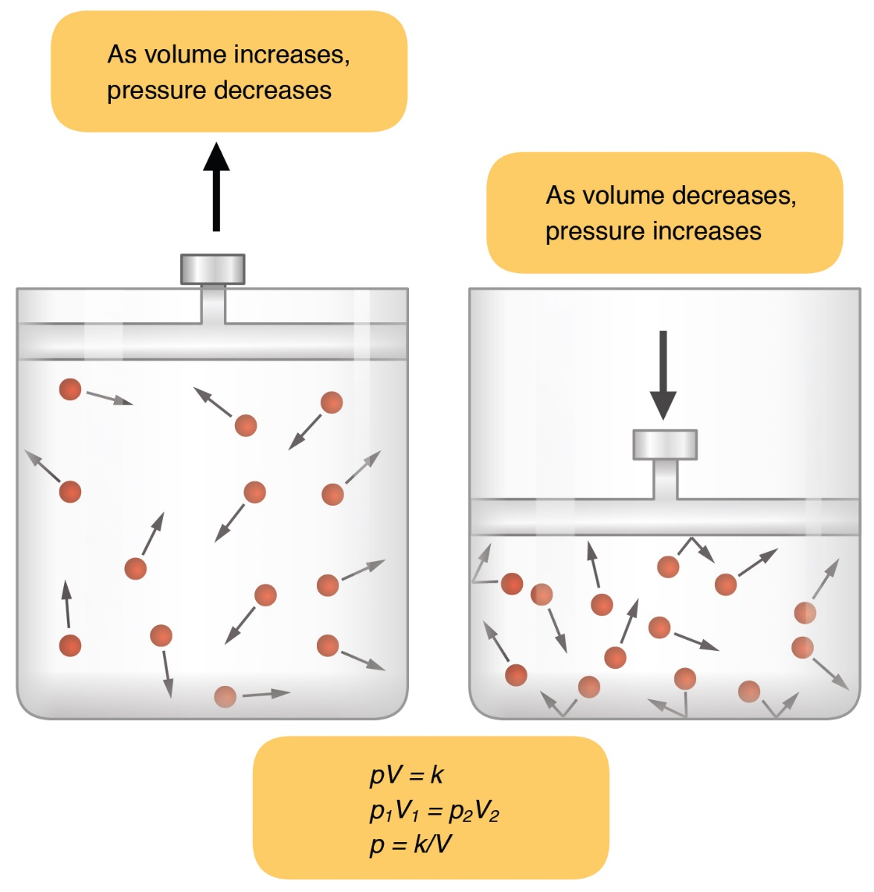
4- Pressure:
*This factor only affect particles of gases.
Increasing the pressure for a reaction that involves gases means that there
are more gas particles per unit volume.
• This results in an increase in the frequency of effective collisions between
reactant particles per unit time therefore faster rate of reaction.
Increasing the pressure by reducing
the volume at constant temperature

Slide 36
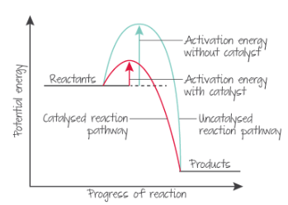
5- Catalyst
A catalyst is a substance that
increases the rate of a
chemical reaction without
being used up.
• Activation energy (Ea): The
minimum amount of energy
required for a reaction to
occur.
• Catalysts provide an
alternative pathway that has
a lower activation energy so
more particles are involved .

