Slide 1
Unit two / Grade 10
Electrolysis
Chemistry 0620

Slide 2
What is electrolysis?
Electrolysis: Is the decomposition (breaking) down of an ionic compound. When molten or in an aqueous Solution by passage an electrical current by electricity
Uses of electrolysis:
purifying copper.
Electroplating (plating) metals with silver or gold.
Extracting reactive metals, such
as Aluminum Making chlorine, Hydrogen or Sodium hydroxide-

Slide 3
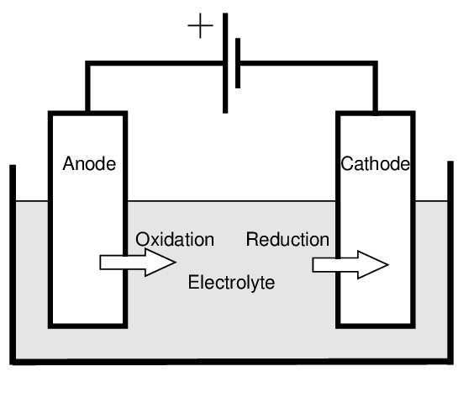
Electrochemical cells
(1) Electrolytic cells
Convert electrical energy to chemical energy ( reactions are non – spontaneous).
(2) Voltaic or Galvanic cells
Convert chemical energy to electrical energy (reactions are spontaneous).
wires
Power supply
electrodes

Slide 4
Components of electrolytic cells are:
Power supply (Battery positive and negative terminals/poles.
Container or a beaker for aqueous or molten compounds.
Wires to allow the passage of electricity.
Electrodes (made up of graphite or platinum).
*Two properties that electrodes must have:
They are good electrical conductors.
They are inert (they do not react with electrolyte or products of electrolysis.
Cheap and available.

Slide 5
Electrodes
Cathode (-)
Is the negative electrode.
“Reduction”
Electrons are gained
Anode (+)
Is the positive electrode.
“Oxidation”
Electrons are lost

Slide 6
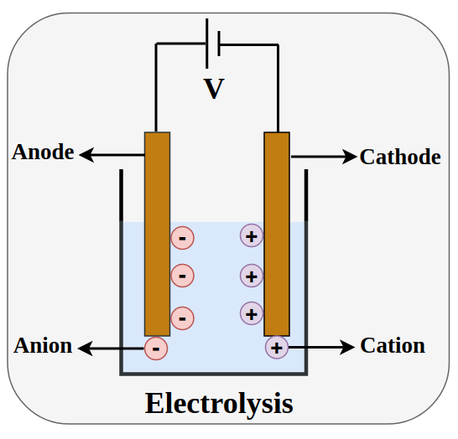
Electrolyte
Electrolyte: is the molten or aqueous ionic compound that conducts electricity during electrolysis.
Electrolyte
Molten (L)
Aqueous (aq)

Slide 7
Internal circuit : Movement of the ions in the electrolyte complete.
External circuit: Electrons flow from the anode (positive) to the cathode (negative electrode).
Electrons are lost from the cathode and gained at the anode.

Slide 8
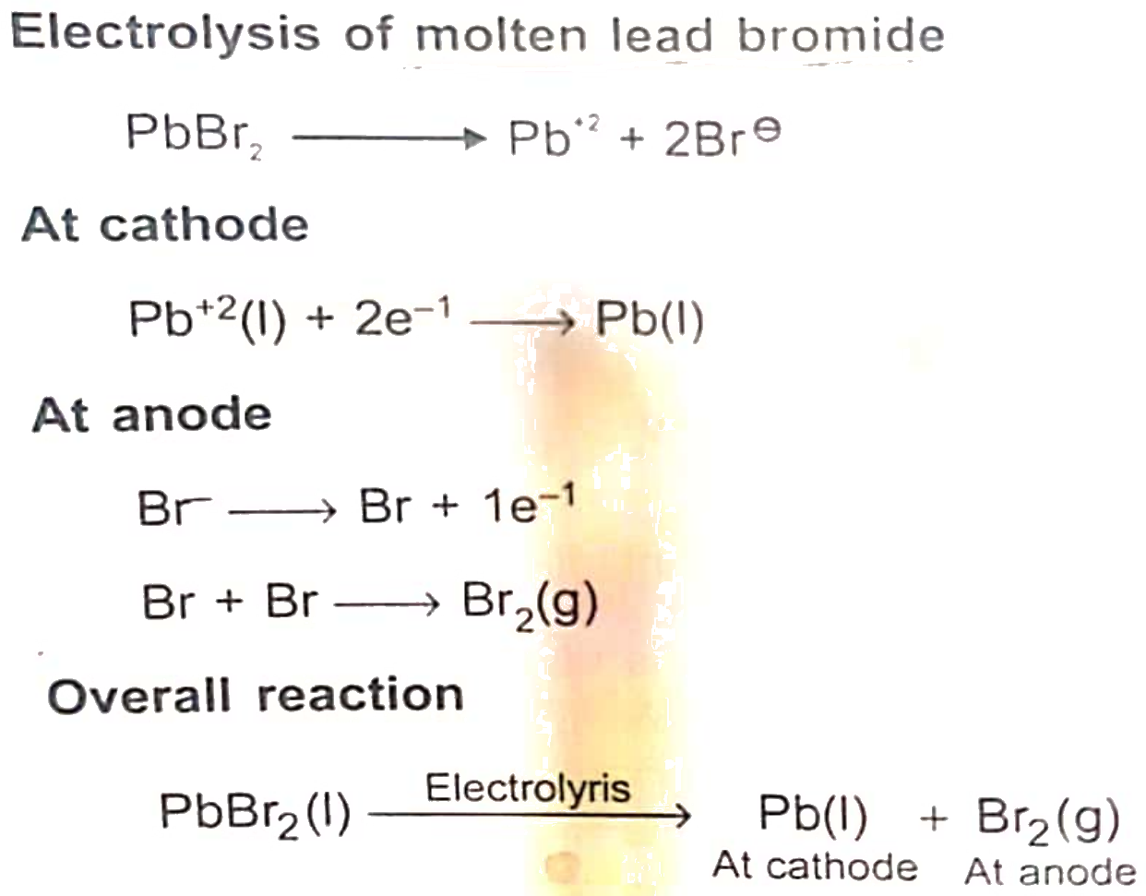
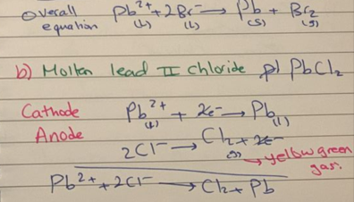
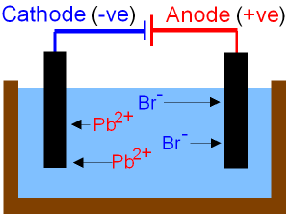
(1) Electrolysis in molten using graphite electrodes.
(a) Molten lead || bromide
(b) Molten lead || chloride

Slide 9
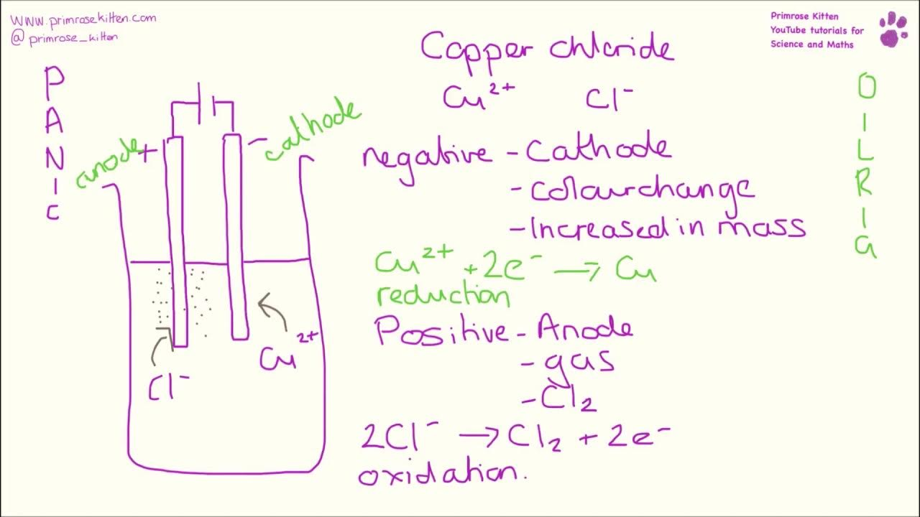
(C ) Copper || chlorides
(D) Aluminum oxide

Slide 10
(E) Sodium chloride
(f) Zinc || chloride

Slide 11
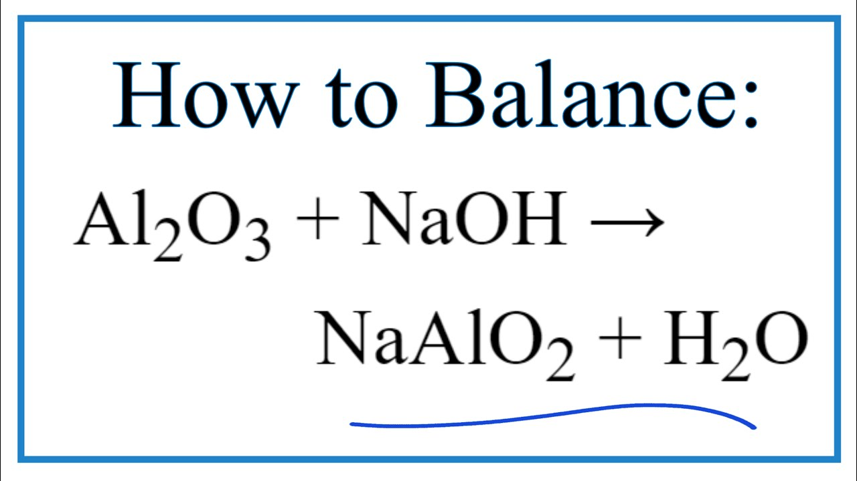
(2) Extracting aluminum
Aluminum is the most abundant metal in the earth’s crust. Its is found in the mineral ore “Bauxite” which contains 50-65 % of aluminum oxide Al2O3. “Alumina” the main impurities in bauxite are oxides of iron, silicon and titanium.
The first step in aluminum extraction is to purify the ore. The ore is first crushed and mixed with sodium hydroxide, the aluminum oxide reacts with sodium hydroxide + dissolves.

Slide 12
*The impurities are insoluble in sodium hydroxide. These are filled off.
The sodium aluminate undergoes further treatment and is finally heated to make pure aluminum oxide Al2O3.

Slide 13
Extracting aluminum from aluminum oxide.
Al2O3 melts at 2040°C, it is very difficult to keep the electrolyte at this very high temperature for any period of time. It is too costly because it needs so much energy. Energy is expensive also, aluminum oxide on its own is a poor conductor of electricity.
Dissolving aluminum oxide is large amount of molten cryolite .
Cryolite, which is sodium aluminum flouride Na3AlF6 melts about 1000°C. since the aluminum oxide is dissolved in cryolite , the melting point of the electrolyte is much lower compared with Al2O3 “saves a lot of energy”.
Improves the electrical conductivity of the electrolyte.
CaF2 is often added to lower the melting point further. In most cases the melting point of electrolyte is about 900°C.

Slide 14
The advantages of cryolite:
1- improves the conductivity.
2- Lowers the melting point of the electrolyte.
3- Reduces energy costs.

Slide 15
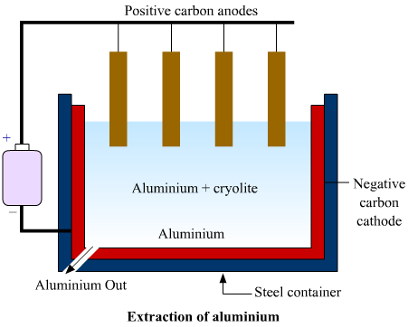
1- The electrolytic cell for the extraction of aluminum has carbon anodes and carbon cathodes.
2- During electrolysis of molten aluminum oxide, aluminum forms at the cathode and oxygen is released at the anode.
3- The anodes have to be replaced regularly because they react with the oxygen formed during electrolysis releasing carbon dioxide gas.
Half equations:
At the cathode: Al³⁺ + 3e⁻ → Al
At the anode: 2O²⁻ → O₂ + 4e⁻

Slide 16
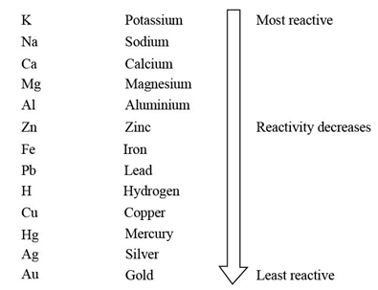
(3) Extraction of aqueous solution using graphite.
Concentrated NaCl (aq)dissolved in water.
O H −, H+, Na+, Cl -
Cathode Na+, H+
If the metal ion is above (H) in the reactivity series the H+ will be reduced white the metal ions remains.
Most likely to be discharged

Slide 17
If the OH-, Cl-, B-, I- the halide ions are oxidized while the OH- remains in the solution.
SO₄²⁻, NO3⁻, OH⁻, Cl⁻, Br⁻, I⁻
Most likely to be dicharged

Slide 18
Example (1):
At the cathode: 2H⁺ (aq)+ 2e⁻ → H2 (g) (Colorless gas)
At the anode: 2Cl⁻ (aq)→ Cl₂ (g) + 2e^{- (yellow green gas).}
Products hydrogen cathode
^{chloride anode}
NaOH solution turns litmus paper blue.
^{Over all equation:}
2H⁺ (aq)+ 2CL⁻ → Cl2 + H2 (g)

Slide 19
Example (2): KBr
K⁻, H+ OH⁻, Br⁻
At the cathode: 2H⁺ (aq)+ 2e⁻ → H2 (g) (Colorless gas)
At the anode: 2Br⁻ → Br₂ (g) + 2e^{- (Redish brown gas).}
^{KOH (turns litmus paper blue).}
^{Over all equation:}
2H⁺ (aq)+ 2Br⁻ (aq)→ H2 (g)+ Br2 (g)

Slide 20
Example (3): CuSO4
H⁺,Cu⁺² SO₄²⁻,OH⁻
At the cathode: 2(Cu⁺²+ 2e⁻ → Cu (s)) (Red brown solid)
At the anode: 4OH⁻ →2H2O +O2+ 4e⁻
*Electrolyte uses its blue colour
Overall : 2Cu⁺²+ 4OH⁻ → 2Cu (s) + 2H2O (l) + 02 (g)
Ions left H2SO4 turns litmus paper red.

Slide 21
Example (4) AgNO3 (aq)
Ag+, H+ NO3⁻, OH⁻
At the cathode: (2H²+ 2e⁻ → H2) 2
At the anode: 4OH⁻ →2H2O +O2+ 4e⁻
Overall equation:
4H⁺ + 4OH⁻ →2H2O +O2+ H2
HNO3 Turns litmus paper red

Slide 22
Concentrated / diluted aqueous solution:
1- when concentrated aqueous solutions of salts of reactive metals are electrolyzed, hydrogen rather than a metal is formed at the cathode.
2- When concentrated aqueous sodium chloride is electrolyzed CL2 is formed at the anode and H2 is formed at the cathode.
3- When aqueous bromide or iodides are electrolyzed the halogens are discharged at the anode.
The anode product formed when aqueous chlorides are electrolyzed depends on the concentration of the solution.

Slide 23
(B) Electrolysis using active electrodes (aqueous solution)
Active electrodes are electrodes made up of the same metal found in the electrolyte.
CuSO4 Using copper electrodes
AgNO3 Using silver electrodes
ZnSO4 Using zinc electrodes

Slide 24
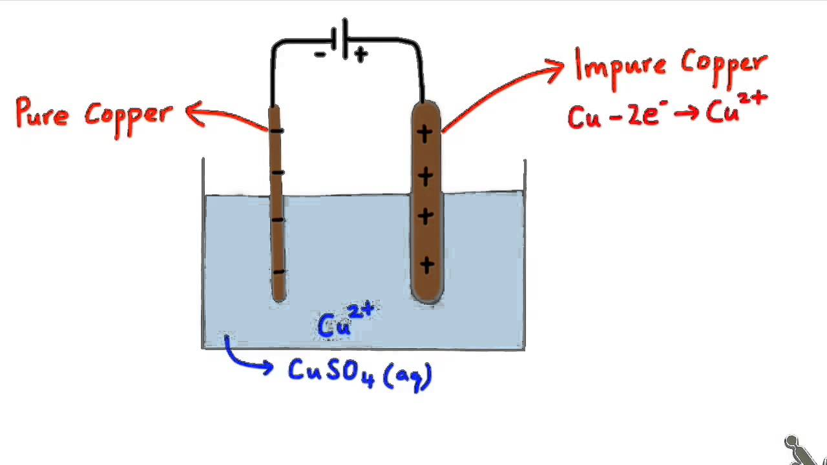
Example (1): refining copper CuSO4 / Cu electrodes
At the anode: Cu →Cu²⁺+ 2e⁻
At the cathode: 2e⁻ + Cu²⁺ →Cu
Observations:
1- mass of the anodes decreases.
2- mass of the cathode increases (bubbles lights up)

Slide 25
AgNO3 (aq) silver anode.
Ag (s) →Ag⁺+ 1e⁻
1e⁻ + Ag⁺ →Aga
Ag (s)+ (aq) Ag⁺+ →(aq)Ag⁺+ Ag (s)

Slide 26
Applications:
1- Electroplating: to cover a metal with a thin layer of another metal by using electricity. Why?
A- To prevent rusting/ resist corrosion.
B- To improve the appearance.
(Cu, Cr, Ni, Ag, Sn)

Slide 27
Example:
1- Connect the object to be electroplated to the negative pole of the power supply (cathode). The object to be electroplated must be clean so the metal which is cover it does not flake off (sulfuric acid or sand paper).
2- The plating metal is connected to the positive pot of the power supply. It becomes the anode.

Slide 28
The electrolyte is a solution of an ionic compound of the plating metal.
Ag Ag +
Cu Cu+2
The spoon must be rotated to distribute the metal equally on the spoon
Some metals corrode easily iron and steel undergo (rusting), (steel can electroplated with tin).
Cr plating gives a shiny surface to object that does not get dull.
Silver plating cutlery jewelry
U gold plating jewelry specialized, electronic equipment.

Slide 29
2- Purification of metals CuSO4 (aq) as the active electrode.
3-Extraction of metals (bauxite).
4- To prepare some solution (NaOH, HNO3,…….)

Slide 30
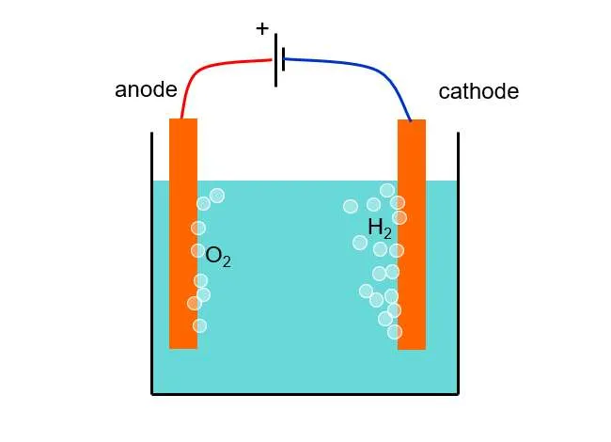
Electrolysis of water
1- Use platinium electrodes to keep the water clean.
2- add acid to increase the conductivity of water

Slide 31
H2O H⁺+ OH⁻
At the anode: 4OH⁻ →2H2O +O2+ 4e⁻
At the cathode: (2H⁺+ 2e⁻ → H2) 2
4OH⁻ + 4H⁺ →2H2O +O2+ 2H2
4H2O → 2H2O + O2 +2H2
2H2O → O2 +2H2
Ratio 1:2

Slide 32
Electrolysis HCl
2H⁺+ 2e⁻ → H2
4Cl⁻ →Cl2+ 2e⁻
2Cl⁻ + 2H⁺→Cl2+ H2
Ratio 1:1

Slide 33
Aqueous solution / Electrolysis
At the anode
At the cathode
Halide not present
Halide present
Lower in reactivity than H⁺
Higher in reactivity than H⁺
Metal formed
H2 formed
Oxygen formed
Dilute
Concentrated
Oxygen formed
Halogen formed

