Slide 1
Biology (0610) Grade 9 Biological molecules and Enzymes

Slide 2
Enzymes
Life of living organisms depends on chemical reactions called metabolic reactions that occur within cells. Metabolic reactions include digestion, respiration, photosynthesis and many others. These reactions require ages to reach completion but in our bodies they take less than a second to be complete.
How is this so?
The answer lies in substances called enzymes.
All biological reactions within human cells depend on enzymes. Their power as catalysts enables biological reactions to occur usually in milliseconds.

Slide 3
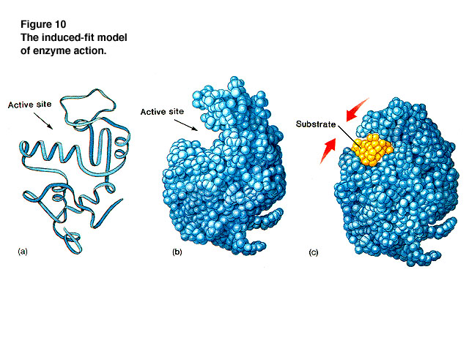
Without enzymes, there would be no life at all, from microorganisms to humans
So what are Enzymes?
Enzymes are biological catalysts, made up of protein molecules used to speed up the rate of reactions, without being consumed.
All Enzymes are made of proteins, but not all proteins are enzymes

Slide 4
Enzyme VS catalyst
Catalyst: Substances that speed up the rate of chemical reactions, without being changed by the reaction or used up . These are used in the lab to speed up chemical reactions e.g. Iron , Copper, manganese (IV) oxide ..etc.
Enzymes are proteins that function as biological catalysts that speed up the rate of chemical reactions :
Enzymes are called biological catalysts because they work in living cells

Slide 5
The shape of an enzyme
Remember that proteins can be different from each other by having different
sequences of amino acids in the chain.
The different sequences of amino acids give different shapes to protein molecules
This is because the amino acids interact with other nearby amino acids in the chain causing the amino acid chain to fold up in a particular way which gives each protein a unique three-dimensional shape (3D).
Enzymes are proteins and like all proteins they have a three dimensional shape.
Different enzymes are considered different proteins that have different sequences of amino acids.
That’s why each enzyme folds up in a particular way. Enzymes are unusual proteins because they have a space in the molecule with a particular 3D shape

Slide 6
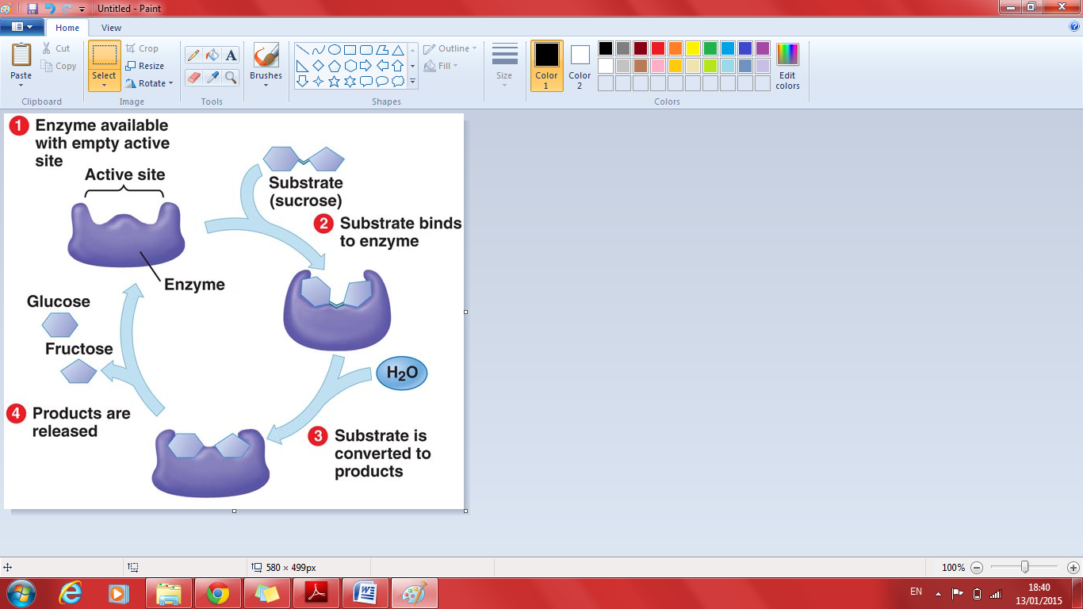

Slide 7
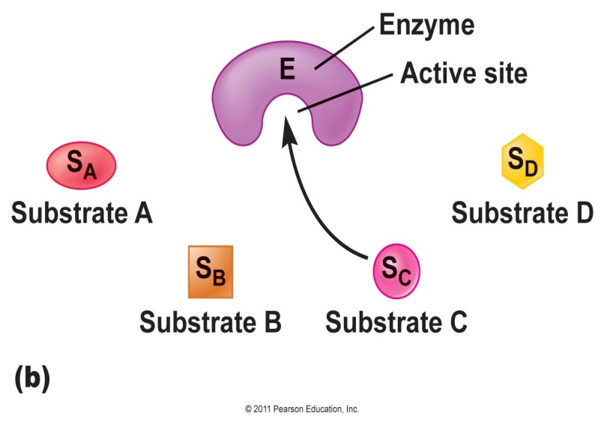
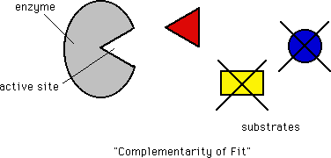

Slide 8
Consider this reaction :
Sucrose → Glucose and fructose
This metabolic reaction takes place in our digestive system during the process of digestion .
This reaction is catalyzed by an enzyme .
The enzyme catalyses the breaking down of sucrose into the monosaccharides glucose and fructose.
The substance which the enzymes works on in a chemical reaction is called the substrate ( in this example it is sucrose) and the substances which are formed at the end of the reaction are called the products ( in this case they are glucose and fructose).

Slide 9
Enzymes are specific
The substrate binds to a region in the enzyme called the active site forming an enzyme-substrate complex.
The active site matches the shape of the substrate molecule “they are complementary “ because the substrate fits into this space in the enzyme
The active site of each enzyme has a specific shape, and only substrates that have a shape complementary to the shape of the active site will be able to bind to the enzyme.
Each enzyme can catalyze only one particular kind of reaction. And because we have many different chemical reactions occurring in our bodies, there many different enzymes are found , one for each of the many different metabolic reactions that must take place for us to stay alive.

Slide 10
Lock and Key model.
Just as a key must exactly fit the shape of a door lock, so must a substrate exactly fit the shape the active site of the enzyme!
If the substrate fits into the active site of the enzyme, then the enzyme will be able to catalyze the reaction , if does not the reaction won't be catalyzed. That’s why enzymes are said to be "specific".
Enzymes are not used during reactions, once the reaction that the enzyme is catalyzing is over, the enzyme will be free to catalyze a new reaction. A single enzyme can carry out many reaction of the same type (with the same substrates or those that are structurally similar to each other) because enzymes are specific.

Slide 11
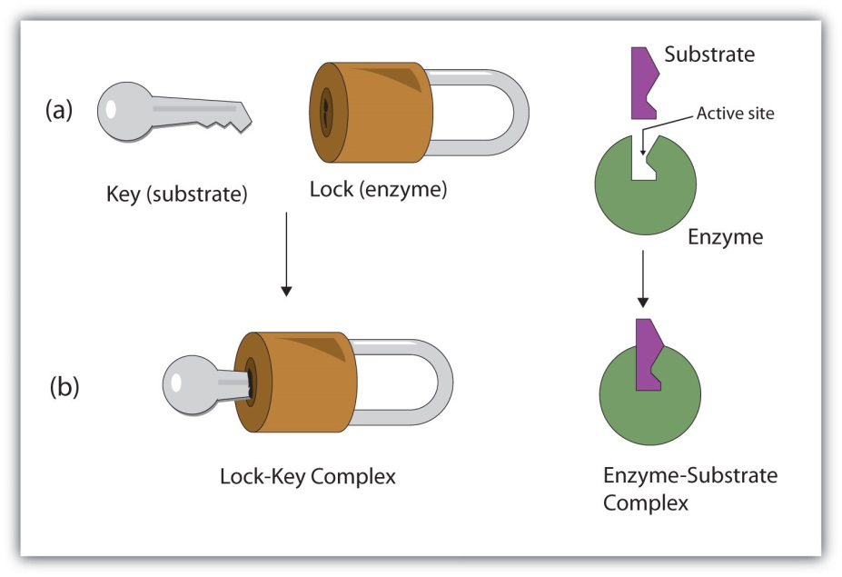

Slide 12
How does the nucleus control the chemical reactions that take place in the cell ?
Enzymes are proteins → so they must be produced on ribosomes (site of protein synthesis) → ribosomes get instructions for synthesizing proteins from the genes that the nucleus of the cell contains → the genes control the types and quantities of enzymes produced inside the cell → so it controls the type of chemical reactions that take place inside the cell →
Since different cells have different types of chemical reactions (specialization) → nucleus controls what the cell will be e.g. Blood cell, Muscle cell, nerve cell.. Etc.
Genes → proteins (enzymes) → catalyze reactions

Slide 13
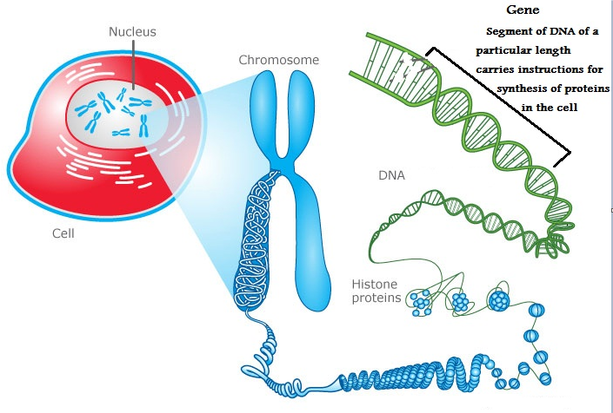

Slide 14
The Effect of High temperature on enzymes
Proteins are affected by high temperatures. High temperatures ruin the shape of the protein and it causes the protein to lose its function.
Why ? Because high temperatures break the bonds between the amino acids that hold the protein , as a result the protein loses its 3D shape → Denatured
Since all enzymes are proteins they are too affected by high temperatures.
High temperatures changes the shape of the active site of the enzyme, as a result, the substrate won't be able to fit to the shape of the active site and form an enzyme-substrate complex anymore, as a result, the enzyme loses the ability to catalyze reactions and is said to be "Denatured".

Slide 15
The difference between chemical and biological catalysts:
Hydrogen peroxide (H₂O₂), is a waste product of some chemical reactions in the cell. This waste product is very toxic so it needs to be broken down immediately.
Our Body breaks hydrogen peroxide down with an enzyme called catalase (a common enzyme found in the cells living organisms both animals and plants e.g. liver cells and potato cells) according to this equation:
H₂O₂→ H₂O +O₂
If you want to carry out the same reaction in the lab you would need MnO₂ as a catalyst
Catalase is an enzyme that functions inside living cells, and is sensitive to high temperature (becomes denatured), while MnO₂ is a catalyst made up of chemical substances and is not sensitive to high temperatures.

Slide 16
Naming enzymes
Typically, to generate the name of an enzyme, the suffix -ase is added to the name of its substrate or the reaction they promote
For example:
Enzymes that catalyze the breakdown of carbohydrates are called → Carbohydrases
Enzymes that catalyze the breakdown of proteins are called → Proteases
Enzymes that catalyze the breakdown of Fats (lipids) → Lipases
Exceptions: Trypsin , pepsin
An enzyme that acts on sucrose as it’s substrate is called Surcrase and it is considered a carbohydrase
An enzyme that removes hydrogen from its substrate is called dehydrogenase

Slide 18
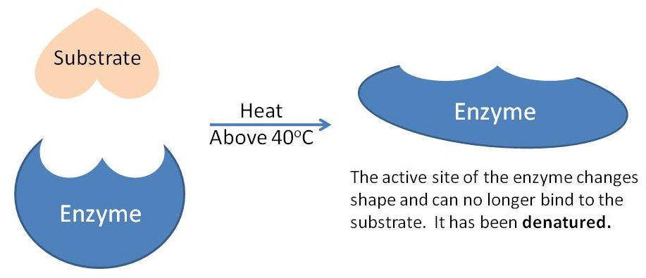

Slide 19
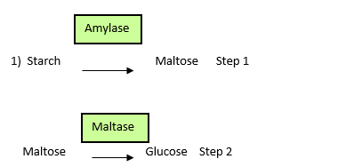
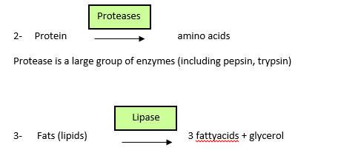

Slide 20
Types of enzymes:
Since metabolic reactions are either catabolic or anabolic , the enzymes that catalyze these are also classified into catabolic enzymes and anabolic enzymes
Catabolic enzymes: enzymes that speed up catabolic reactions by breaking down large molecules into smaller ones.
Anabolic enzymes: enzymes that speed up anabolic reaction by building up large molecules from smaller ones

Slide 21
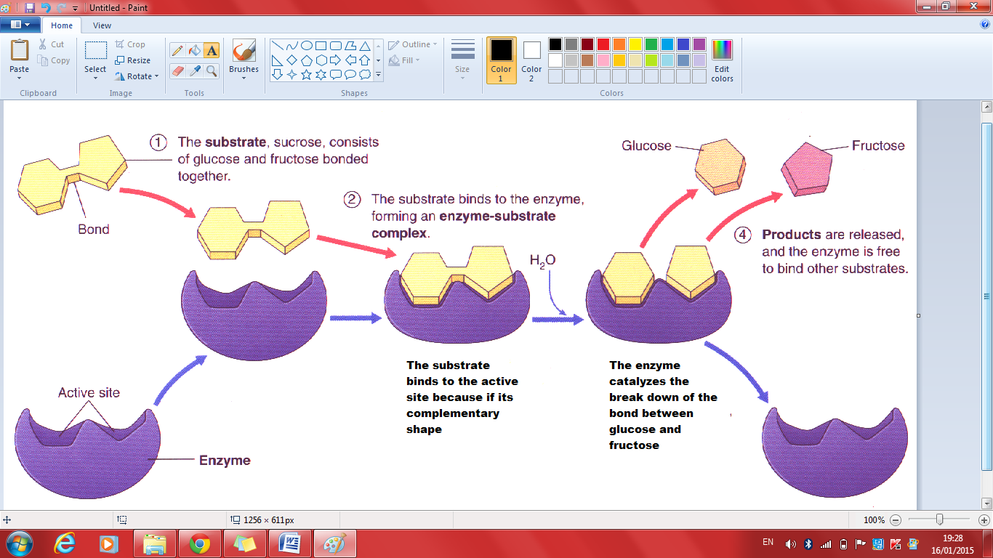

Slide 22
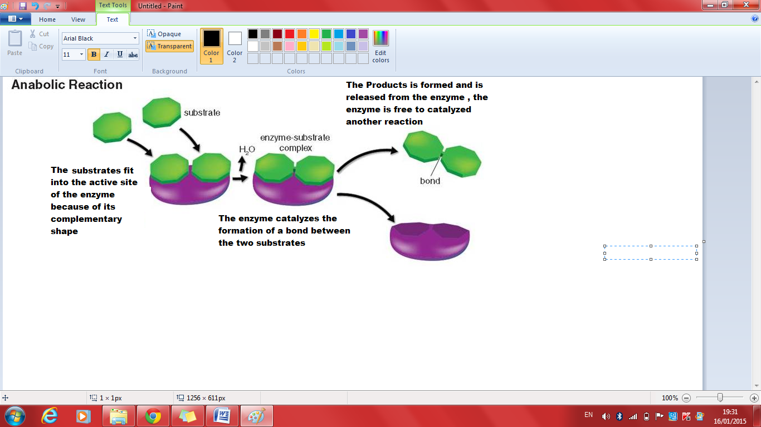

Slide 23
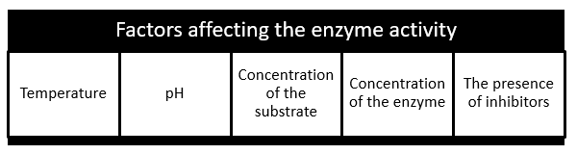

Slide 24
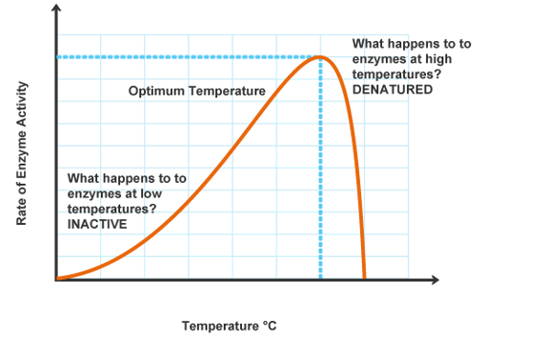
1-Temperature:

Slide 25
As the temperature increases, the activity of the enzyme increases, this happens because the kinetic energy of molecules increases with increasing temperature ( they move faster) , so more effective collisions take place between enzymes and substrates, so more enzyme-substrate complexes will form so the activity of the enzyme increases. The temperature at which the activity reaches its maximum is called "The Optimum Temperature". If the temperature increases too much above the optimum temperature, the bonds holding the shape of the enzyme will start to break, changing the shape of the active site permanently and denaturing the enzyme → the rate of reaction drops sharply
Enzyme is inactive at low temperatures
At low temperatures , the enzyme and the substrate molecules move slowly , so they take longer time to collide ( less effective collisions ) with enough force to start the reaction.
Optimum Temperature: is the temperature at which the activity of the enzyme is the maximum. “The enzyme works best at this temperature”
The optimum temperature for enzymes that work in organs at the center of the human body is 37 ºC denaturation of human enzymes begins to happen at 40 ⁰C and above
The optimum temperature for plant enzymes is 28 -30 ⁰C
Note : Enzymes from bacteria that live in hot springs may have optimums as high as 75⁰C

Slide 26
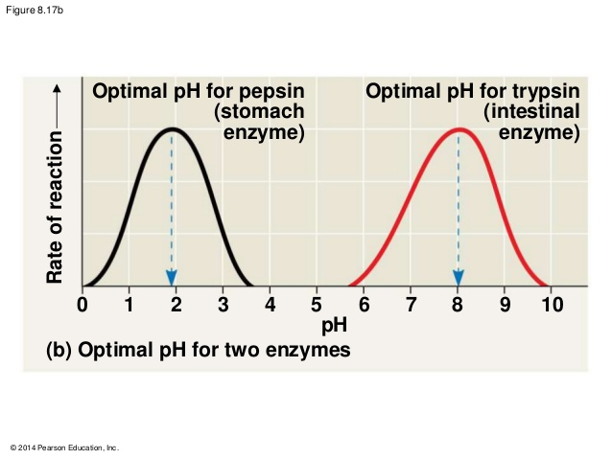
2- The Effect of pH on the activity of Enzymes:

Slide 27
pH is the measure of H⁺ ions in the solution
The greater the number of H⁺ ions in a solution the greater it's acidity and the lower its pH
Different enzymes work best in different degrees of acidity. The best pH for each enzyme to work is called optimum pH
Extremes of pH (very high→ very alkaline or very low→ very acidic) can slow down the rate of action of the enzyme by causing the enzyme to lose its shape and denature , this means that the active site will no longer fit to the substrate and so the enzyme can no longer catalyze the reaction.
Activity here drops gradually unlike the previous graph (Temp Vs Enzyme activity), where the activity drops sharply. This is because an increase in temperature has a greater effect on the shape of the active site than an increase or decrease in pH.

Slide 28
Examples on enzymes and their optimal pH
-Proteases: work in the stomach at optimum pH=2 ➔ HCl in the stomach provides the optimum pH for Pepsin
-Salivary amylase: in the saliva optimum PH= 7
- Enzymes secreted by the pancreas : Lipase , trypsin and pancreatic amylase works at pH =9
Most Enzymes work best at neutral conditions PH= 7

Slide 29
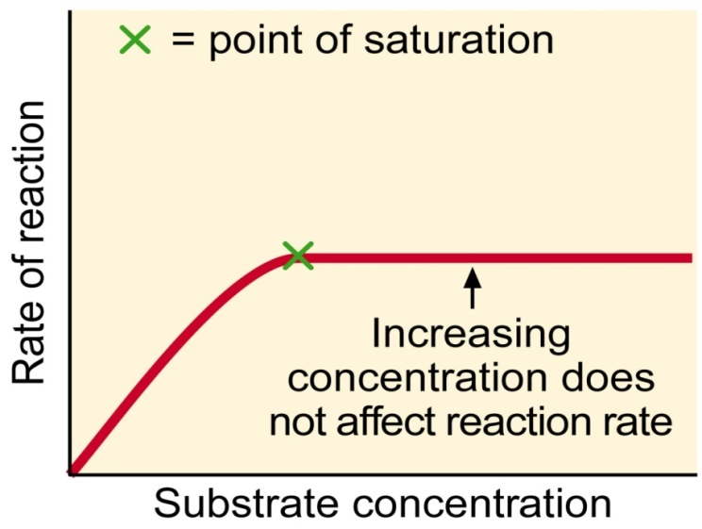
4) Concentration of enzyme:

Slide 30
Summary: Enzymes have the following properties :
All enzymes are proteins
Enzymes are catalysts
Enzymes are inactive at low temperatures and are denatured at high temperatures
Enzymes work best at a particular temperature → Optimum temperature
Enzymes work best at a particular pH → optimum pH
Enzymes are specific

