Slide 1
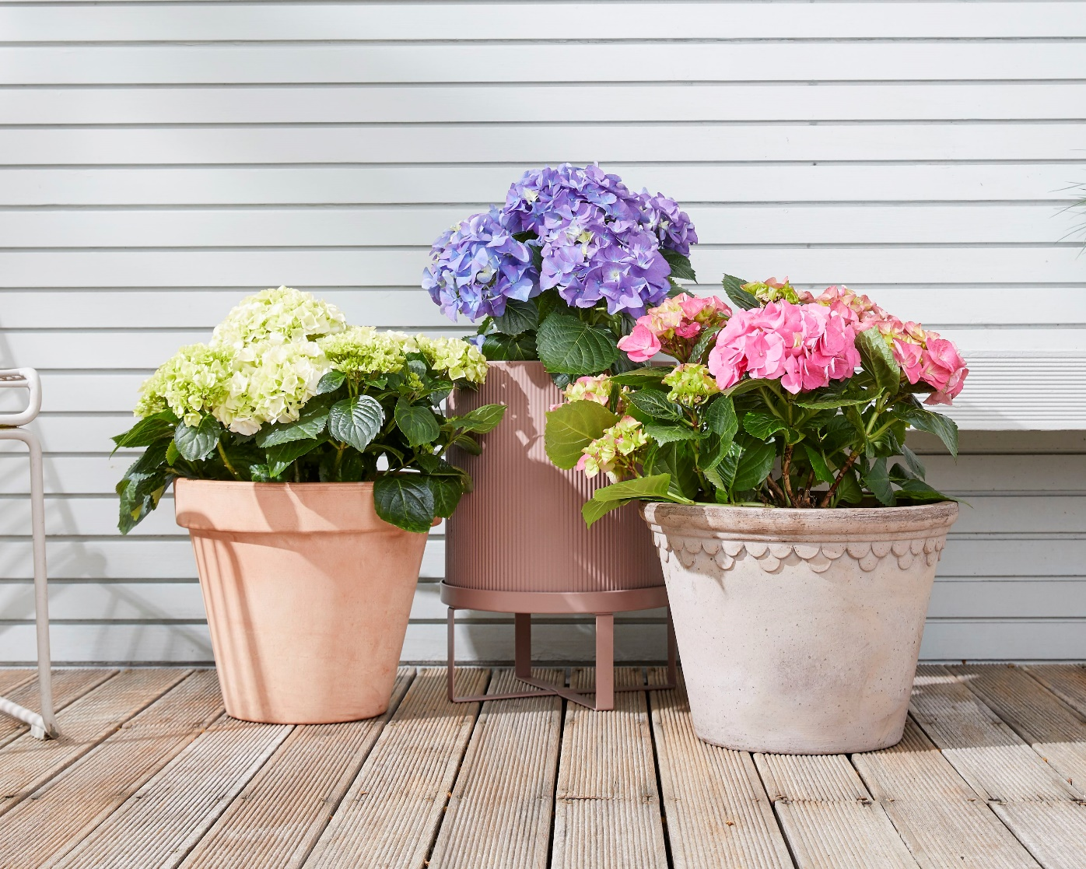
Asexual and sexual reproduction in plants

Slide 2
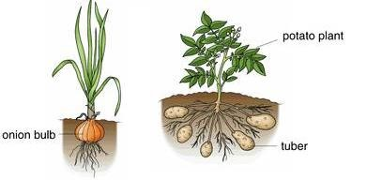
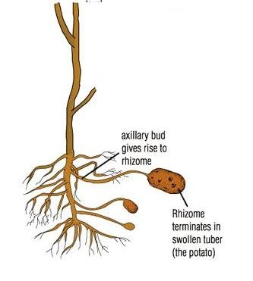
Humans can reproduce only sexually. Bacteria, fungi and many flowering plants can reproduce both sexually and asexually.
As we already know, asexual reproduction is a type of reproduction that requires only one parent. This parent passes on its genetic material to the offspring. Since both the parent and the offspring have the same genetic material, they will end up having the same characteristics, they are clones, asexual reproduction does not produce variation, It occurs by mitosis.
In Plants; asexual reproduction is also called "vegetative propagation".
Onions and potatoes have modified stems that serve biological functions like food storage (in the form of starch) and asexual reproduction

Slide 3
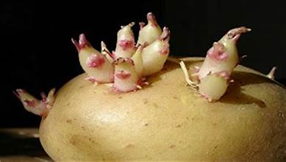
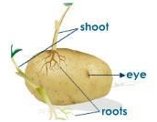
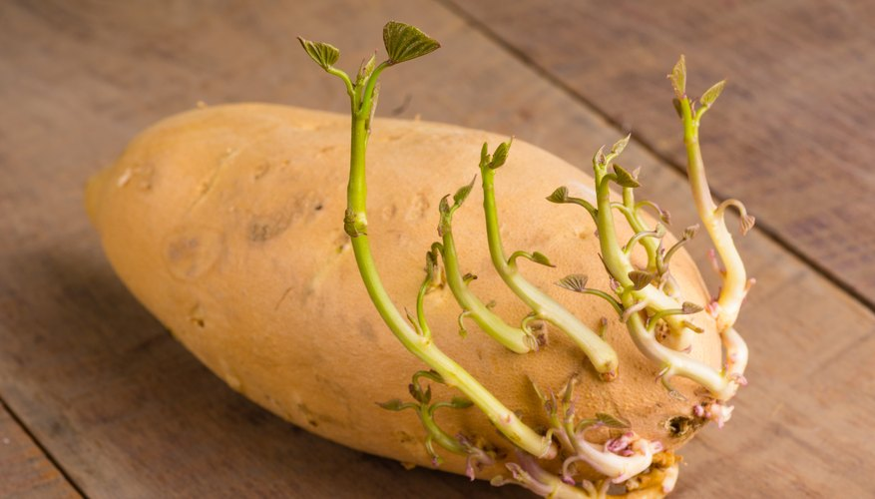
(1) Potato (asexual reproduction or vegetative propagation)
Potato plants can also reproduce asexually by producing stem tubers, as the plant grows, some stems grow down into the soil instead of upwards these underground stems are called rhizomes. As the plant photosynthesizes, food made in the leaves is translocated to these underground stems and is stored as starch at their tips. The tips of these rhizomes swell with starch forming tubers.
The underground stems, by being situated below the surface of the soil, protect themselves against unfavorable conditions of weather and the attack of animals.
In warm weather, the new tubers will begin to grow stems and roots using the stored food materials in the tuber. Each tuber can grow into a completely new plant
Since the new potatoes that are produced are identical to the parent and one another (because it is asexual reproduction). they are all at risk to the same diseases, so if a certain disease that they are not resistant to sets in All the potato crop will be affected

Slide 4
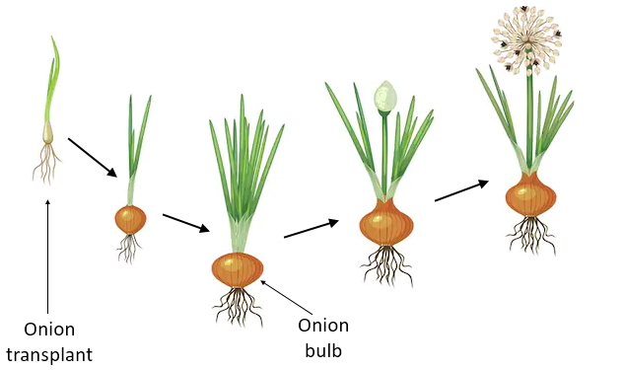
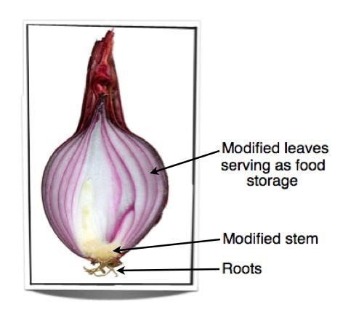
(2)Onions asexual reproduction or vegetative propagation)
This process involves the generation of bulbs, which are small onion-like structures that can develop into mature plants. Asexual reproduction allows onions to spread and thrive in their environment without the need for cross pollination or fertilization from other plants.

Slide 5
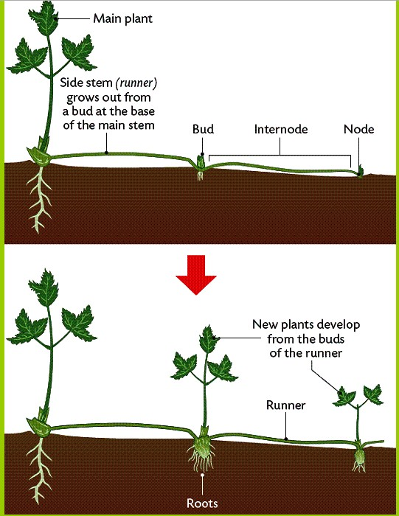
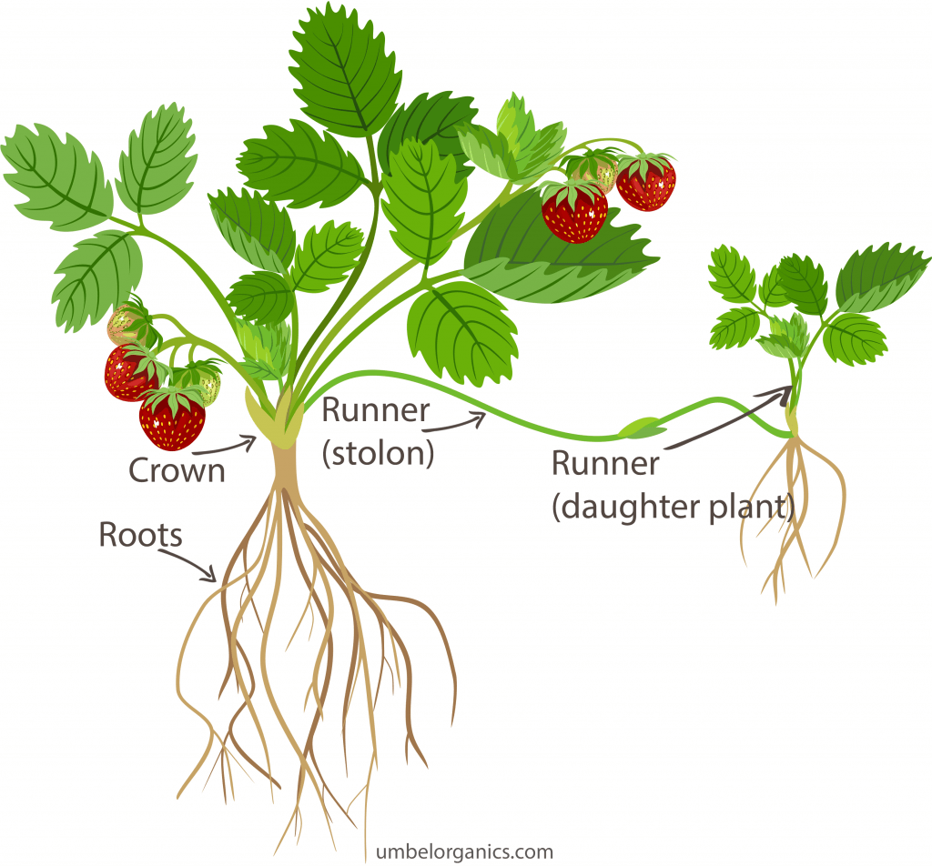
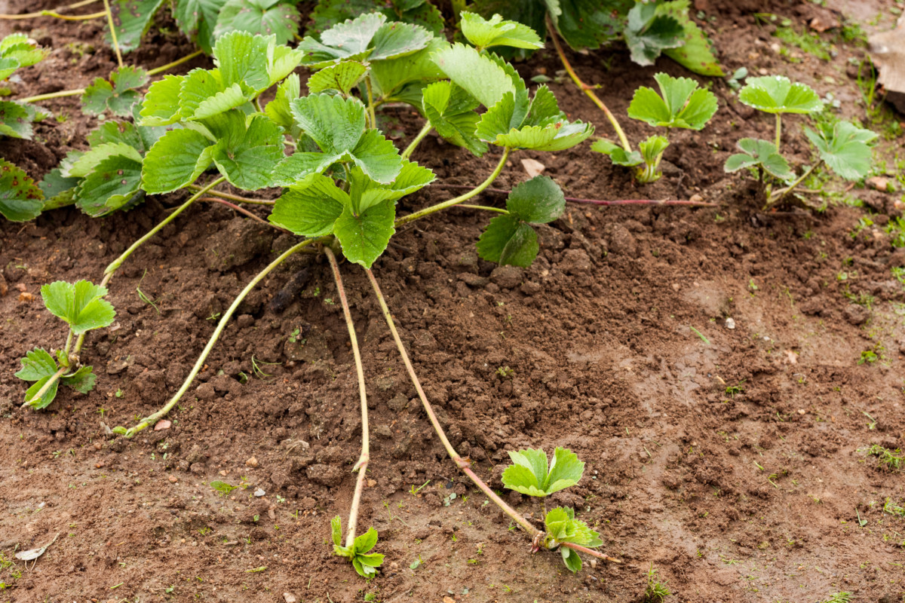
(3)In strawberries “Runners”
(asexual reproduction or vegetative propagation)
Runners are stems that grow horizontally above the ground. They have nodes where buds are formed. These buds grow into new roots and shoots when they touch the ground

Slide 6
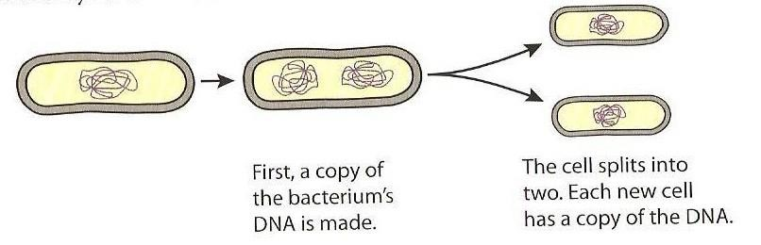
(4)In Bacteria (asexual reproduction)
Bacteria are single celled organisms that reproduce asexually by a process called binary fission. In some bacteria, Binary fission can take place every 20 minutes (Only when all the suitable conditions are present). Details of the process are discussed in Bacterial Kingdom.

Slide 7

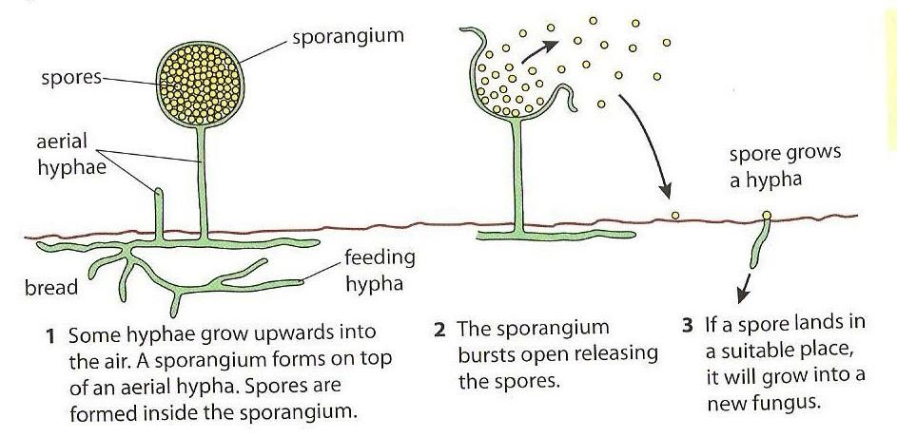
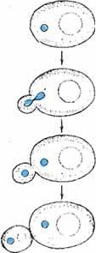

(5)In Fungi (asexual reproduction )
Fungi can also reproduce asexually e.g. bread mold
The mold grows on food like bread, the hypha grows upward with a sac called sporangium at the top. Sporangium contains spores when it bursts open, spores are spread by wind and land on a new medium. If suitable conditions are found, it will reproduce producing new hyphae.
Budding in yeast

Slide 8
Sexual VS Asexual reproduction in plant
Advantages and disadvantages to
Population of species in the wild
To crop production

Slide 9
Disadvantages of asexual reproduction: | Disadvantages of asexual reproduction:
1)One parent is needed→ greater chance of reproduction (2) Asexual reproduction involves mitosis, so the new plants produced are genetically identical to their parents & to each other, so if the parents are well adapted Note: Remember that plants can self & p to the conditions in which they’re living then this is a very good way of producing many well-adapted plants living in the same area. (3) There is No need for a pollinating agent. (4) There is no variation between the offspring; this has the advantage of maintaining the good characteristics of successful species from generation to generation (5) Faster and less energy is needed | (1) No variation because they are genetically identical, so if an infection kills one of them it is likely to kill them all. If there are bad conditions all the crop will be affected → Greater chance of extinction and lower arent. chance of adapting to changes in the environment (2) Asexual reproduction can produce offspring that are living closely together which increases competition for food & space.

Slide 10
(1) There is variation between offspring. Thus, if the environment changes e.g. If a disease sets in there is a good chance that some of the offspring have resistance to this disease → not all crop will be affected → as a result there is a greater chance of survival if the environment changes (2) There will be no competition among offspring because they will colonize in different regions due to seed dispersal. (3) More chance of evolution | (1) Many seeds are wasted It requires two parents, the need to find a second parent causes ^{sexual} reproduction to take a longer time to (2) produce offspring. (3) Requires a lot of energy. Not as rapid & efficient as other forms of asexual reproduction. (4) Fertilization may not happen (5) The new genetic combinations produce variations among offspring and some combinations may produce less successful individuals.
Advantages of Sexual Reproduction:
Disadvantages of Sexual Reproduction:

Slide 11
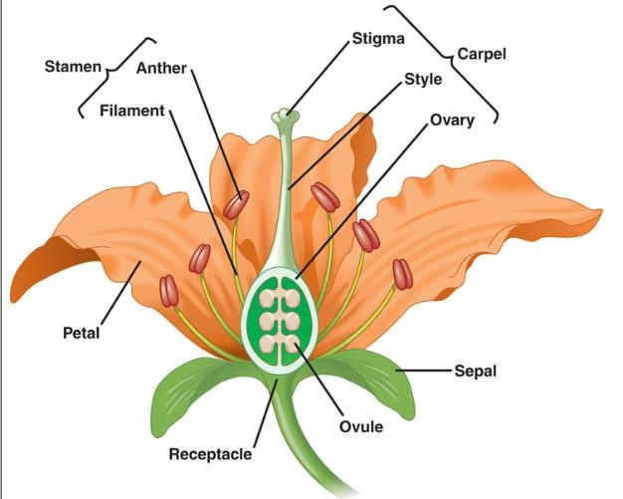
Sexual reproduction is defined as a process involving the fusion of the nuclei of two gametes to form a zygote and the production of offspring that are genetically different from each other.

Slide 12
Reproduction in plants can be either:
1) Asexual reproduction
2) Sexual reproduction.
Flowers carry the reproductive structures of the plant thus; they are responsible for sexual reproduction in plants.
Sexual | Asexual
2 parents are needed | Only one parent is needed
The offspring have a unique combination of genes inherited from both gametes of the two parents | Genetically identical to parent plant
Gametes (sex cells) are involved | No gametes involved
Animal’s | VS | Plants
Male gamete | Sperm | Pollen grain
Female gamete | Eggs | ovules

Slide 13
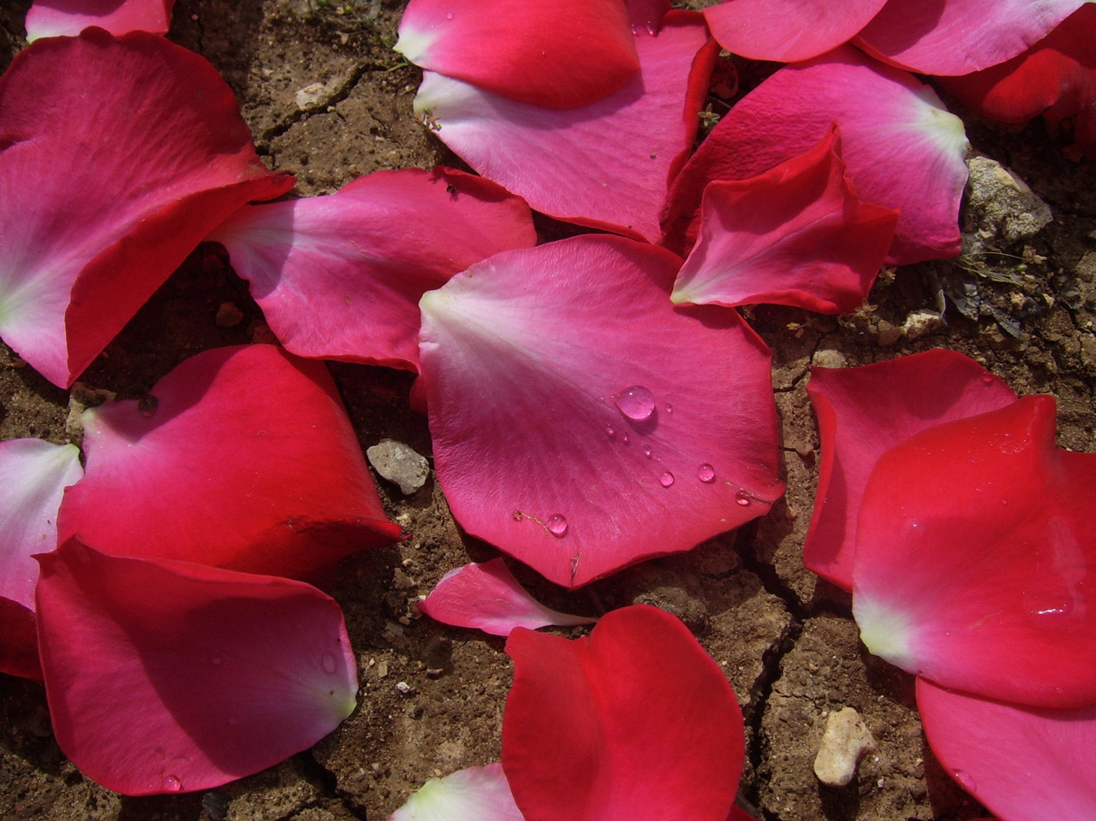
The Structure of a flower:
(1) Petals
Brightly colored usually, and sometimes scented.
Petals are arranged in a circle or a cylinder.
Function:
A- The colour and scent attract insects to the flower for pollination.
B- Protection of internal structures.
*Note: Grasses do not have petals instead they have green leafy like structures which enclose the reproductive organs.

Slide 14
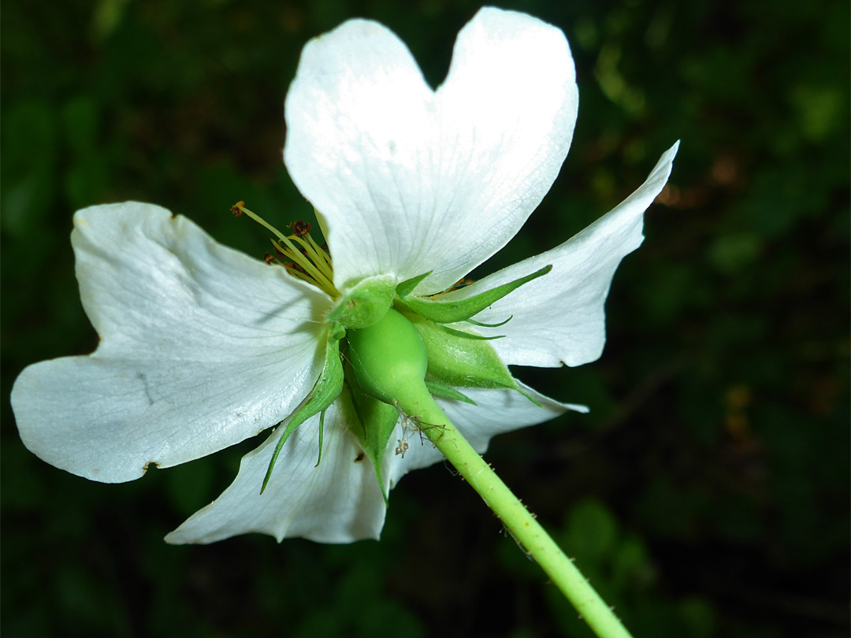
(2) Sepals:
Sepals are normally green found outside petals; they are arranged in a circular pattern to form the calyx.
Function:
Hold the petals together
Sepals are used to protect the flower while it is still inside the bud.
Reproduction organs in flowers
Male reproductive organ is called stamen
Female reproductive organ is called carpel

Slide 15
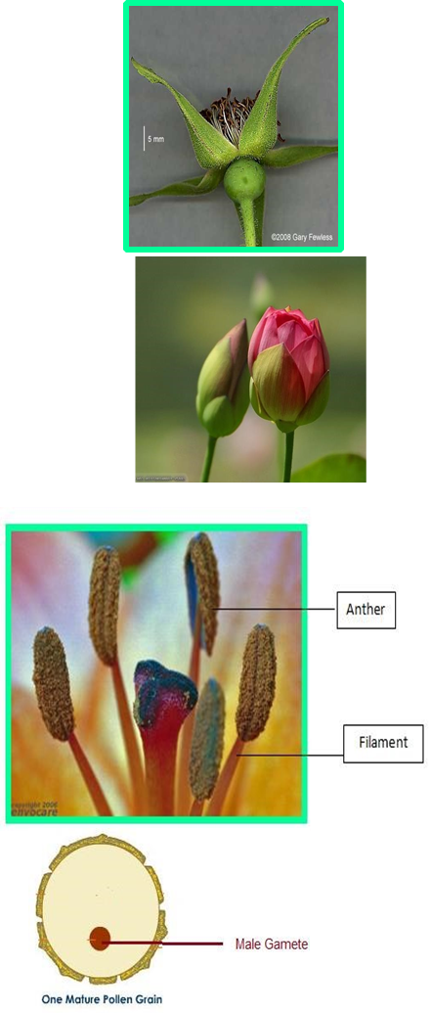
(3) Stamen:
Stamen is the male reproductive organ in a flower.
Stamens consist of Anthers and Filaments. Anther: contains pollen grains, which contain male gametes. Each anther contains four pollen sacs inside which pollen grains are produced by a division called meiosis (a division that halves the number of chromosomes producing haploid cells).
Filament: thread like structure that holds the anther.

Slide 16
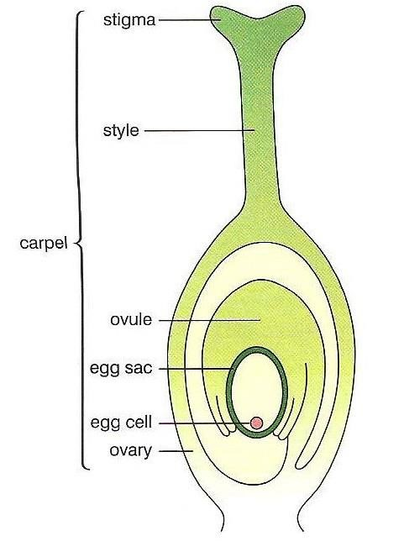

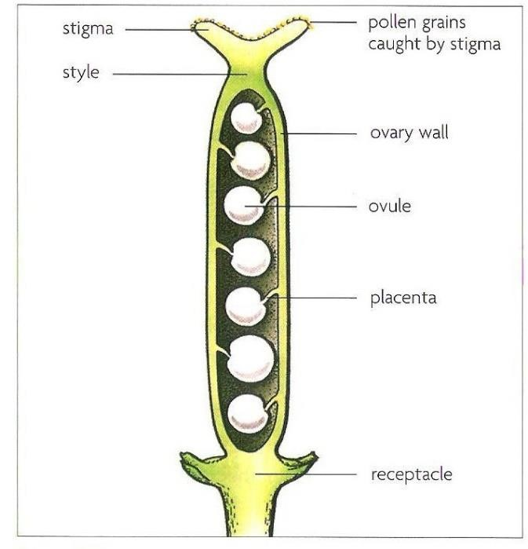
The female part of the flower, found at the center, made up of stigma, style and ovary
Stigma: has a sticky surface to make pollen grains stick to it during the process of pollination.
Style: the part that connects stigma to ovary.
Ovary: Inside the ovary, there are one or more ovules. Each Ovule contains a female gamete (egg cell) containing half the number of chromosomes (Haploid)
Flowers can be bisexual that is; the flower contains both female & male reproduction organs (hermaphrodite)
Or Unisexual containing either the male or female reproduction organs.

Slide 17
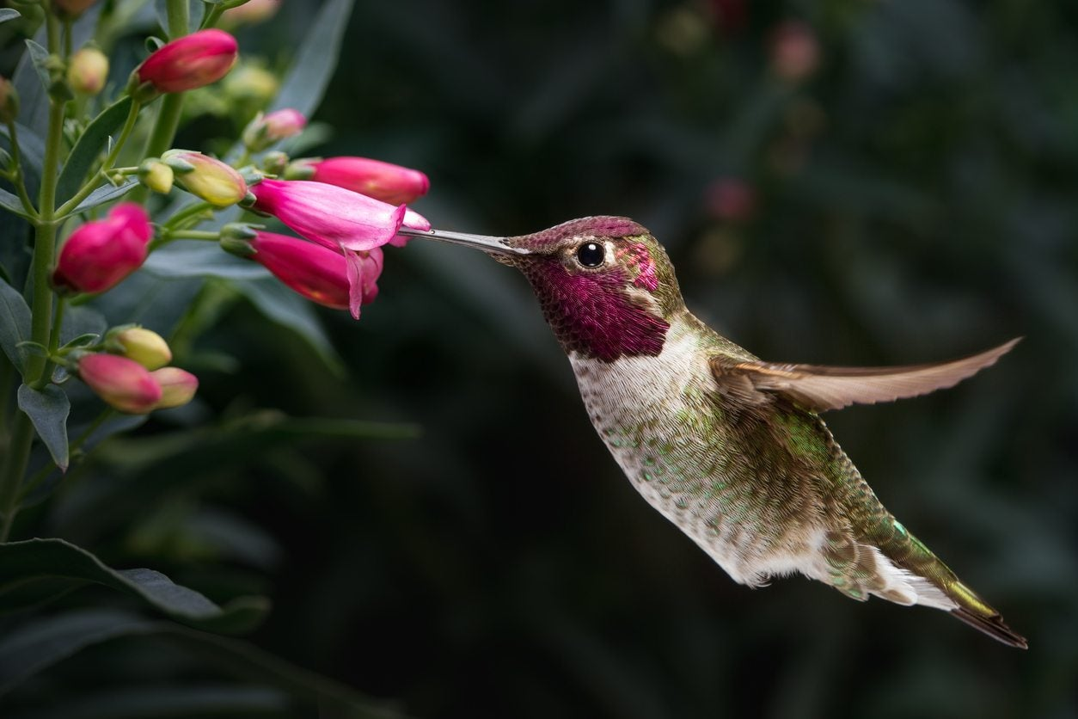
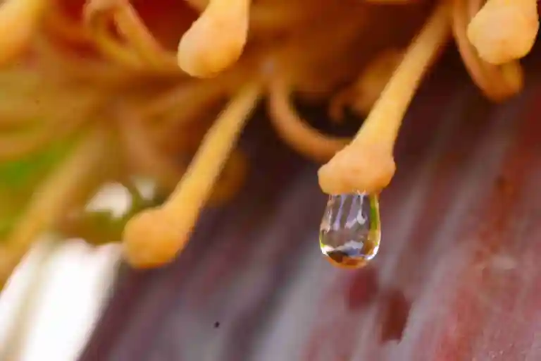
(4) Nectary
It is a swelling at the base of the carpel that contains nectar which is a sugary solution used to attract insects for pollination.

Slide 18
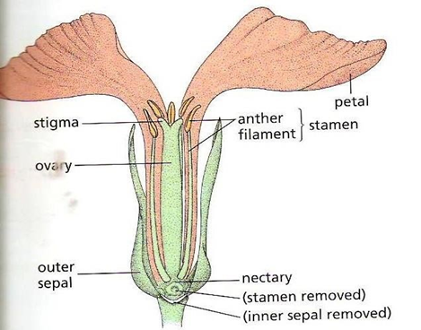
(5) Receptacle
Carries all the structures of the flower

Slide 19
The Mechanism of Sexual Reproduction in plants:
Sexual reproduction in plants involves two steps:
Pollination : The transfer of pollen grains from the anther of a stamen to the stigma of a carpel. Once pollen grains reach the stigma pollination ends.
Fertilization: is when the nucleus of the male gamete (pollen) fuses with the nucleus of the female gamete (ovule) to form a zygote
(fertilized egg).

Slide 20
(1)Pollination
There are two types of pollination:
1- Self pollination.
2- Cross pollination.

Slide 22
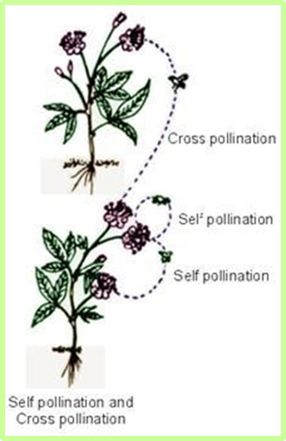
(2) Cross- pollination
Cross pollination is the transfer of pollen grains from the anther of one flower on one tree to the stigma in a flower of another tree but of the same species. This type of pollination produces great variation than self-pollination, because it is likely that the plant which produced the pollen grains & the plant which produced the ovules have different genetic makeup, so the offspring may turn out more successful than their parents.
Implications of cross-pollination Advantages:
Greater variation (different genes from different plants)
Allows adaptations to new conditions (changes in the environment) so it allows for evolution
More chance of disease resistance
Cross Pollination
Disadvantages:
It needs a pollinating agent
Less chance of successful pollination as the pollens may never reach the stigma.
How do plants prevent self-pollination?
  Some plants produce only flowers of single sex, which makes self-pollination impossible
  Some plants have flowers that contain male and female parts but the different parts mature at different times

Slide 25
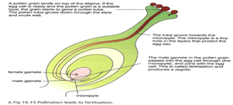
What is fertilization
Fertilization is when the nucleus of the male gamete (pollen) fuses with the nucleus of the female gamete (ovule) to form a zygote
(fertilized egg).
The process of fertilization
1) As pollen lands on the stigma, if the egg cell is ready and the pollen is from the same species, the pollen starts absorbing liquids from it forming a tube called “pollen tube” which grows down the style into the ovule inside the ovary.
* Enzymes are secreted from the tip of the pollen tube and these will digest the tissues of the style.
The male gamete travels down the pollen tube which grows down the style into the ovary and eventually into the ovule.
The pollen tube tip then enters an opening called micropyle in the ovule (which contains female gamete) releasing the male gamete into the ovule.
At last, the nucleus of the male gamete fuses with the nucleus of the female gamete producing a fertilized egg called zygote which is a diploid cell (containing full number of chromosomes)
The zygote undergoes many cell divisions by mitosis producing the embryo which consists of a tiny root called radicle and a tiny shoot called plumule.

Slide 26

From a Flower into a Fruit:
The seed consists of two special parts called cotyledons which enclose the embryo that consists of a tiny shoot called plumule and a tiny root called radicle.
Note:
The number of cotyledons in the seed, depends on species; monocots have one cotyledon, whilst dicots have two cotyledons.
Cotyledons are structures that store starch and other nutrients, that the embryo will make use of when it starts germinating.
In Monocots, the food store is laid down in a special tissue called endosperm.
Lastly, water is withdrawn from the seeds; as a result, seeds become dehydrated and enter dormancy because without water all the metabolic reactions inside the seeds stop.
E.g. Watermelons contains hundreds of seeds inside, therefore hundreds of fertilization.
Peach contains only one seed which indicates that only one fertilization took place
One pollen grain can only fertilize one ovule.

Slide 27
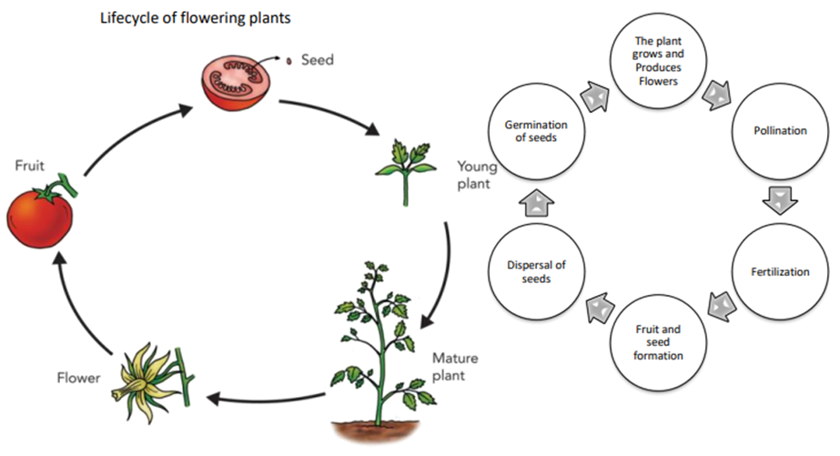

Slide 28
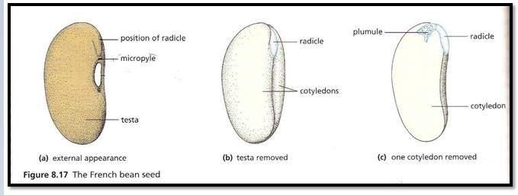
Seed germination
Seed germination: is when the seed coat breaks open and the embryo starts to grow and develop into a new plant.

Slide 29
Conditions needed for germination
1) Use of water in seedling:
As we said previously, the seeds are dehydrated, so to start germinating the seed must absorb water by osmosis from the soil through the micropyle, as a result the seed begins to swell and increase in mass bursting the testa (seed coat). As soon as the embryo starts to grow, it starts to use the stored food. The absorbed water is used:
To activate enzymes which digest the stored food (mainly starch and proteins). The sugars dissolve in water and diffuse to the embryo which starts respiring to release energy needed for growth.
Amylase breaks down starch into maltose which is then broken down by maltase into glucose some of which will be built up into cellulose to make cell walls for the new cells. Water is needed in hydrolysis reactions.
Proteases break down proteins into amino acids which are used to make new protein molecules for cell membranes (which is made up of phospholipids and PROTEINS)
Transport of sugar (food) from the cotyledons to the growing regions.
Expands the vacuoles of the new cells & thus keeps the shoot straight & the leaves expanded

Slide 30
(2) Use of Oxygen:
In some seeds, the seed coat is not very permeable to oxygen and the early stages of germination are anaerobic (with very little energy produced and the by-products are toxic). When the seeds absorb water they increase in size as a result the seed coat splits open, it allows oxygen to enter, and then oxygen is used in aerobic respiration providing energy for the growing embryo to germinate.
(3) Temperature:
  IMPORTANT NOTE: Factors affecting germination are very similar to those that affect enzyme activity this indicates that GERMINATION IS A PROCESS THAT IS CONTROLLED BY ENZYMES.
  Germination takes place rapidly at temperatures up to 40 ⁰C (as the temperature increases the activity of enzymes increases).
  At temperatures above 40⁰C the enzymes will be denatured and the chemical reactions will stop and the seedling will die.
  At very low temperatures enzymes will be inactive and germination will not be taking place.
  Keep in mind that plant enzymes have an optimum temperature of around 28-30 ⁰C
(4) Light
Light is not a major factor for germination because it takes place under the ground (away from light), but some species of seeds need to be exposed to light before germination starts e.g. lettuce seeds (light is a trigger for germination).
In general, seeds require light once the shoot is above the ground.
Dormancy:
What is dormancy?
Dormancy is the period during which seeds cannot germinate due to the lack of one or more of the required factors (light, water, O₂). Dormancy delays the period of germination until suitable conditions are available. When favorable conditions are provided the seed escapes dormancy and starts germinating.
Keep in mind that seeds once formed in the fruit are dormant because they are dehydrated (lost water).

Slide 31
 | Factors affecting dormancy
Low temperature | Testa being impermeable to water & oxygen (if kept in anaerobic conditions) | Water availability (if seeds are kept dry) | Light for some species.

Slide 32
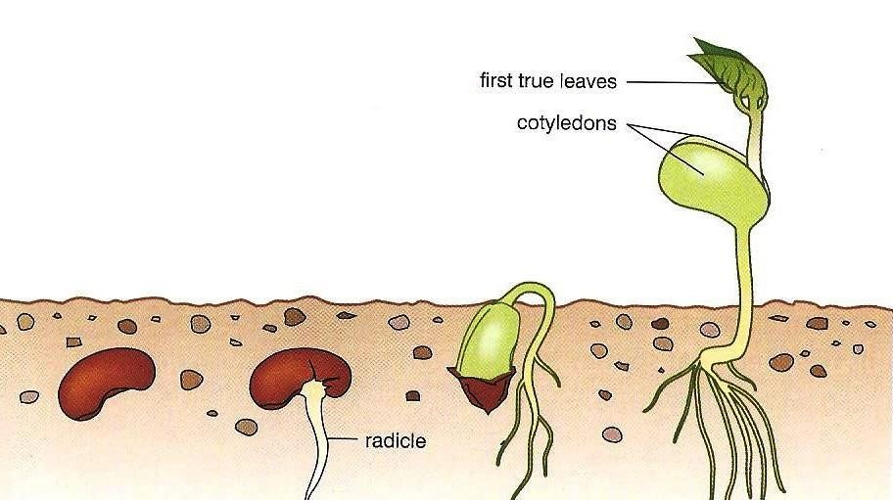
Advantages of Dormancy:
The seed can survive harsh conditions until suitable conditions are available (temp, water, oxygen).
Steps of germination
The seed contains only 5-20% water, so it starts absorbing water by osmosis (seeds have low water potential compared to the solution of water around them).
Water enters through the micropyle.
Water activates enzymes, which will start digesting the stored food in the cotyledons which is then used to release energy in respiration for growth.
The radicle grows first with its tip is covered by root cap, which protects the root tip.
Leaves of the plumule open out, the plant can now photosynthesize and make its own food, its mass begins to increase.
The plumule is well protected from damage while it is being pulled up through soil particles.
Cotyledons shrivel & fall off because their food reserve has been used up.

Slide 34

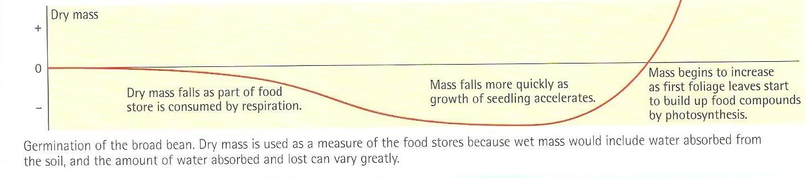

Slide 35
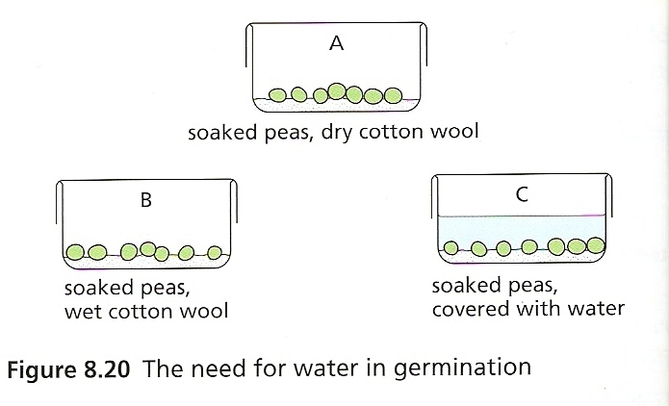
Seed Germination Experiments
Investigating the conditions necessary for germination of seeds
You have now become familiar with the conditions (WATER, WARMTTH, OXYGEN) that a seed requires to exit dormancy and start germinating, In this booklet we are going to investigate the need for each factor.
A. the need of water:
1) Label three containers A, B and C
2) Place three dry cotton wools in each container
3) Add an equal number of soaked seeds (SAME TYPE OF SEEDS) in the three containers.
4) Leave A quite dry. Add water to B to make the cotton moist.
Add water to C until the seeds are completely submerged.
Results:
A will not germinate. Germination without water will not take place (water is needed to activate enzymes in the seed without water germination will never happen)
Germination in B will be normal since enough water is present
Germination in C may have started but it will not be as advanced as B→ Because too much water will prevent oxygen from entering → if no oxygen is present germination will not continue because germination needs energy and without oxygen aerobic respiration will not take place.

Slide 36
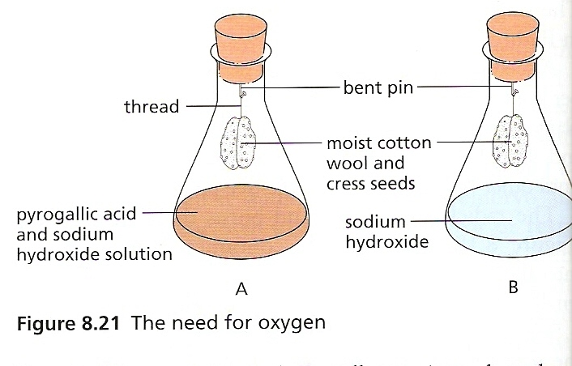
B. Need for oxygen
Set up the experiment as shown in the figure above.
Be careful: Sodium hydroxide and pyrogallic acid are highly caustic so handle with care and use protective eye goggles→ Safety Precaution!
Pyrogallic acid and sodium hydroxide placed in Flask A. Pyrogallic acid absorbs oxygen
The Bungs must make an airtight seal in the flask (to prevent air from entering)
Make sure that the seeds don’t touch the solution
Leave the seeds for one week at room temperature.
Flask B is the control experiment → is to show that germination can take place as long as oxygen in present and to make a comparison (one without oxygen and one with oxygen; the one without oxygen didn’t germinate whereas the one with oxygen did. Since they are both treated in the exact same way and only oxygen is the difference then the absence of oxygen in the test plant is the reason that has prevented germination.
Result:
Seeds in B will germinate→ since oxygen is present so respiration can take place normally
Seeds in A will not germinate since oxygen is not present.
Conclusions that can be drawn from this experiment
To show that the chemical in flask A had not killed the seeds the cotton wool can be swapped from A to B → Seeds in A will now germinate
Important note: Sodium hydroxide absorbs carbon dioxide from the air → So the mixture of pyrogallic acid + Sodium hydroxide in test tube A absorbs both carbon dioxide and oxygen. In flask B only sodium hydroxide is present so only carbon dioxide is absorbed. Because seeds in B germinated, it is a proof that the lack of carbon dioxide didn’t affect them but the lack of oxygen did.
C. Temperature and germination:
KEEP IN MIND GERMINATION IS A PROCESS CONTROLLED BY ENZYMES!
This is done using maize seeds (corn). Soak some maize grains for a day and then roll them up in three strips of blotting paper.
Place equal number of maize seeds in each strip.
Place one strip at room temperature.
Place one strip in an incubator at 30ºC.
Place the last strip in a refrigerator at 4ºC.
After a week, examine the seedlings and measure the length of the roots and shoots.
Because seeds in the refrigerator will be in the darkness, the other seeds must also be enclosed in a box or cupboard otherwise it might be argued that the lack of light rather than the low temperature is the reason that might have been affected germination

Slide 37
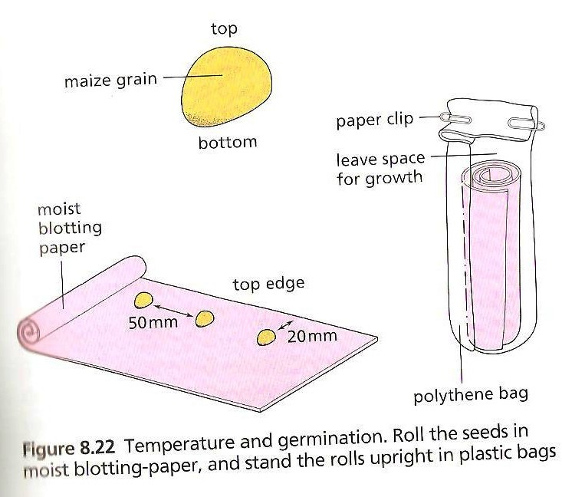
Result:
The Strip placed in the incubator at 30⁰C will germinate more than the other two because it is the optimal temperature for the enzymes, so more growth will take place.
The strip placed at room temperature will germinate but not as the one placed in the incubator.
The Strip Placed in the refrigerator may not germinate at all since the temperature is too low and the enzymes will be inactive.
Conclusion: The Higher the temperature at least up to 35-40 ⁰C the faster the germination
Controlled variables (constants):
In the above experiments, or any other experiment, some variables need to be controlled (kept constant) because they may affect the results and to make sure that only one variable is changed at a time.
In the experiments you have just studied, some variables might have also affected your results but you might not have thought about or considered:
Some of the seeds you have used were dead or diseased, so they would not germinate in any condition and this affects the results → that’s why it is advisable to use a large sample as possible.
You have to ensure that when temperature is the variable the exclusion of light from the seeds is not an additional variable → this is done by putting the seeds in the darkness.
Some seeds might have been scratched while you were handling them → these might germinate more successfully because the test became more permeable to oxygen and water.
“The Older the seeds, the lower the percentage of seeds that will germinate “
How can you design an experiment to test the effect of storage time on the germination rate of the seeds?
Whenever you’re asked to design an experiment
Remember to think about the variables that you will change (Independent variable) and what you will keep constant and what you will measure (dependent variable) and how you will measure it!

