Slide 1


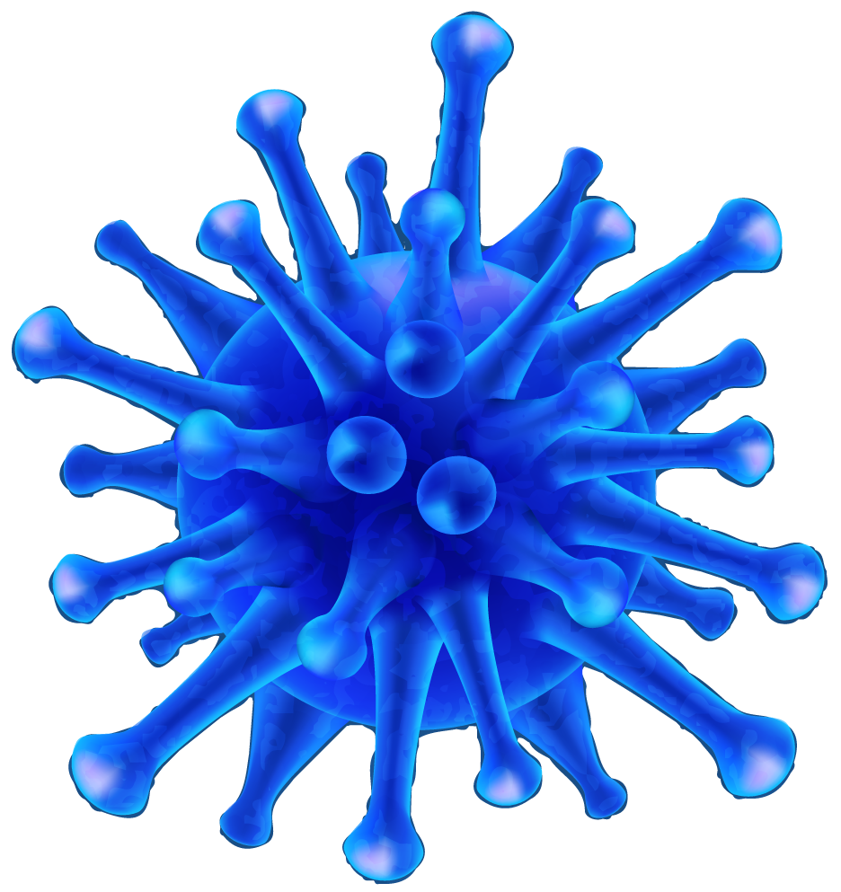



Grouping and identifying organisms
Unit 4

Slide 2
Table of contents
01
02
03
What is a virus?
Structure of a virus
How viruses replicate

Slide 3
01
What is a viruse?

Slide 4
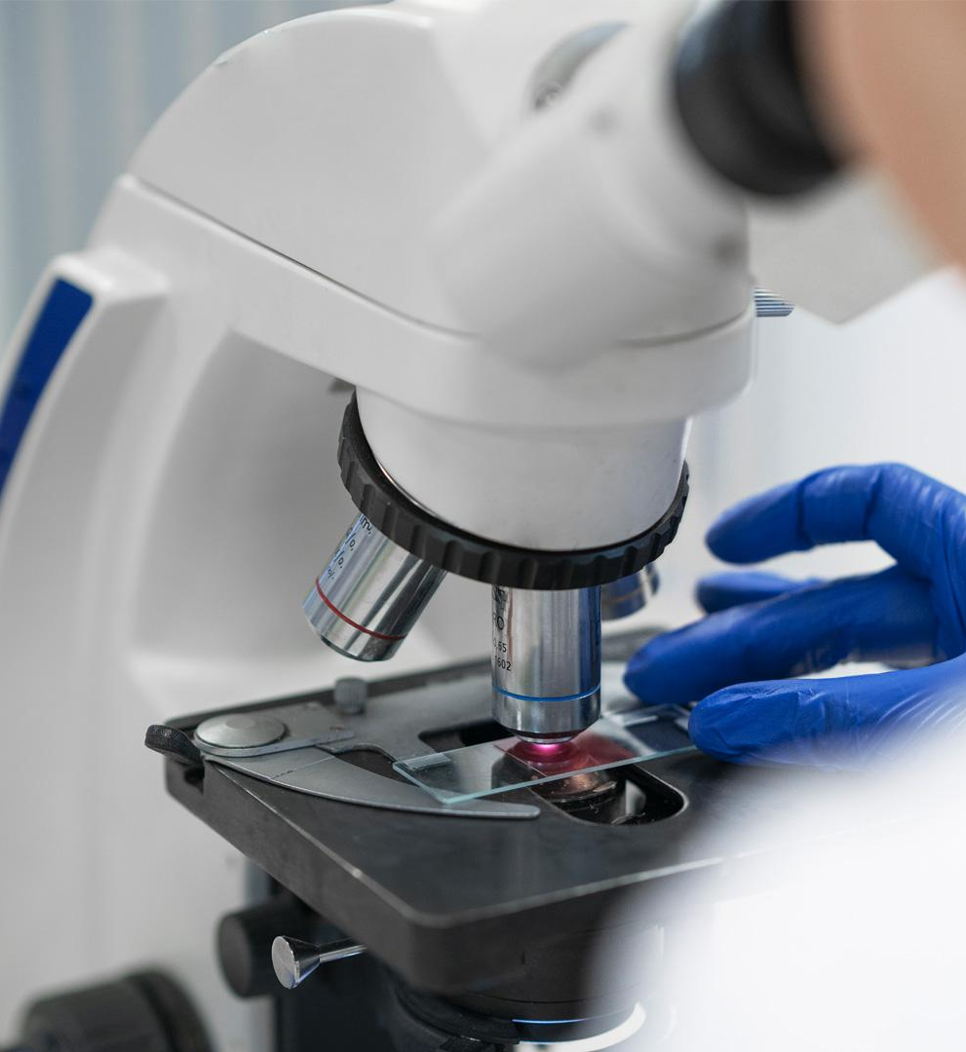
Virus: An extremely small structure made of a protein coat surrounding RNA(or DNA);viruses can invade cells and cause them to produce new viruses.
*RNA: A substance inside the virus containing a set of coded instructions for making more viruses.
*To see a virus, you need to use a special kind of microscope called electron microscope.

Slide 5
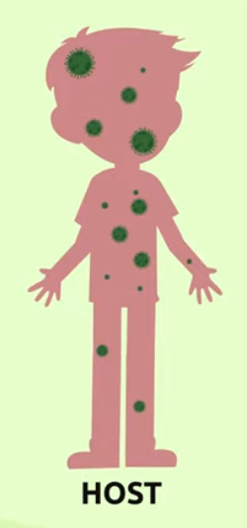
Did you know that viruses are not living organisms
This is because unlike cells viruses cannot carry out a vital function of reproduction by themselves.
To be able to carry the vital function of reproduction they need a host.
A hos that is a living being in which to live when they find one the host will be infected by the virus .
From this point forward the virus will be able to replicate in .

Slide 6
02
Structure of a virus

Slide 7
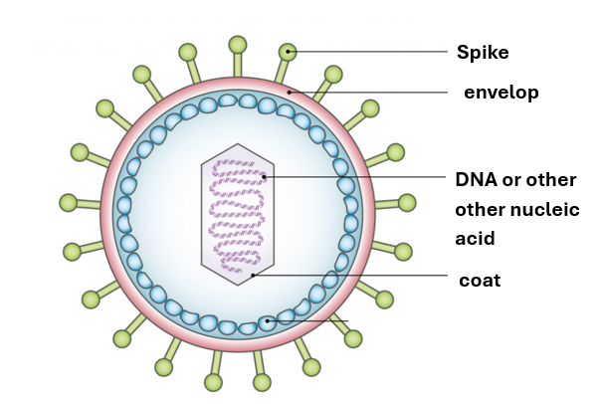
Basic structure of a virus.
-The spike helps the virus to enter cell where it can start to replicate.
-The envelop is the outer protective covering of the virus .
-The DNA or other nucleic acid is the replicating part of the viruses.
-The coat around the replicating part of the virus keeps it safe.

Slide 8
03
How viruses replicate

Slide 9
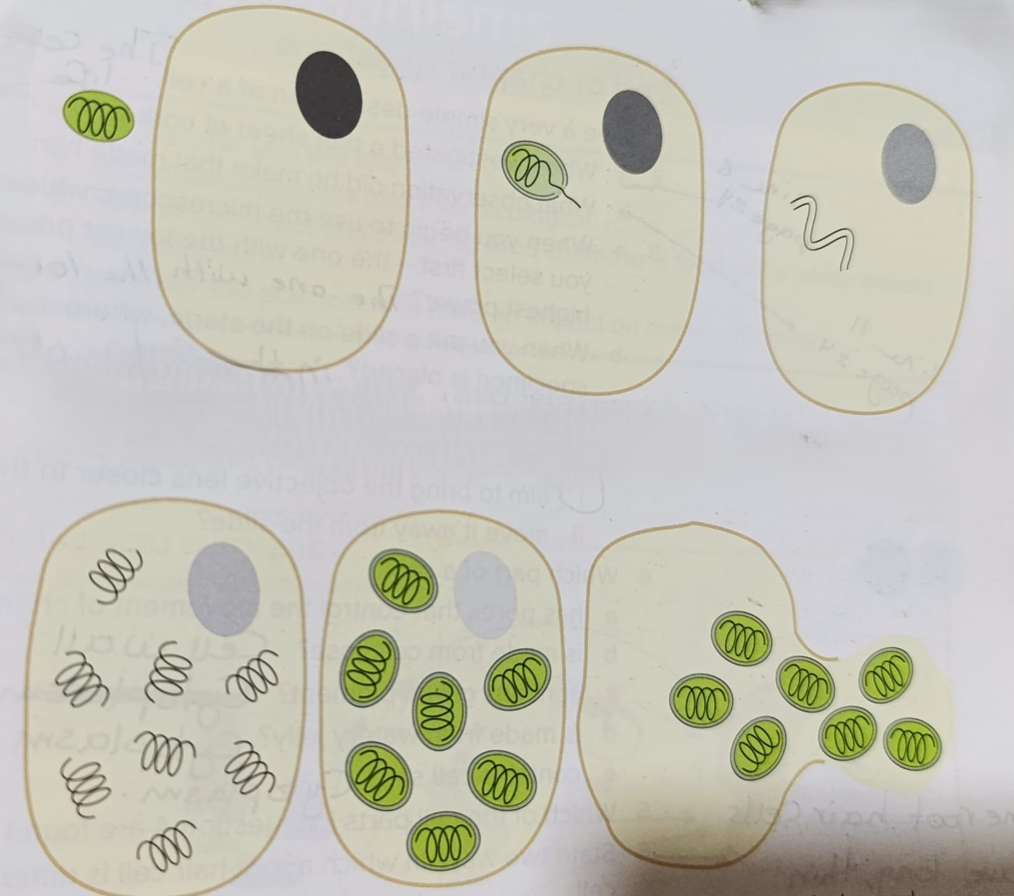
How viruses replicates
1
1-The virus approaches a cell in a host.
2-The virus enters the cell and bursts out of its coat .
*some viruses leave their coat outside the host cell before they enter it.
3-The virus replicates inside the cell.
4- The host cell makes a coat for each new virus, via instructions from the virus.
5-The cell membrane breaks down and releases the new viruses.
2
4
3
5

Slide 10
How do viruses spread?

Slide 11

Viruses can spread through different vectors
Victor: is the carrier of a virus that can infect other organisms.
Examples on vectors:
-food
-water
-objects
-animals
-air

