Slide 1









ADVERBS

Slide 2


Adverbs are words used to modify a verb, an adjective, or another adverb.
Here are examples showing how adverbs modify a verb, an adjective, and another adverb:

Slide 3
Adverbs that modify a verb (action)
Lina crept quietly into the dark hallway.
The wind howled loudly outside the cabin.
The puppy ran eagerly toward the gate.
Sami whispered nervously when he heard the footsteps.
The door opened suddenly, and everyone froze.
The knight fought bravely to protect the village.

Slide 4
Adverbs that modify an adjective
The cave was extremely dark, so we used a torch.
The map was almost useless, with half the ink washed away.
Her voice was surprisingly calm during the storm.
The treasure chest felt too heavy to lift alone.
The ending was quite mysterious, leaving me confused.

Slide 5
Adverbs that modify an adverb
He ran very quickly before the guard returned.
The owl flew quite silently over the trees.
She answered too confidently and made a mistake.
The boat drifted so slowly that time felt stuck.
I hid almost completely behind the curtain.
The old gate creaked really loudly in the wind.

Slide 6

Spelling Rules
General Rule:
Add -ly to the adjective.
quick- quickly
quiet- quietly
Notes:
Wonderful
Gracefu
Playful
Final

Slide 7
Spelling Rules
When the words end in -l, add -ly
careful- carefully
beautiful- beautifully
Notes:
Wonderful
Gracefu
Playful
Final

Slide 8
Spelling Rules
When the words end with -y, change -y to i and add -ly
happy- happily
easy- easily

Slide 9
Spelling Rules
When the words end in –le, drop the -e and add -y
possible-possibly
gentle-gently

Slide 10
Spelling Rules
When the words end with -ic, add
-ally
historic-historically
tragic-tragically

Slide 11


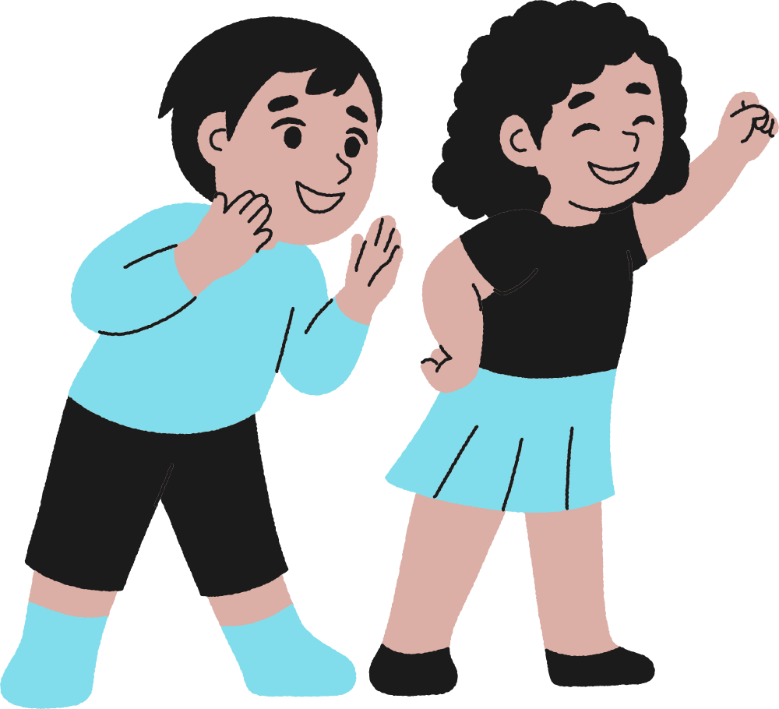
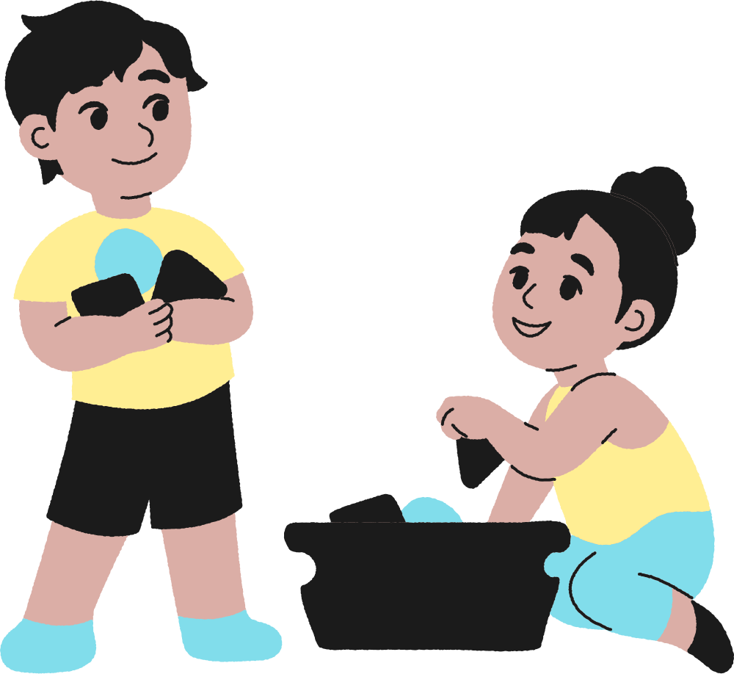



Thank You!
Do you have any questions?

