Slide 2
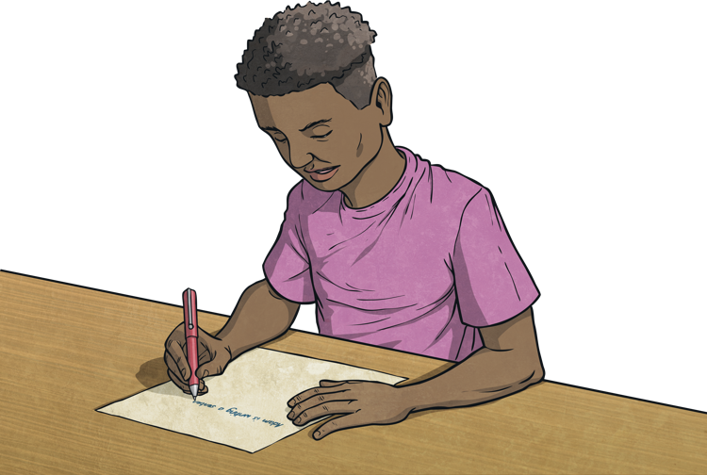
What is a Biography?
A biography is a true story about someone's life, written by someone else. Biographies tell us about famous people or ordinary people who have done exciting things. They usually center on one person's life and how they have contributed to the world.
Biographies offer us a way to experience adventures by reading about others who have accomplished amazing things.
A biography is a text written about someone else's life

Slide 3
Features of a Biography
A biography text may feature some of the following:
tells real life stories
gives facts about a person’s life
includes details such as the place and date that the person was born (and died, if they're no longer living)
describes a person's importance to the world or why they are famous
may describe the person's early life and childhood
should include the person's achievements, accomplishments and any challenges they overcame
include descriptions of the person's personality and what they were like
is usually written in chronological order (in time order)

Slide 4
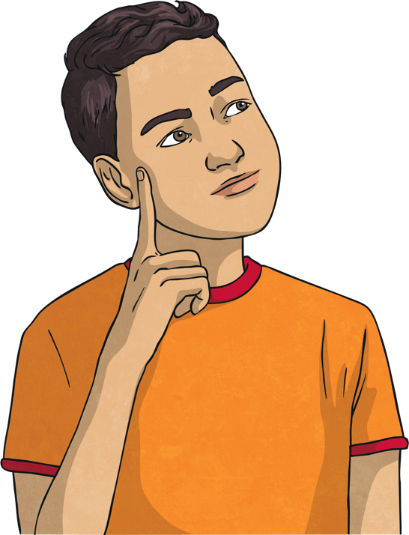
Language Used in a Biography
The language used to write a biography should include the following:
formal language
past tense
dates to identify specific details around when things happened to the subject of the biography
Phrases such as: 'It is believed', 'It was thought', 'Many people claimed', 'There was a rumour that' etc. to show that the text is based on stories and histories and so may not be able to be stated as fact

Slide 5
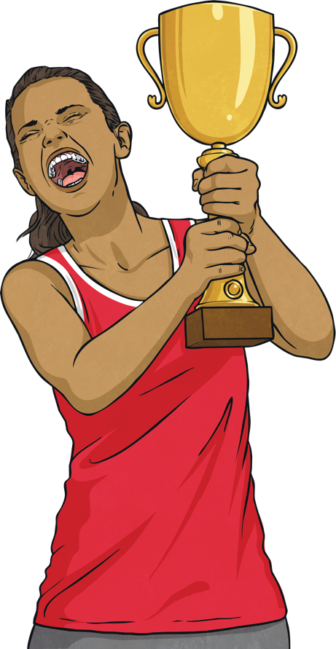

Biography Subjects
Biographies may be written about athletes, artists, writers, historical figures, world leaders, inventors, actors, musicians, comedians, scientists, or anyone else who has made a contribution to society throughout history.
Who would you like to write a biography about?

Slide 6
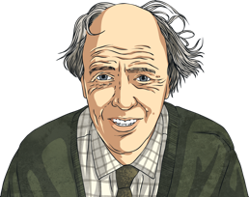
Mini Biography Example Text Roald Dahl
Roald Dahl was born on 13 September 1916, in Llandaff, Cardiff. His parents were Norwegian.
He did not start writing for children until he had children of his own. His first-ever children’s book published was in 1943 entitled ‘The Gremlins’. It is said that Dahl was never very fond of this book.
Roald Dahl loved chocolate, but not chocolate cake or ice cream! Maybe this is why he chose to write about Willy Wonka’s Chocolate Factory.
He always wrote his stories in pencil on yellow paper. He would write in a small hut in his garden.
Before becoming a beloved children’s author, Dahl was a hurricane fighter pilot and spy during World War II.
Roald Dahl died At the age of 74 on the 23rd of November 1990. He is buried in St Peter and Paul’s Church in Great Missenden, England.

