Slide 1
Forces

Slide 2
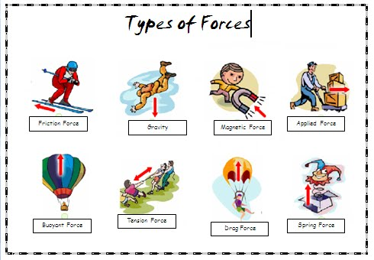
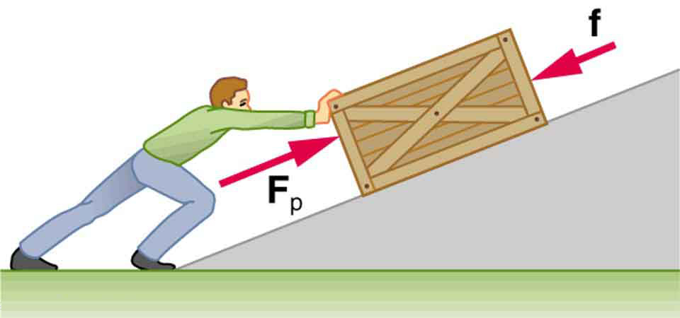
Objective: Student will understand what a force is and what it does.

Slide 3
What are forces?
A force is a push, pull, twist or turn when 2 objects are interacting with each other.
They usually come in pairs and work opposite to each other.
What is happening to the object as a result of the force?
Show children cards with pictures of different forces. Move around class adding labels to the pictures.
Words
Interacting
Working with each other to have an effect
Applied
To use on
Creates movement: speeds thing up
slows things down
makes things change direction
makes things change shape

Slide 4
What do forces do?
Make things:
move faster
move slower
change direction
turn
change shape

Slide 5

The arrows are the same size.
The forces are equal
The book does not move.
Gravity
Reaction force

Slide 6
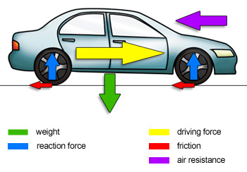

Push
Push
A resistance to motion
Push
Push
Pull
/ Gravity

Slide 7
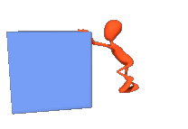
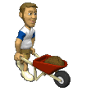
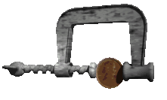
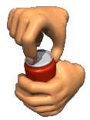

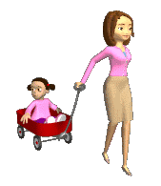
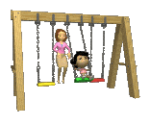
Push
Click on the 2 pictures that show something being pushed.
twist
pull
pull

Slide 8
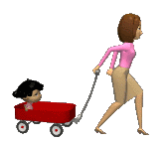
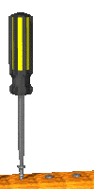
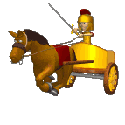
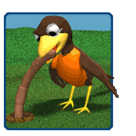
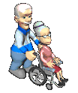

Pull
Click on the 2 pictures that show something being pulled.
twist
push
twist

Slide 9
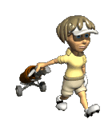
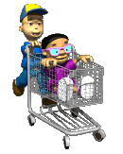
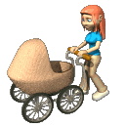
Twist
Click on the 2 pictures that show something being twisted.
pull
push
push

Slide 10
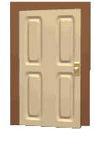
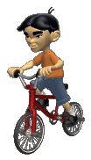
Other Objects
Some objects use more than 1 force to get them moving.
When you ride a bicycle you push on the pedals and pull on the handlebars.
When you open a door you twist the handle and pull or push the door.

Slide 11
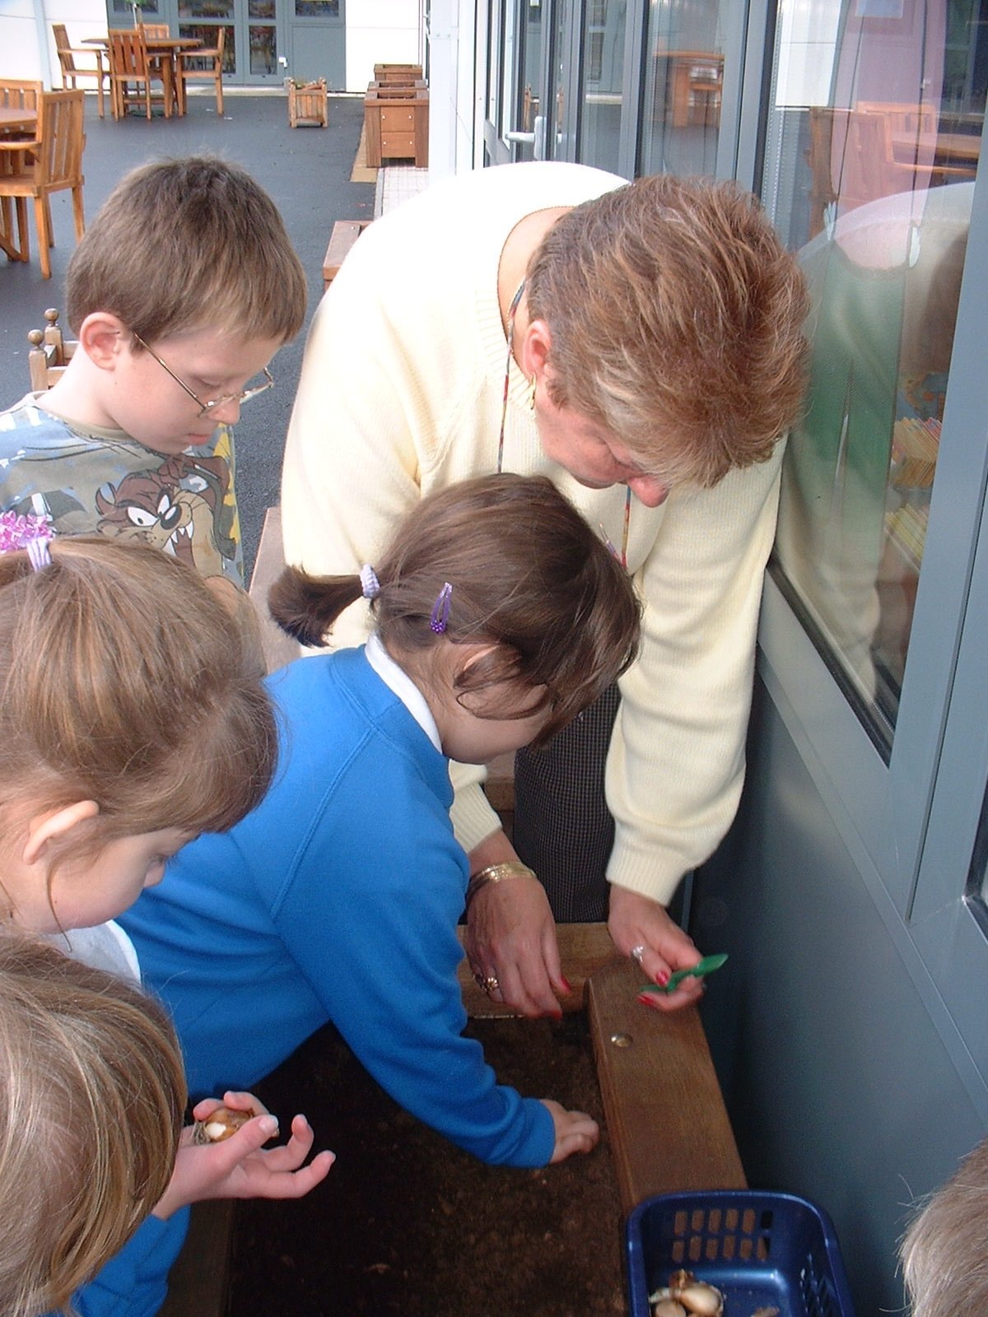
See if you can identify which force or forces are being used in these photos.
The seed is being
into the ground.

Slide 12
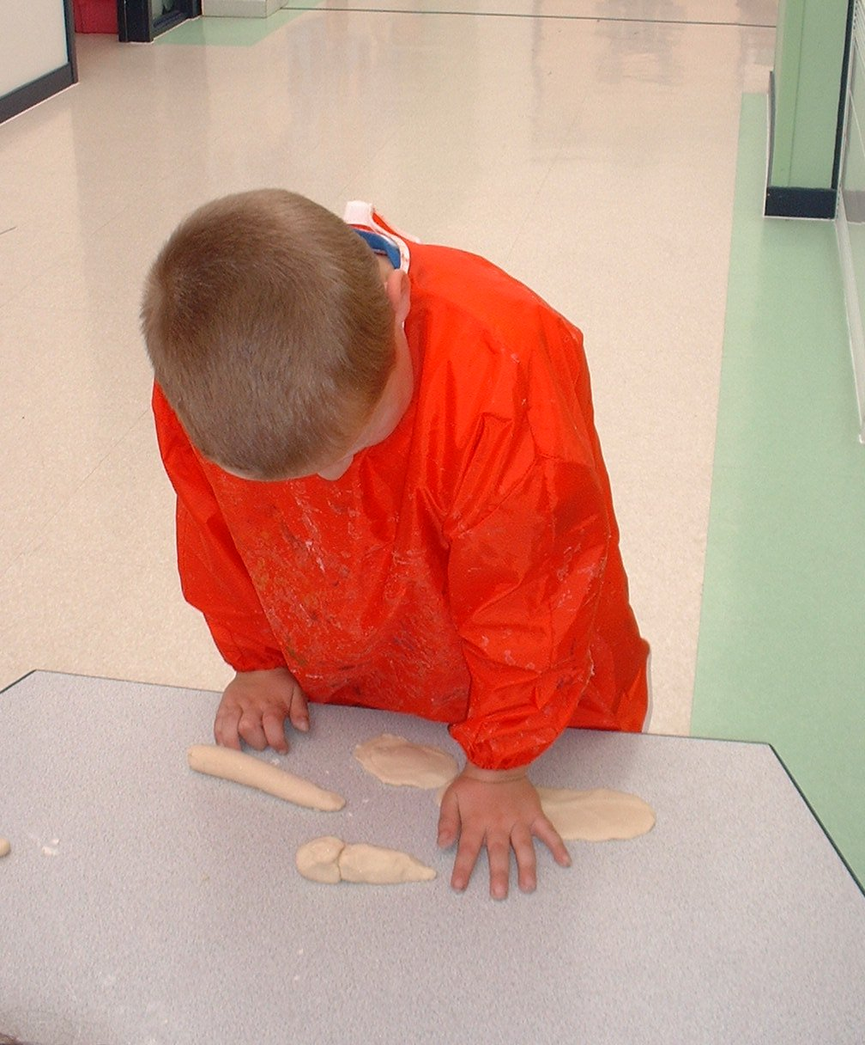
The boy is
the dough with his hand.

Slide 13
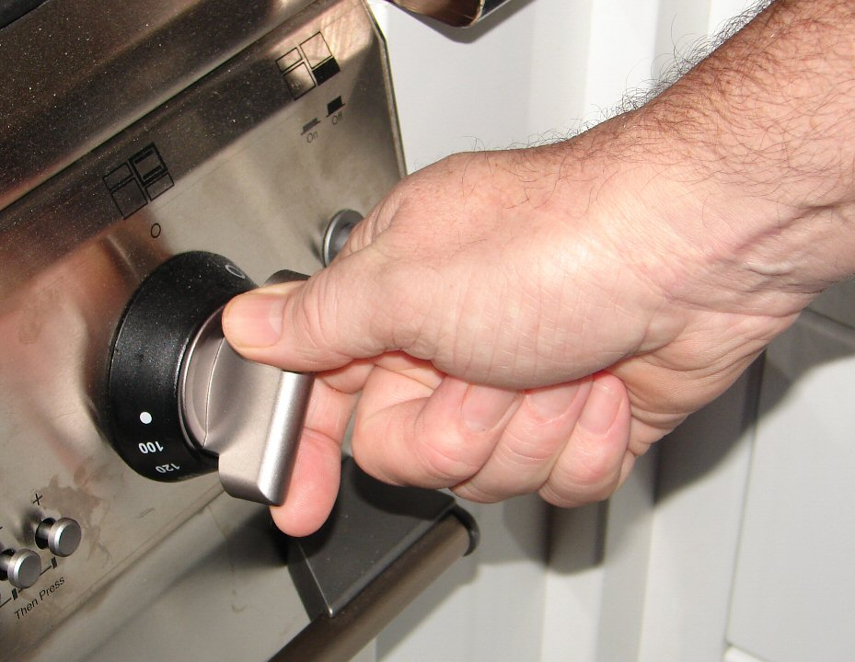
The hand is
the knob to turn on the oven.

Slide 14
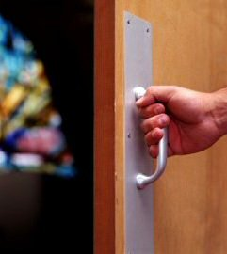
The door is being
open.

Slide 15
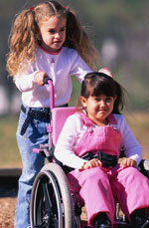
The little girl is
her friend in her wheelchair.

Slide 16
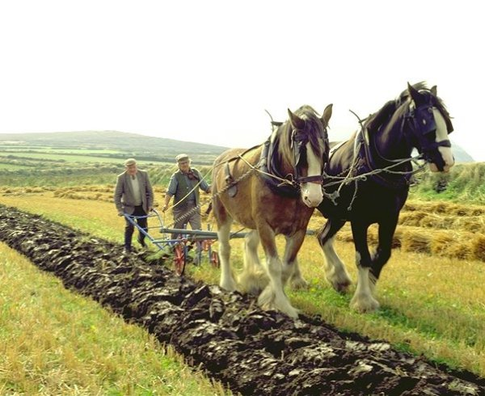
The horses are
the old fashioned plough.

Slide 17
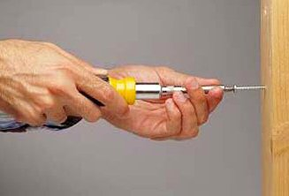
The screwdriver
the screw into the wood.

Slide 18
How did you do?
Could you spot the different forces? Let’s have one more try. What forces can you see in these pictures
twist
pull
push
Did you get them right?

Slide 19
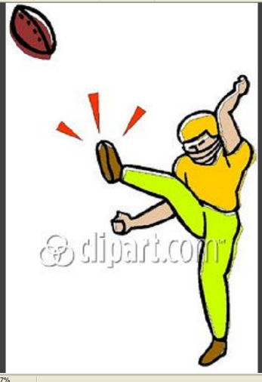
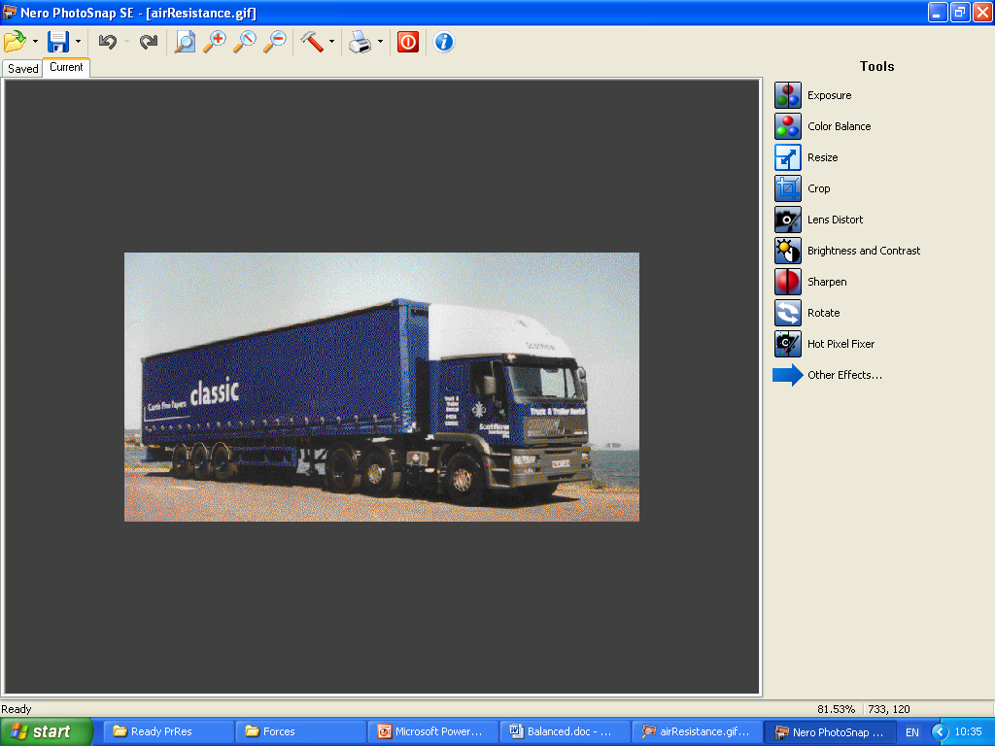

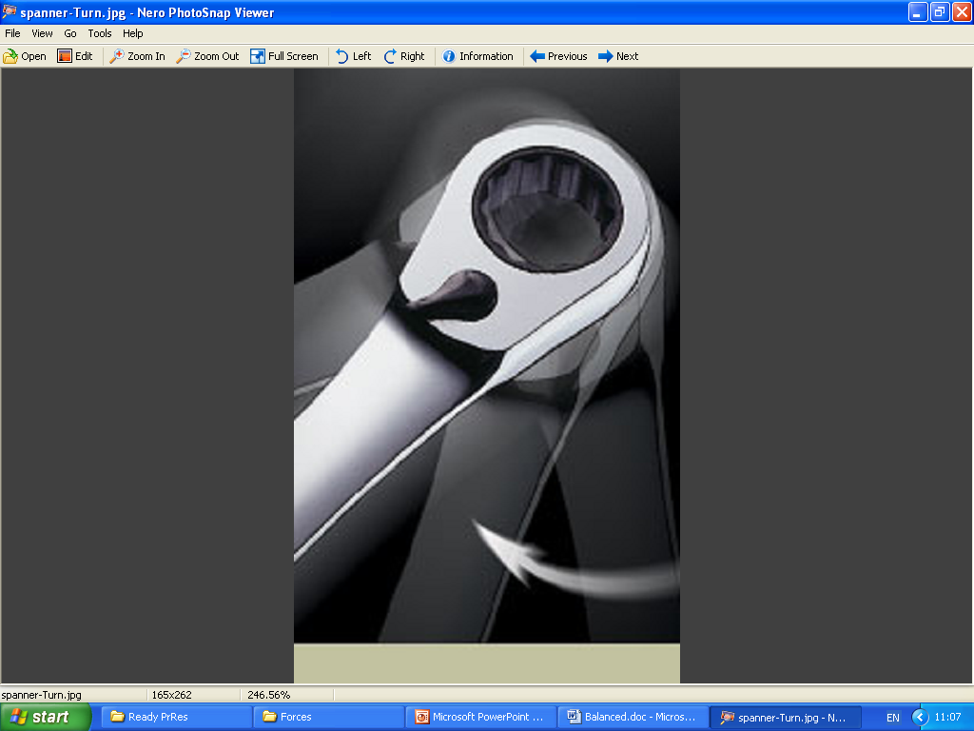
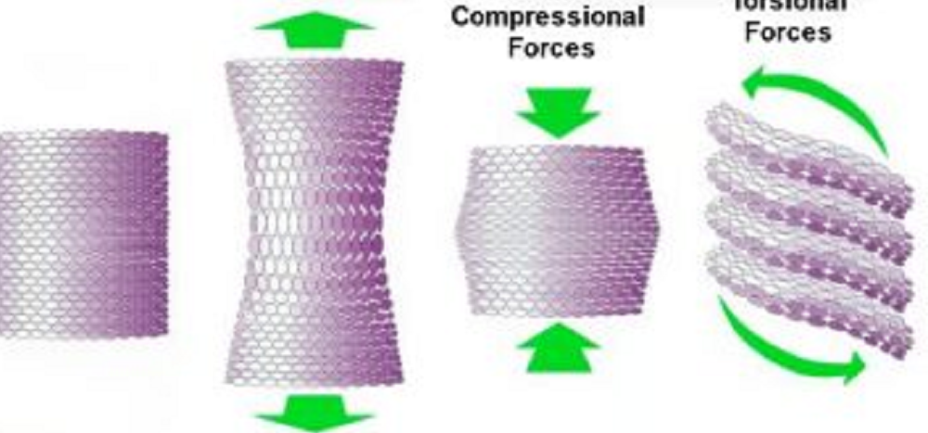
Forces can make objects do FIVE things
Speed up
Like kicking a ball
2. Slow down
Like drag or air resistance
3. Change Direction
Like hitting a ball with a bat
5. Change shape
Like stretching, twisting, compressing and Bending
4. Turn
Like turning a spanner

Slide 20
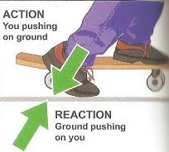
Types of Forces – Use the explanations below. Look at the pictures from earlier. Label the types of forces onto the pictures.
Applied Force a force being applied by another object
Gravitational Force the force that attracts (pulls)objects with mass towards each other
Normal / Reaction Force a force that stops objects falling through other solid objects – reaction force
Frictional Force two objects / surfaces rubbing against one another to slow down
Air Resistance Force air pushing against an object to slow it down
Tension Force a force travelling through a string when pulled tight from both ends
Spring Force a force caused by a spring that returns the object to its original position
Magnetic force a force that attracts objects or pushes them away (repels)

Slide 21
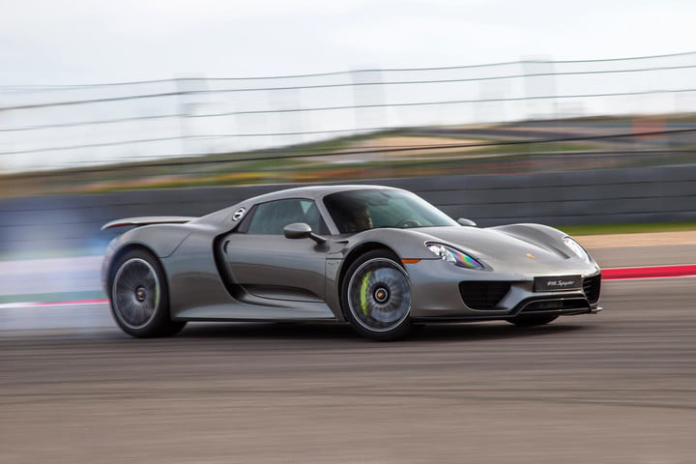
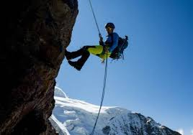
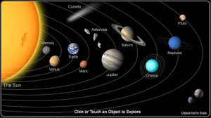

Slide 22
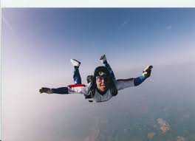
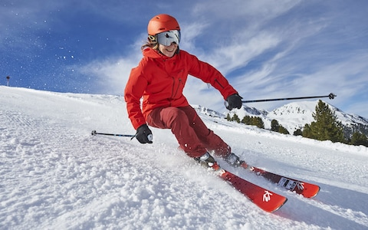
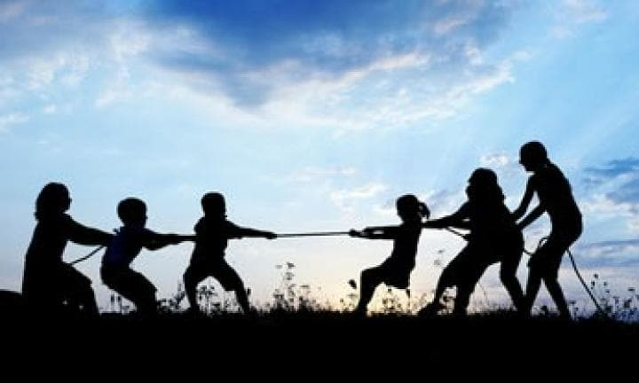

Slide 23
Understand that a force is and what it does?
Create your own poster to explain what forces are and what type of movement forces cause.
A force is …..
Forces make things ……………..
WILF
Draw some example of objects and the force being applied.
Arrows are the correct size to show the size of the force.
Arrows have to have arrow heads.
Arrows touch the object and point in the correct direction.

