Slide 1
How to Write
An Informal Letter

Slide 2
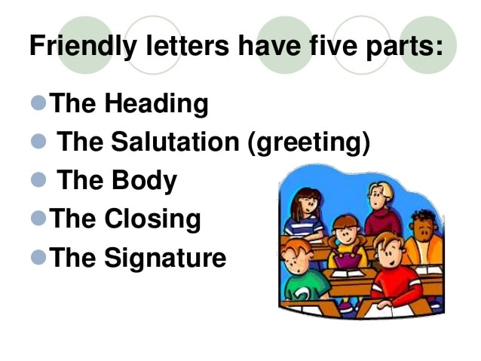

Slide 3
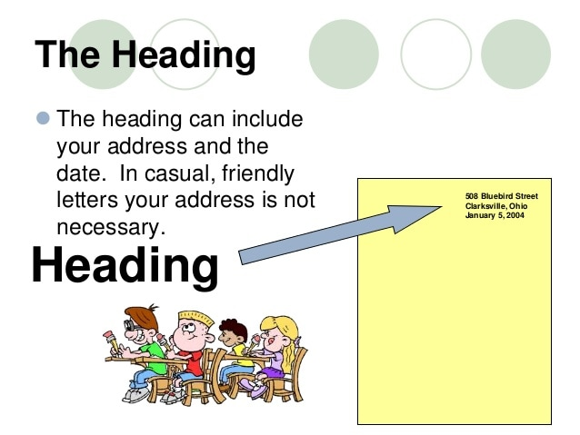

Slide 4
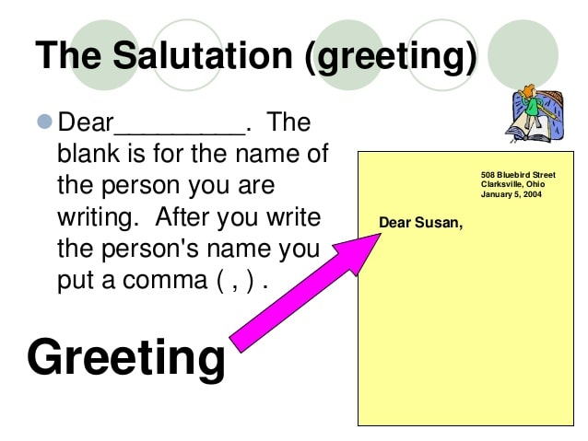

Slide 5
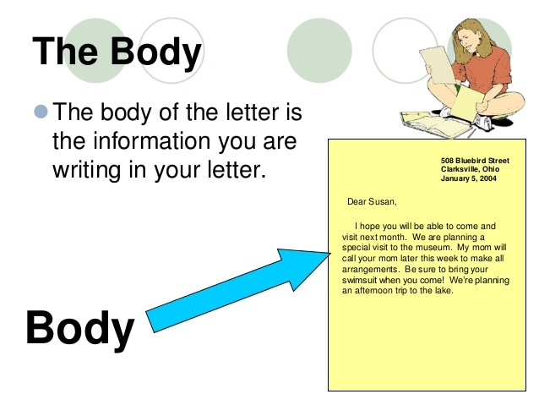

Slide 6
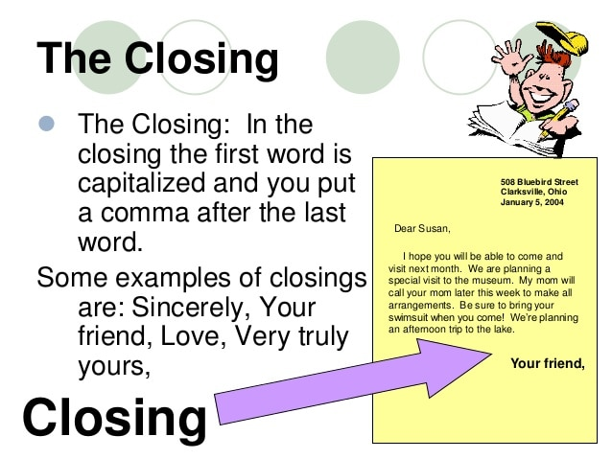

Slide 7
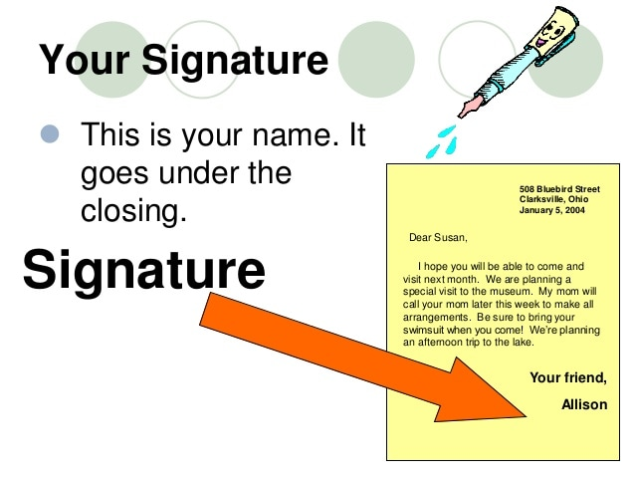

Slide 8
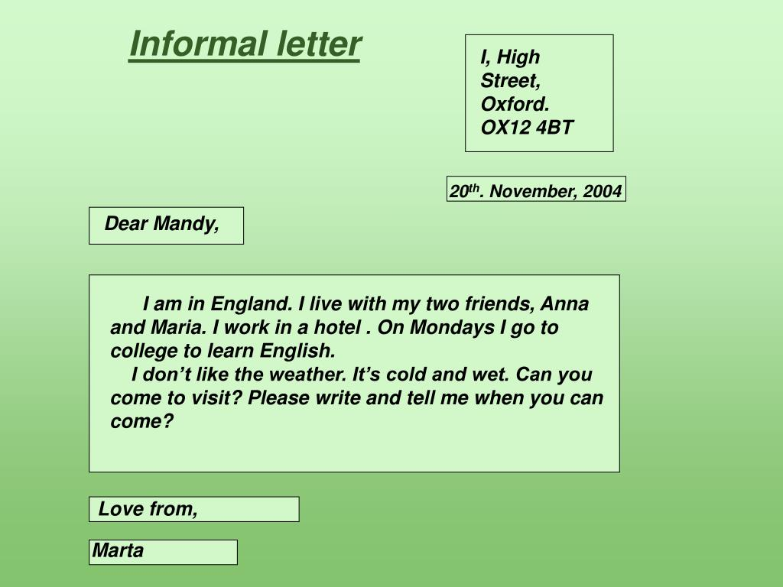
Let’s read this informal letter

Slide 9
Let’s read more
Learner’s book page: 30
Solve “ Get started” Q1(a to c)
Workbook page: 14,17 ,18 ( for revision and practice)

