Slide 1



Haikus

Slide 2

2. Haikus have seventeen syllables.

Slide 3
3.Haikus have three lines with seventeen syllables :
five syllables in the first line ,
seven syllables in the second line,and
five syllables in the last line.

Slide 4
4.Originally they were written to give images of the natural world, but now they include a wider range of topics.

Slide 5

Let’s read the following Haiku:

Slide 6
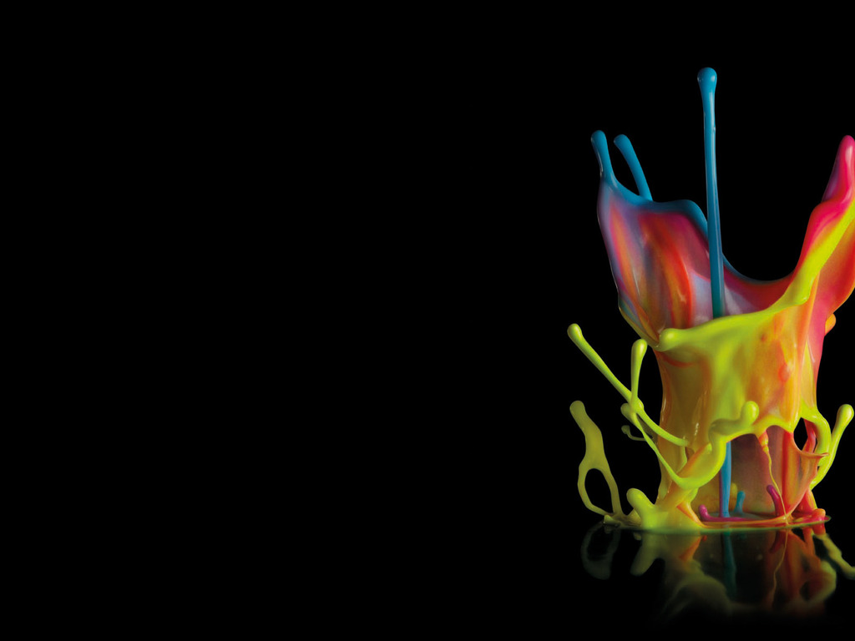



Outbreak of peace, Haiku
My mum declares peace.
She hands out bouquets of smiles.
Laughter like church bells.
By Pie Corbett

Slide 7
Outbreak of Peace, Haiku Line( 1 ):My mum declares peace. Line( 2):She hands out bouquets of smiles. Line(3 ):Laughter like church bells.

Slide 8
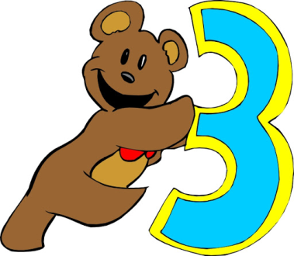
1. How many lines does a haiku have? Each haiku has lines

Slide 9

2.How many syllables does line 1 have?

Slide 10
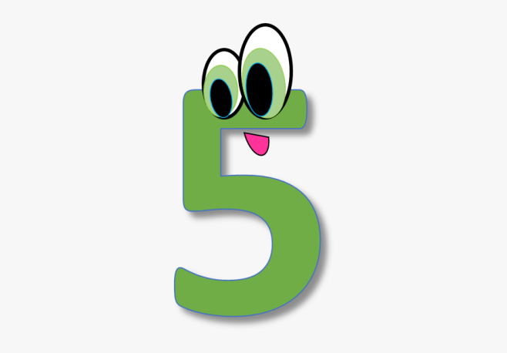
Line one has five syllables. 1 2 3 4 5 My / mum / dec / lares /peace .

Slide 11

3. How many syllables does line 2 have?

Slide 12

Line two has seven syllables. 1 2 3 4 5 6 7 She / hands / out / bou / quets / of / smiles.

Slide 13
4.How many syllables does line 3 have?

Slide 14
Line three as five syllables. 1 2 3 4 5 laugh / ter/ like / church / bells .

Slide 15


