Slide 1
Particles are matter

Slide 2

All materials are made of very tiny pieces called particles.
Notes:
This is the question that your experiment answers

Slide 3
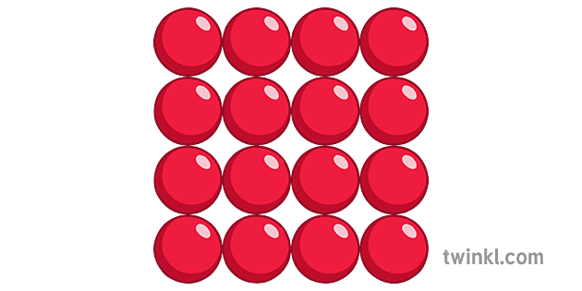

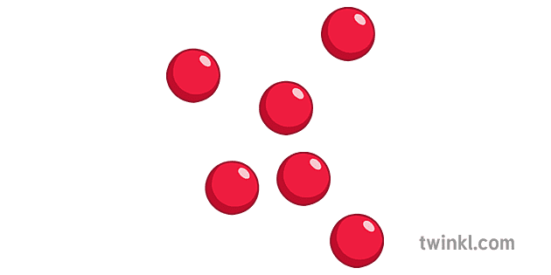
Particles in the three states of matter and their properties
Particles in solid
Particles in liquid
Particles in gas

Slide 4
In solid each particle is held in place very tightly .
The particles are in fixed positions and cannot move about .They can only vibrate.
The particles In solids cannot escape so the mass and volume stay the same.

Slide 5

Liquids need a container to hold them. They take its shape.
The particles in liquids can flow freely around each other and slid over each other, so the whole liquid can move.
The particles cannot escape from the liquid so the amount of space does not change .
*Liquids keep their mass and volume .

Slide 6
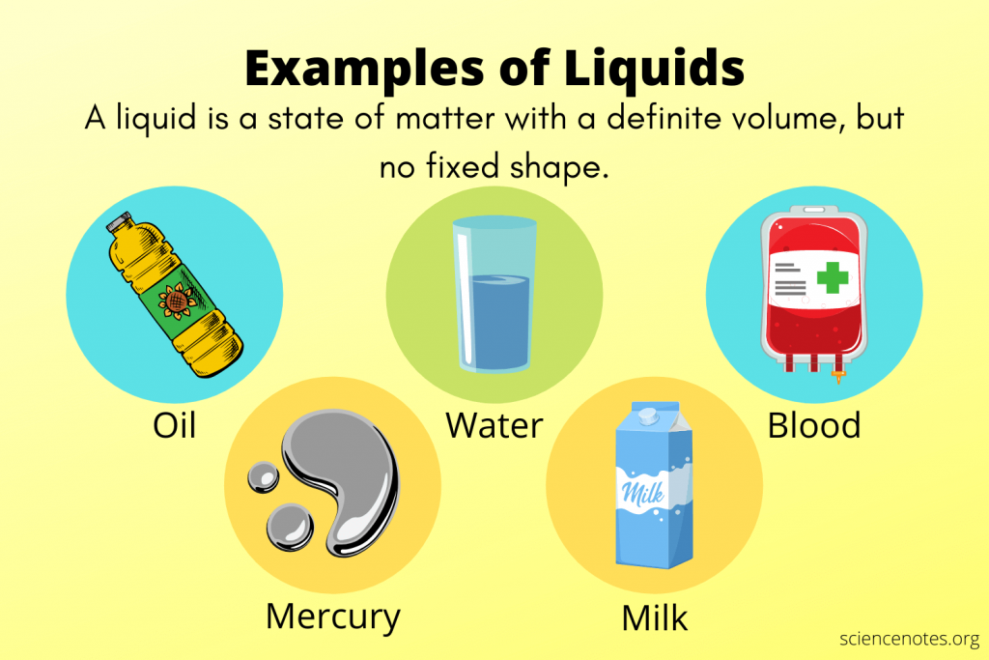

Slide 7
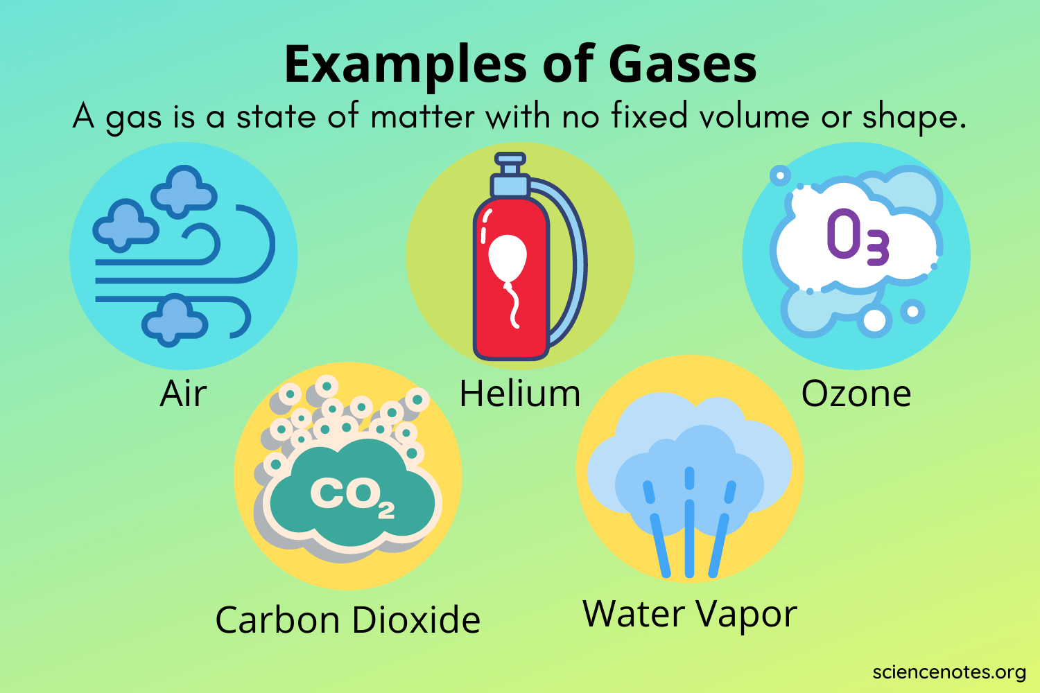
Gases are easy to compress, they expand to fill the space

Slide 8

Here is an interesting scientific problem.
Are salt and sugar solids or liquids?

Slide 9
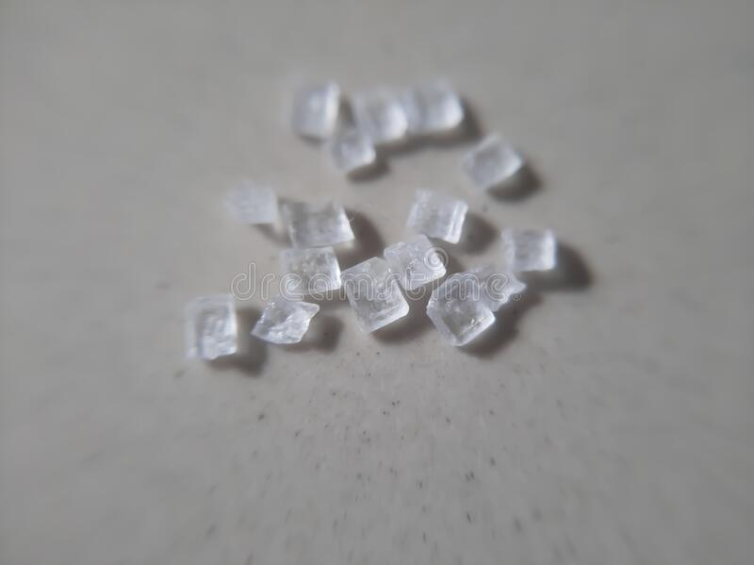
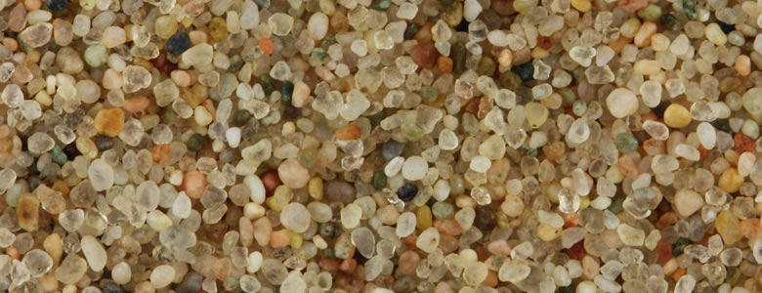
Salt, sand and sugar are made of grains. Each grain is a tiny solid.
Salt, sugar and sand are solids, even though they flow and move in a similar way to liquid.
Notes:
Establish hypothesis before you begin the experiment. This should be your best educated guess based on your research.

Slide 10
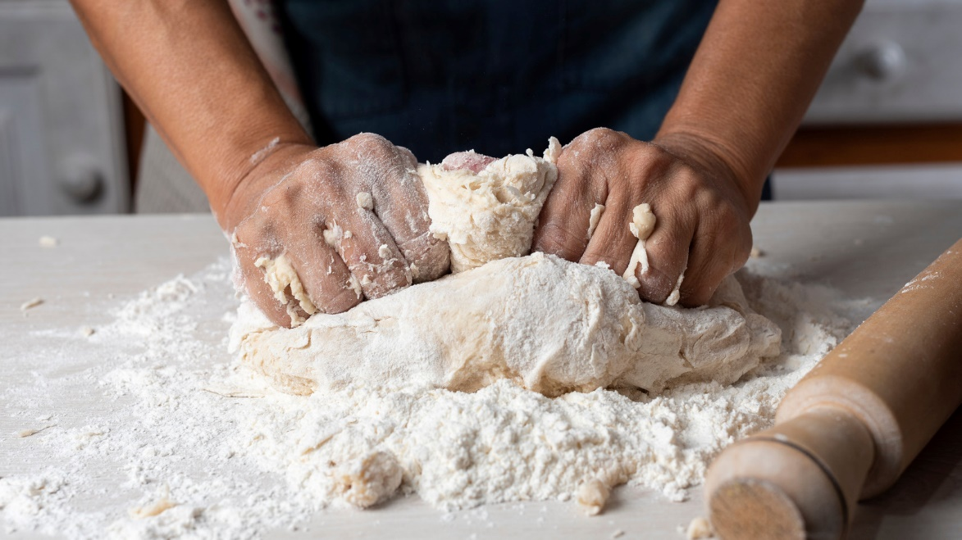

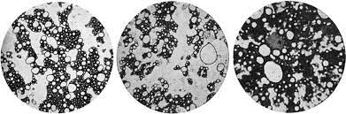
Powders are classified as solids as well.
This is how baking flour looks like under a magnifier

