Slide 1
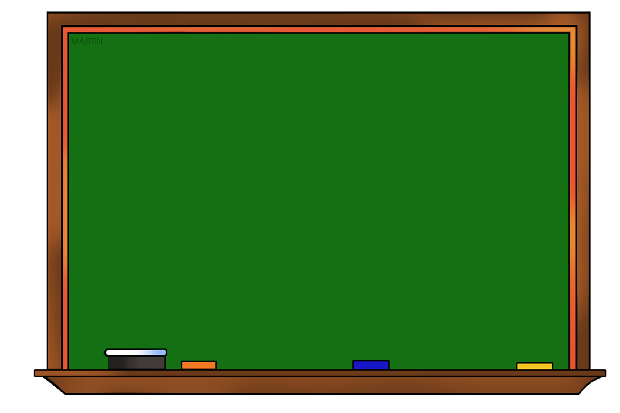

Alphabetical order
By teacher: Maram Moien Dayoub

Slide 2
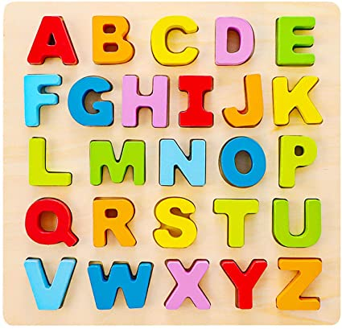
Lesson objective
At the end of the lesson you will
be able to list words in alphabetical
order.

Slide 3




To order the following words we must look at the first letter:

Slide 4

Look at the alphabet again.
A B C D E F G H I J K L M N O P
Q R S T U V W X Y Z

Slide 5
Look at the alphabet again.
A B C D E F G H I J K L M N O P
Q R S T U V W X Y Z

Slide 6
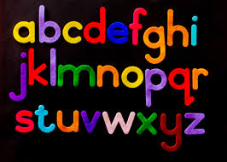
*Put this group of words into alphabetical order.
snake
elephant
kangaroo
bear
1. bear
2. elephant
3. kangaroo
4. snake

Slide 7
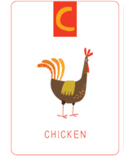
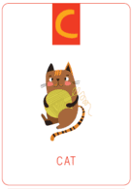
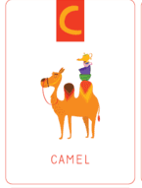
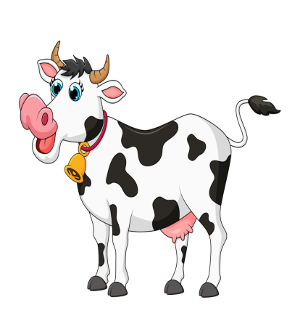

To order words that start with the same letter we must look at the second letter in the word. If that letter is the same ,then we look at the third letter, and so on.
A B C D E F G H I J K L M N O P Q R S T U V W X Y Z
cow
Chicken
Cat
Camel
Cow

Slide 8
*Put this group of words into alphabetical order.
Chicken
Cat
Camel
Cow
1. Camel
2. Cat
3. Chicken
4. cow

Slide 9
*Put this group of words into alphabetical order.
mum
mouse
mirror
mat
1. mat
2. mirror
3. mouse
4. mum

Slide 10
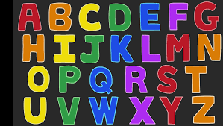
Let’s put this group of words into alphabetical order.
1.
apples
oranges
grapes
bananas
1. apples
2. bananas
3. grapes
4. oranges

Slide 11
Let’s put this group of words into alphabetical order.
2 .
museum
bank
school
house
1. bank
2. house
3. museum
4. school

Slide 12
Let’s put this group of words into alphabetical order.
3.
green
yellow
red
blue
1. blue
2. green
3. red
4. yellow

Slide 13
Let’s put this group of words into alphabetical order.
4.
ladybird
ant
spider
butterfly
1. ant
2. butterfly
3. ladybird
4. spider

Slide 14
Let’s put this group of words into alphabetical order.
6.
pizza
meat
rice
fish
1. fish
2. meat
3. pizza
4. rice

Slide 15
Let’s put this group of words into alphabetical order.
7.
pay
paint
pass
park
1. paint
2. park
3. pass
4. pay

Slide 16
Let’s put this group of words into alphabetical order.
8.
free
fat
four
fly
1. fat
2. fly
3. four
4. free

Slide 17
Let’s put this group of words into alphabetical order.
9.
fix
follow
fly
fact
1.fact
2. fix
3. fly
4. follow

Slide 18
Let’s put this group of words into alphabetical order.
1o.
read
run
jar
walk
1. jar
2. read
3. run
4. walk

Slide 19
Let’s put this group of words into alphabetical order.
11.
cow
cheetah
cat
crocodile
1. cat
2. cheetah
3. cow
4. crocodile

Slide 20
Let’s put this group of words into alphabetical order.
12.
Syria
Lebanon
Jordan
Egypt
1. Egypt
2. Jordan
3. Lebanon
4. Syria

Slide 21
Let’s put this group of words into alphabetical order.
13.
Spend
sit
stare
see
1. see
2. sit
3. spend
4. stare

Slide 22
Let’s put this group of words into alphabetical order.
14.
nosey
nice
neat
nasty
1. nasty
2. neat
3. nice
4. nosey

Slide 23


