Slide 1
Fossils
Grade 2 Science

Slide 2
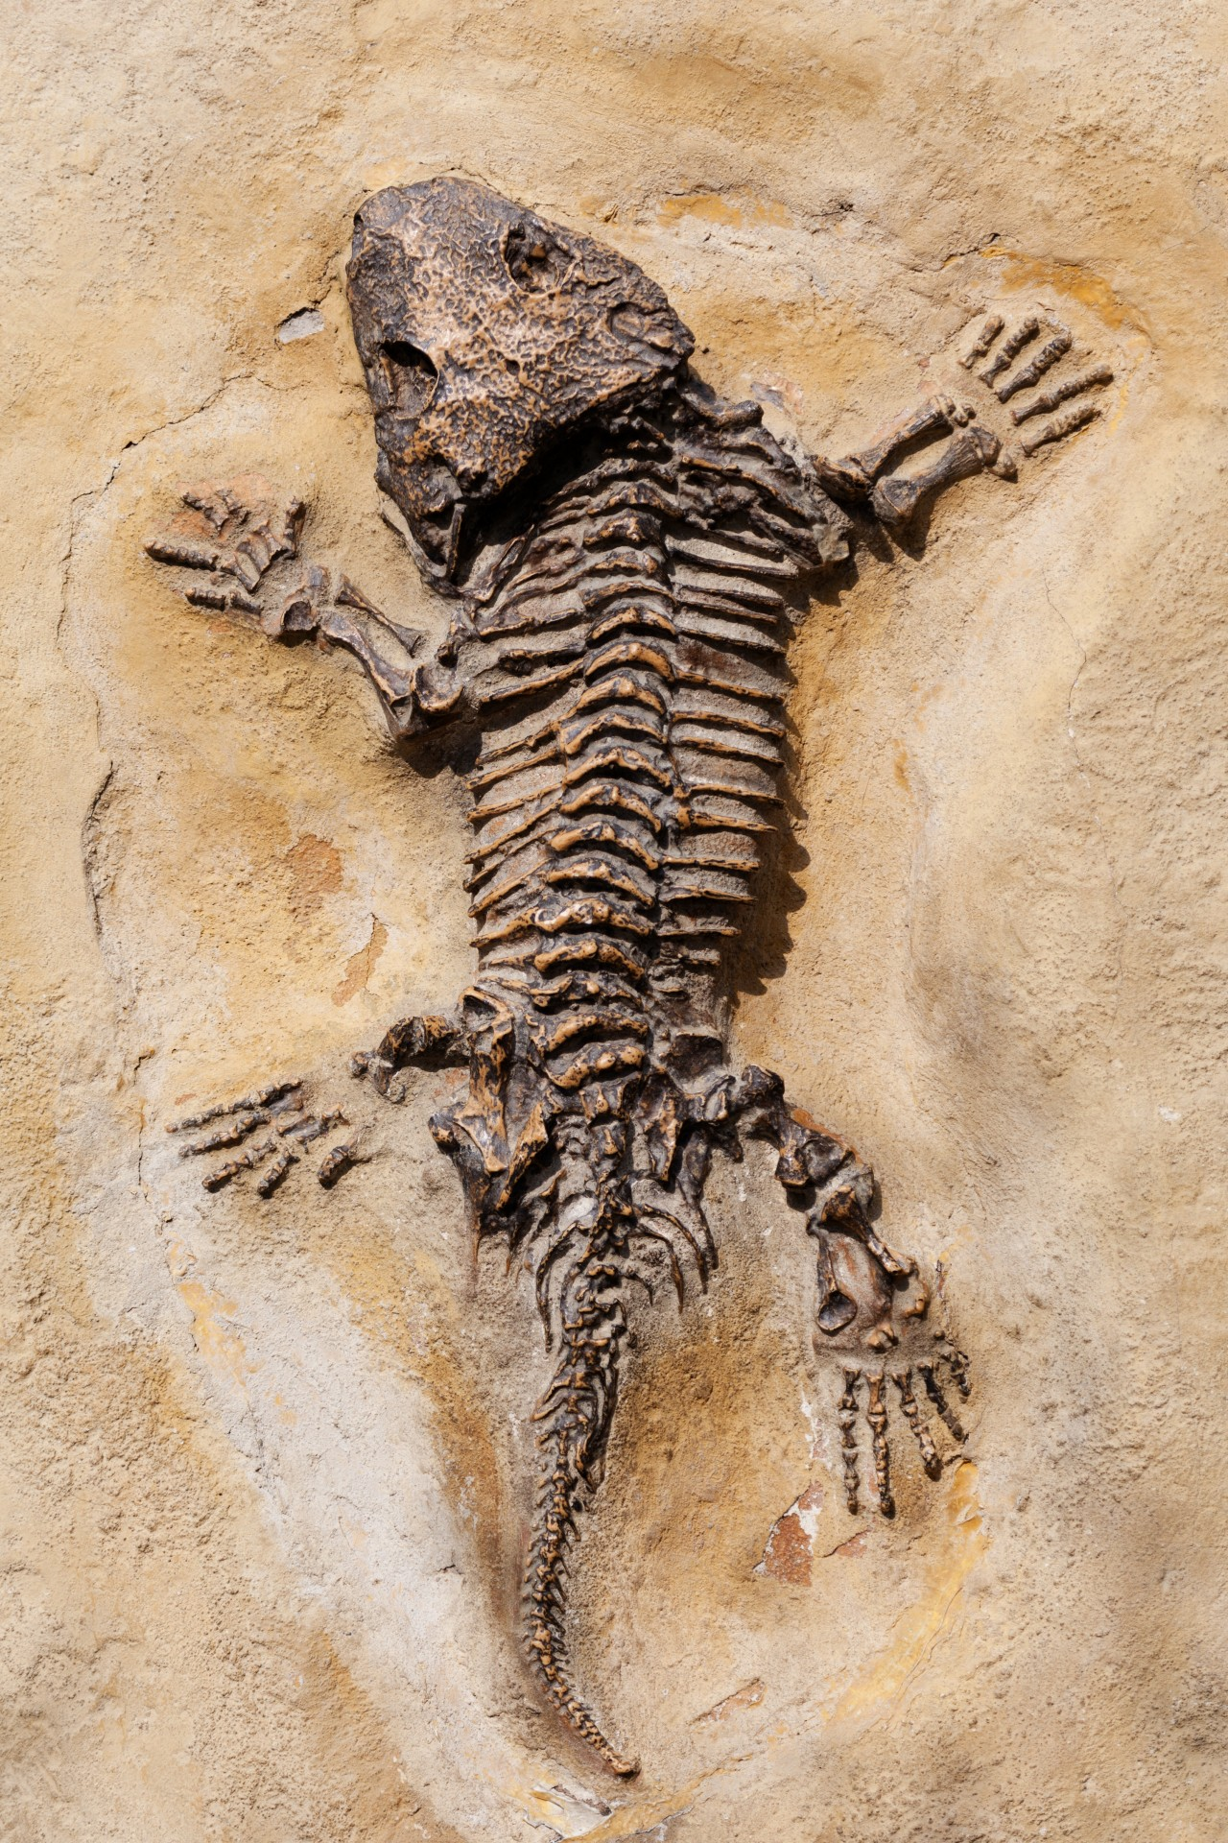
What Are Fossils?
Fossils are the remains or traces of plants and animals from long ago.

Slide 3
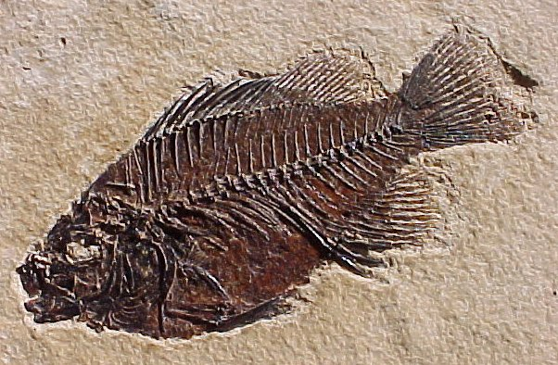
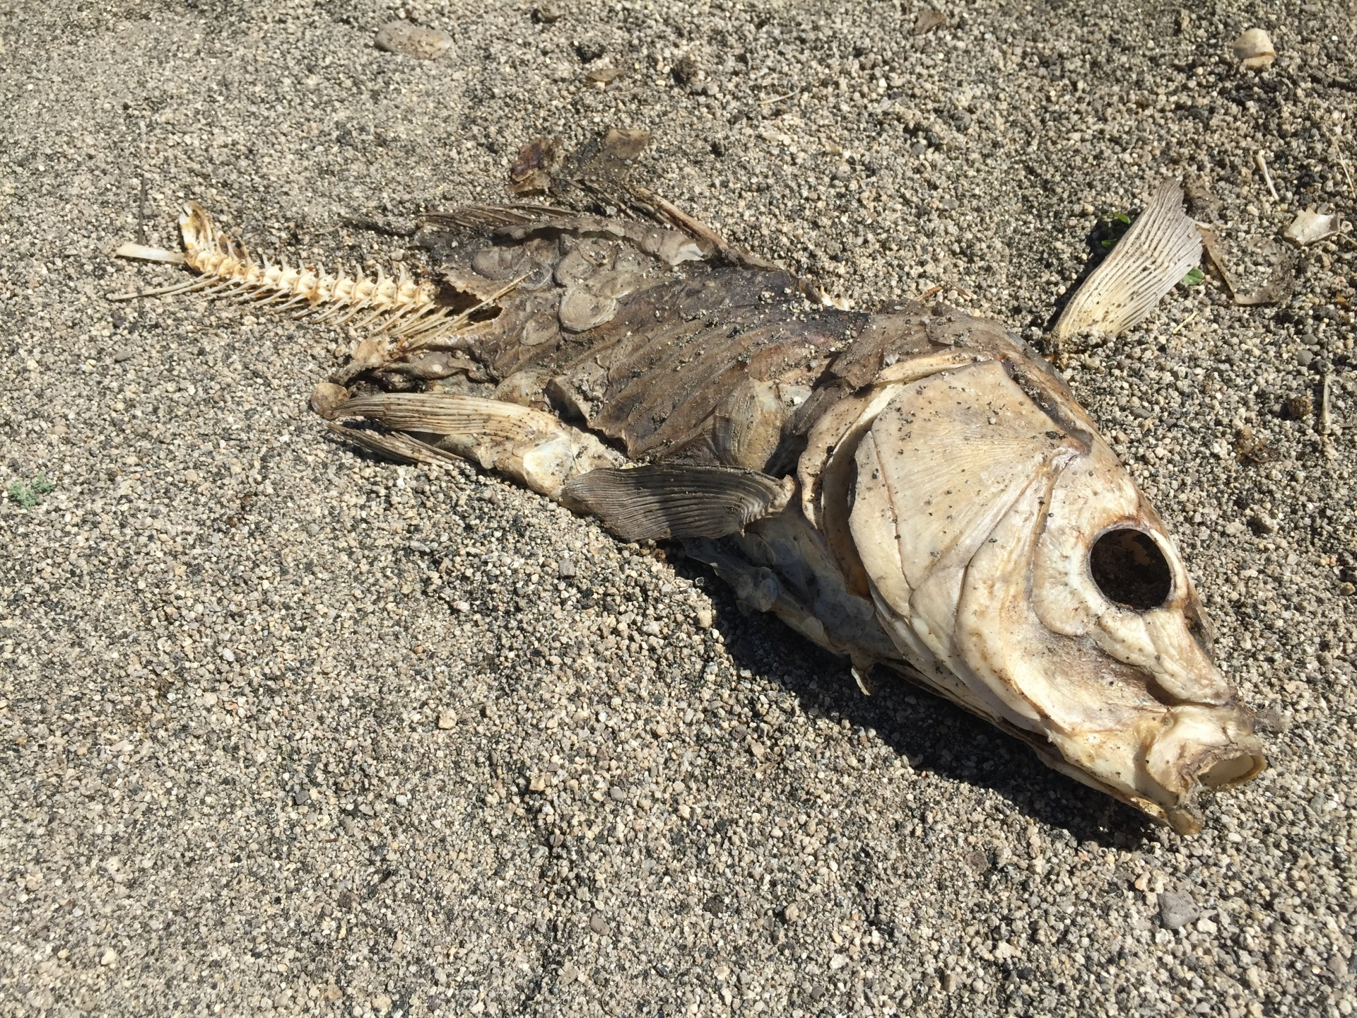
How Fossils Form
1. A plant or animal dies.
2. It gets buried under sand or mud.
3. Over many years, it hardens into rock.

Slide 4
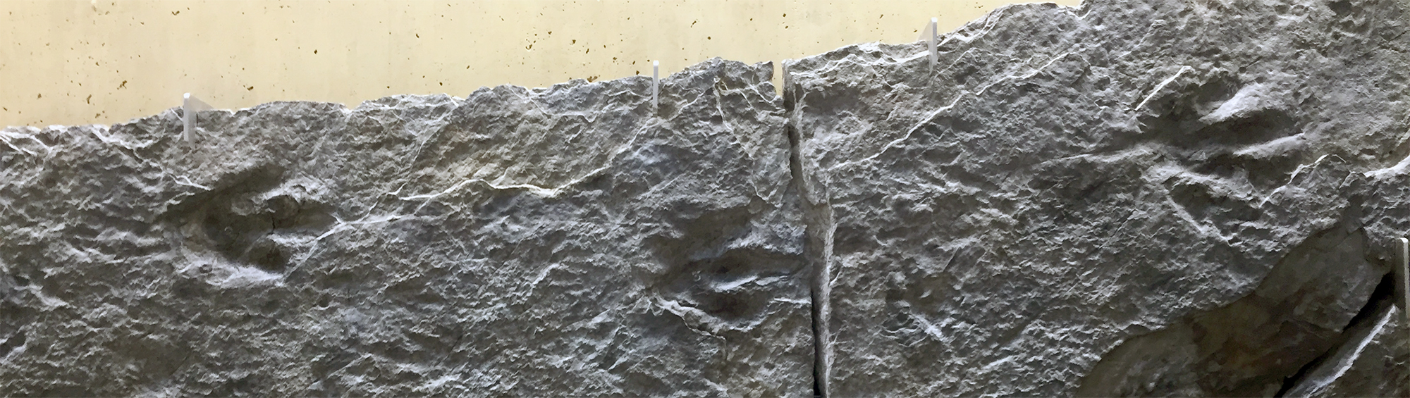
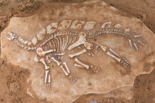
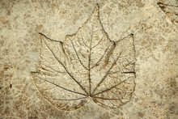
Types of Fossils
• Bone fossils
• Leaf fossils
• Footprint fossils

Slide 5
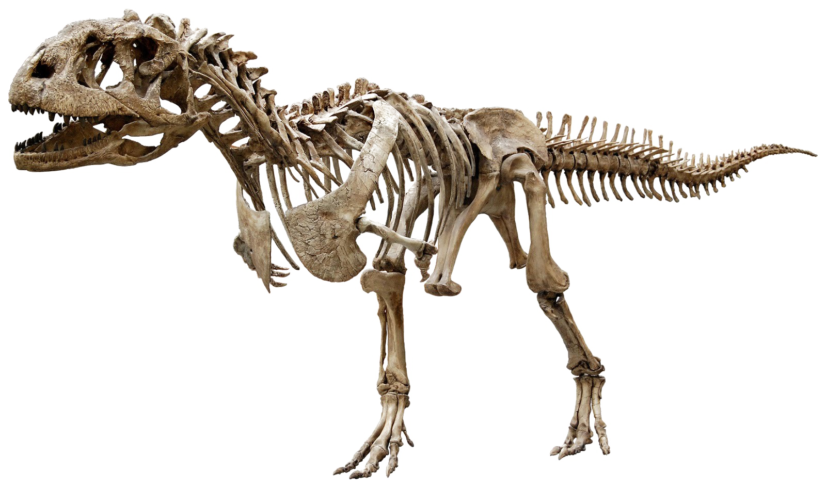
What Fossils Tell Us
Fossils help us learn about animals and plants that lived long ago.

Slide 6
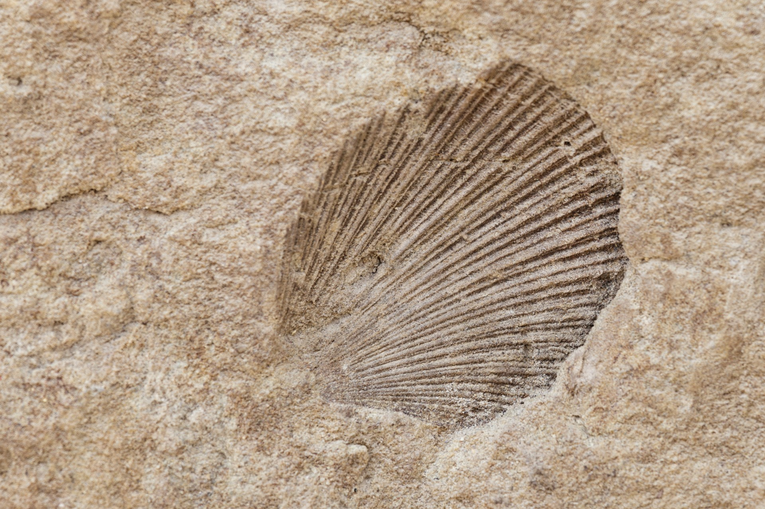
Examples
• Dinosaur fossils
• Shell fossils

Slide 7
Why Fossils Are Important
They help scientists understand Earth's history!

