Slide 1

Myths and Legends
Traditional Stories for Grade 2

Slide 2
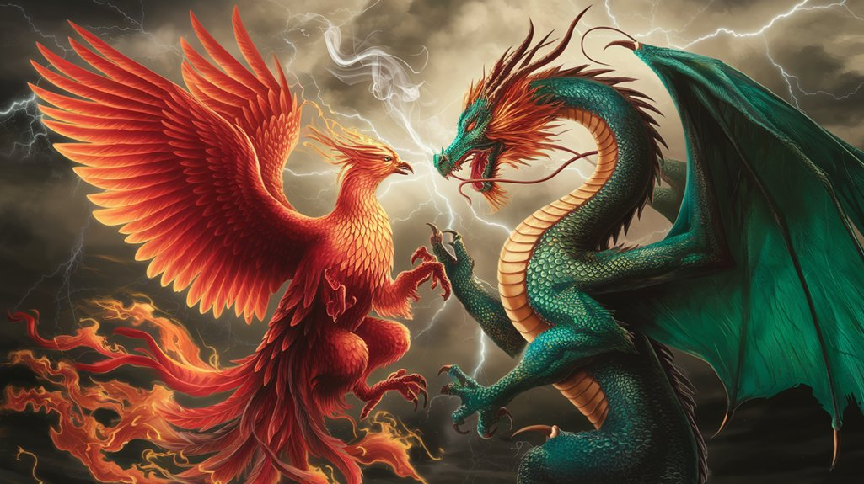
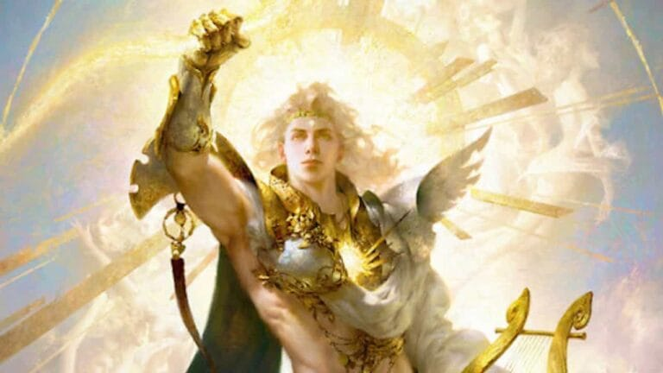
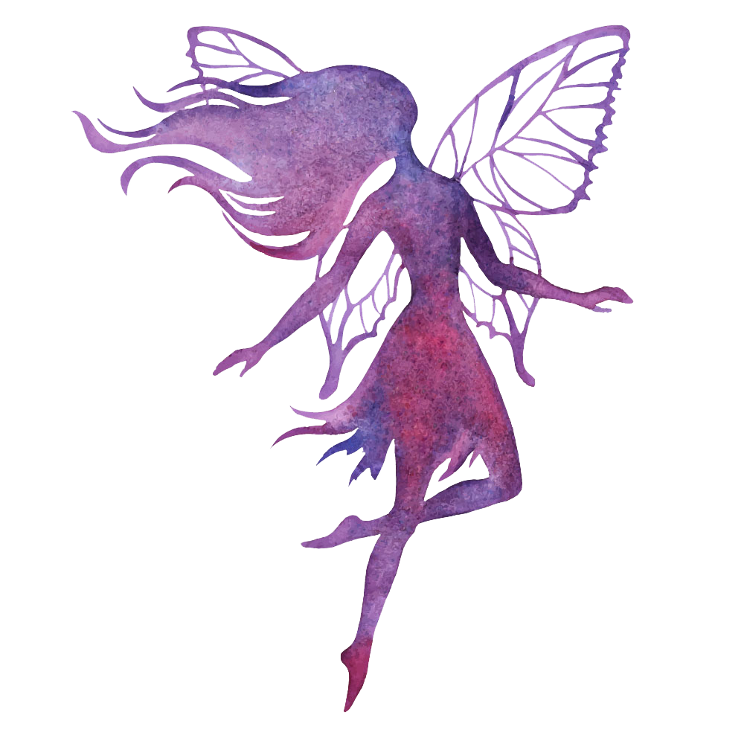
What Are Myths?
Myths are old stories told long ago.
They often explain how things began.
Myths usually have gods, magical creatures, or heroes.

Slide 3
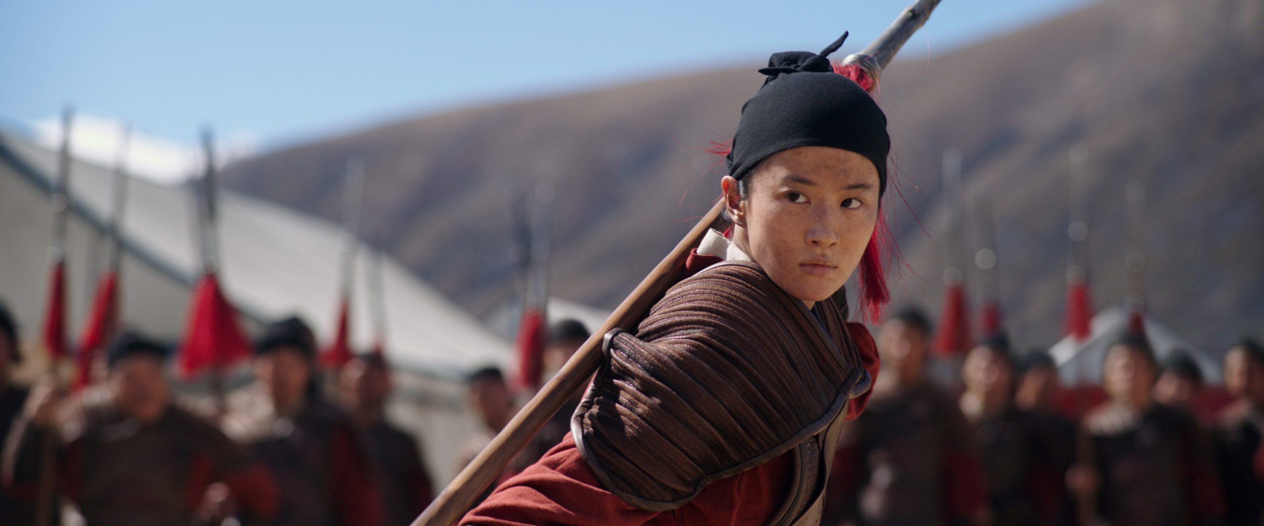
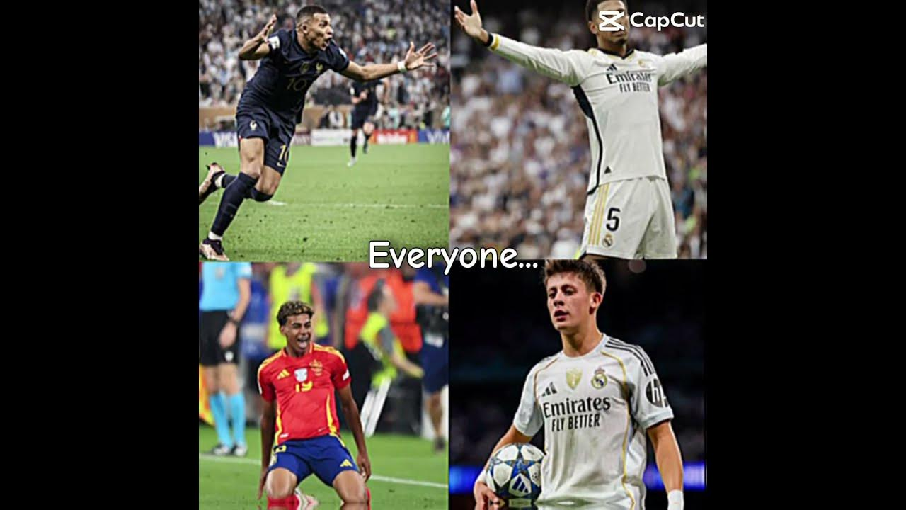

What Are Legends?
Legends are traditional stories about real people or places.
They may have some truth, but parts are exaggerated.
Legends often teach lessons or show bravery.

Slide 4
Myths vs Legends
Myths: magical, explain nature, gods and creatures.
Legends: real people, real places, heroic actions.

Slide 5
Why Do We Read Them?
They teach lessons.
They help us understand cultures.
They are fun and exciting!

Slide 6
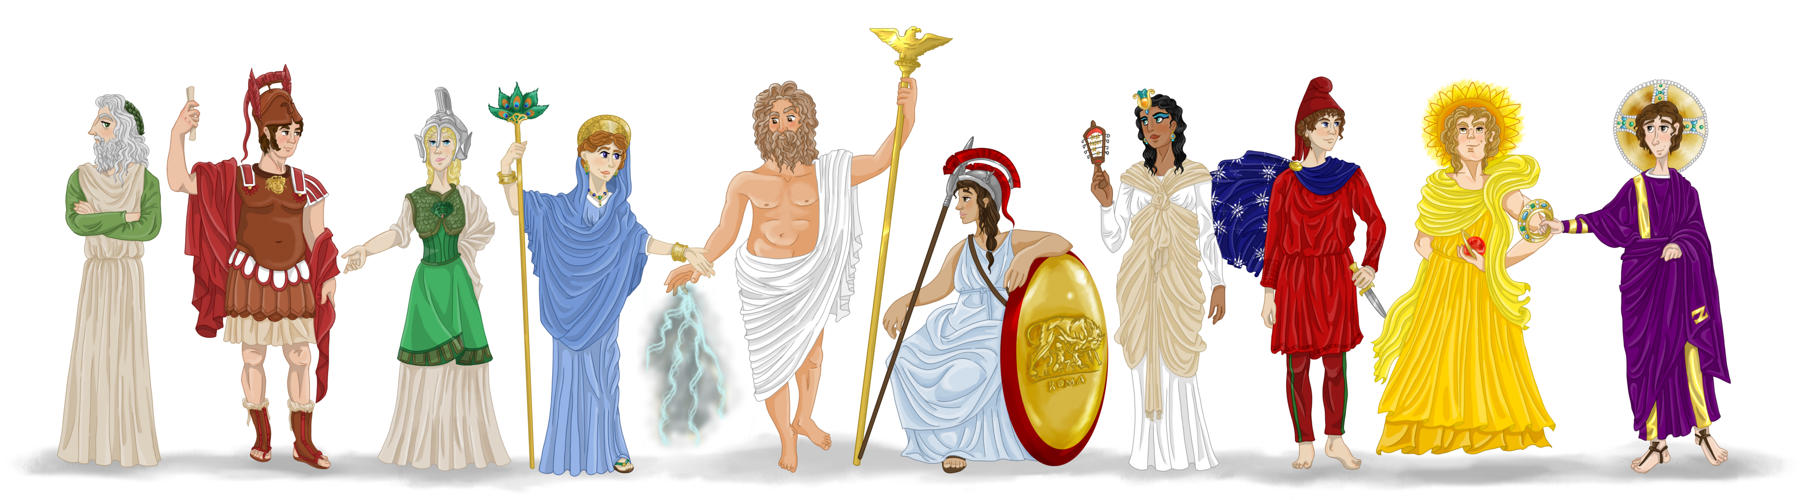
Examples of Myths
• Greek gods (like Zeus)
• Stories about how the sun or moon was created.

Slide 7
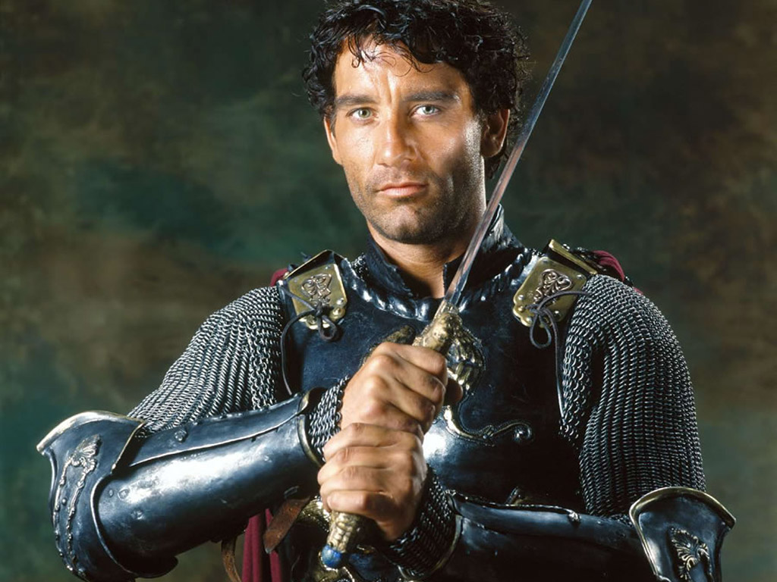
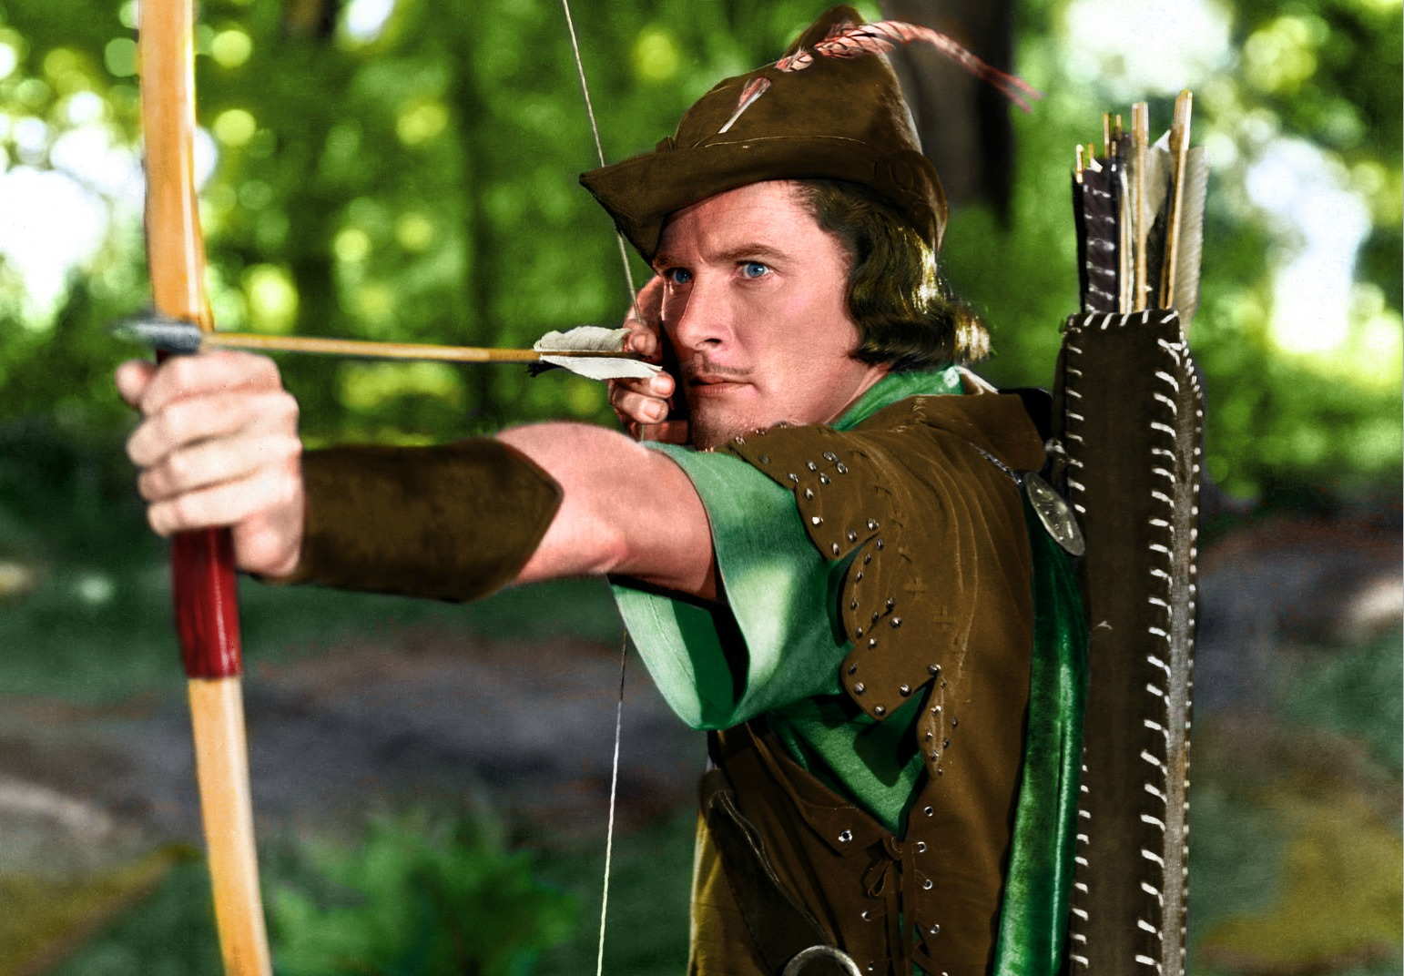
Examples of Legends
• King Arthur
• Robin Hood

Slide 8
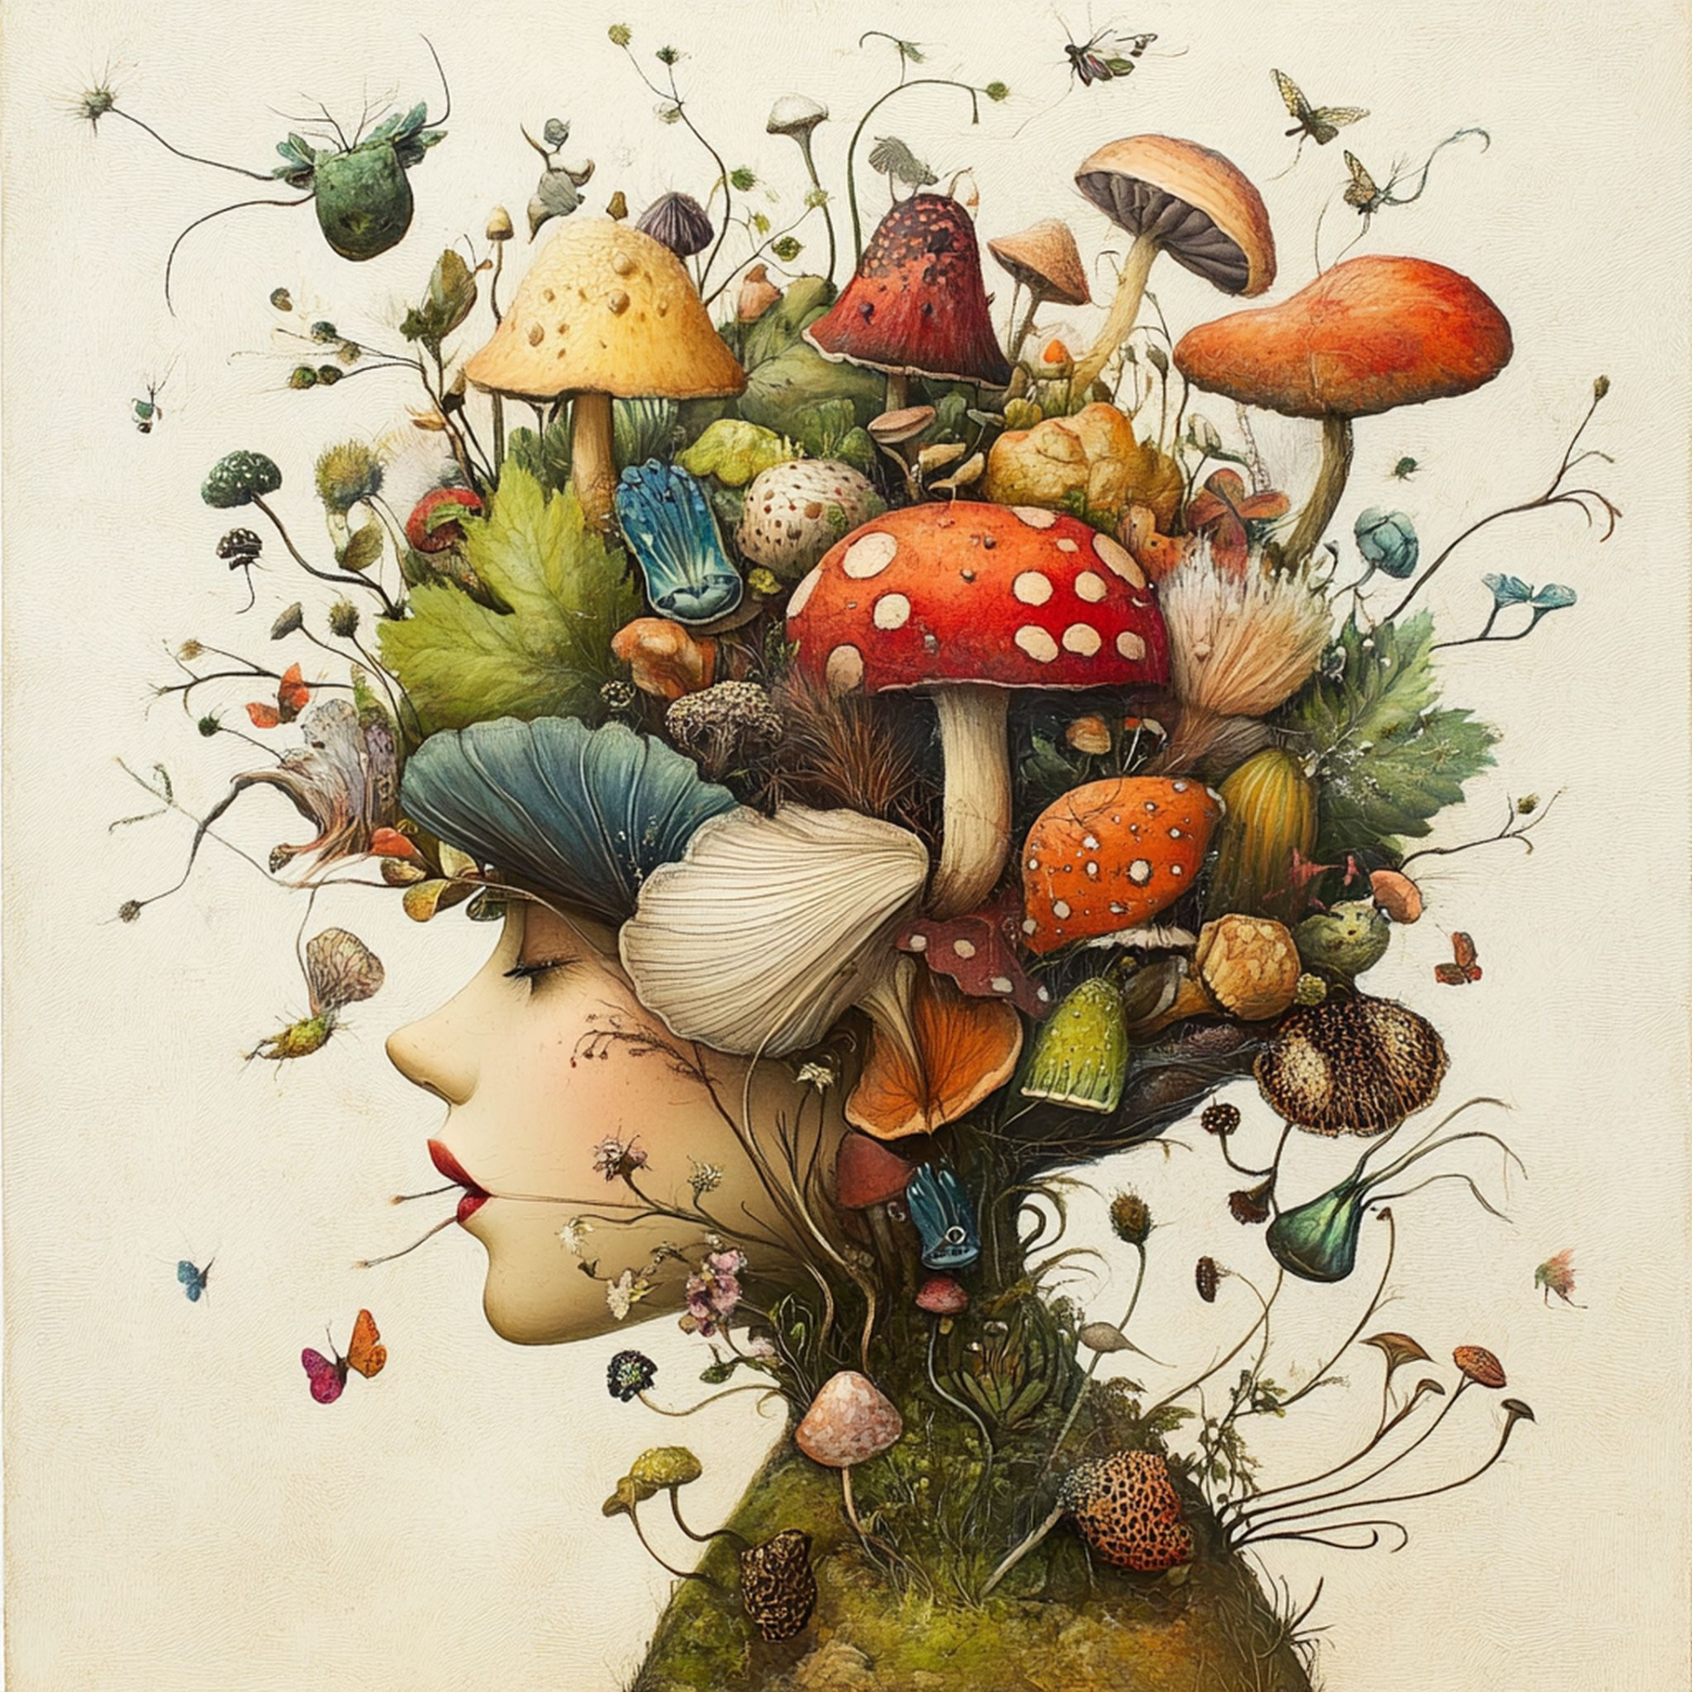
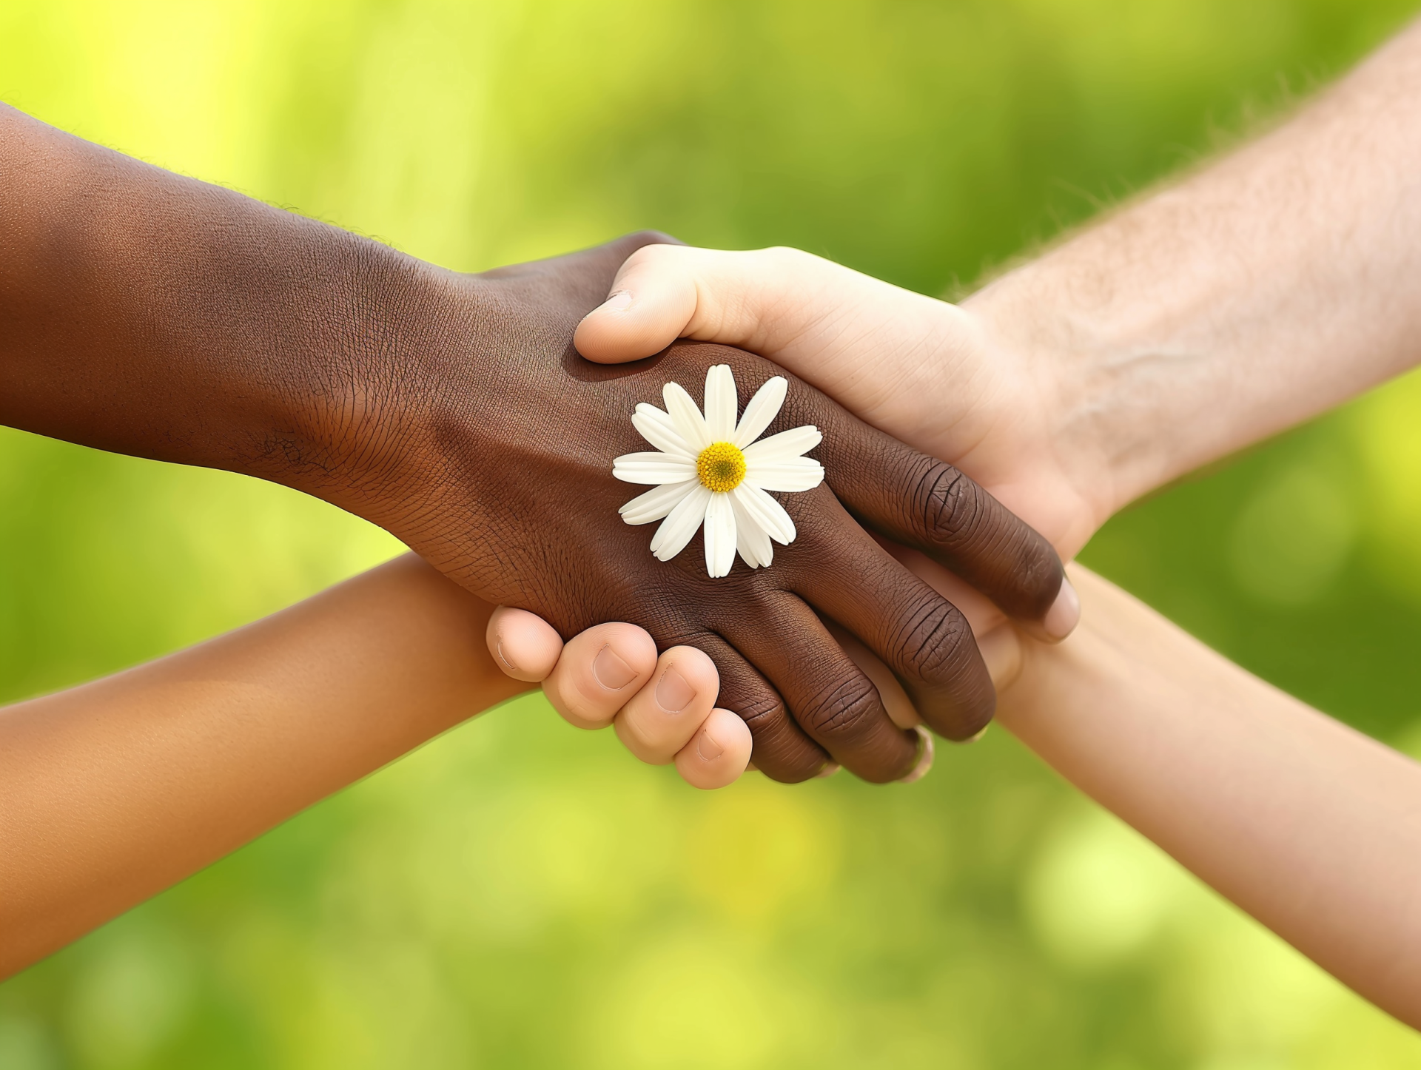
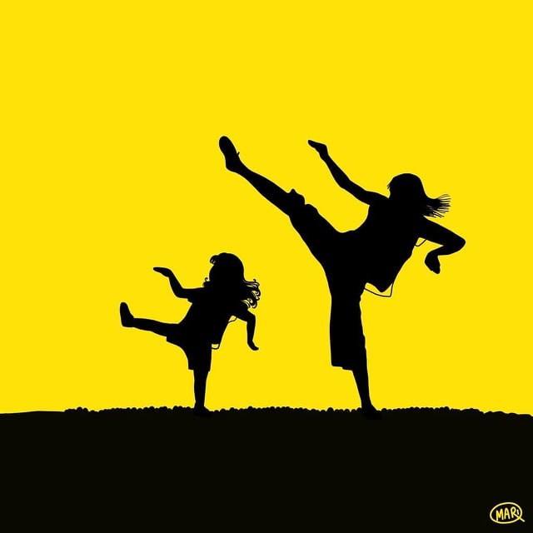
What Can We Learn?
Myths teach us about imagination and beliefs.
Legends teach us about courage and kindness.

