Slide 1
VERB TO BE / Present
+
Subject pronouns

Slide 2

What are the subject pronouns?

Slide 3
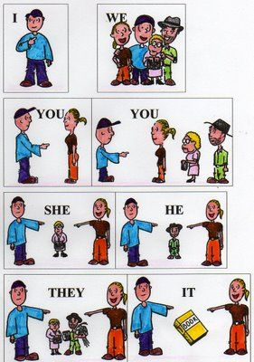
Subject pronouns are:
I
He
She
It
We
You (singular / plural)
They

Slide 4


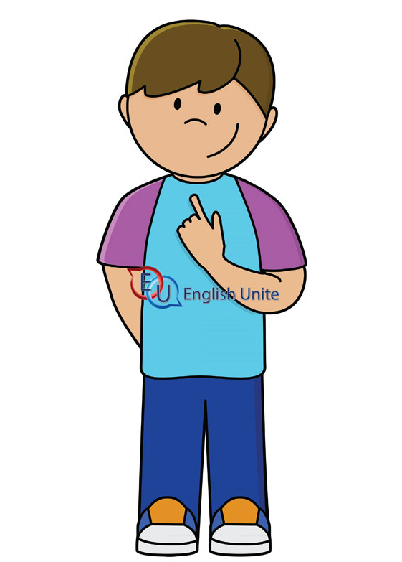
“I”
I am Tom.
I am 10 years old.
I am a student.

Slide 5
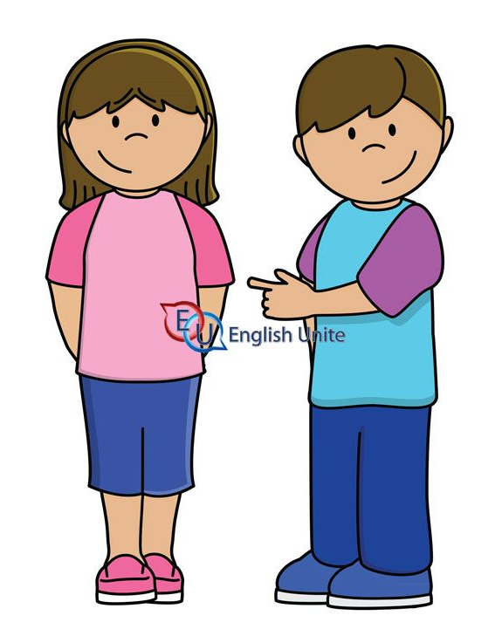
My friend Leen! (She)
She is Leen.
She is 10 years old.
She is a student.

Slide 6
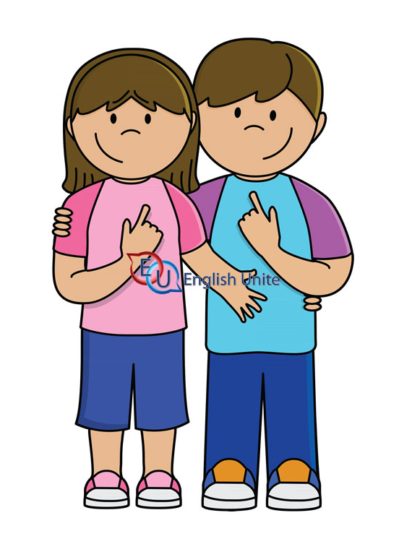
Leen and I.(We)
We are 10 years old.
We are students.
We are friends !

Slide 7

This is Jack. (He)
He is 12years old.
He is a student.
He is from England.

Slide 8

Ben and Dan are friends.(They)
They are Ben and Dan.
They are 12 years old.
They are friends.

Slide 9

YOU (Singular)
You are Kate.
You are 12 years old.
You are a student.

Slide 10
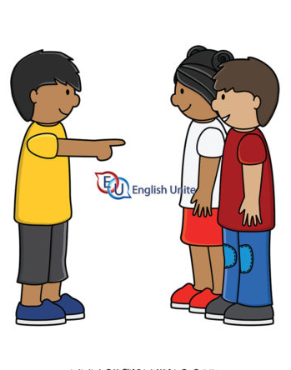
You as (plural).
You are Sally and Sami.
You are from Jordan.
You are students.

Slide 11
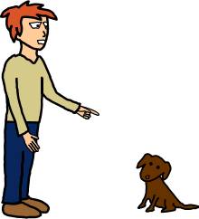
This is my dog.(It)
It is Max.
It is a dog.
It is brown.

Slide 12

This is a book.(it)
It is my book.
It is green.
It is big.

Slide 13

My books.(They)
They are my books.
They are big.
They are useful.

Slide 14
Verb to be in the present : (am / is/ are)
The subject pronouns | Verb to be in the present
 | Verb to be in the Affirmative form (+) | Verb to be in the Negative form (-) | Verb to be in the Interrogative form (?)
I | I am a good student. | I am not a good student. | Am I a good student?
He | He is a good student. | He is not a good student. | Is he a good student?
She | She is a good student . | She is not a good student. | Is she a good student?
It | It is a cute cat. | It is not a cute cat. | Is it a cute cat?
We | We are good students. | We are not good students. | Are we good students?
You (singular) | You are a good student. | You are not a good student. | Are you a good student?
They | They are good students. | They are not good students. | Are they good students?
You (plural) | You are good students. | You are not good students. | Are you good students?

Slide 15

Q1: Complete the description of this girl. Use verb to be (is / am / are).
Hello! I.………. Mona, and I .…… from Madrid in Spain. I ……… 11 years old, and I love music. I’ve got two sisters and one brother. My brother’s name ……… Alberto, he ……… tall and thin ,and he loves computer games. He ……… great at playing football. My two sisters ………… younger than me and my brother. I ………… the oldest of my sisters. My sisters………… three and four years old. They like playing with dolls. I ………… very funny. I usually go out with my friends Marta and Nana on Saturdays. They …………… 11 and 12 years old. They …………… my best friends. My mum loves cinema and my dad loves sport and nature. My parents ………very kind. I ……..…… very happy to have such a family.

Slide 16
Answers (1).
Hello! I am Mona, and I am from Madrid in Spain. I am 11 years old, and I love music. I’ve got two sisters and one brother. My brother’s name is Alberto, he is tall and thin ,and he loves computer games. He is great at playing football. My two sisters are younger than me and my brother. I am the oldest of my sisters. My sisters are three and four years old. They like playing with dolls. I am very funny. I usually go out with my friends Marta and Nana on Saturdays. They are 11 and 12 years old. They are my best friends. My mum loves cinema and my dad loves sport and nature. My parents are very kind. I am happy to have such a family.

Slide 17
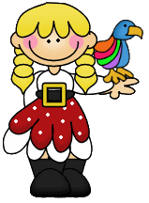

Q2. Circle the correct answers below.
1. (Is/Are/ Am) your mum American?
2. (Is/Are/ Am) you at school?
3. Where (is/are/ am) my dictionary?
4. What (is/are/ am) it?
5. How old (is/are/ am) you?
6. (Is/Are/ Am) your father OK?
7. (Is/Are/ Am) you good students?

Slide 18
Answers (2)
1. Is your mum American?
2. Are you at school?
3. Where is my dictionary?
4. What is it?
5. How old are you?
6. Is father OK?
7. Are you good students?

Slide 19
Q2. Circle the correct answers below .
8. (Is/Are/ Am) Sam your brother?
9. (Is/Are/ Am) they your best friends ?
10. Where (is/are/ am) your dog ?
11. What (is/are/ am) your name?
12. (Is/Are/ Am)Bob here?
13. Where (is/are/ am) your parents?
14. (Is/Are/ Am) I a good teacher?

Slide 20
Answers (2)
8. Is Sam your brother?
9. Are they your best friends ?
10. Where is your dog ?
11. What is your name?
12. Is Bob here?
13. Where are your parents?
14. Am I a good teacher?

Slide 21
Q3. Fill in the spaces with the negative form of the verb (to be):
is not / are not / am not
1. We ______ happy today.
2. My mother _____ in the gym.
3. Rami and Sami ______ 10 years old.
4. My cat _____ under the chair.
5. I _____ at home.
6 You _____ nine years old.
7. He _____ a good singer.

Slide 22
Answers (3)
1. We are not happy today.
2. My mother is not in the gym.
3. Rami and Sami are not 10 years old.
4. My cat is not under the chair.
5. I am not at home.
6 .You are not nine years old.
7. He is not a good singer.

Slide 23
Q3. Fill in the spaces with the negative form of the verb (to be):
is not / are not / am not
8. Dad ______ at home now.
9. I _____ a lazy student.
10. We ______ watching TV.
11. This house_____ very big.
12. Turtles _____ fast animals.
13. You _____ working hard.
14. Dana _____ sleeping now.

Slide 24
Q3. Fill in the spaces with the negative form of the verb (to be):
is not / are not / am not
8. Dad is not at home now.
9. I am not a lazy student.
10. We are not watching TV.
11. This house is not very big.
12. Turtles are not fast animals.
13. You are not working hard.
14. Dana is not sleeping now.

Slide 25
VERB TO BE / Past

Slide 26
Verb to be in the past : (was/ were )
The subject pronouns | Verb to be in the past
 | Verb to be in the Affirmative form (+) | Verb to be in the Negative form (-) | Verb to be in the Interrogative form (?)
I | I was happy yesterday. | I was not happy last night. | Was I busy yesterday?
He | He was happy yesterday. | He was not happy last night. | Was he busy yesterday?
She | She was happy yesterday. | She was not happy last night. | Was she busy yesterday?
It | It was sick last night. | It was not sick yesterday. | Was it sick last night?
We | We were happy yesterday. | We were not happy last night. | Were we busy yesterday?
You (singular) | You were happy yesterday. | You were not happy last night. | Were you busy yesterday?
They | They were happy yesterday. | They were not happy last night. | Were you busy yesterday?
You (plural) | You were happy yesterday. | You were not happy last night. | Were you busy yesterday?

Slide 27

Q1.Choose the correct answers.
1. Where ______ you yesterday?
a) were
b) was
c) are
d) is

Slide 28
Q1.Choose the correct answers.
1. Where ______ you yesterday?
a) were

Slide 29

2. What_____the weather like last week?
a) is
b) are
c) was
d) were

Slide 30
2. What_____the weather like last week?
c) was

Slide 31

3. I _________late for school yesterday.
a) am
b) was
c) were
d) is

Slide 32
3. I _________late for school yesterday.
b) was

Slide 33
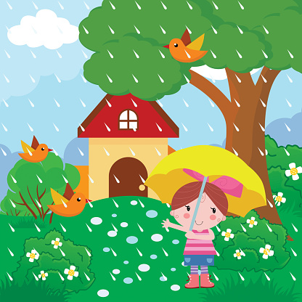
4. The weather is sunny today ,but it _____ sunny yesterday.
a) wasn’t
b) were
c) weren’t
d) was

Slide 34
4. The weather is sunny today ,but it _____ sunny yesterday.
a) wasn’t

Slide 35

5. Tom and I _________ at the concert last night.
a) was
b) am
c) were
d) are

Slide 36
5. Tom and I _________ at the concert last night.
c) were

Slide 37
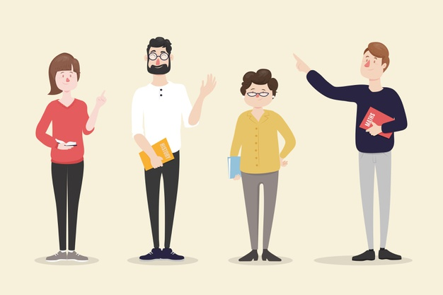
6. We ______ at university in 2001 ,but now we are teachers.
a) were
b) was
c) weren’t
d) wasn’t

Slide 38
6. We ______ at university in 2001 ,but now we are teachers.
a) were

Slide 39
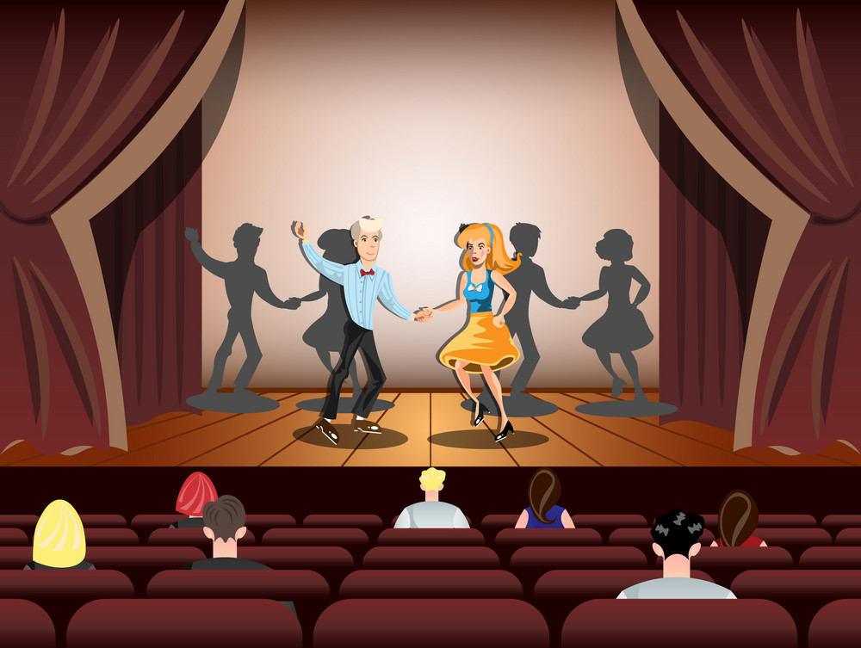
7. _______ you at the theatre two days ago?
a) Was
b) Is
c) Were
d) Are

Slide 40
7. _______ you at the theatre two days ago?
c) Were

Slide 41

8. I am a pilot. I am in London now, but I ____ in New York yesterday.
a) were
b) is
c) was
d) are

Slide 42
8. I am a pilot. I am in London now, but I ____ in New York yesterday.
c) was

Slide 43

9. Mary is very happy now ,but yesterday she ______happy.
a) was
b) wasn’t
c) were
d) weren’t

Slide 44
9. Mary is very happy ,but yesterday she ______happy.
b) wasn’t

Slide 45
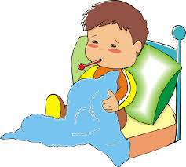
10. _________You ill last week?
a) Am
b) Was
c) Is
d) Were

Slide 46
9. _________You ill last week?
d) Were

Slide 47
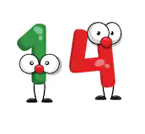
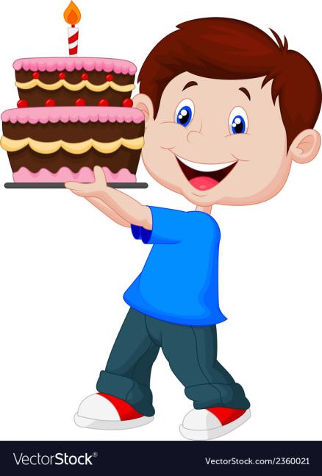
10. Paul ______ 13 years old two years ago. He was 14.
a) was
b) wasn’t
c) were
d) weren’t

Slide 48
10. Paul ______ 13 years old two years ago. He was 14.
b) wasn’t

Slide 49
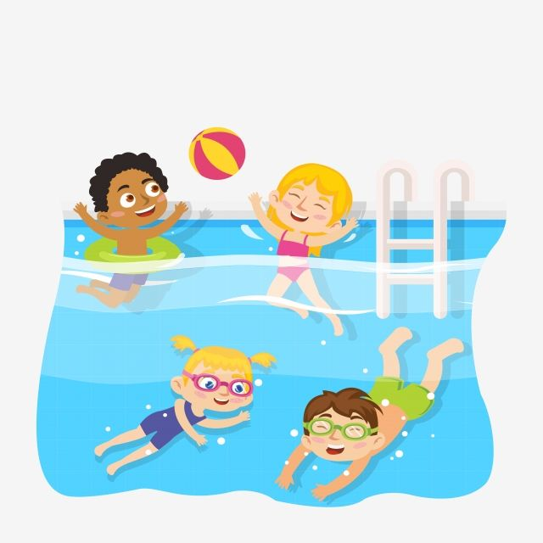
11. The children ______ playing football, they were swimming.
a) weren’t
b) wasn’t
c) were
d) was

Slide 50
11. The children ______ playing football, they were swimming.
a) weren’t

Slide 51
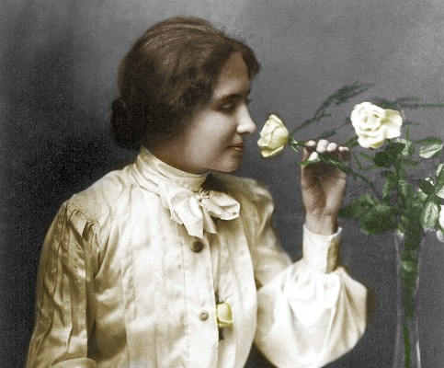
12. ______ Helen Keller deaf when she was born ?
a) Are
b) Were
c) Is
d) Was

Slide 52
12. ______ Helen Keller deaf when she was born ?
d) Was

Slide 53

13. Ned and I ………………….in Dubai six years ago.
a) is
b) are
c) were
d) was

Slide 54
13. Ned and I ………………….in Dubai six years ago.
c) were

Slide 55
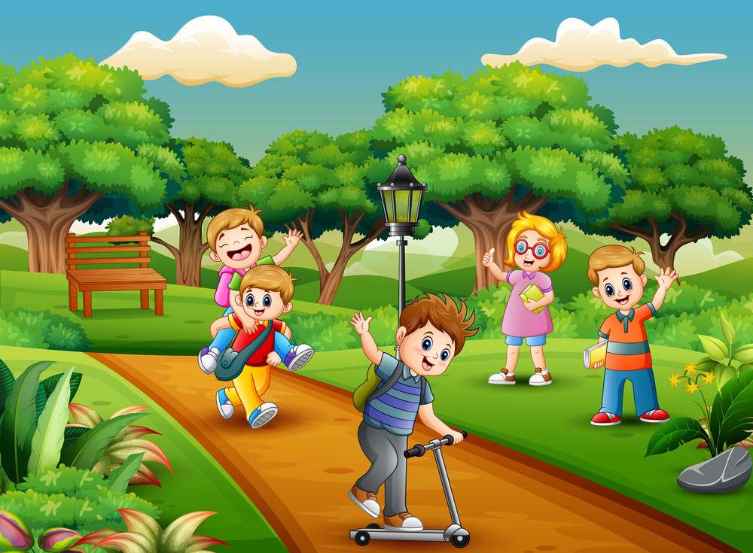
14. I …………………. at the park yesterday.
a) is
b) are
c) were
d) was

Slide 56
14. I …………………. at the park yesterday.
d) was

Slide 57


