Slide 1

Facts and Opinions

Slide 2
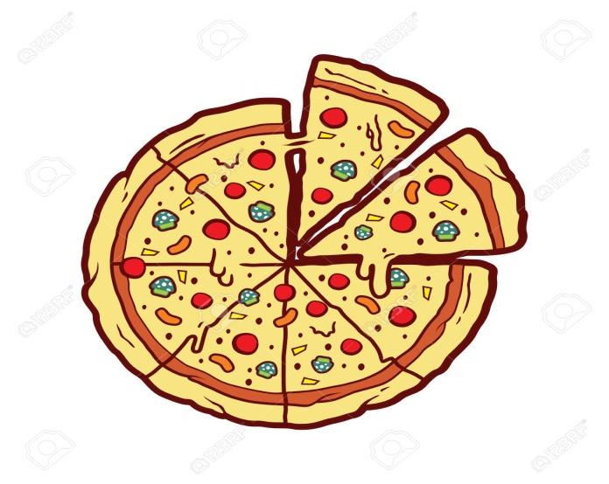

Read the following sentences and then decide which sentence is a fact and which one is an opinion?
Elephants eat grass and leaves.
Pizza is yummy.

Slide 3
Elephants eat grass and leaves. (Fact)
Pizza is yummy. (Opinion)

Slide 4
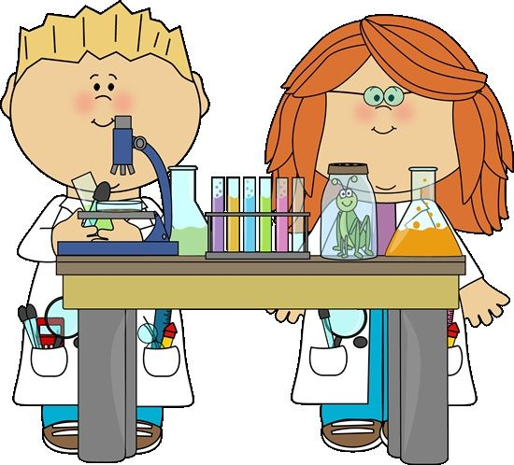
What is a fact?
A fact is a statement that can be proven true or false.

Slide 5
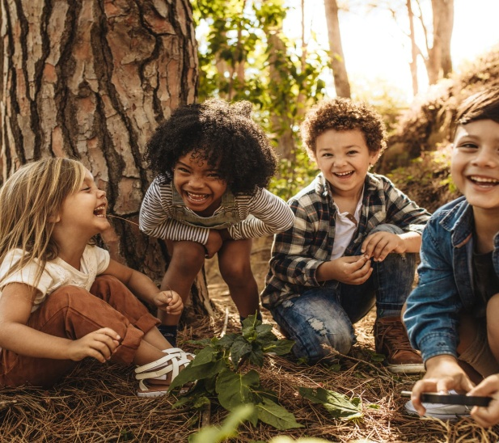
What is an opinion?
An opinion is a personal feeling ,belief thought or attitude . It can not be proven.

Slide 6



*Sort the following sentences as fact or opinion.
1.The letter ( ) refers to facts.
2.The letter ( ) refers to opinions.

Slide 7
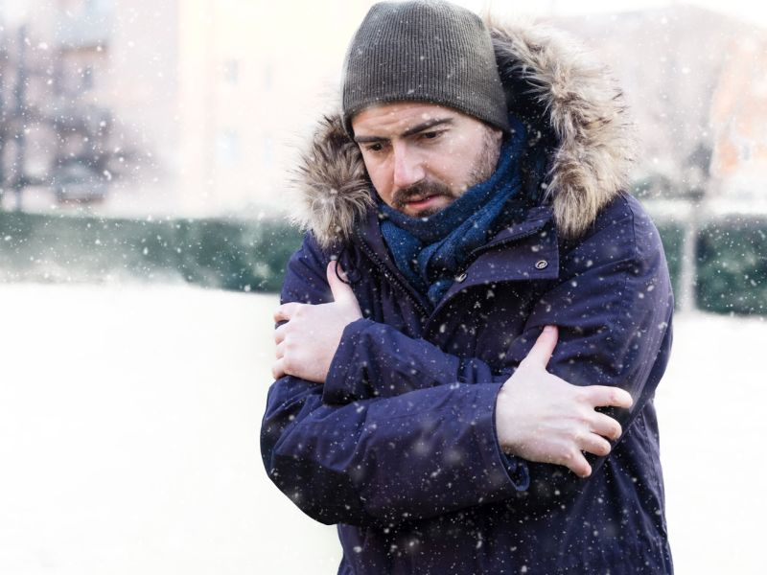
Winter time is really cold.

Slide 8
Winter time is really cold.

Slide 9
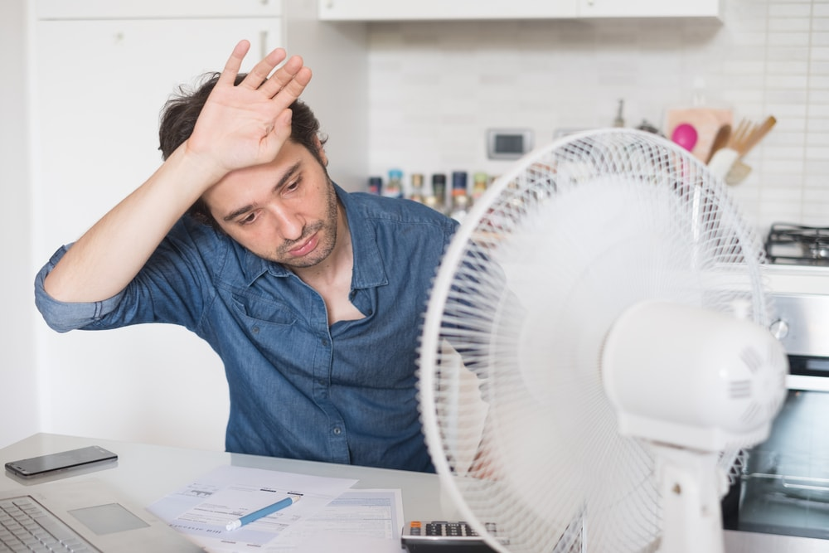
I don’t like hot weather.

Slide 10
I don’t like hot weather.

Slide 11
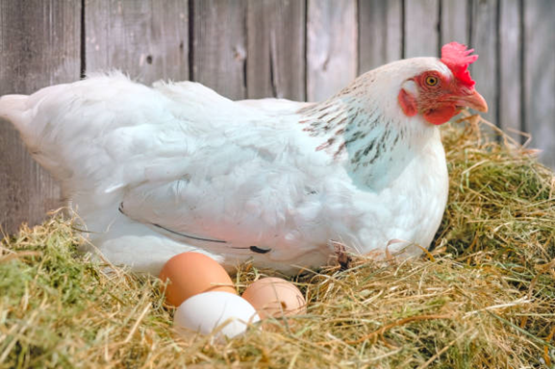
Hens lay eggs.

Slide 12

Hens lay eggs.

Slide 13
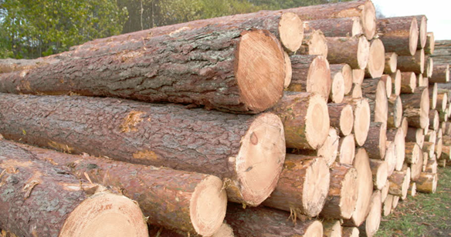
Wood comes from trees.

Slide 14
Wood comes from trees.

Slide 15

School is great .

Slide 16

School is great .

Slide 17
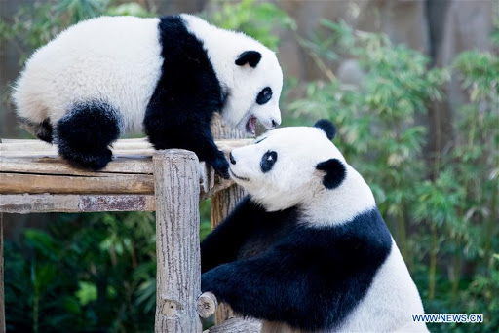
Pandas are black and white .

Slide 18
Pandas are black and white .

Slide 19
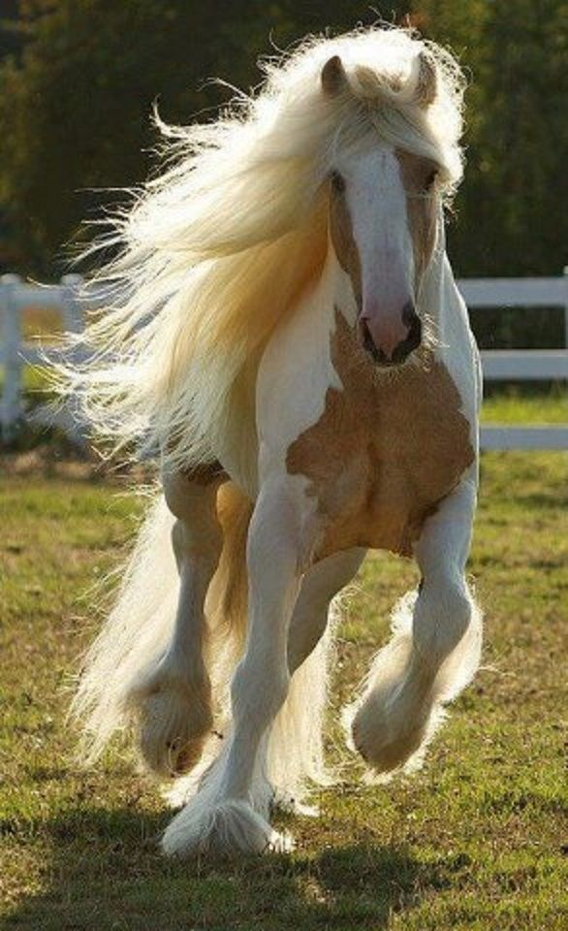
Horses are lovely animals .

Slide 20
Horses are lovely animals. .

Slide 21
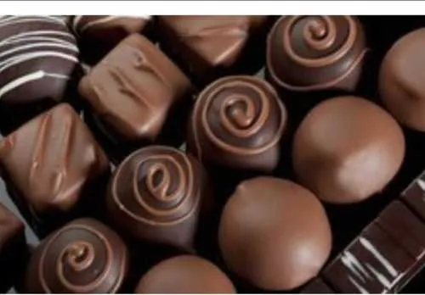
Chocolate is yummy.

Slide 22
Chocolate is yummy.

Slide 23
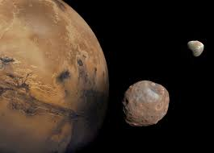
Mars has two moons.

Slide 24
Mars has two moons.

Slide 25

Amman is the capital city of Jordan.

Slide 26
Amman is the capital city of Jordan.

Slide 27

Reading stories is interesting.

Slide 28
Reading stories is interesting.

Slide 29
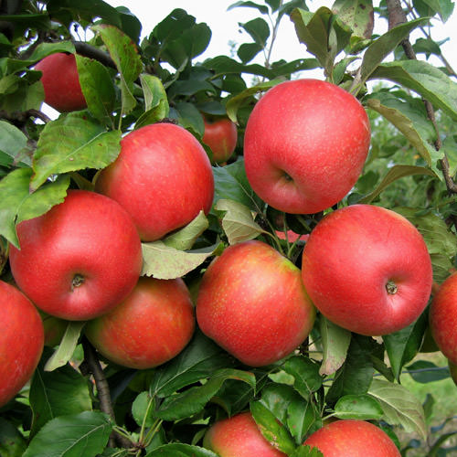
Apples grow on trees.

Slide 30
Apples grow on trees.

Slide 31

The sun is yellow and huge.

Slide 32
The sun is yellow and huge.

Slide 33
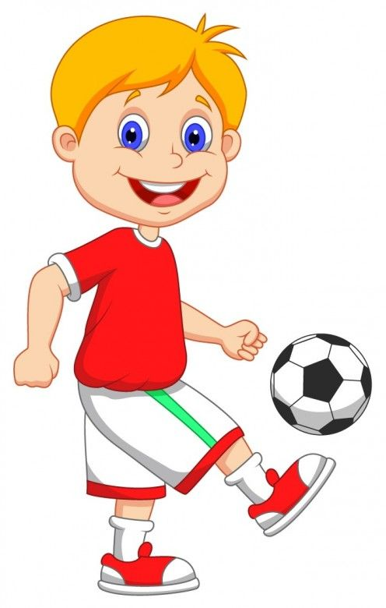
My favourite sport is football.

Slide 34
My favourite sport is football.

Slide 35

Clues to an opinion are words such as:
like, hate,seem, love , think , believe , guess, should, amazing , fantastic , excellent ..

Slide 36

Clues to facts are words, such as :Dates ,historical events, numbers , names…

Slide 37


Choose the correct answers : 1. There are four seasons in the year. a. It is a fact. b. It is an opinion. 2.Monday comes after Sunday. a. It is a fact. b. It is an opinion. 3.I think dogs are the best pets. a. It is a fact. b. It is an opinion

Slide 38
Choose the correct answers : 1. There are four seasons in the year. a. It is a fact. 2.Monday comes after Sunday. a. It is a fact. 3.I think dogs are the best pets. b. It is an opinion

Slide 39
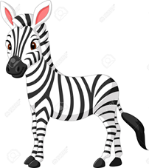
4. I love to play tennis everyday. a. It is a fact. b. It is an opinion. 5.Camels live in the desert. a. It is a fact. b. It is an opinion. 6. Zebras are the most beautiful animals in the world. a. It is a fact. b. It is an opinion 7. Reading books is better than watching TV. a. It is a fact. b. It is an opinion.

Slide 40
4. I love to play tennis everyday. b. It is an opinion. 5.Camels live in the desert. a. It is a fact. 6. Zebras are the most beautiful animals in the world. b. It is an opinion 7. Reading books is better than watching TV. b. It is an opinion.

Slide 41
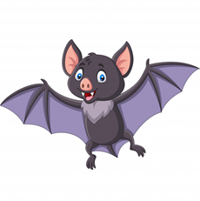

8. Bats eat insects and small animals. a. It is a fact. b. It is an opinion. 9.Cats are cute animals. a. It is a fact. b. It is an opinion. 10.Plants need water to grow. a. It is a fact. b. It is an opinion 11.Flowers grow in soil. a. It is a fact. b. It is an opinion.

Slide 42
8. Bats eat insects and small animals. a. It is a fact. 9.Cats are cute animals. b. It is an opinion. 10.Plants need water to grow. a. It is a fact. 11.Flowers grow in soil. a. It is a fact.

Slide 43
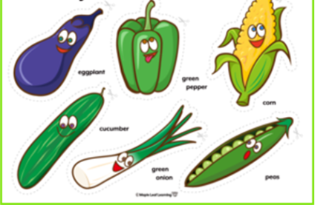

12. Vegetables are good for your health. a. It is a fact. b. It is an opinion. 13.Germs are small and tiny. a. It is a fact. b. It is an opinion. 14.Playing computer games is fun. a. It is a fact. b. It is an opinion.

Slide 44
12. Vegetables are good for your health. a. It is a fact. 13.Germs are small and tiny. a. It is a fact. 14.Playing computer games is fun. b. It is an opinion.

Slide 45


