Slide 1
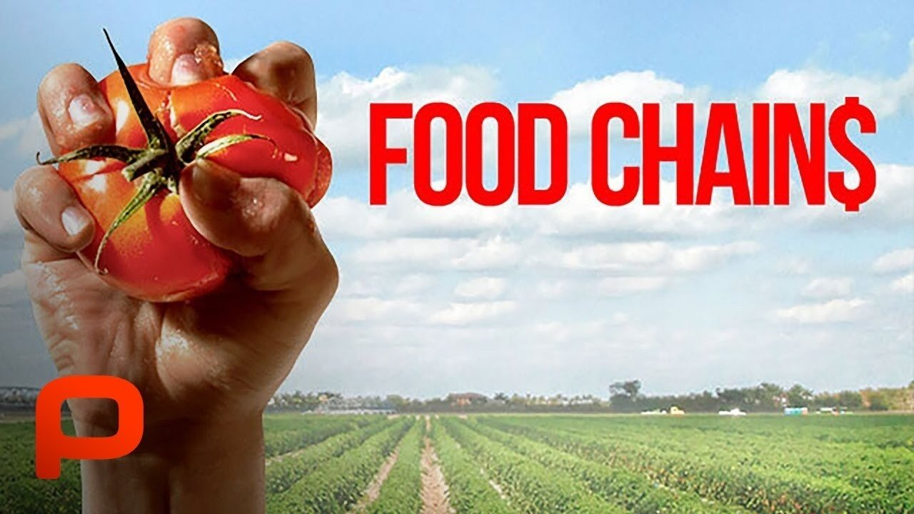
Food Chain
Grade 2 Science

Slide 2
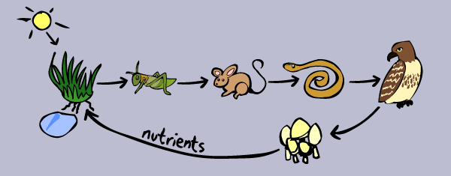
What is a Food Chain?
• A food chain shows how living things get their food.
• It tells us who eats what in nature.

Slide 3
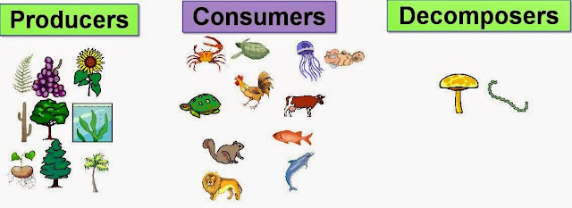
Producers
• Plants are called producers.
• They make their own food using sunlight.

Slide 4

Consumers
• Animals are consumers.
• They eat plants or other animals.

Slide 5
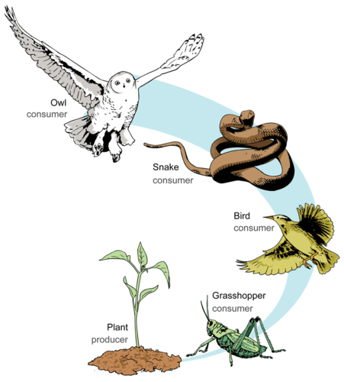
Simple Food Chain
Plant → Grasshopper → Frog → Snake → Eagle

Slide 6
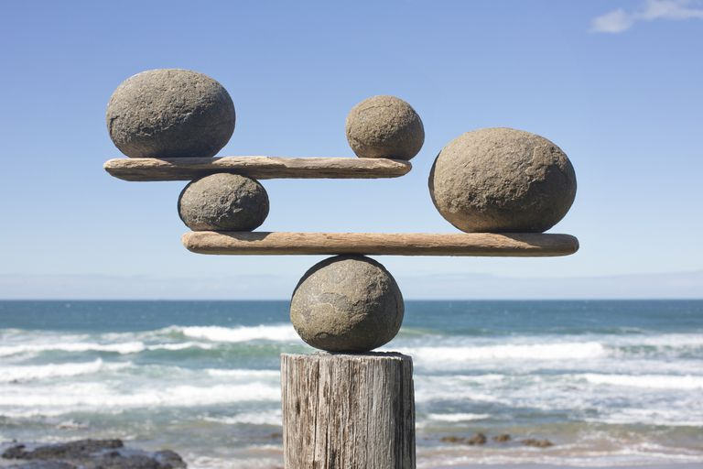
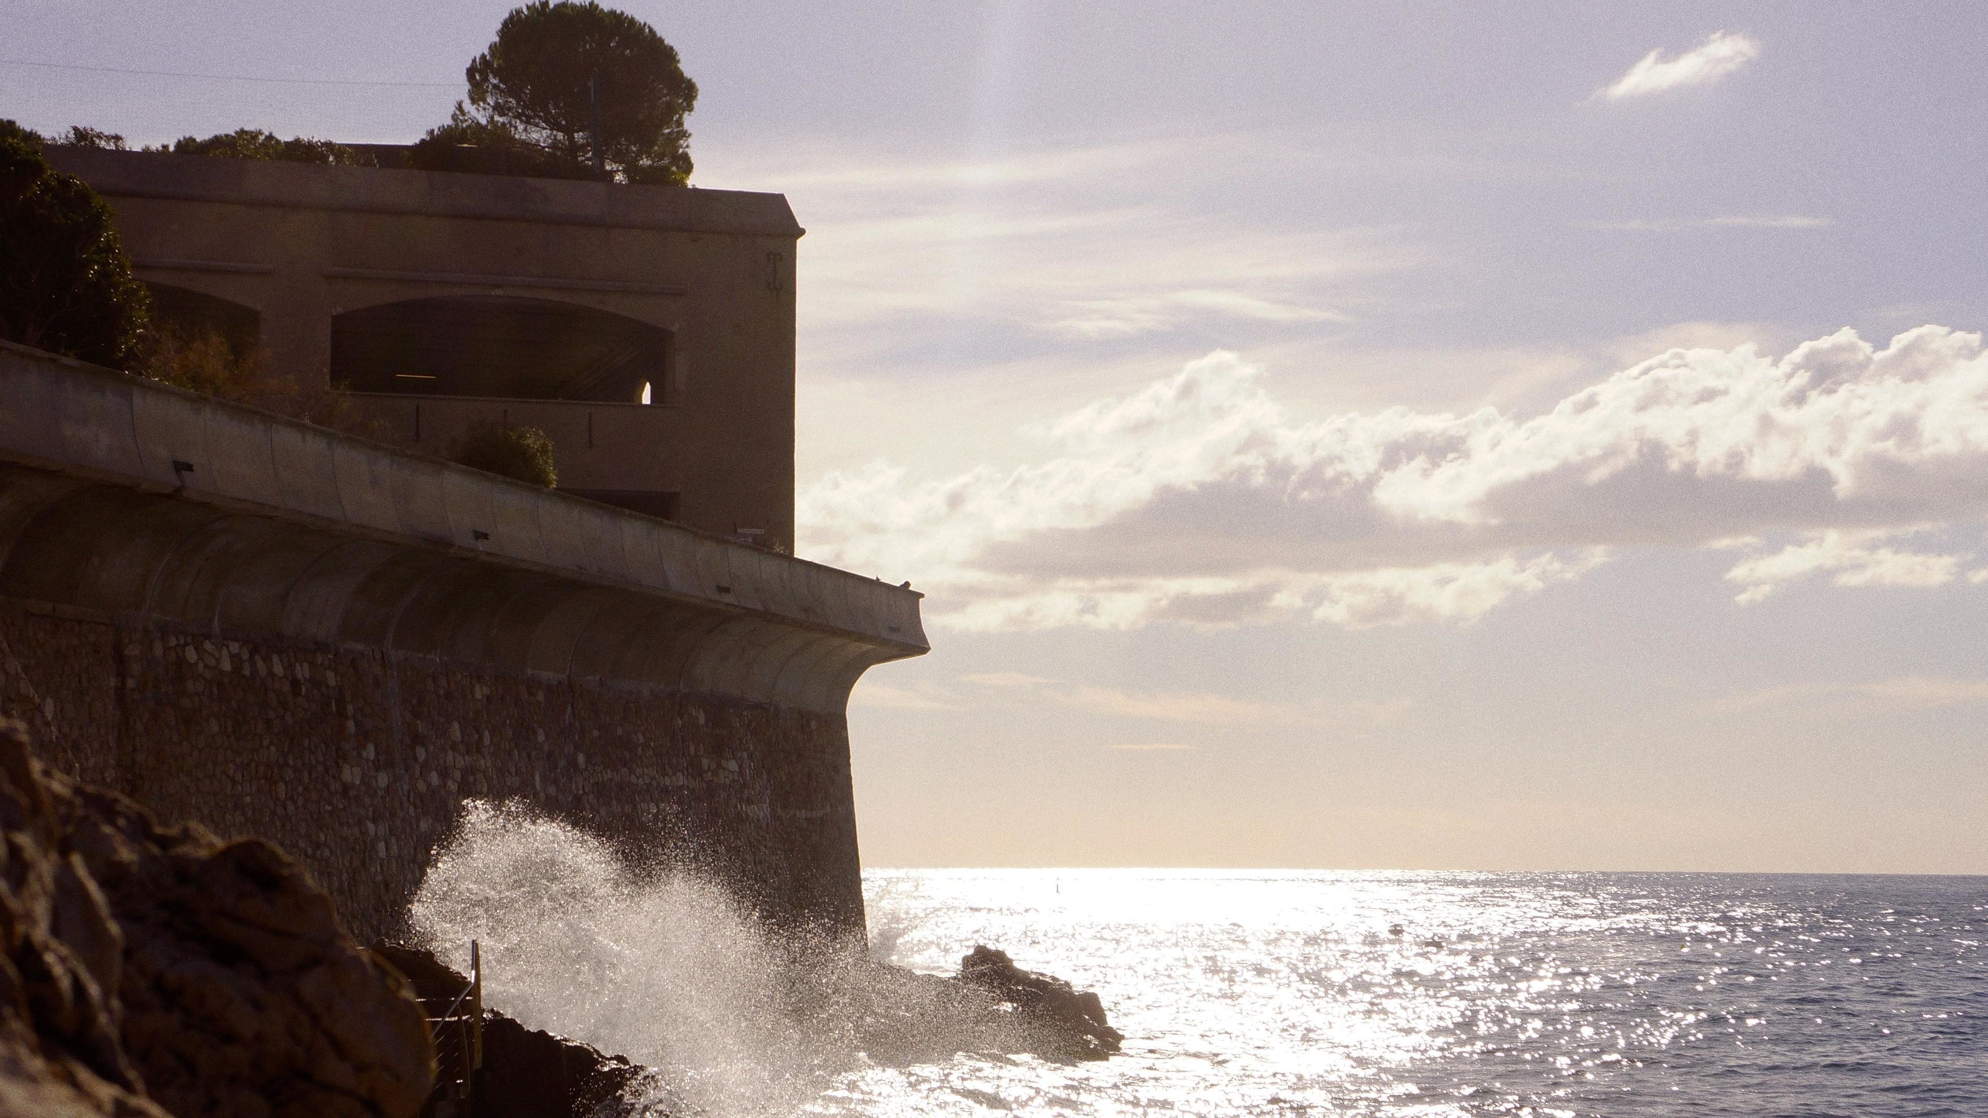
Why Food Chains Are Important
• They help us understand how living things depend on each other.
• They keep nature balanced.

