Slide 1
Prepositions
Grade 2 English

Slide 2
What Are Prepositions?
Words that tell where something is
They describe position
Example: in, on, under

Slide 3
Common Prepositions
In Between
On Above
Under on the left
Behind on the right
In front of
Next to
Inside
Over
Outside
Inside

Slide 4
Example Sentences
The cat is **on** the table.
The ball is **under** the chair.
The bird is **in** the cage.

Slide 5
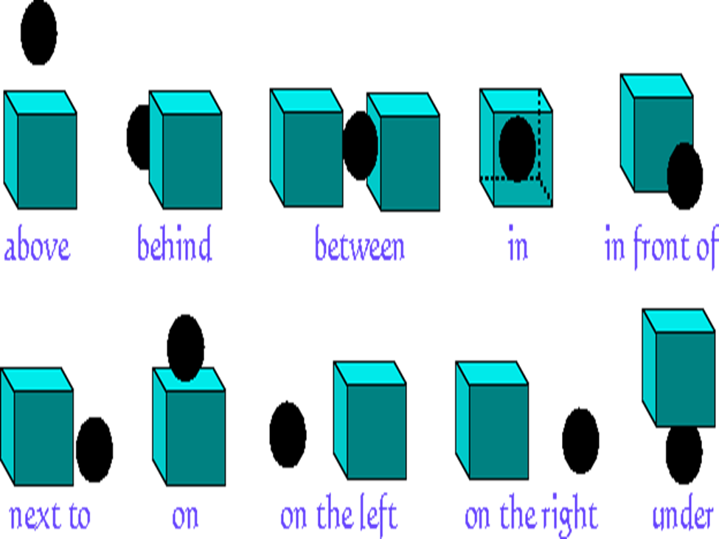
Prepostions

Slide 6
Let’s Practice!
The book is ___ the bag.
The dog is ___ the box.
The cup is ___ the table.

