Slide 1



Name Two
Name two addition connecting words.
and
also
in addition
furthermore
moreover
reveal answer

Slide 2
Name Two
Name two contrast connecting words.
but
while
despite
however
in spite of
whereas
although
even though
nevertheless
reveal answer

Slide 3
Name Two
Name two result connecting words.
so
as a result
therefore
reveal answer

Slide 4
Name Two
Name two reason connecting words.
because
since
as
due to
owing to
reveal answer

Slide 5
Name Two
Name two purpose connecting words.
to
in order (not) to
so as (not) to
reveal answer

Slide 6

Multiple Choice
We arrived late at the cinema, and we missed the beginning of the movie.
therefore
therefore / whereas
reveal answer

Slide 7
Multiple Choice
I love playing basketball I’m not very good at it.
although
despite / although
reveal answer

Slide 8
Multiple Choice
the heavy rain, we decided to go ahead with the school trip.
Despite
Due to / Despite
reveal answer

Slide 9
Multiple Choice
She enjoys travelling she is terrified of flying.
even though
even though / however
reveal answer

Slide 10
Multiple Choice
being tired, he stayed up all night to finish the project.
In spite of
Due to / In spite of
reveal answer

Slide 11
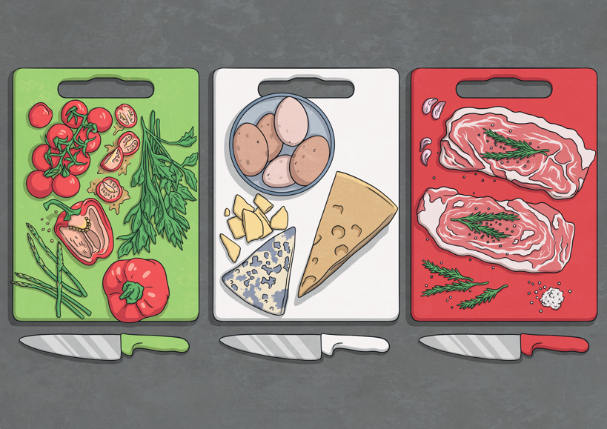
Fill the Gap
learn more about Italian cuisine, I travelled to Rome to take a cooking class with a local chef.
In order to
reveal answer

Slide 12
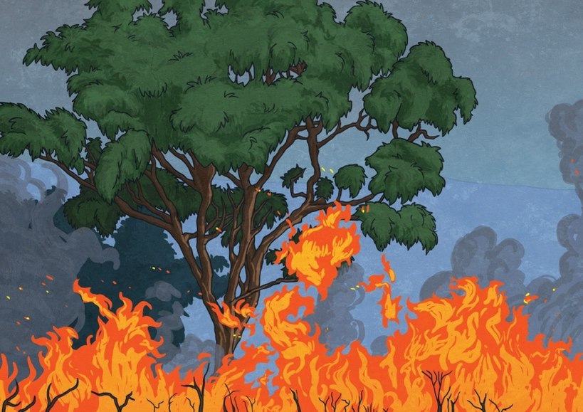
Fill the Gap
The forest fires have been spreading rapidly this summer. , many animals have lost their natural habitat.
As a result
reveal answer

Slide 13

Fill the Gap
saving money is important for the future. On the other hand, it can be difficult when there are so many daily expenses.
On the one hand
reveal answer

Slide 14
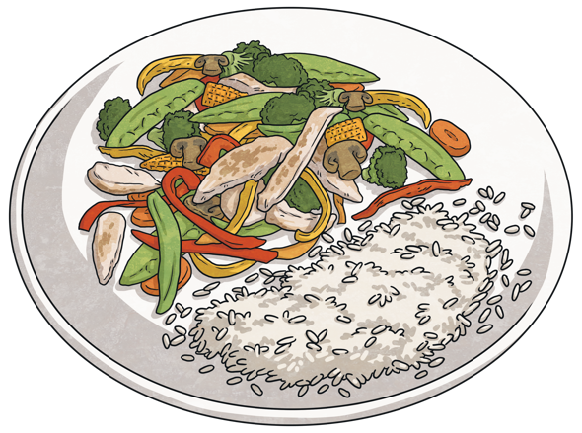
Fill the Gap
People are becoming more aware of the benefits of healthy eating. , many restaurants now offer more nutritious menu options.
Furthermore
reveal answer

Slide 15
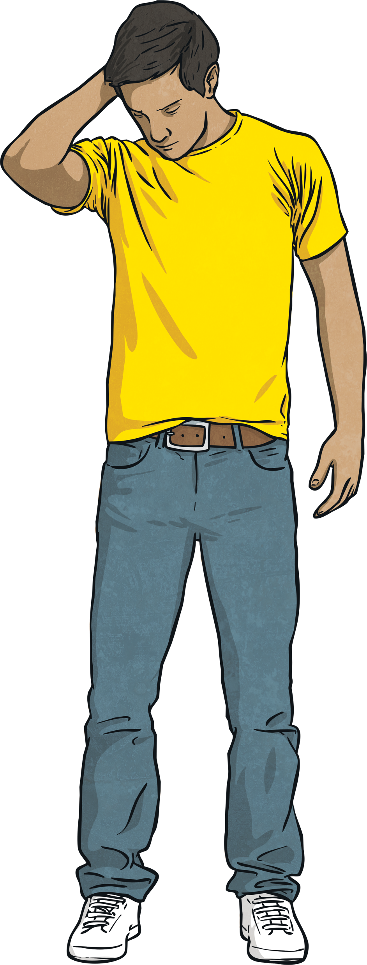
Fill the Gap
He joined several clubs to meet new people and make friends in his new city. , he felt lonely and found it difficult to adapt.
Nevertheless
reveal answer

Slide 16

Join the Two
Join the two sentences using the connecting word.
moreover
Smartphones have completely transformed the way we access information.
They enable us to stay connected with friends and family.
Smartphones have completely transformed the way we access information. Moreover, they enable us to stay connected with friends and family.
reveal answer

Slide 17
Join the Two
Join the two sentences using the connecting word.
moreover
Smartphones have completely transformed the way we access information.
They enable us to stay connected with friends and family.
Smartphones have completely transformed the way we access information. Moreover, they enable us to stay connected with friends and family.
reveal answer

Slide 18
Join the Two
Join the two sentences using the connecting word.
although
Regular exercise is essential for maintaining good health.
Many teenagers find it challenging to fit physical activity into their busy schedules.
Although regular exercise is essential for maintaining good health, many teenagers find it challenging to fit physical activity into their busy schedules.
reveal answer

Slide 19
Join the Two
Join the two sentences using the connecting word.
so as to
They are saving money for their upcoming trip to Asia.
They want to visit as many countries as possible.
They are saving money for their upcoming trip to Asia so as to visit as many countries as possible.
reveal answer

Slide 20
Join the Two
Join the two sentences using the connecting word.
due to
Many students found it difficult to concentrate during online classes.
They had distractions at home and lacked a proper study environment.
Many students found it difficult to concentrate during online classes due to having distractions at home and lacking a proper study environment.
reveal answer

Slide 21
Join the Two
Join the two sentences using the connecting word.
despite
Many people prefer to travel during the summer.
Prices for flights and accommodation are much higher then.
Many people prefer to travel during the summer despite prices for flights and accommodation being much higher then.
reveal answer

Slide 22

Say Your Own
Create your own sentence using the connecting word below. You have 20 seconds.
in addition
0
1
2
3
4
5
6
7
8
9
10
11
12
13
14
15
16
17
18
19
20
Start Timer
Reset Timer

Slide 23
Say Your Own
Create your own sentence using the connecting word below. You have 20 seconds.
therefore
0
1
2
3
4
5
6
7
8
9
10
11
12
13
14
15
16
17
18
19
20
Start Timer
Reset Timer

Slide 24
Say Your Own
Create your own sentence using the connecting word below. You have 20 seconds.
owing to
0
1
2
3
4
5
6
7
8
9
10
11
12
13
14
15
16
17
18
19
20
Start Timer
Reset Timer

Slide 25
Say Your Own
Create your own sentence using the connecting word below. You have 20 seconds.
in spite of
0
1
2
3
4
5
6
7
8
9
10
11
12
13
14
15
16
17
18
19
20
Start Timer
Reset Timer

Slide 26
Say Your Own
Create your own sentence using the connecting word below. You have 20 seconds.
nevertheless
0
1
2
3
4
5
6
7
8
9
10
11
12
13
14
15
16
17
18
19
20
Start Timer
Reset Timer

