Slide 1
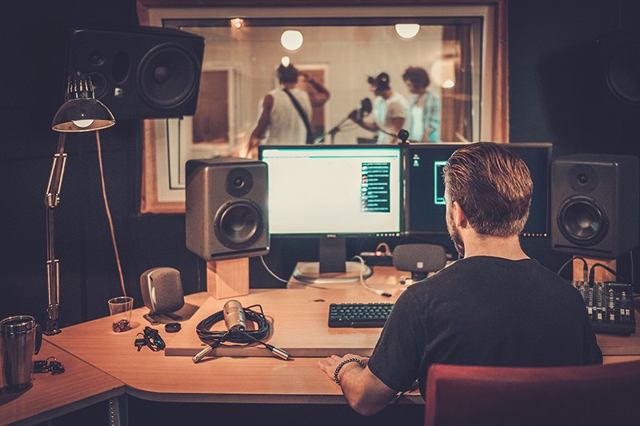
Reducing sound levels

Slide 2
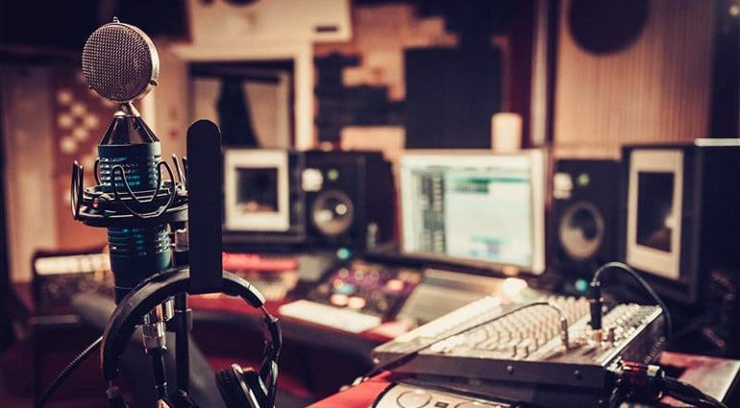
The photograph shows a recording studio where music is recorded .
The microphones in the studio are sensitive, and they will record sound that are quite soft.

Slide 3

But if you are recording a music CD ,you would not want any sounds from outside to be recorded as part of your song, right?

Slide 4
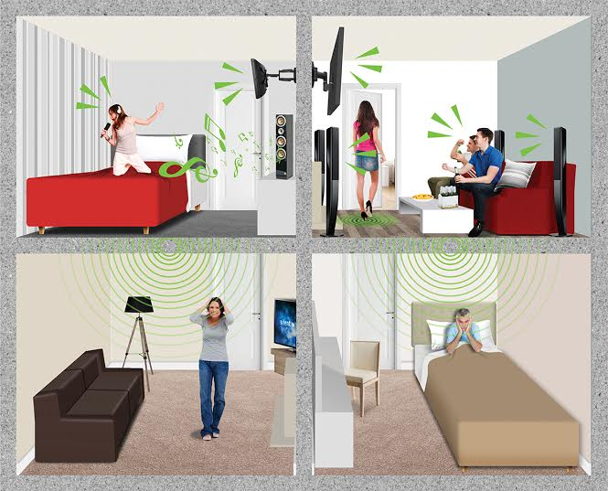
Think about the room you are in .Can you hear sounds from outside?
Yes

Slide 5
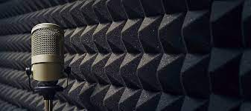
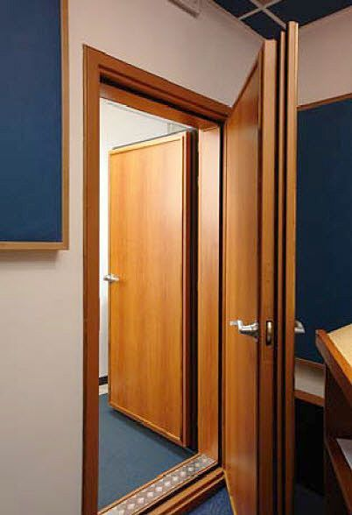
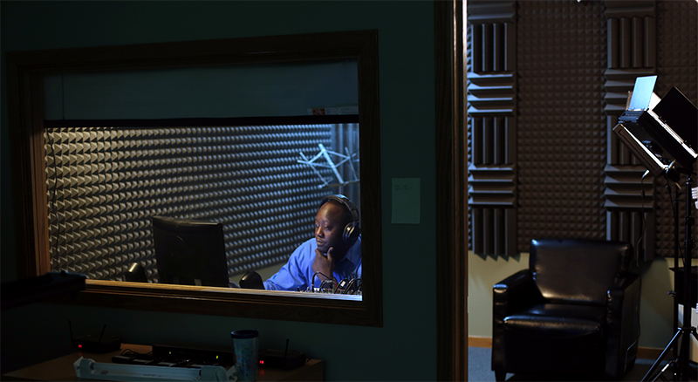
What do you think stops the sounds from outside the recording studio from spoiling the song?
The room is specially built so that the walls and any other openings are soundproof.

Slide 6

Soundproof means :Something that prevent sound from entering or leaving (the sound stop from travelling )

Slide 7
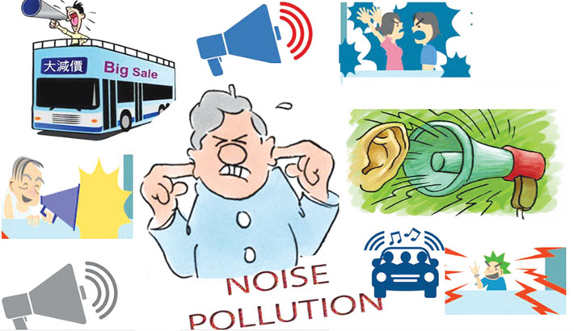
Some sounds are annoying or harmful and we need to stop them from reaching to our ears .

Slide 8
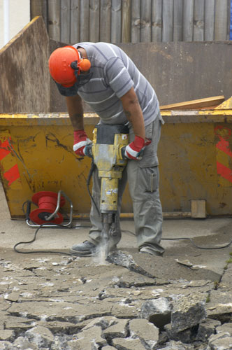
If you look at this picture what is making the sound in it ?
The vibration of the drill .

Slide 9
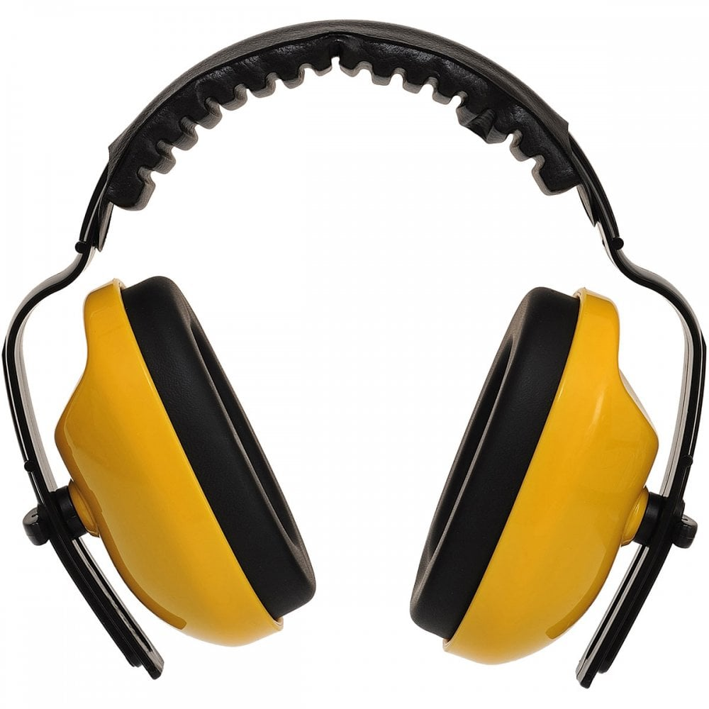
Why are ear defenders necessary for workers who use machinery like this?
Because these ear defenders muffle sound and they are are made from materials that reduce sound level.

