Slide 1
Warm-up Activity
Can you think of one word to complete each sentence? Work in pairs.
1.
so
She studied hard for the exam she felt confident on the test day.
2.
but
I wanted to go to the concert the tickets were already sold out.
because
3.
He was late to the meeting there was heavy traffic.
Despite
4.
the freezing weather, we still decided to go hiking.
and
5.
I have a lot of homework to do I need to clean my room.

Slide 2
What Are Connecting Words?
Connecting words, also known as linking words, are used to connect ideas, sentences or paragraphs together.
They create a smooth flow in both written and spoken communication.
They make speech and writing more coherent by linking ideas logically.

Slide 3
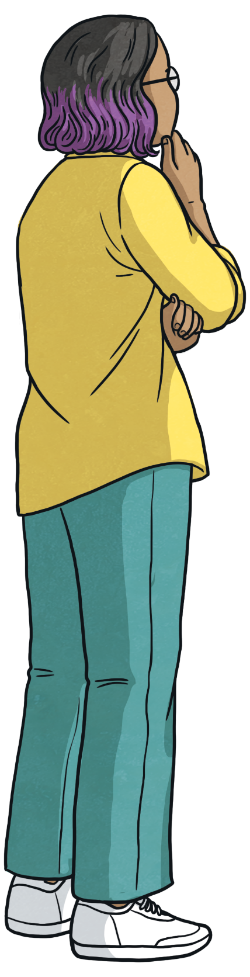
What types of connecting words do you know?
addition
contrast
result
reason
purpose

Slide 4
Addition
Addition connecting words add more information to a point.
Can you think of examples?
and
in addition
moreover
also
furthermore
Reveal Answer

Slide 5
Contrast
Contrast connecting words show different or opposing ideas.
Can you think of examples?
but
despite
although
while
in spite of
even though
however
whereas
on the one hand… on the other hand
Reveal Answer

Slide 6
Reason
Reason connecting words are used to explain why something happens or the reason behind an action.
Can you think of examples?
because
as
since
due to
owing to
Reveal Answer

Slide 7
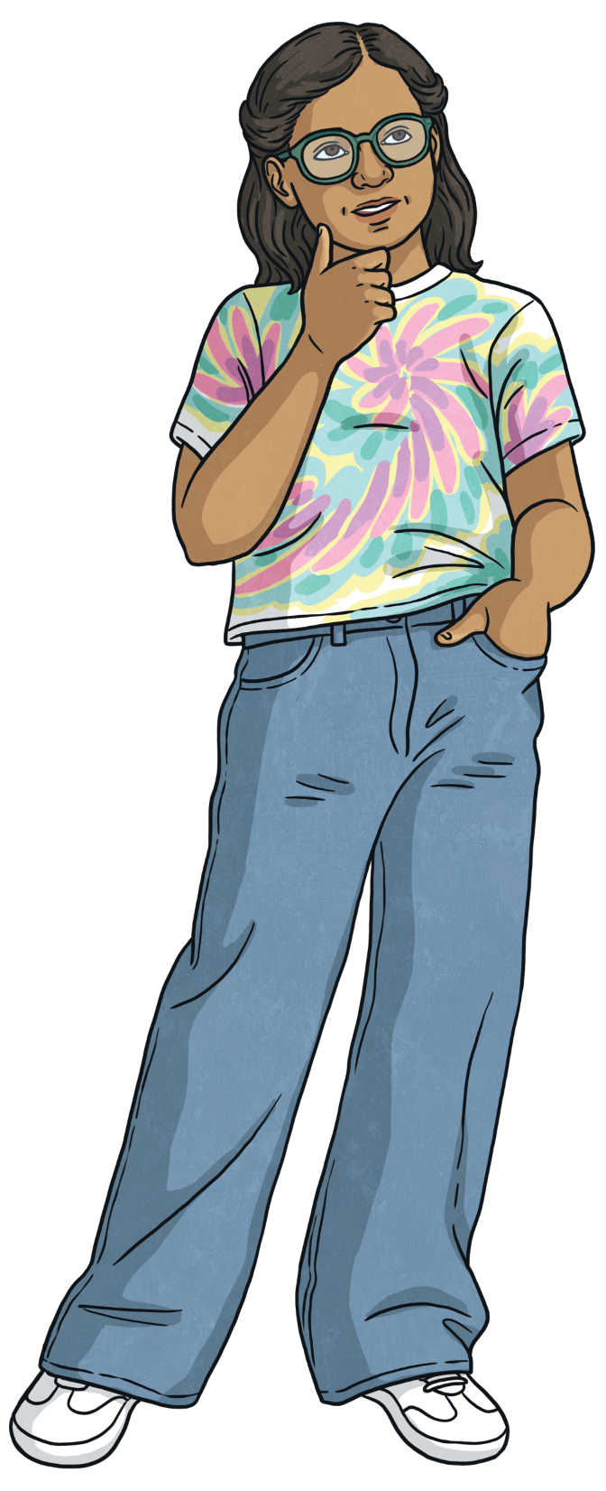
Result
Result connecting words are used to show the outcome of an action or event.
Can you think of examples?
so
as a result
therefore
Reveal Answer

Slide 8
Purpose
Purpose connecting words are used to explain why something is done or the intended goal of an action.
Can you think of examples?
to
in order (not) to
so as (not) to
Reveal Answer

Slide 9
Important!
Sometimes linking words have to be followed by certain structures. It’s important to remember these!
However and nevertheless are usually used at the beginning of a sentence to connect it to the previous one and followed by a comma.
Example:
She wanted to go on holidays with her friends. However, she didn’t have enough money.
After despite and in spite of use a gerund, a noun, or ‘the fact that’ + clause.
Example:
He was late for work despite leaving home on time.
In spite of the bad weather, they still went to the beach.

Slide 10
Important!
To, in order to and so as to are followed by an infinitive.
Example:
She got a loan from the bank in order to open her own business.
Although, even though, while and whereas can go at the beginning or in the middle of a sentence. If they are at the beginning, then you need to put a comma in the middle.
Example:
I didn’t buy the shoes although they were beautiful.
Even though the shoes were beautiful, I didn’t buy them.

Slide 11
Important!
Due to, owing to and because of are usually followed by a gerund, a noun, or ‘the fact that’ + clause.
Example:
He was late for the wedding because of the traffic.
He went to the doctor due to feeling very ill.
He could speak with the locals on holidays owing to the fact that he had learnt Spanish in school.

Slide 12
Let’s practise!
Match the connecting word to the correct sentence.
due to
She studied all night for the exam. , she still found it difficult.
however
The movie was very entertaining. ,the acting was excellent.
as a result
The match was cancelled the
heavy rain.
moreover
The flight was delayed for several hours.
, we missed our connection.

Slide 13
Let’s practise!
Match the connecting word to the correct sentence.
although
He finished the race feeling exhausted.
owing to
The event was postponed to technical difficulties.
despite
The course is challenging. , it requires a lot of independent study.
furthermore
she didn’t know many of the songs, she still enjoyed the concert.

Slide 14
Complete the gaps.
Complete the following sentences with a suitable connecting word and say what type of connecting word it is. In some cases more than one answer may be possible.
Despite
(contrast)
1.
the bad weather, they decided to go hiking.
whereas
2.
John prefers studying in the morning, Sarah prefers studying at night.
(contrast)
since
3.
They postponed the meeting many people couldn’t attend.
(reason)
in order to
(purpose)
4.
She left early avoid the rush hour traffic.

Slide 15
Complete the gaps.
Complete the following sentences with a suitable connecting word and say what type of connecting word it is. In some cases more than one answer may be possible.
However
5.
I wanted to go to the party. , I had too much homework.
(contrast)
6.
In addition
The hotel offers free breakfast. , it has a gym and a pool.
(addition)
7.
On the one hand, I want to hang out with my friends this weekend.
I really need to study for my exams.
On the other hand
(contrast)
8.
so
It started raining heavily, we had to cancel the outdoor game.
(result)

Slide 16
Find the mistakes in these sentences and correct them.
1.
Even though it was raining, we decided to go to the park anyway.
In addition it was raining, we decided to go to the park anyway.
2.
He didn’t train much. However, he passed the fitness test easily.
He didn’t train much so he passed the fitness test easily.
3.
She loves playing tennis, despite she doesn’t like basketball.
She loves playing tennis, but she doesn’t like basketball.
4.
I didn’t pass the end of year exam due to I didn’t study enough.
I didn’t pass the end of year exam because/due to the fact that I didn’t
study enough.

Slide 17
Find the mistakes in these sentences and correct them.
5.
She is studying languages in order to get a good job.
She is studying languages in order get a good job.
6.
In spite of being 90, he still travels all over the world.
Although being 90, he still travels all over the world.
7.
We enjoyed the film owing to it was long.
We enjoyed the film even though it was long.
8.
The was a really sunny day. Therefore, the temperature was really cool.
It was a really sunny day. Nevertheless, the temperature was very cool.

Slide 18
Wrap-up
addition | contrast | result | reason | purpose
and also in addition furthermore moreover | but while despite however in spite of whereas although even though on the one hand…on the other hand nevertheless | so as a result therefore | because since as due to owing to | to in order (not) to so as (not) to

