Slide 1
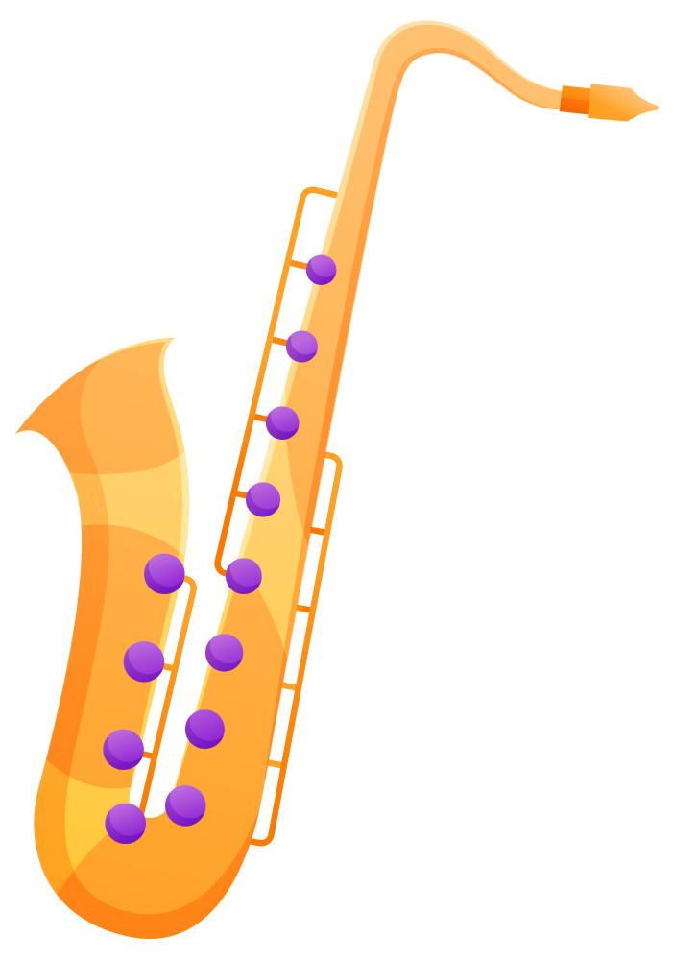
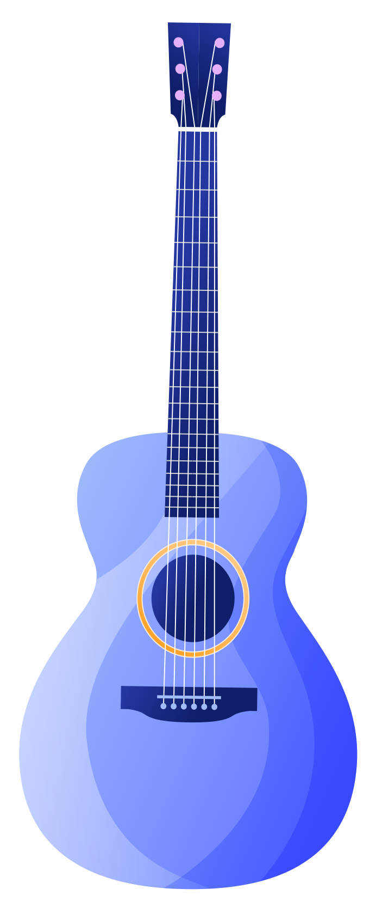
Sound
Unit 2

Slide 2
Table of contents
01
02
03
04
How sounds are made
How sounds travel
05
Pitch and volume
How to measure sound
How to change pitch and volume in musical instruments

Slide 3

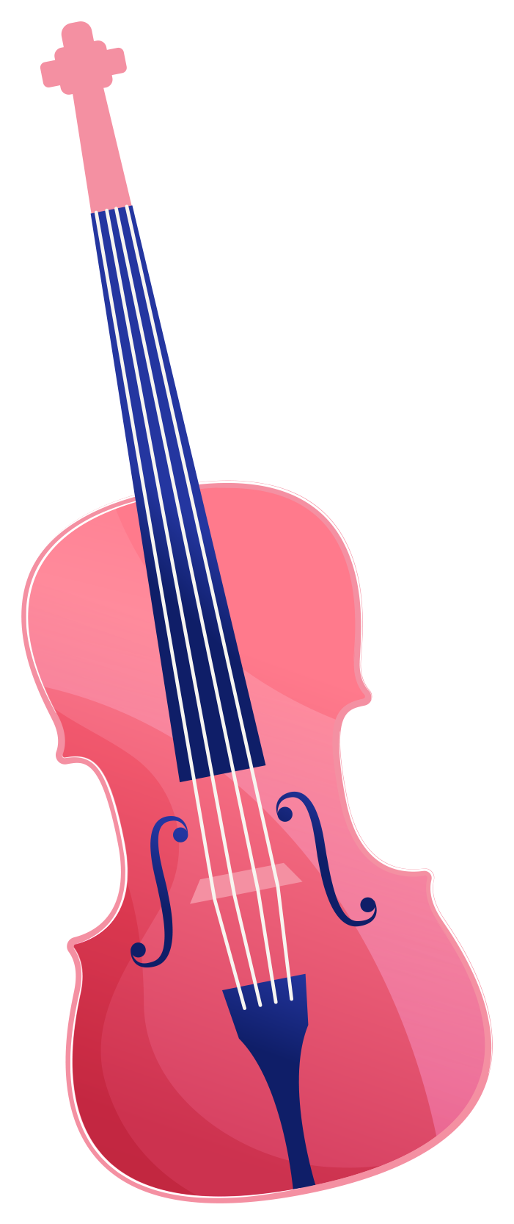
01
How sounds are made

Slide 4
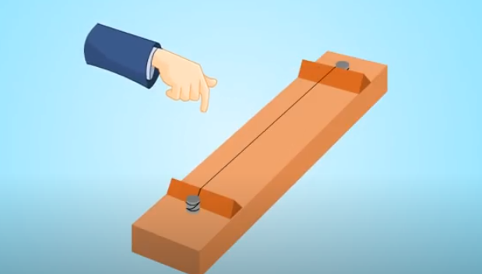
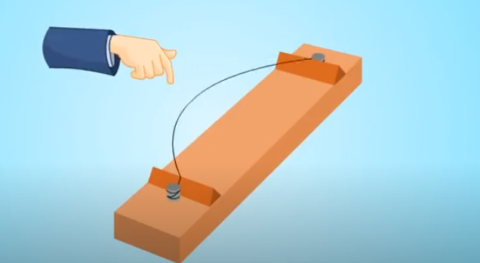
Sounds are made when objects vibrate.
Vibration means to move backwards and forwards(or up and down).

Slide 5
02
How sounds travel

Slide 6
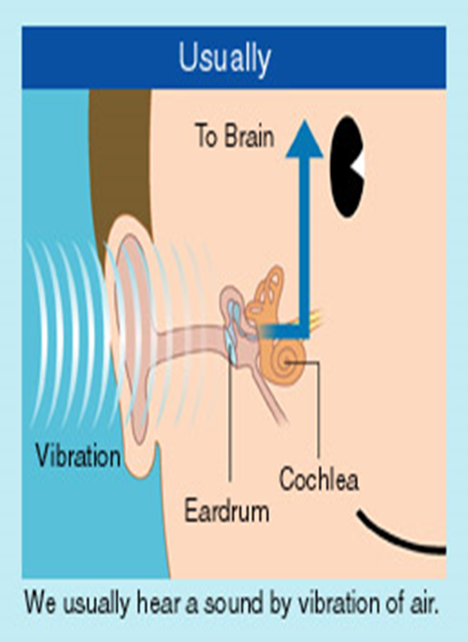
How do we hear sounds?
Sounds reach our ears through vibrating air particles.
Our ears capture sound waves and turn them into
signals that go to our brain .

Slide 7
Sound can travel through
Sounds can travel through
Solids
Liquids
Gases

Slide 8
03
Pitch and volume

Slide 9

Pitch
Pitch is the highness or lowness of a sound.

Slide 10
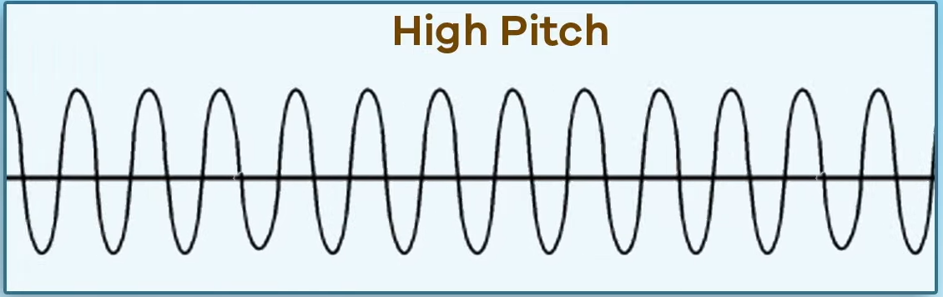
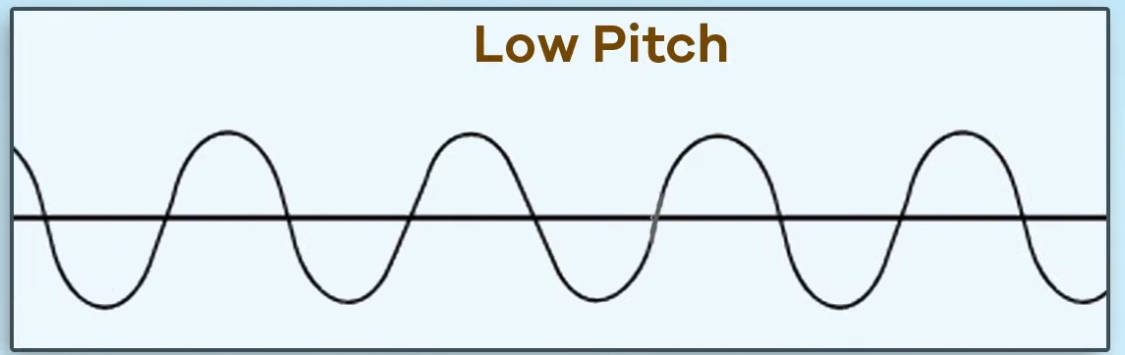
When the vibrations are fast you hear a high pitch
When the vibrations are slow you hear a low pitch

Slide 11
Volume measures the loudness or quietness of the sound.
We measure volume in decibels (dB).

Slide 12

Measuring Sounds

Slide 13
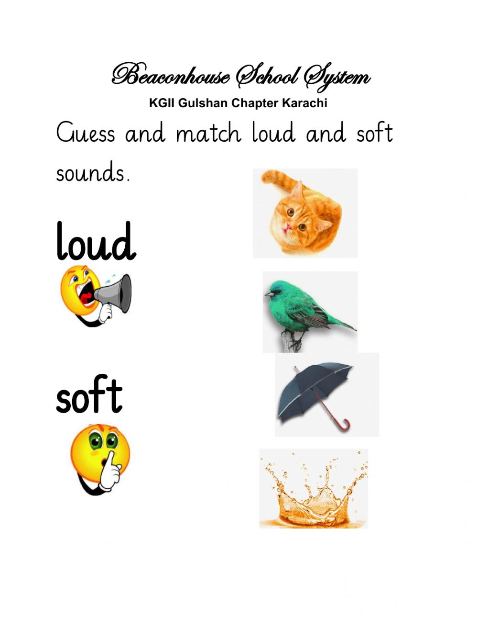
Some sounds are soft while others are loud.
The loudness of a sound is called volume of the sound.

Slide 14
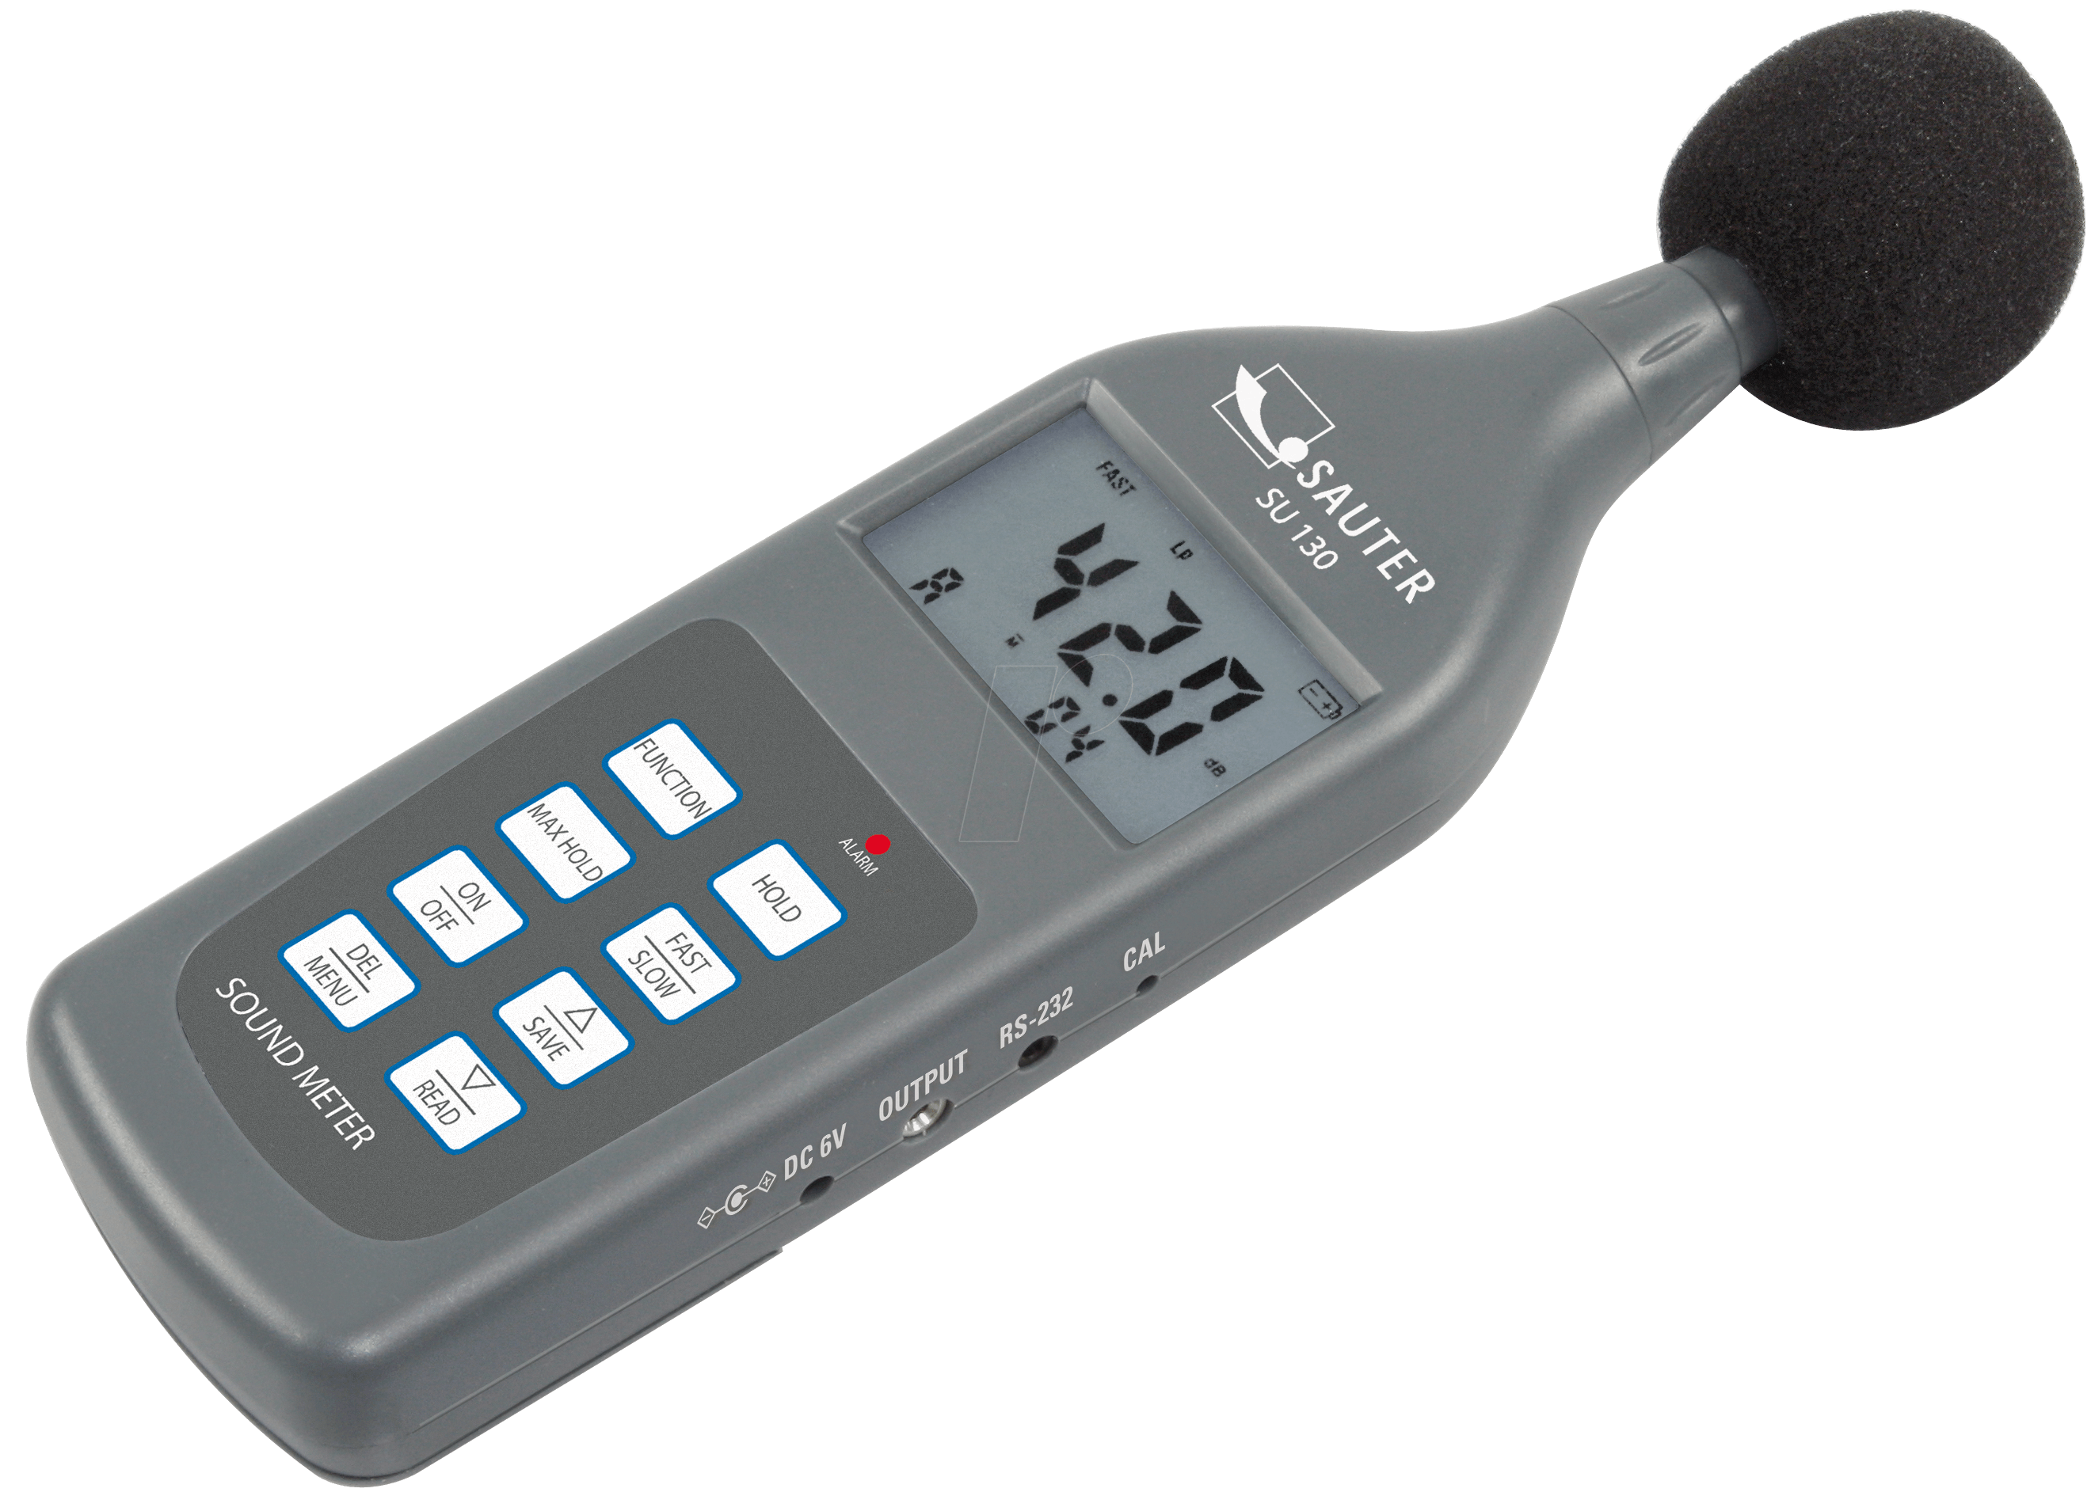
Sound levels can be measured in decibels using a sound level meter.

Slide 15
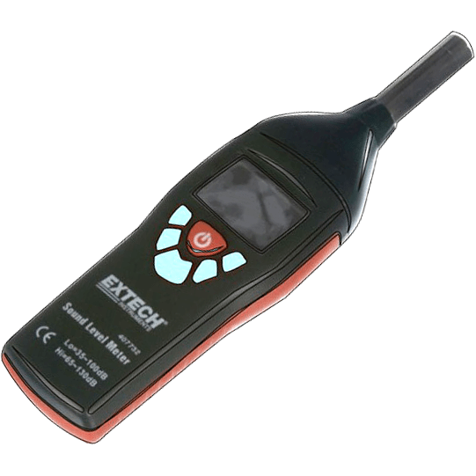
How do you think a sound level meter works?
The microphone records the sound ,the meter measures its volume and the sound level is displayed digitally on a small screen.

Slide 16
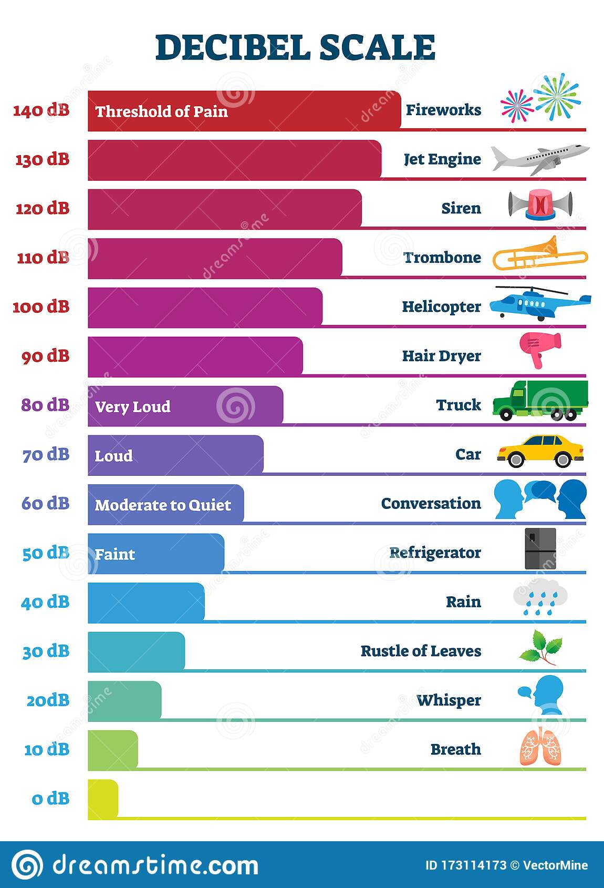
Sound levels, or volumes, are measured in special units called decibels (dB).
This scale shows you the decibel levels of some common sounds.

Slide 17
05
How to change pitch and volume in musical instruments

Slide 18
There are three types of instruments
String
Instruments
Percussion
Wind

Slide 19
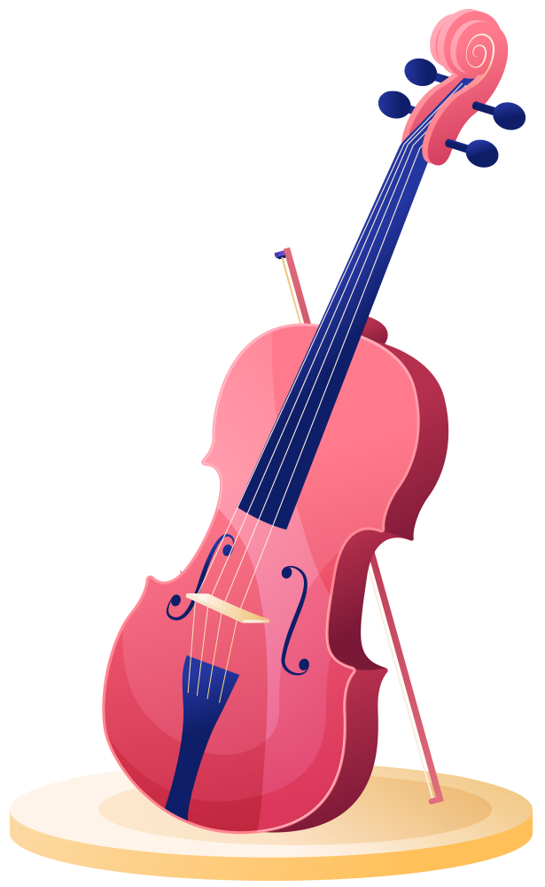
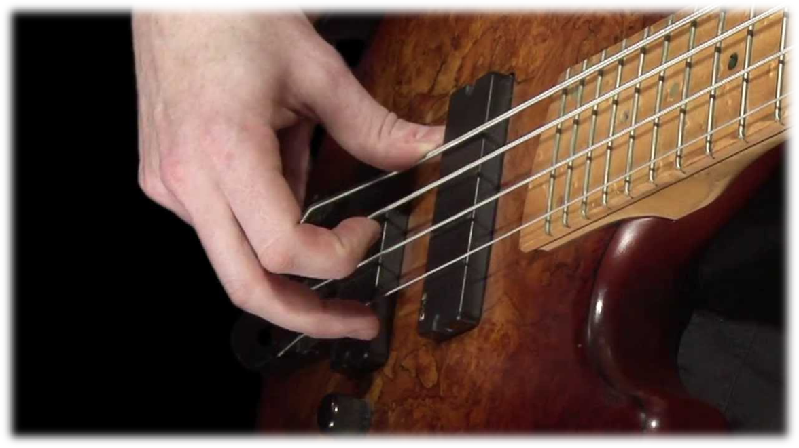
String instruments
Stringed instruments make a sound when you pluck the strings causing them to vibrate.

Slide 20

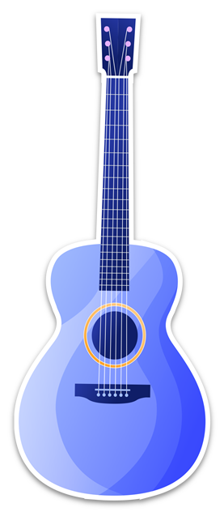
To change the pitch you need to make the string longer to produce low pitch and shorter to produce high pitch.
To change the volume you need to pluck hard to produce loud sound or gently to produce soft sound.

Slide 21

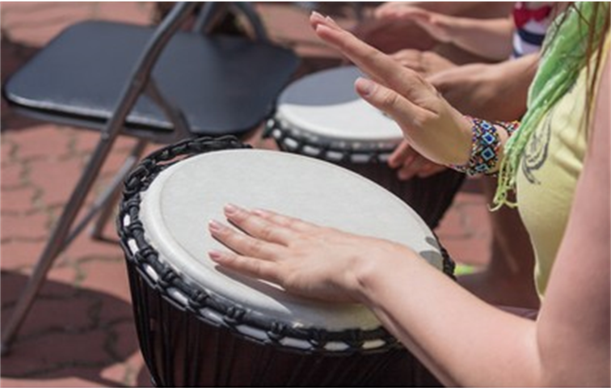

Percussion instruments
To make a sound by using percussion instruments you bang on them to make the skin vibrate.

Slide 22
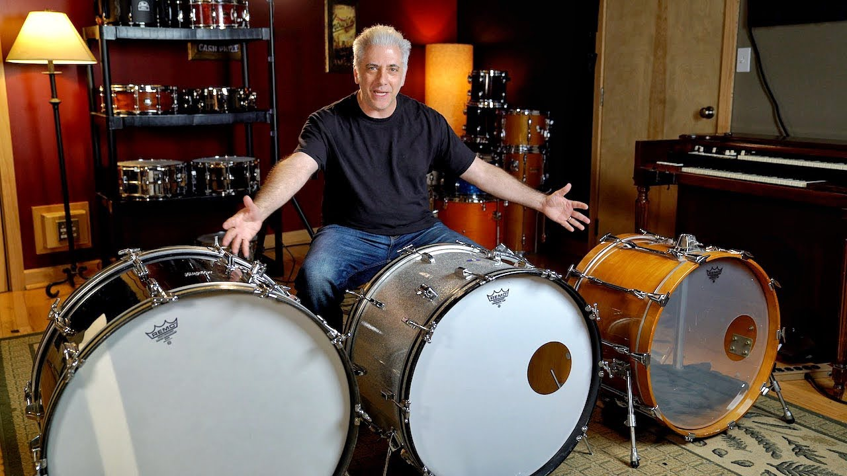
The sound you make depends on the size and shape of the instrument.
For example:
A large drum makes a lower sound than a smaller one.

Slide 23

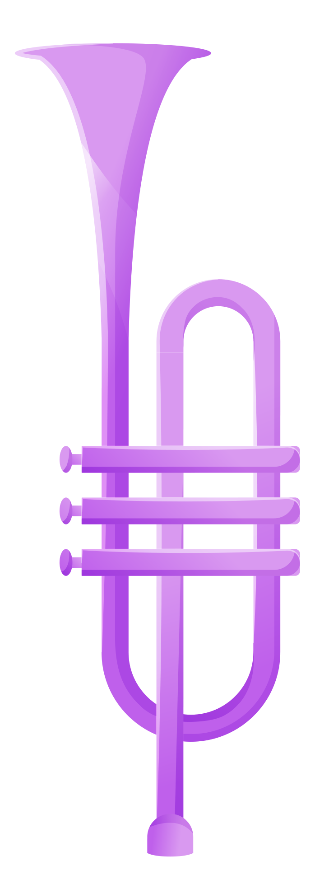

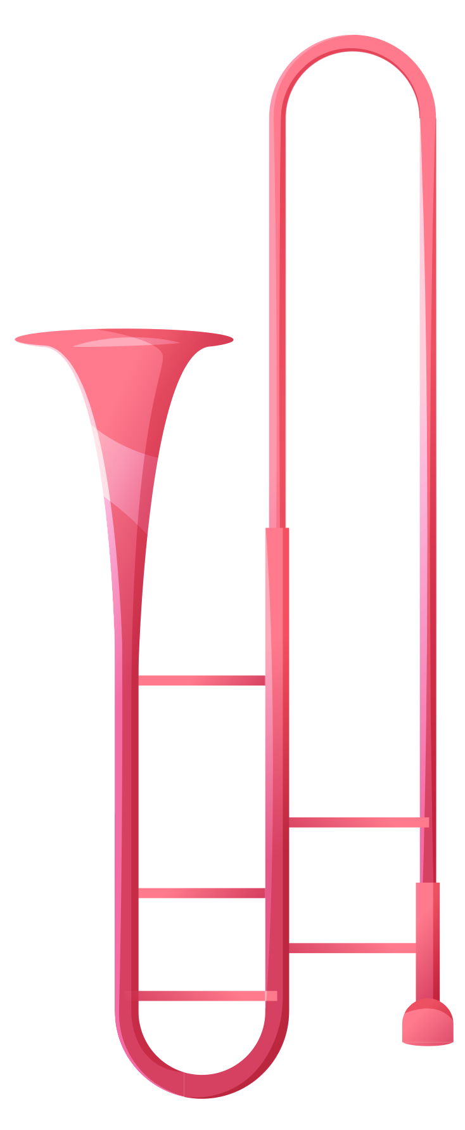
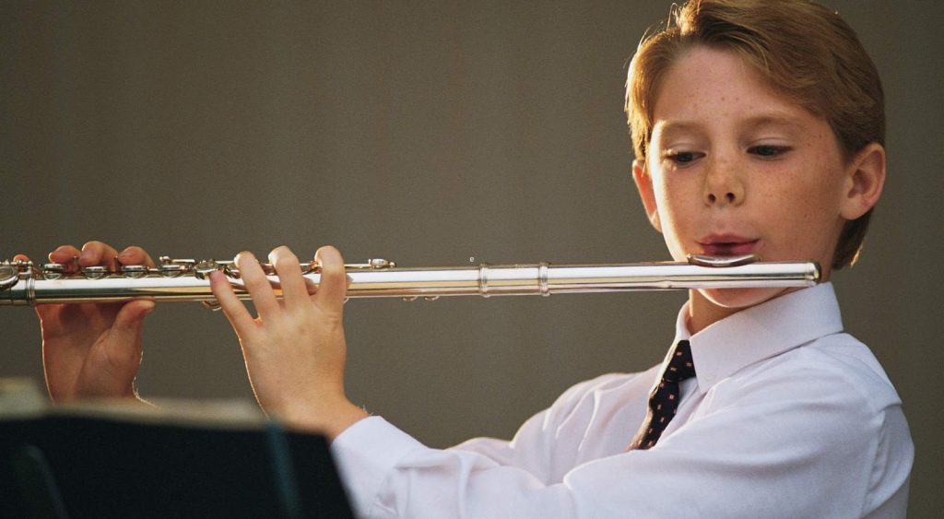
Wind Instruments
You blow into them to make sounds and the sound depends on the shape of the instrument and the length of the pipe or tube.

Slide 24
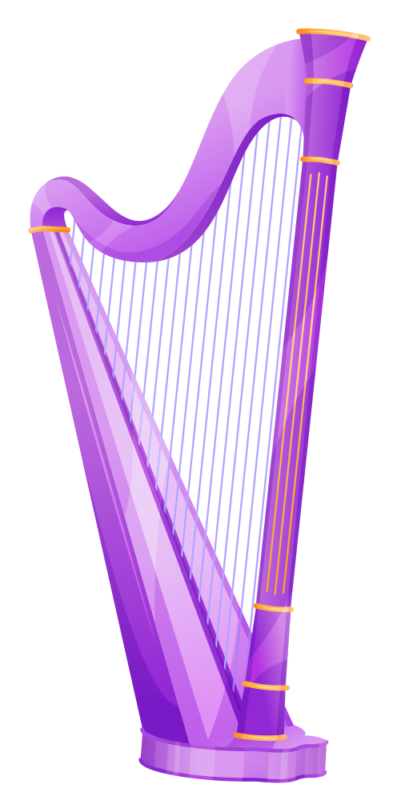
Check this link https://www.youtube.com/watch?app=desktop&v=vXAVduzMyO8

