Slide 1
MOLD ATTACKK
MADE BY HASHEM ALDOUD

Slide 2
WHAT TO DO
Place one banana in a sealed container or zip lock bag. Leave the other banana exposed to air on a plate . Keep both in the same location (room temperature, away from sunlight).Observe and record changes daily: color, texture, smell, mold spots.📊 What to Track Day mold first appears Mold color and spread Banana softness or break down Smell changes🧠 Expected Results The exposed banana may mold faster due to oxygen and airborne spores . The sealed banana might rot more slowly but could develop mold if moisture builds up inside.

Slide 3
5+ FUN FACTS ABOUT MOLD
1 Mold is a Fungus: Mold is a type of fungus, similar to mushrooms, and it reproduces through tiny airborne spores that can travel through the air.
2 Rapid Growth: Mold can grow in as little as 24 to 48 hours under the right conditions, particularly in warm, damp, and humid environments.
3 Diverse Species: There are over 100,000 known species of mold, and they exist almost everywhere, both indoors and outdoors.
4 Health Risks: Mold exposure can lead to various health issues, especially for individuals with respiratory conditions, allergies, or weakened immune systems. Symptoms may include sneezing, runny nose, and skin rashes.
5 Beneficial Mold: Not all mold is harmful; some types, like Penicillium, are used to produce antibiotics and certain foods, such as blue cheese.
6 Structural Damage: Persistent mold growth can weaken the structural integrity of building materials, leading to significant damage in homes and buildings.

Slide 4
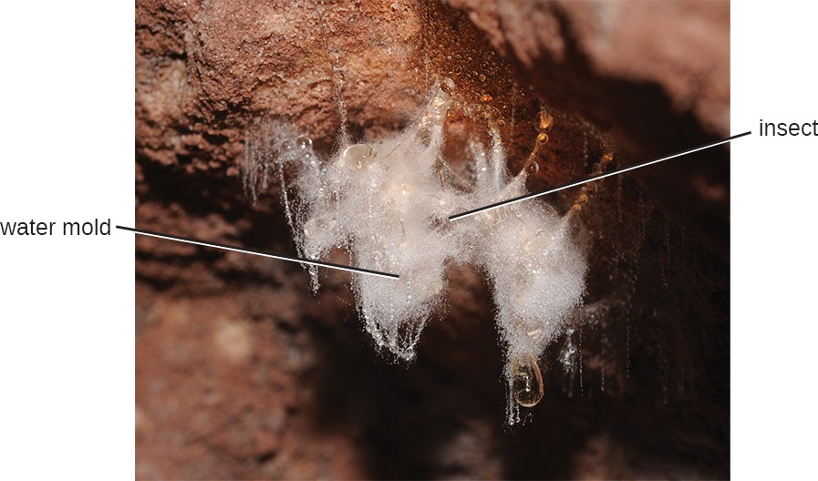
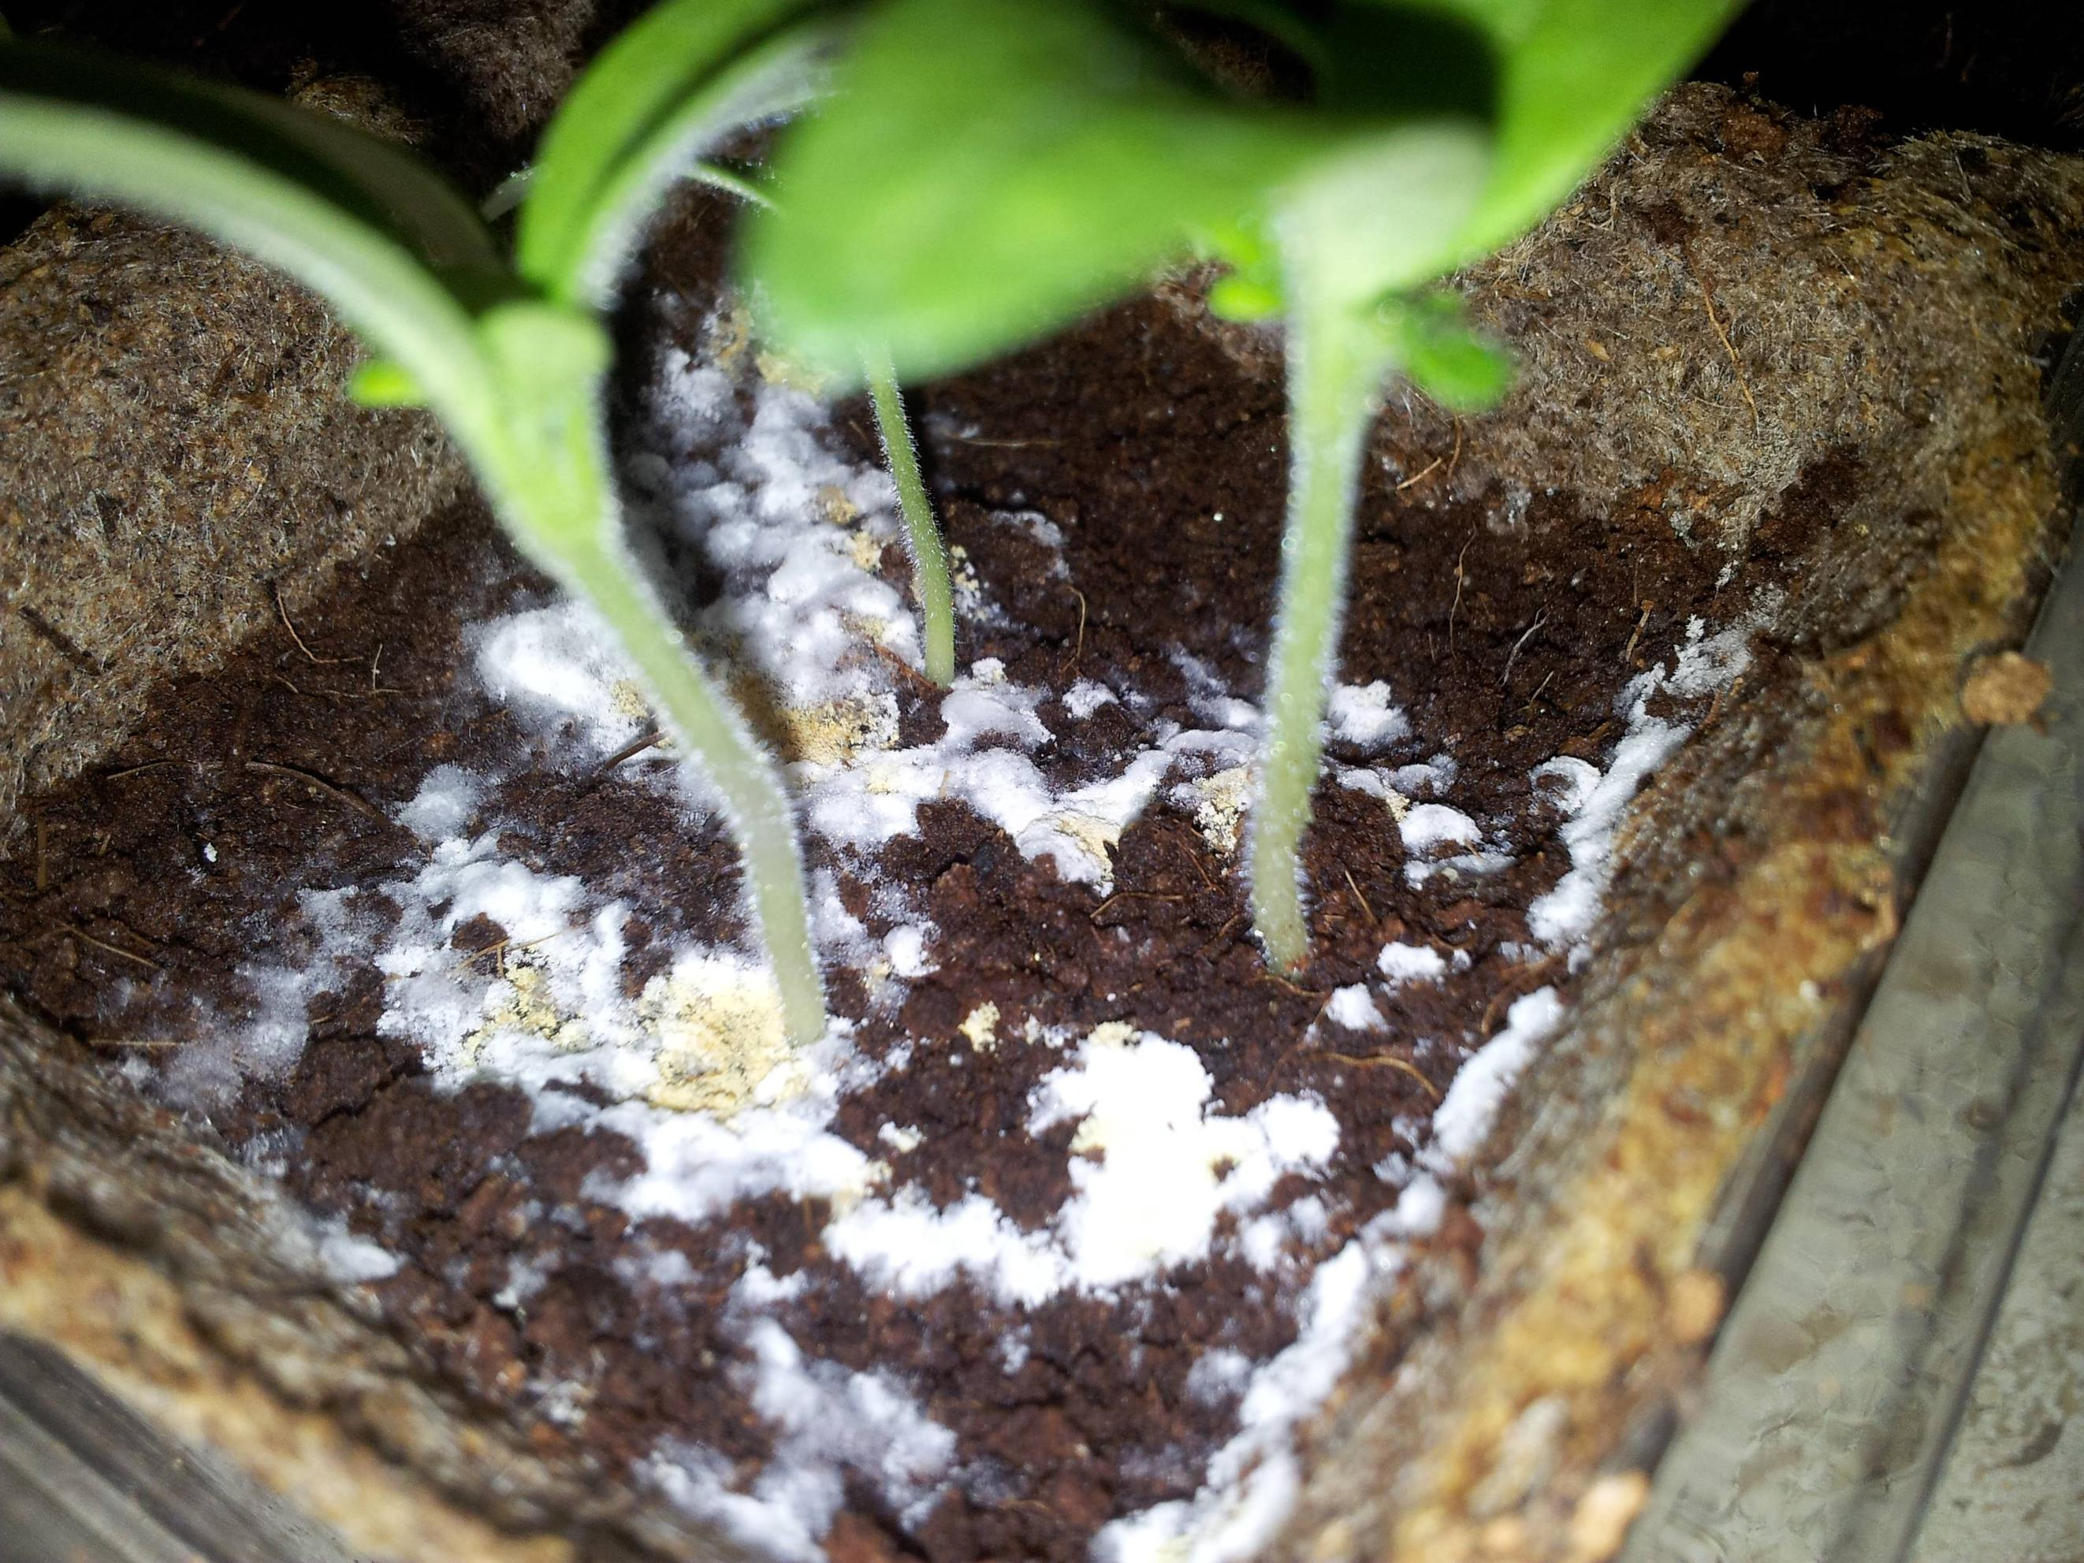
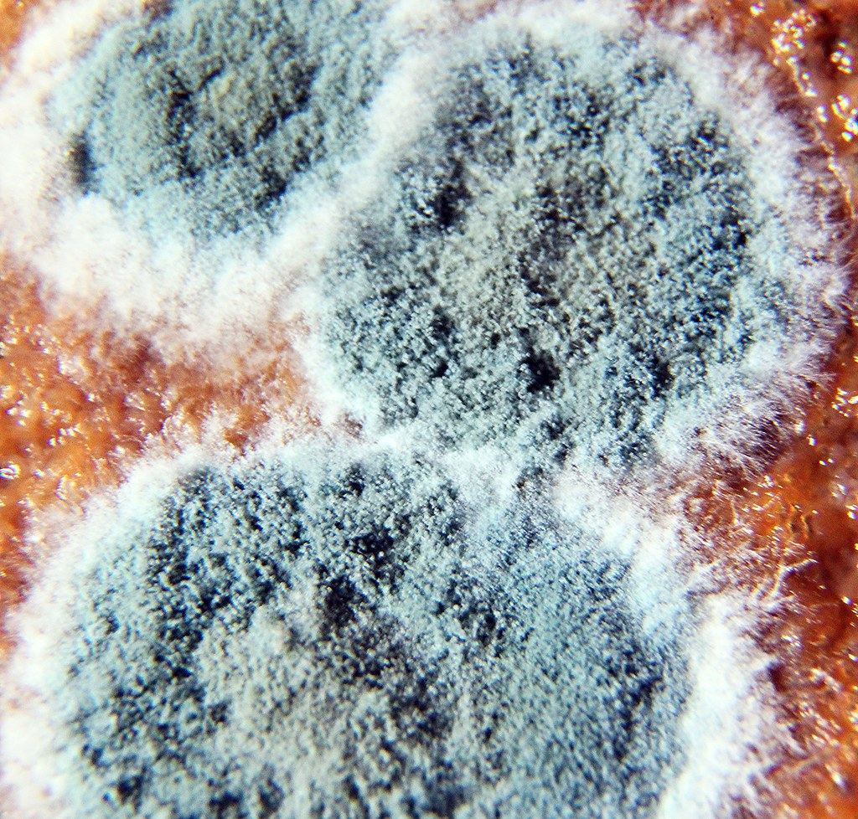
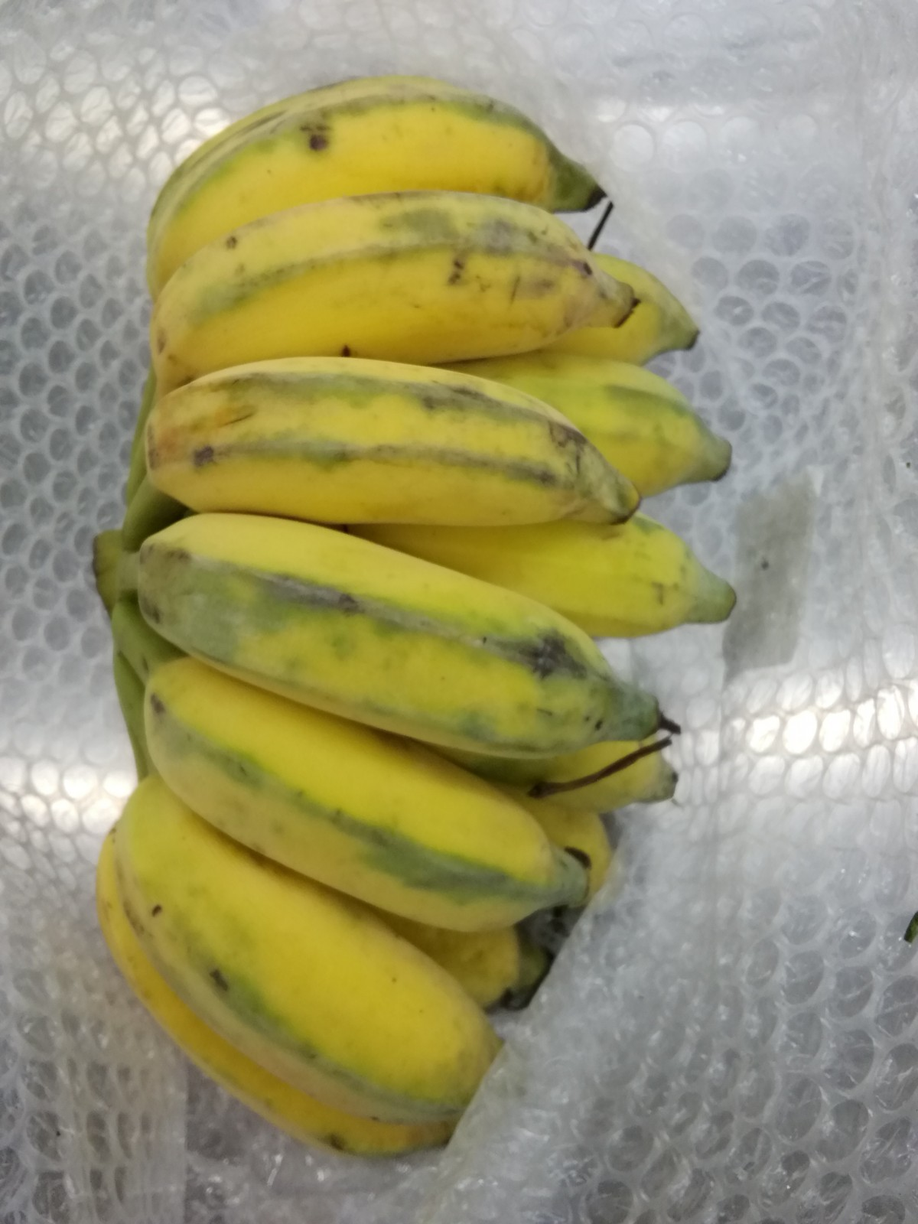
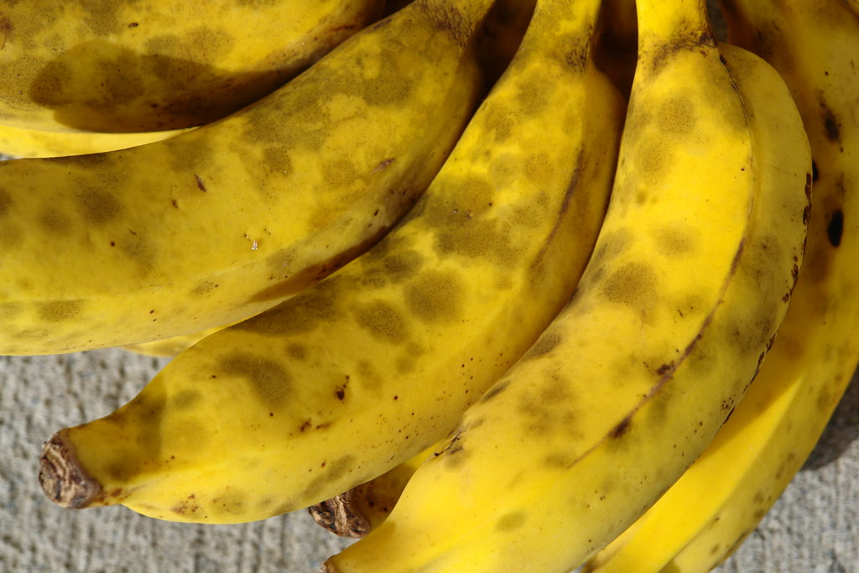
HERE IS A ALBUM OF MOLDDD
This Photo by Unknown Author is licensed under CC BY
This Photo by Unknown Author is licensed under CC BY-SA
This Photo by Unknown Author is licensed under CC BY-ND

Slide 5
WHY IT MOLDS

