Slide 1
Mold Attack
By Meera Adili

Slide 2
Causes
Like any allergy, mold allergy symptoms are triggered by an overly sensitive immune system response. When you inhale tiny airborne mold spores, your body recognizes them as foreign invaders and develops allergy-causing antibodies to fight them.
Exposure to mold spores can cause a reaction right away, or the reaction can be delayed.
Various molds are common indoors and outdoors. Only certain kinds of mold cause allergies. Being allergic to one type of mold doesn't mean you'll be allergic to another. Some of the most common molds that cause allergies include mildew, alternaria, aspergillus, cladosporium and penicillium.

Slide 3

When to see a doctor
If you have a stuffy nose, sneezing, watery eyes, shortness of breath, wheezing or other bothersome symptoms that persist, see a healthcare professional.
Request an appointment
This Photo by Unknown Author is licensed under CC BY-SA-NC

Slide 4

Overview
Overview
If you have a mold allergy, your immune system is overly sensitive to mold spores. A mold allergy can cause coughing, itchy eyes and other symptoms that make you uncomfortable. In some people, a mold allergy is linked to asthma. If mold allergy is linked to asthma, mold exposure can cause restricted breathing and other airway symptoms.
If you have a mold allergy, the best defense is to reduce your exposure to the types of mold that cause your reaction. Medicines can help keep manage mold allergy reactions.
This Photo by Unknown Author is licensed under CC BY-SA

Slide 5
Risk factors
Risk factors
A number of factors can make someone more likely to develop a mold allergy or make mold allergy symptoms worse, including:
Having a family history of allergies. If allergies and asthma run in your family, you're more likely to develop a mold allergy.
Working in a job that exposes you to mold. Occupations where mold exposure can be high include farming, dairy work, logging, baking, millwork, carpentry, greenhouse work, winemaking and furniture repair.
Living in a home with high humidity. Having indoor humidity higher than 50% can increase mold in your home.
Mold can grow virtually anywhere if the conditions are right — in basements, behind walls in framing, on soap-coated grout and other damp surfaces, in carpet pads, and in carpet itself. Exposure to high levels of household mold can trigger mold allergy symptoms.
Working or living in a building that's been exposed to excess moisture. Examples include leaky pipes, water seepage during rainstorms and flood damage. At some point, nearly every building has some kind of excessive moisture, which can encourage mold growth.
Living in a home with poor ventilation. Tight window and door seals can trap moisture indoors and prevent proper ventilation, creating ideal conditions for mold growth. Damp areas — such as bathrooms, kitchens and basements — are most likely to have mold.

Slide 6
Symptoms
Symptoms
A mold allergy causes the same symptoms that happen in other types of upper respiratory allergies, such as hay fever. Symptoms caused by a mold allergy can include:
Sneezing.
Runny or stuffy nose.
Cough and postnasal drip.
Itchy eyes, nose and throat.
Watery eyes.
Dry, itchy skin.
Mold allergy symptoms vary from person to person and range from mild to severe. You might have year-round symptoms or symptoms that flare up only during certain times of the year. You might notice symptoms when the weather is damp or when you're in indoor or outdoor spaces that have high concentrations of mold.

Slide 7
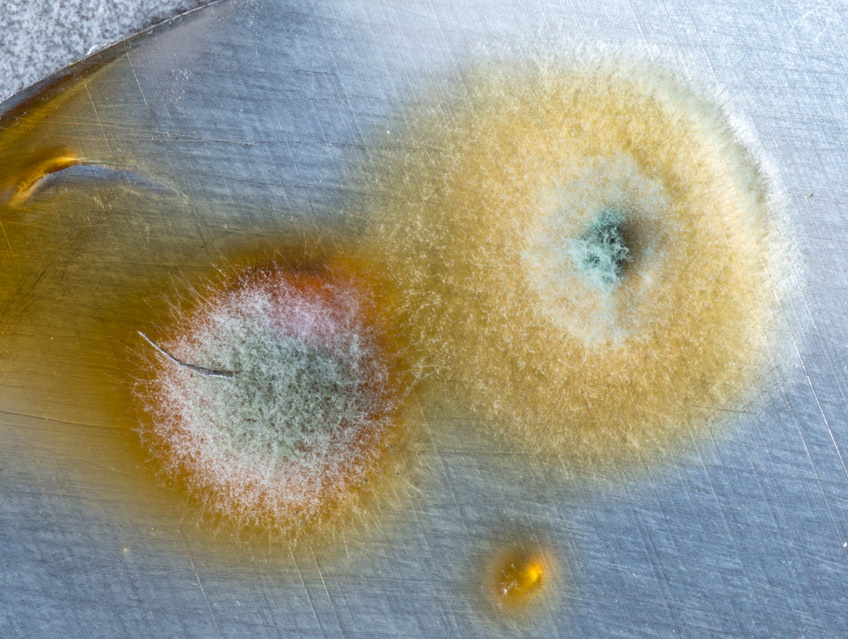
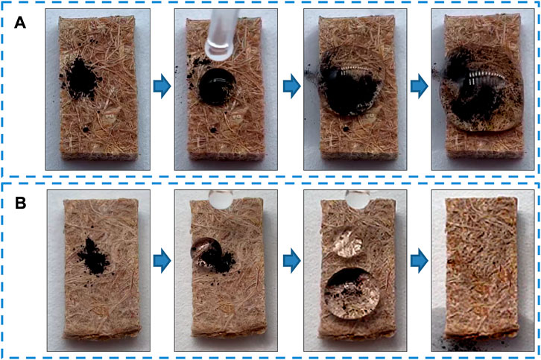
This is a pic
This Photo by Unknown Author is licensed under CC BY

