Slide 1
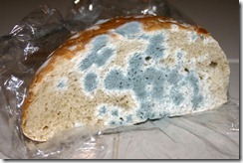
MOLD ATTAK
C
DONE BY CARMEN

Slide 2
Mold grows on cheese when airborne spores land on a piece of cheese and, given enough moisture, oxygen, and nutrients, start to reproduce. The process is similar to how plants grow from seeds, with spores acting like seeds for fungi. While some molds are intentionally added to make cheeses like blue or brie, other molds can grow on cheese due to improper storage and handling, especially with soft, high-moisture cheeses.

Slide 3
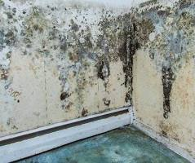
Mold grows on walls when its spores land on a surface with moisture, a food source (like drywall paper or dust), and oxygen, and then find a suitable temperature. The most common cause is excess moisture from sources like condensation, leaks, or poor ventilation, which creates a damp environment where mold can thrive.

Slide 4
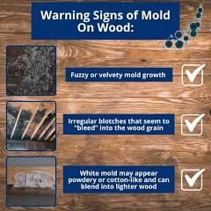
Mold grows on wood when airborne mold spores land on a moist surface, as wood contains the cellulose mold feeds on and its porous nature allows it to absorb moisture from high humidity, condensation, or water damage. Once conditions are favorable, the mold spores germinate and begin to grow, forming a visible colony.

Slide 5


