Slide 1

MOLD ATTACK!!!! DOE BY STEVE MADANAT
Notes:
1

Slide 2
What is mold
. Molds are microbes that do not form a specific taxonomic or phylogenetic grouping, but can be found in the divisions Zygomycota and Ascomycota. In the past, most molds were classified within the Deuteromycota.^{[5]} Mold was the common name for water molds or slime molds, which were formerly classified as fungi.

Slide 3
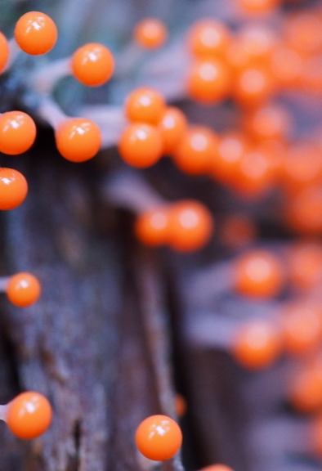
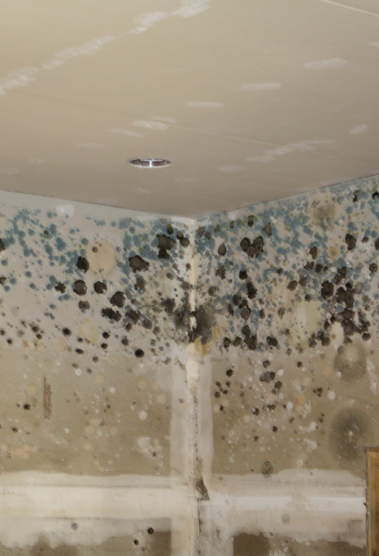
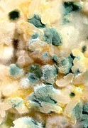
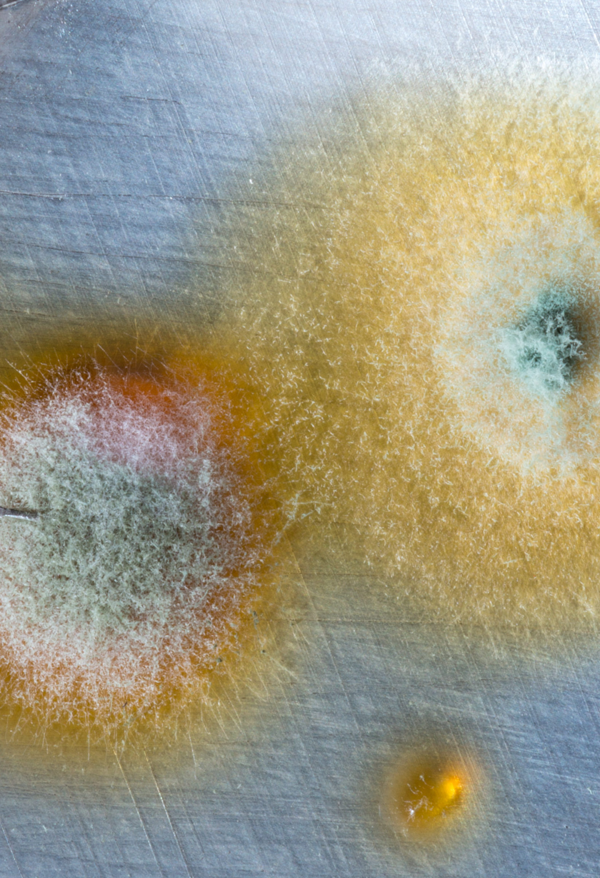
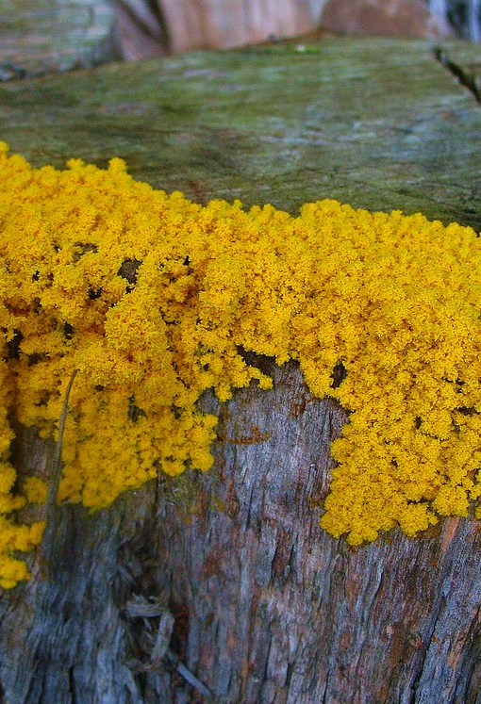
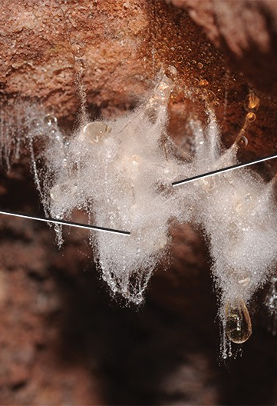
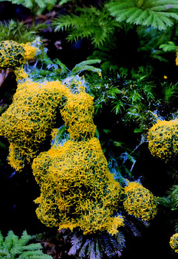
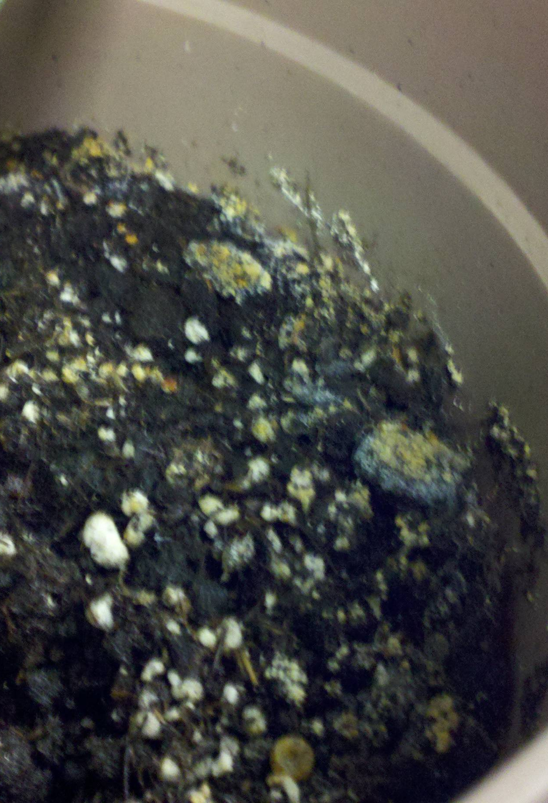
Here are pictures
This Photo by Unknown Author is licensed under CC BY
This Photo by Unknown Author is licensed under CC BY-NC-ND
This Photo by Unknown Author is licensed under CC BY
This Photo by Unknown Author is licensed under CC BY-SA

Slide 4
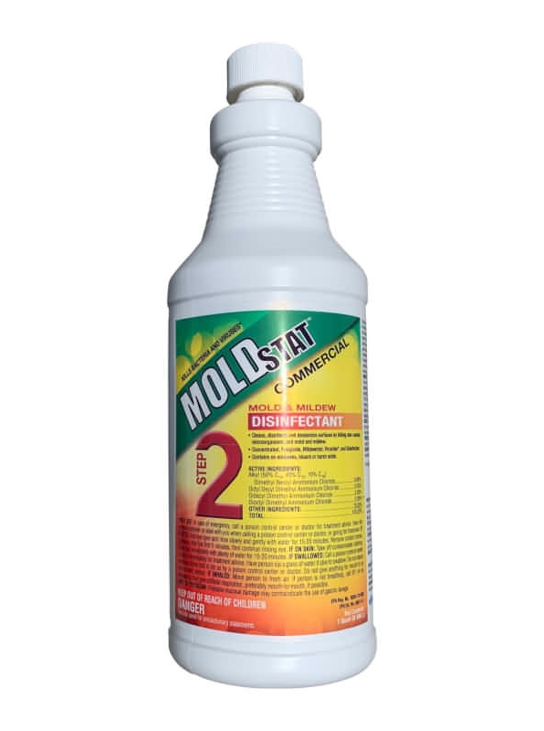
How to stay safe from mold
control moisture by fixing leaks and using dehumidifiers, ventilate with fans or open windows, and clean up any water-damaged areas within 24-48 hours.
This Photo by Unknown Author is licensed under CC BY-NC-ND

