Slide 1
The rising of the dough
Done by: dany sweis

Slide 2
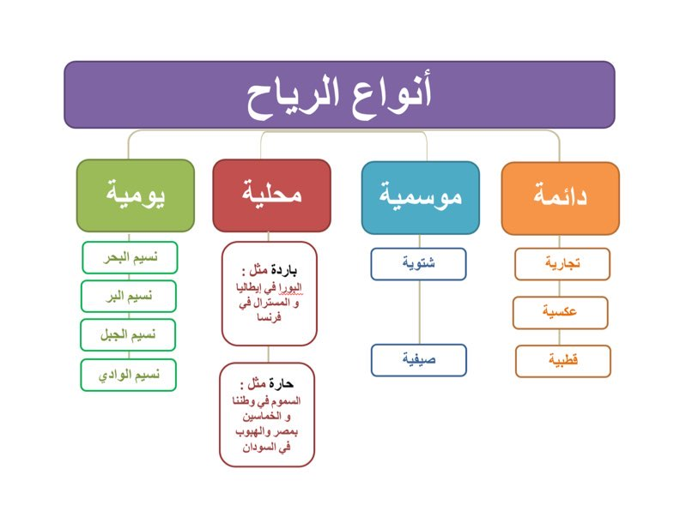
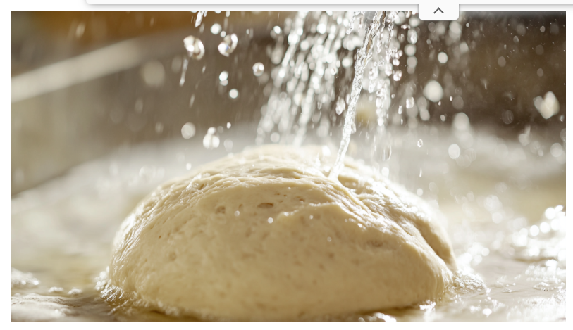
How water helps dough
It helps by hydrating flour to form gluten, which provides structure and elasticity

Slide 3
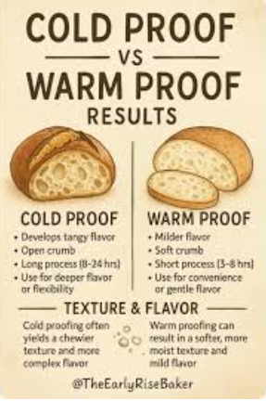
Does warm and cold water make a difference?
Action: Warmer temperatures activate yeast more quickly, causing the dough to rise faster. This process is often called "blooming" the yeast.

Slide 4
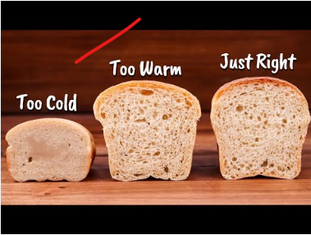
Cold water
Cold water dramatically slows down yeast activity and the fermentation process. This "cold fermentation" is often done in a refrigerator for 8 to 24 hours or longer.

