Slide 1
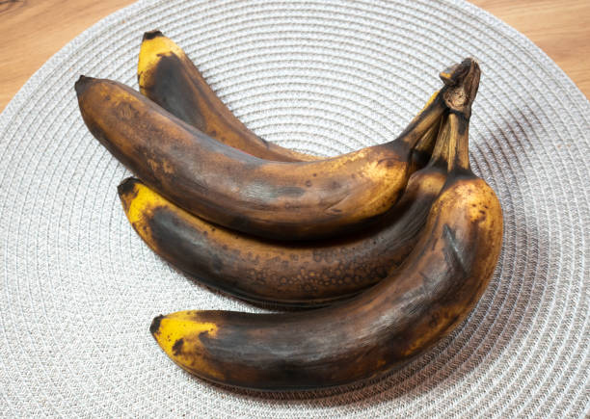
WHAT IS MOLD ATTACT
We’ve all scrutinised the white spots on Cheddar or little blooms of fur on bread, trying to decide whether to turn it into sandwiches or throw it in the bin. With an estimated 6.6 million tonnes of food thrown away by households in the UK every year, some needlessly, how can you know if food with a little mould is safe to eat?

Slide 2
IS IT SAFE TO EAT MOLDED FOOOD
Mold can produce harmful mycotoxins that can make you sick. Consuming moldy bread could cause food poisoning symptoms like nausea, vomiting, diarrhea, or breathing problems. ng moldy food is not harmful always. OK. In the case of mold, it is almost certainly instantly destroyed when it comes into contact with the acid produced in the stomach .Therefore in short having accidentally consumed some moldy food shouldn't have any harmful effect on your body. Because the body has different defense mechanism to protect against any organisms that we indigest. In the case of mold ,if you have any symptoms of nausea, pain, fever, vomiting you should consult with your doctor.
Thanks

Slide 3
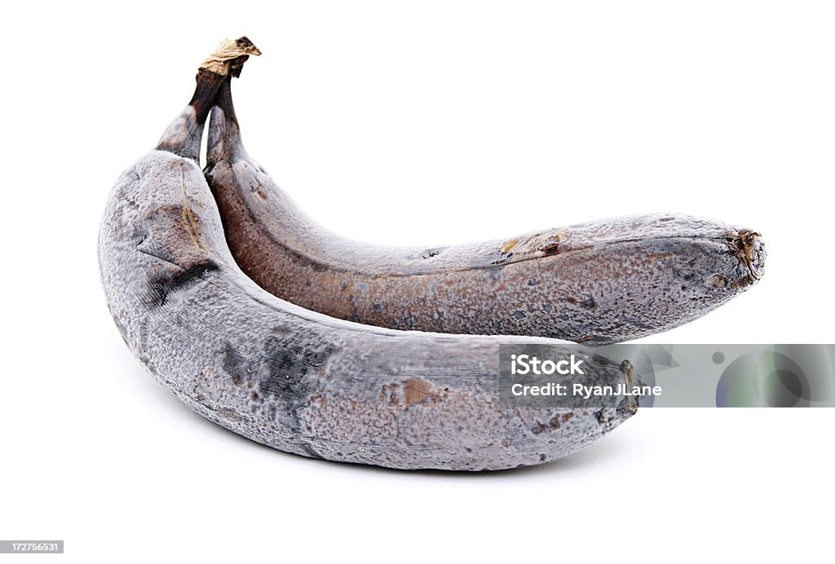
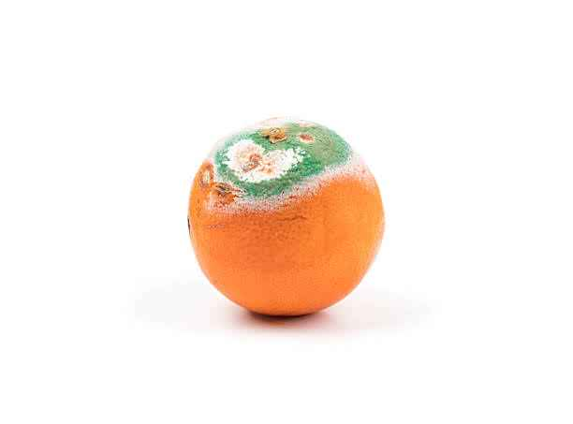
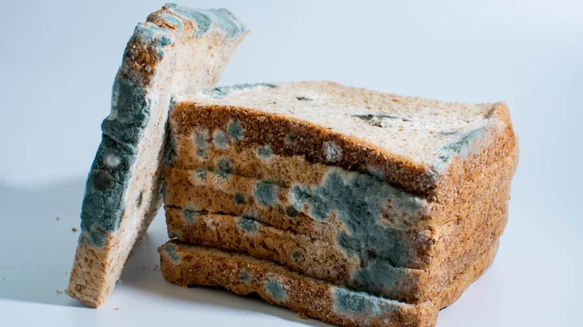
PICTURES OF MOLDED FOOD

Slide 4
