Slide 1
Yeast makes it rise
by salam awwad

Slide 2
Test how yeast helps dough rise using warm and cold water :
the dough with warm water rises significantly faster because yeast is more active in warmer temperatures, while the cold water dough rises much more slowly as the yeast remains dormant.
.

Slide 3
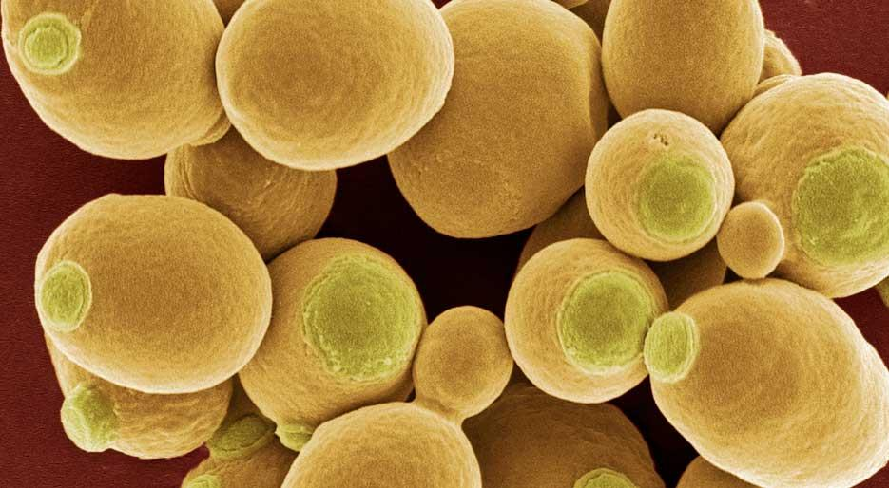
Does temperature affect yeast growth .
Yes, temperature strongly affects yeast growth, with a significant impact on its metabolic rate and overall activity.
This Photo by Unknown Author is licensed under CC BY-NC

Slide 4
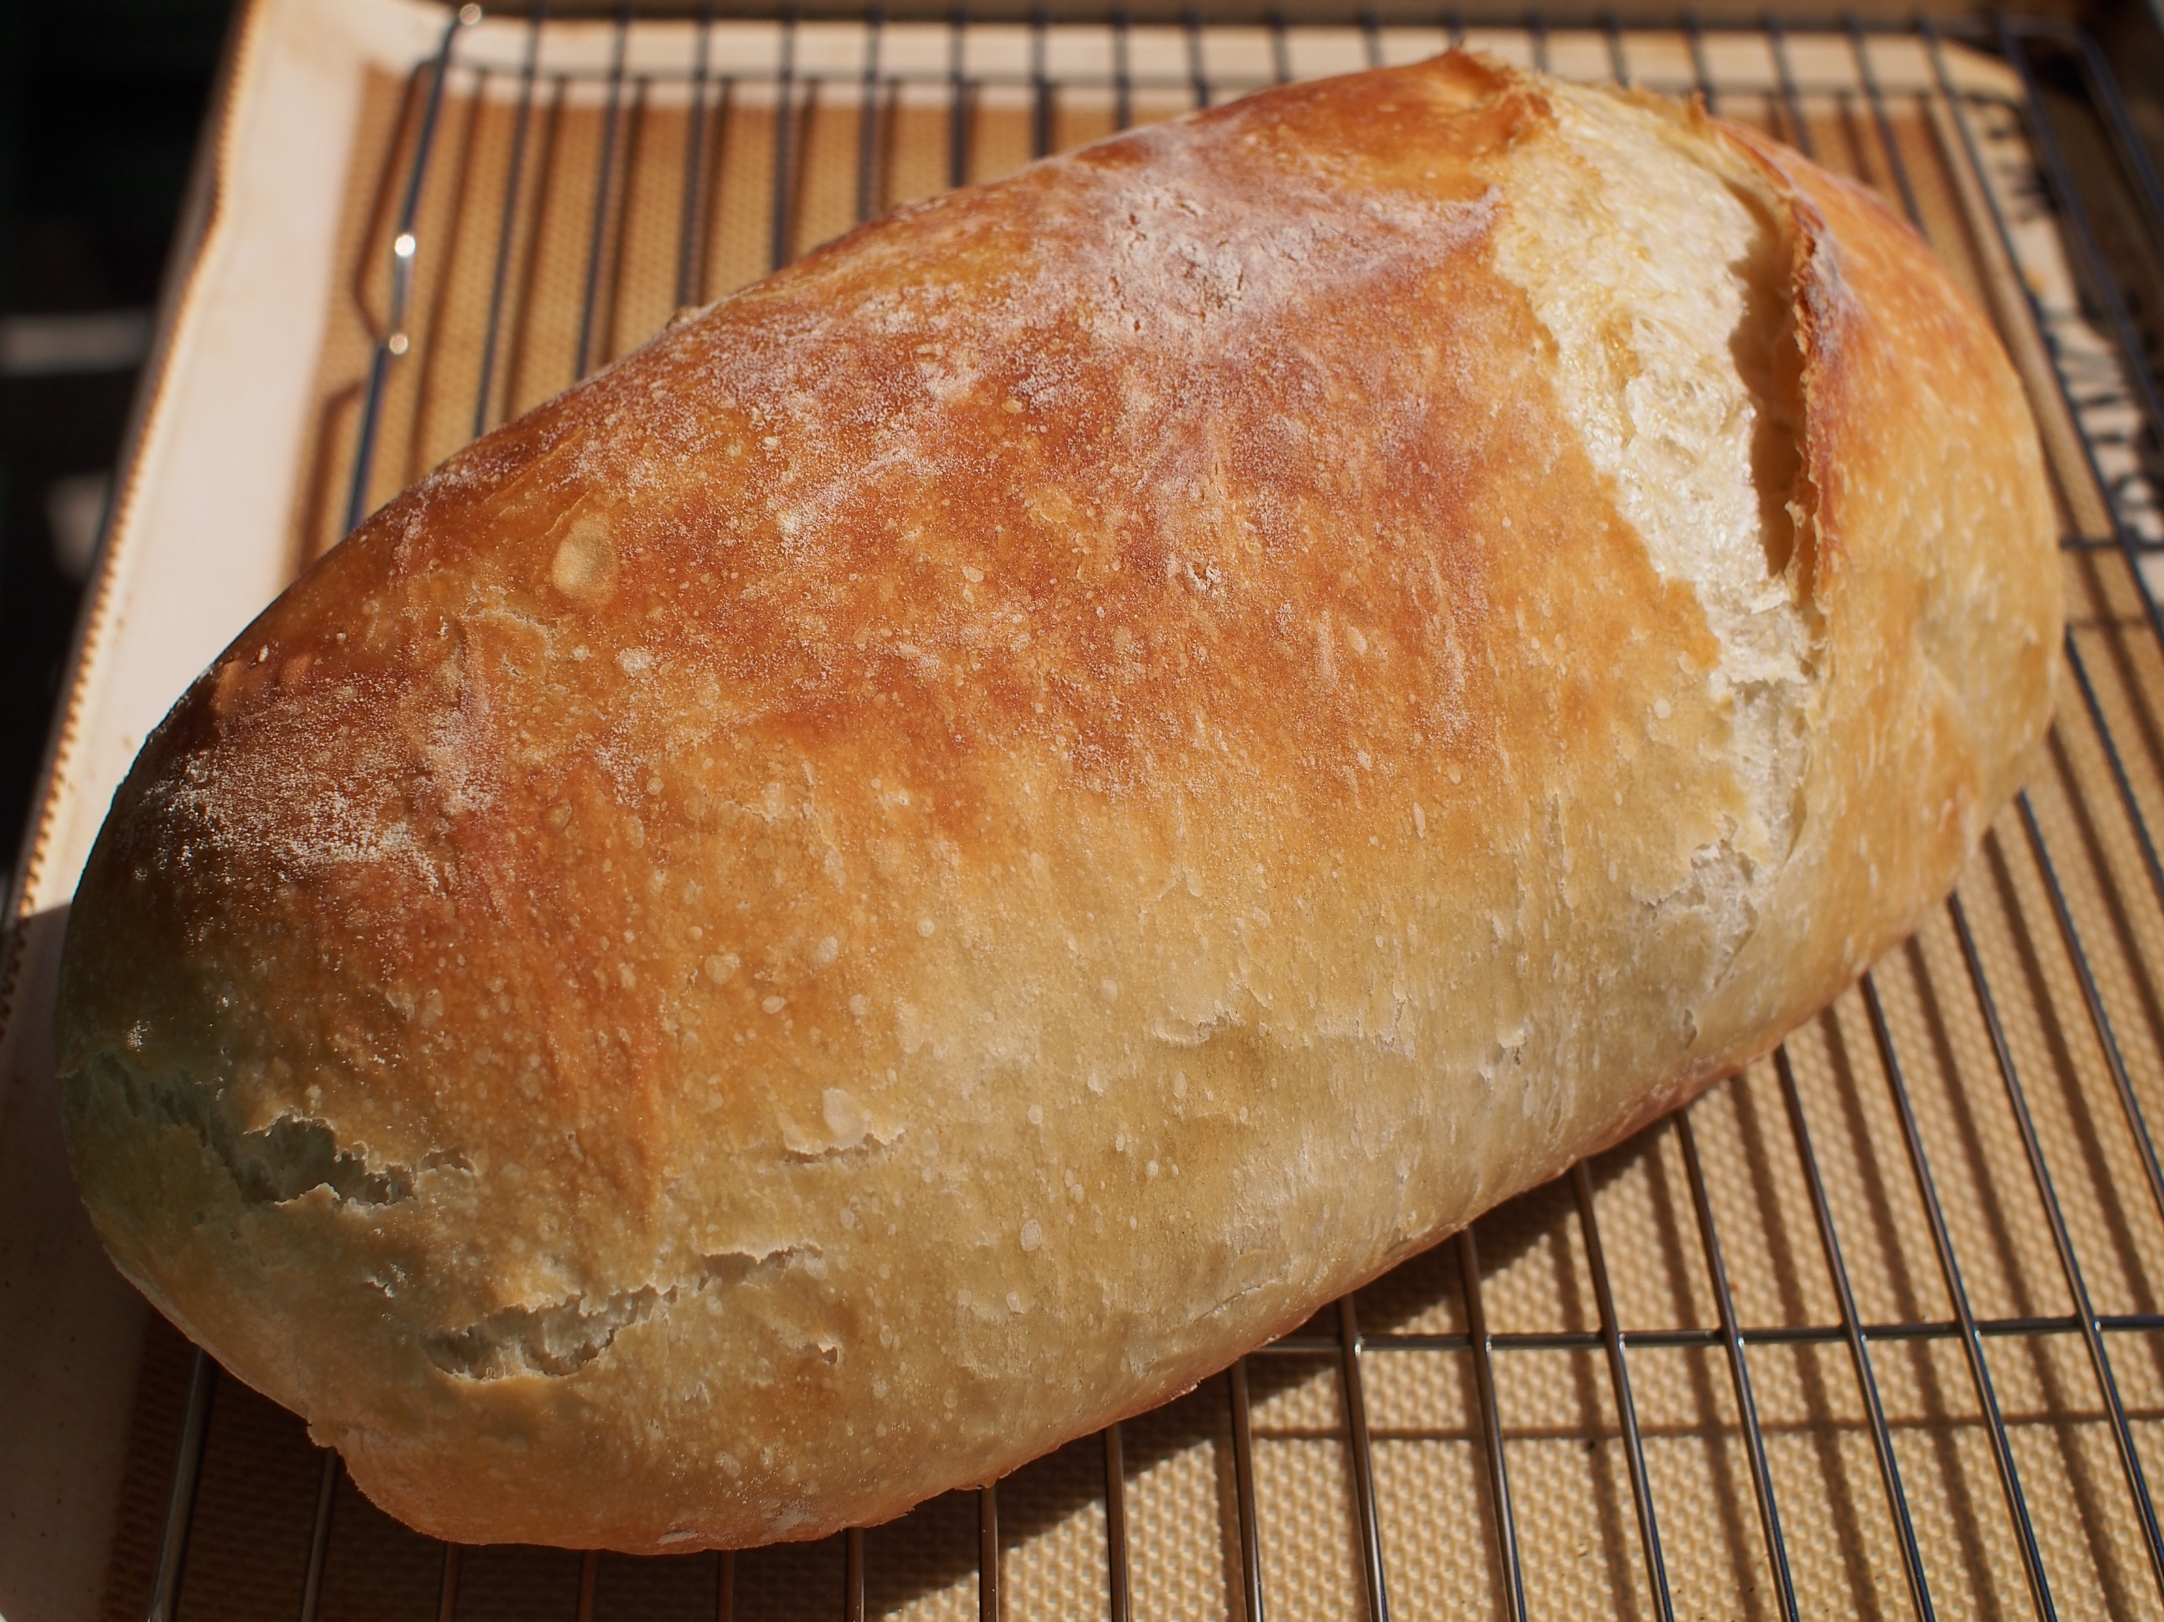
This Photo by Unknown Author is licensed under CC BY-NC

Slide 5
The end

