Slide 1
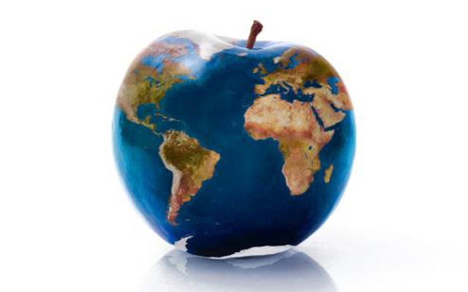
Keep food safe
By Zainah Al zghoul

Slide 3
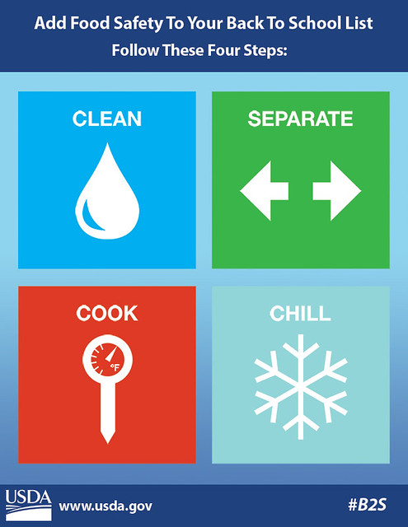
Food storage is Food storage is crucial for several reasons:
Preserving Freshness: Storing food properly helps maintain its nutritional value and flavor. Certain foods, like fruits and vegetables, are sensitive to temperature and humidity, and improper storage can cause them to spoil prematurely
Reducing Waste: When food is stored properly, it lasts longer. This helps reduce food waste and makes your grocery budget go further.
Keep food in a cool, dry place: Avoid storing food in areas exposed to heat and humidity, such as above the stove or near windows. This helps maintain the quality and extends the shelf life of pantry staples.
This Photo by Unknown Author is licensed under CC BY

Slide 4

steps for saving food:
Wash your hands often, especially during these key times when germs can spread:
  Before, during, and after preparing food
  After handling raw meat, poultry, seafood, or their juices, or uncooked eggs
  Before eating
  After using the toilet
  After changing diapers or cleaning up a child who has used the toilet
  After touching an animal, animal feed, or animal waste
  After touching garbage
  Before and after caring for someone who is sick
  Before and after treating a cut or wound
  After blowing your nose, coughing, or sneezing
  After handling pet food or pet treats.
This Photo by Unknown Author is licensed under CC BY-SA

Slide 5

big question
How we can stop harmful microorganisms from growing?
Answer:cover food and keep food in a cold place

Slide 6


