Slide 1















Why Expiry Dates Matter?
Made by: Maya Khalaf 6A

Slide 2
Expiry dates history and information
Expiration dates were used after an Italian mafia boss named Capone lost a family member after they fell ill due to drinking expired milk. He was livid and demanded the use of expiration dates in the 1950s.
An expiry date is the last date a product is considered safe to use or consume.
After a food's expiration date, it gradually loses quality, with spoilage leading to changes in taste, texture, and nutritional value

Slide 3
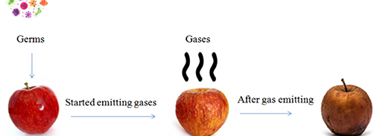
Food before vs after expiration
This image shows how an apple looks like before and after expiring

