Slide 1
Mold attack
By Rayankawar
About: Observing Mold Growth on Different Foods
Grade 6A

Slide 2
What is MOLD
Mold is a type of fungus.
It grows in damp, warm, and dark places.
Mold can grow on food, walls, and other surfaces.

Slide 3
How much time it takes to mold
Banana Day 5
Bread Day 5
Cheese Day 5

Slide 4
What I learned
Mold grows differently on different foods.
Mold grows faster in moist environments.
It’s important to store food properly to avoid mold.

Slide 5
Tips for safety
Always wear gloves when handling moldy food
.Never eat moldy food.
Wash your hands after touching mold.

Slide 6
Big question
People would ask which food grows molds the fastest?
Actually they are :
Banana
Bread
Cheese

Slide 7
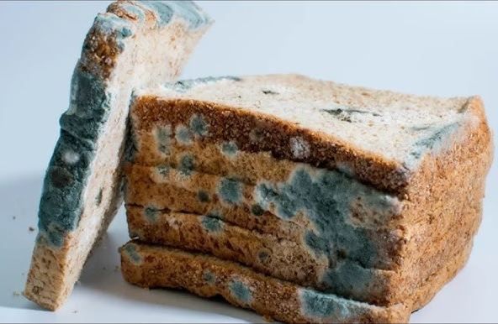
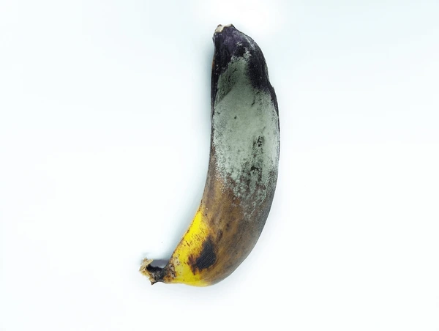
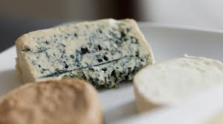
Pictures of mold
Bread:
Bananna:
Cheese:

