Slide 1
HELPFUL VS HARM FUL MICROORGANISIMS
DONE BY MAS KHLIEFAT

Slide 2
GOOD MICROORGANISIMS
Microscopic creatures—including bacteria, fungi and viruses—can make you ill. But what you may not realize is that trillions of microbes are living in and on your body right now. Most don’t harm you at all. In fact, they help you digest food, protect against infection and even maintain your reproductive health

Slide 3
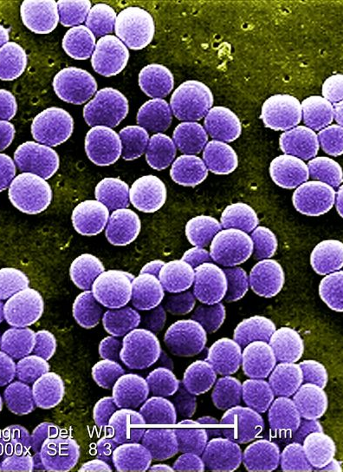
BAD MICRORGANISIMS
Pathogens are microorganisms that can cause disease. They can reproduce quickly in your body and give off poisons (toxins) that can cause infection. Harmful bacteria examples include: Streptococcus: Bacteria that cause strep throat. Staphylococcus: Bacteria that cause staph infections.

Slide 4
ARE ALL MICRORGANISIMS HARMFUL?

Slide 5
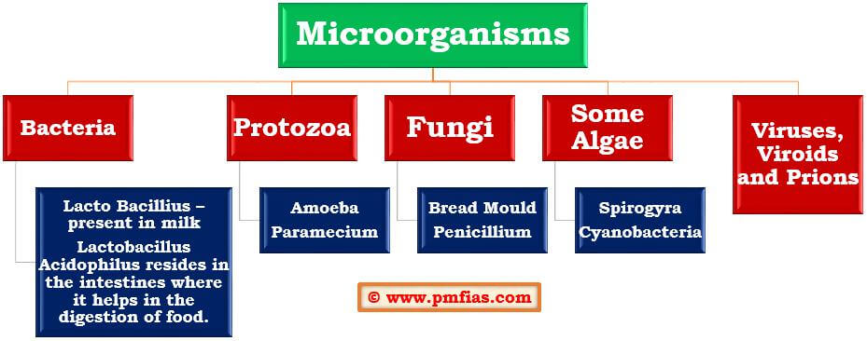
A CHART

Slide 6
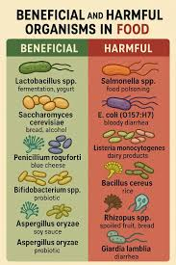
HARMFUL AND HELPFUL ORGANISIMS

Slide 7
thank you

