Slide 1
The rising of the dough
DONE BY MARITTA sweis

Slide 2
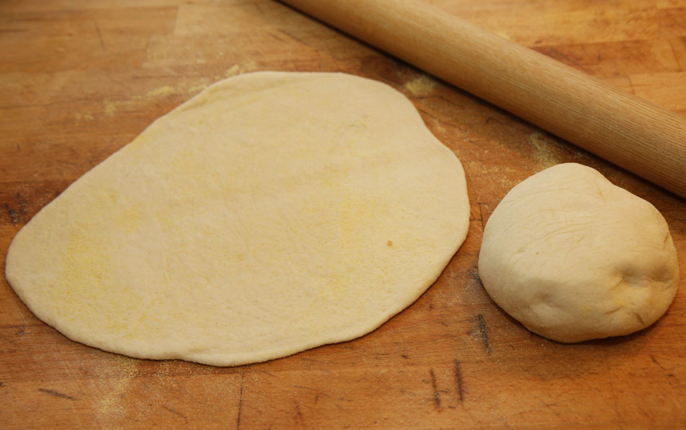
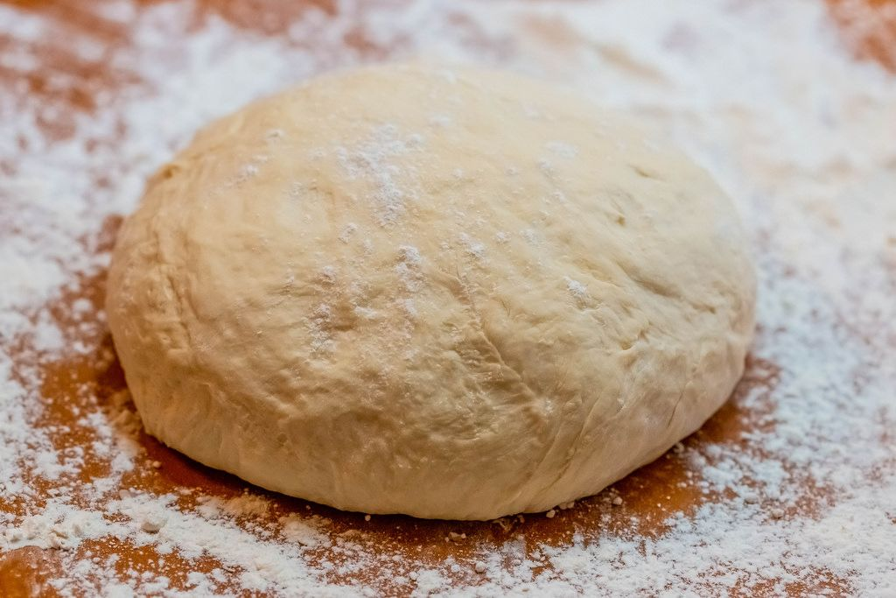
How does yeast help the dough rise???
how yeast helps make bread rise. The hypothesis is that yeast produces carbon dioxide gas, which makes bread rise and gives it a fluffy texture.
This Photo by Unknown Author is licensed under CC BY
This Photo by Unknown Author is licensed under CC BY

Slide 3
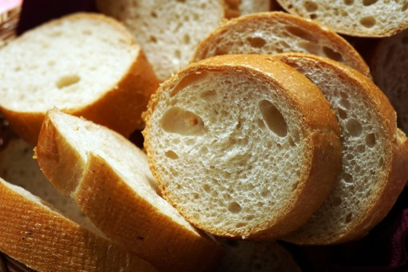
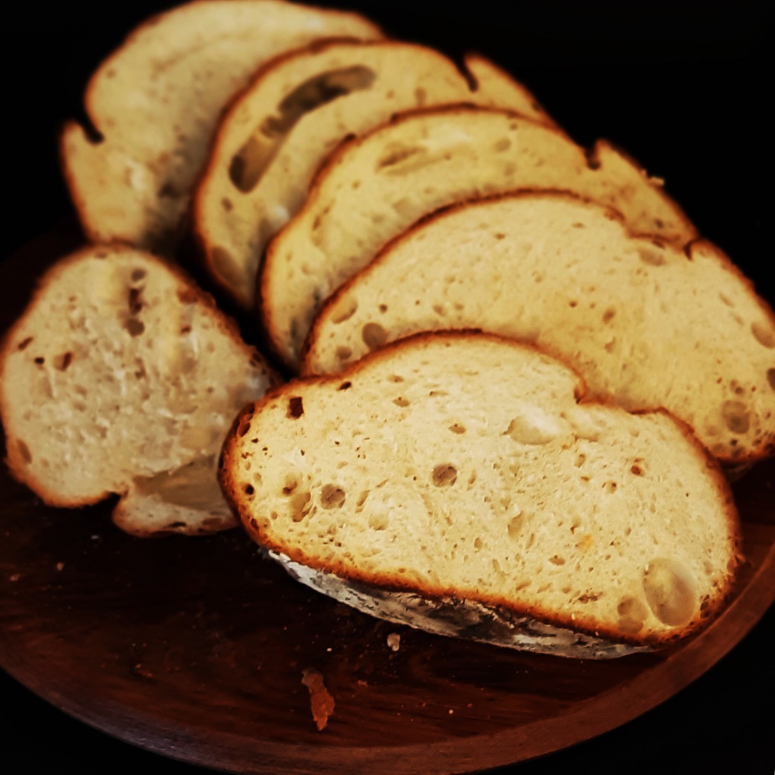
WHY WARM WATER HELPS
The temperature of the water you use can change the texture, elasticity, and purpose of your dough. Read ahead for the science behind these two techniques

Slide 4
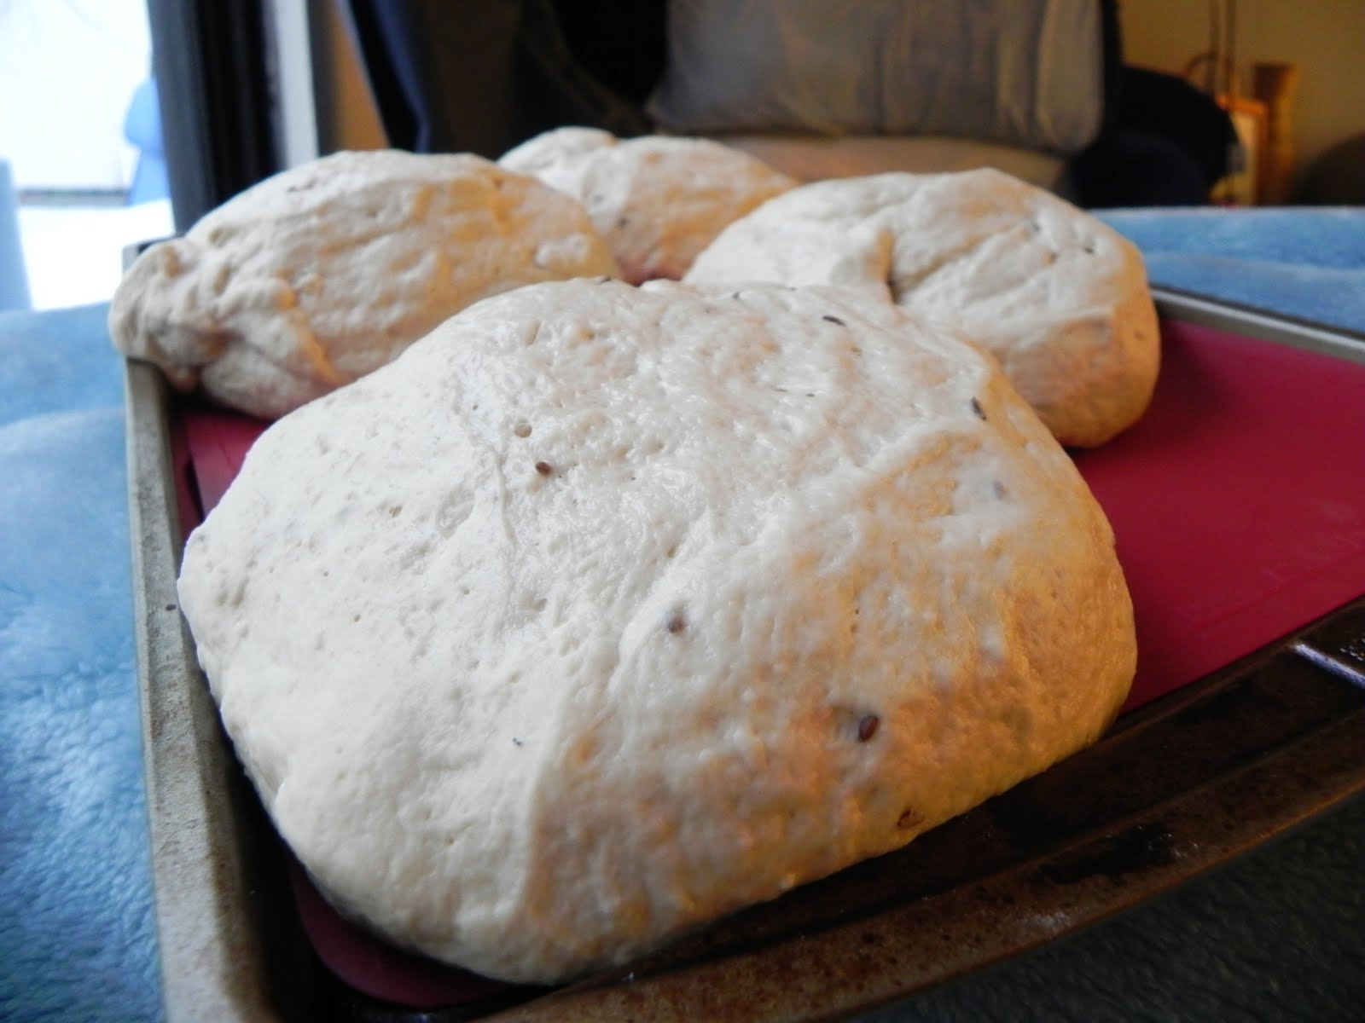
WHY COLD WATER MAKES IT DENSE
Cold water can be refreshing and hydrating, but warm water has additional benefits related to physiological processes and discomfort relief.
This Photo by Unknown Author is licensed under CC BY-ND

Slide 5
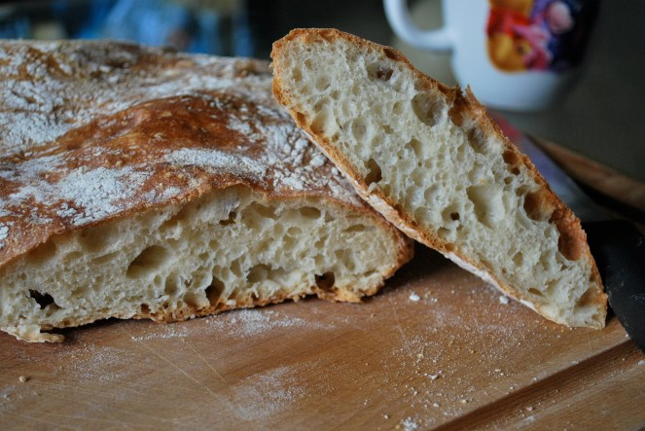
This Photo by Unknown Author is licensed under CC BY-ND

