Slide 1

Mold attack
Done by: Karam Hamdan and Adam Shaheen
Grade 6A

Slide 2
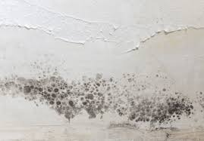
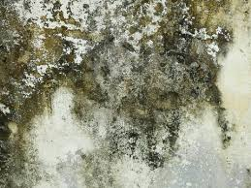
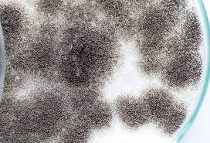
Mold Attack
Fungi represent one of the most diverse and abundant eukaryotes on earth. The interplay between mold exposure and the host immune system is still not fully elucidated. Literature research focusing on up-to-date publications is providing a heterogenous picture of evidence and opinions regarding the role of mold and mycotoxins in the development of immune diseases. While the induction of allergic immune responses by molds is generally acknowledged, other direct health effects like the toxic mold syndrome are controversially discussed. However, recent observations indicate a particular importance of mold/mycotoxin exposure in individuals with pre-existing dysregulation of the immune system.

Slide 3
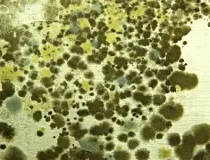
Here is a picture of mold .

Slide 4
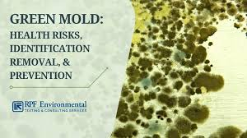
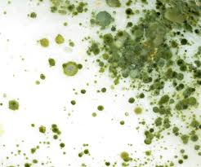
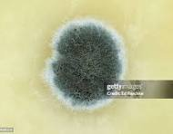
Introduction
Humans are exposed to multiple fungi. Many fungi live in harmony with humans, rarely causing diseases. Possible health effects associated with fungi generally fall into the category infections (mycosis), allergic reactions, or toxic effects . Fungi causing mycosis include dermatophytes, yeast, and mold. Fungal infection requires exposure to spores via inhalation, ingestion of contaminated food, or skin contact . Although fungal infection can occur in healthy individuals, especially individuals with a weakened immune system are of risk (reviewed by Kohler et al
Molds are fungi.

Slide 5
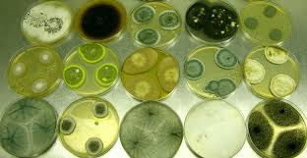
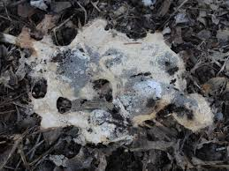
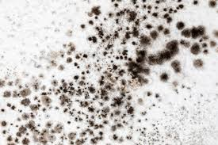
2.2. Mold-Induced Hypersensitivity
Mold can cause different hypersensitivity reactions. Hypersensitivity reactions are exaggerated or inappropriate immunologic responses occurring in response to an allergen . Allergens act as antigens resulting in a strong immune response. The four genera Alternaria spp., Cladosporium spp., Aspergillus spp. and Penicillium spp. belong to the phylum Ascomycota for which currently 88 allergens are described accessed on 30 August 2021). Allergens include enolase, heat shock proteins, cyclophilins, proteases, redoxins, and disulphide isomerases . According to our current knowledge, there is no evidence that mycotoxins may function as allergens.
Type 1 allergies are characterized by antigen-specific IgE-antibodies, which are produced shortly after exposure to already sensitized mold antigens. Not all the mold produced IgE-binding antigens are equally important . Although the exact prevalence is unknown.

Slide 6
Done by : Karam Hamdan and Adam Shaheen

