Slide 1
Food spoilage
By naya
Grade six a

Slide 2
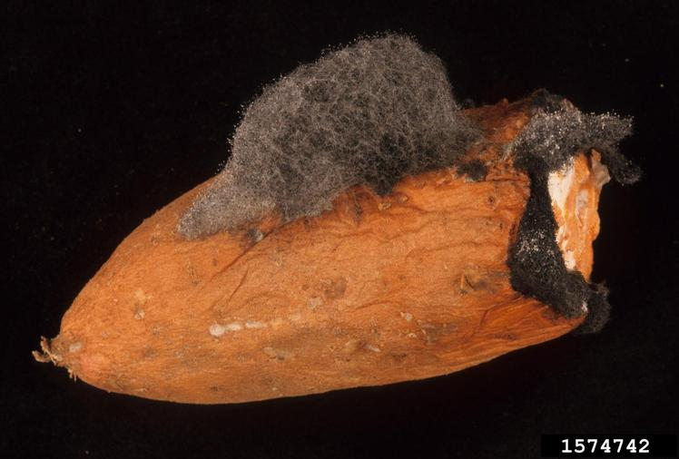
the process where food becomes unfit for consumption due to undesirable changes in its physical, chemical, or microbial properties
This Photo by Unknown Author is licensed under CC BY-NC

Slide 3
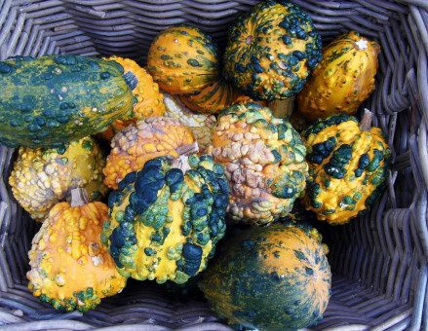
Causes of food spoilage Microbiological: The most common cause, involving the growth of bacteria, yeast, and mold. These microorganisms produce enzymes that break down food components, leading to spoilag

Slide 4
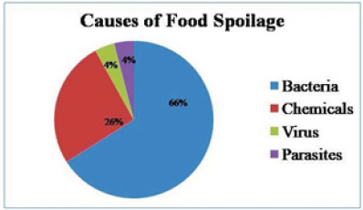
This Photo by Unknown Author is licensed under CC BY

Slide 5
How bacteria cause spoilage
Decomposition:
Bacteria break down the complex molecules in food, a process similar to decomposition.
Waste products:
This breakdown process releases waste products, such as acids, which lead to off-odors and unpleasant flavors

