Slide 2
L.O: To explain the life cycle of animals including humans.

Slide 3
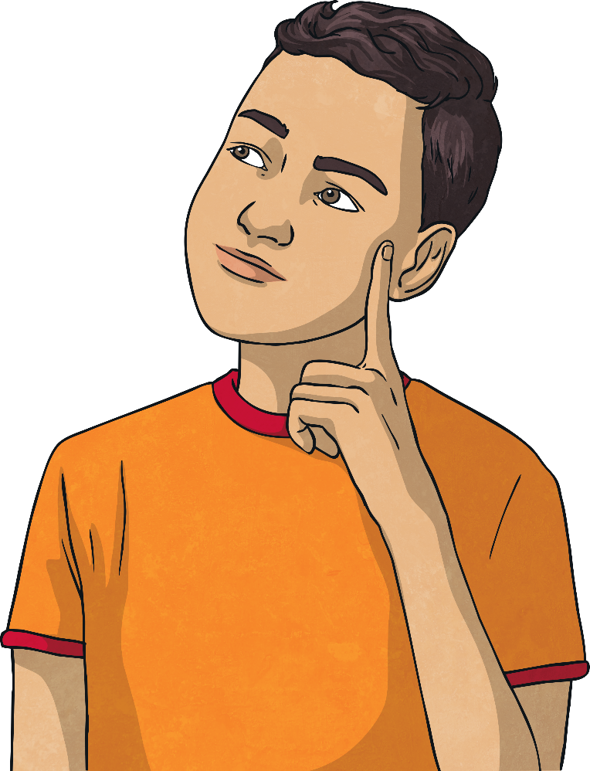
What is a Lifecycle?
What is a life cycle?
What life cycles do you know about?
Can you describe the life cycle of an animal or plant?

Slide 4
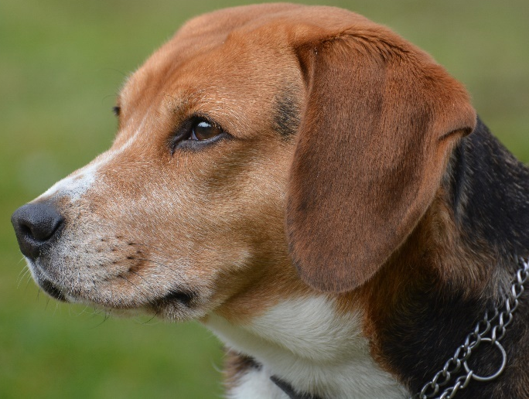
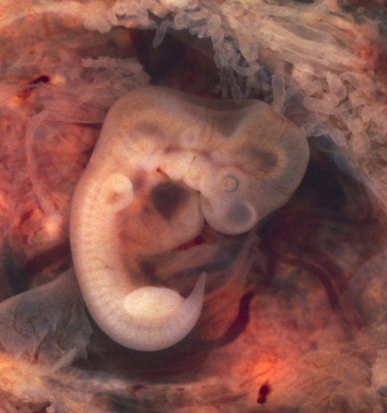
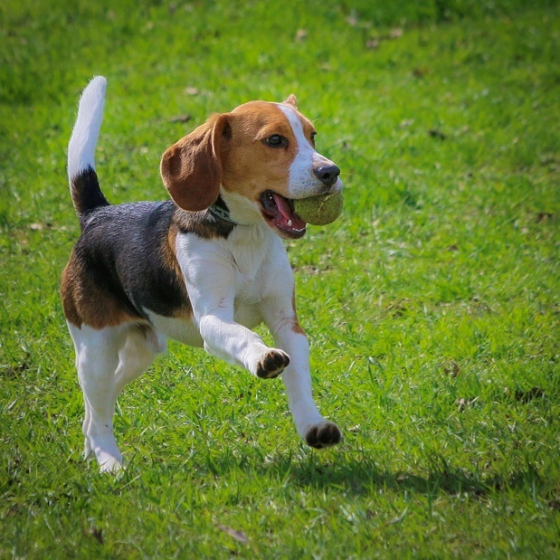
Mammals
The lifecycle of a mammal involves 3 main stages:
Start
Gestation: Embryo growing inside the mother, where it is completely reliant upon the mother.
Independent adult usually seeks company from the opposite sex. Adult female nurses their young.
Mammals:
have hair or fur
warm-blooded
feed babies milk
give live birth
Young: Main period of growth and developing independence from the parents.
Photo courtesy of euthman, Frank Shepherd, camerashake (@flickr.com) - granted under creative commons licence – attribution

Slide 5
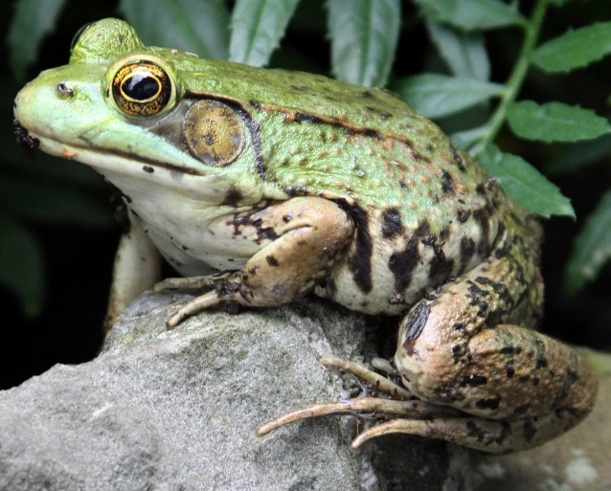
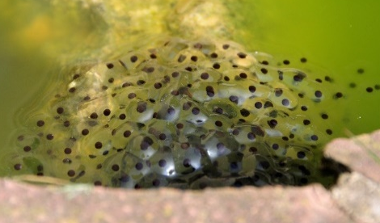
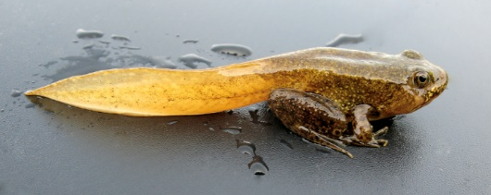
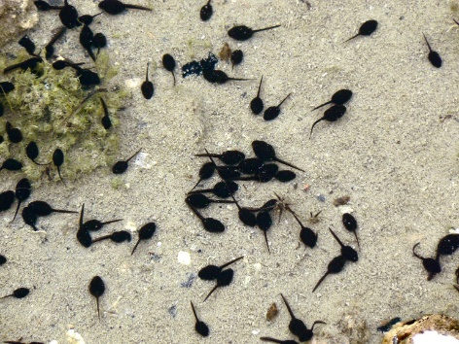
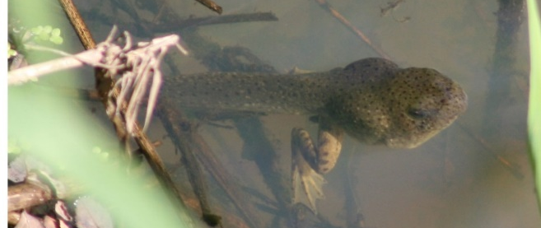
Amphibian
The lifecycle of a frog involves 5 main stages:
Start
The tadpole grows fins and a stronger tail. Then it develops lungs and hind legs.
The female lays mass of eggs which are fertilised by the male.
The tail disappears and it starts to eat insects instead of plants. It takes 2-4 years to become an adult frog, when it can lay eggs.
After 2-25 days the tadpole hatches from the egg. It swims and eats plants. It breathes through gills.
The tadpole grows front legs and tail shortens. Uses nutrients in tail as food. It jumps out of water onto land.
Amphibians:
live in water and on land
moist slimy skin
lays eggs
babies different from adults
Photo courtesy of Richard.Fisher, Anthony Masi, Benimoto, born 1945, Beckwith-Zink (Diane) (@flickr.com) - granted under creative commons licence – attribution

Slide 6
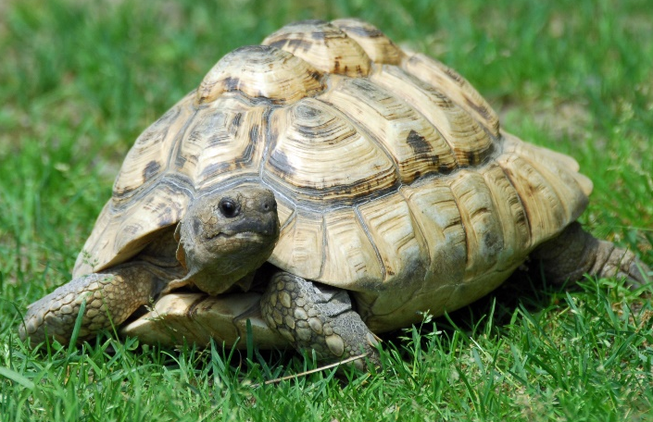
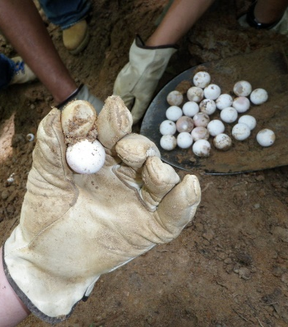
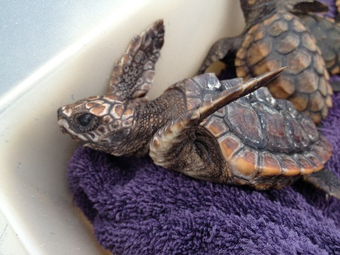
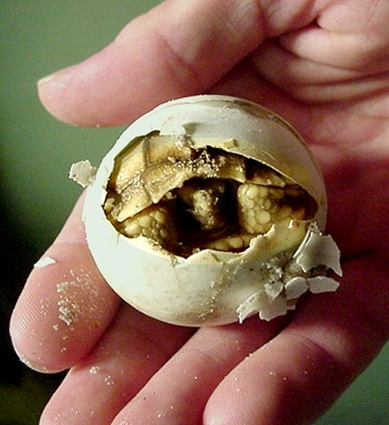
Reptiles
.
Start
Fully grown and ready to have its own babies.
The female and male mate, then the female reptiles lays fertilised eggs. An embryo starts to grow within the egg. Most reptiles bury their eggs and leave them to hatch alone.
The hatchling begins to grow and becomes a juvenile. The juvenile looks just like the adult reptile. The juvenile grows slowly over a long period before reaching adulthood.
Interesting Fact
Although most reptiles lay eggs, a few species give birth to living offspring.
Reptiles:
most hatch from eggs.
are cold blooded.
have dry, scaly skin
Interesting Fact
Due to the Mother burying her eggs and leaving them to hatch, the hatchlings have to fend for themselves from the moment they leave their egg.
When the embryo is fully formed, it is called a hatchling. It uses an egg tooth to break out of the egg or ‘hatch’.
Photo courtesy of vastateparksstaff, EraPhernalia Vintage, MyFWCmedia, Eric Kilby (@flickr.com) - granted under creative commons licence – attribution

Slide 7
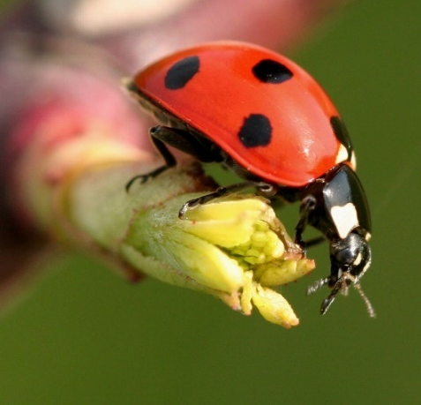
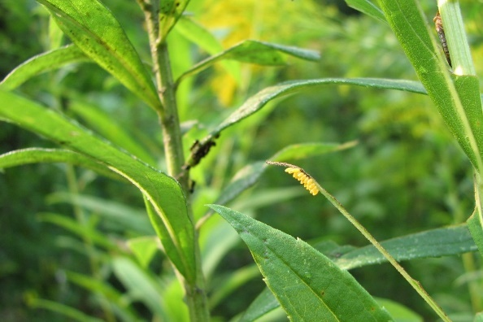
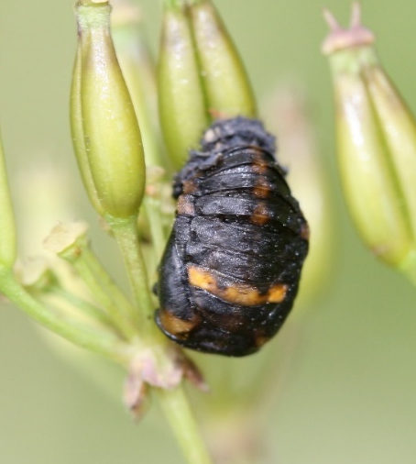
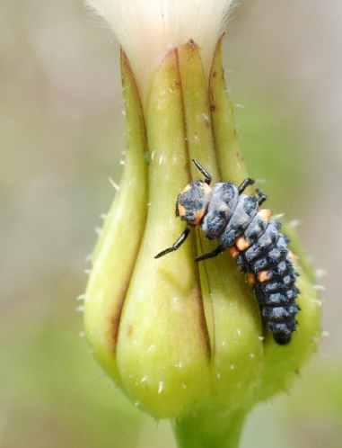
Insects
Most insects undergo complete metamorphosis. This involves 4 main stages:
Start
Eggs are laid by the female insect.
The pupa is formed when the larva moults for the last time. Pupa have a hard protective coating and are often camouflaged. The larva transforms completely inside the pupa.
The adult breaks out of the pupa and matures.
The eggs hatch into larva. The larva look nothing like the adult. This varies depending on species. Common forms are caterpillars, maggots, grubs.
Insects:
hatch from eggs
some look like parents and shed skin as grow
some go through metamorphosis young and adult are different.
Photo courtesy of Strange Ones, Eran Finkle and Sandy_R (@flickr.com) - granted under creative commons licence – attribution

Slide 8
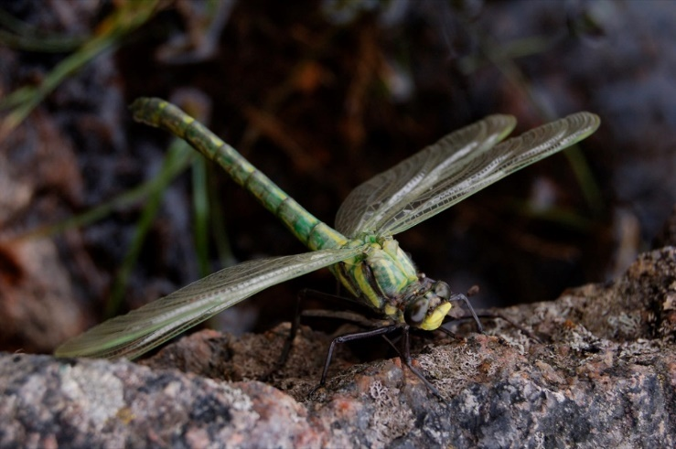
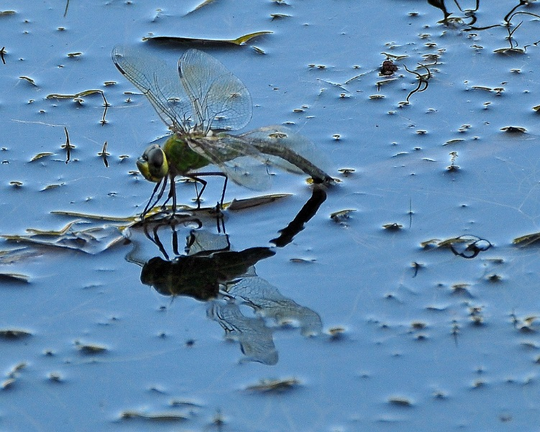
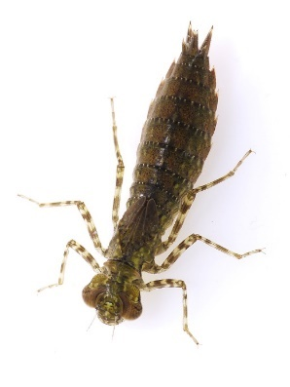
Insects
The lifecycles of insects that don’t complete metamorphosis involve 3 main stages:
Eggs are laid by the female insect.
The nymph grows into the adult form, sometimes shedding skin. In winged insects fully functional wings mark the adult stage. Adult females lay eggs.
Eggs hatch into nymphs. Appearance varies depending on species. Nymphs look like a smaller adult insect and usually share the same habitat and food as the adult.
Photo courtesy of leopard gecko, Dano and Tony Cyphert (@flickr.com) - granted under creative commons licence – attribution

Slide 9
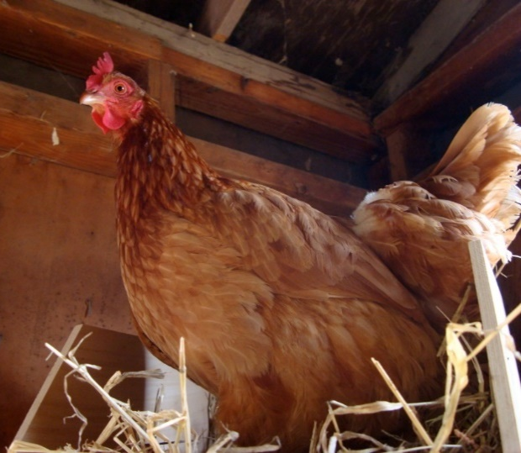
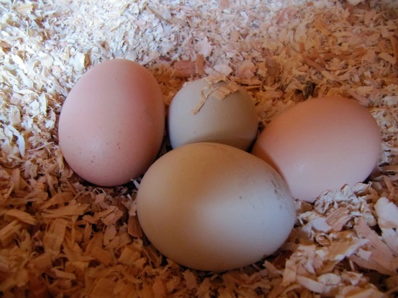
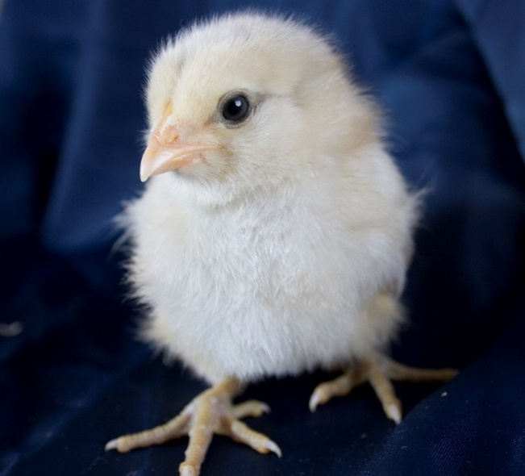
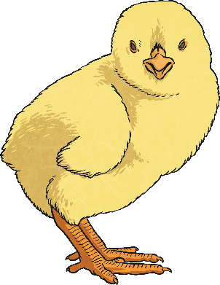
Birds
The lifecycle of a bird involves 3 main stages:
Start
Eggs are laid by the mother and the mother and father care for the egg until it hatches.
Independent adult usually seeks company from the opposite sex.
Mother and father feed the young bird until it is old enough to fly and find its own food.
Birds:
have feathers and wings
warm-blooded
lays eggs
Photo courtesy of Katie@!, portmanteaus and mazaletel (@flickr.com) - granted under creative commons licence – attribution

Slide 10
Life Cycles
Compare the life cycles of mammals and birds.
Similarities
Differences
3 main stages
First stage is where embryo forms and grows
Second stage is where young is supported by parents.
Third stage is adult stage where reproduction takes place.
Mammals give birth to live young
Birds lay eggs
Mammal usually nursed by mother
Young birds usually fed by adult male and female.

Slide 11
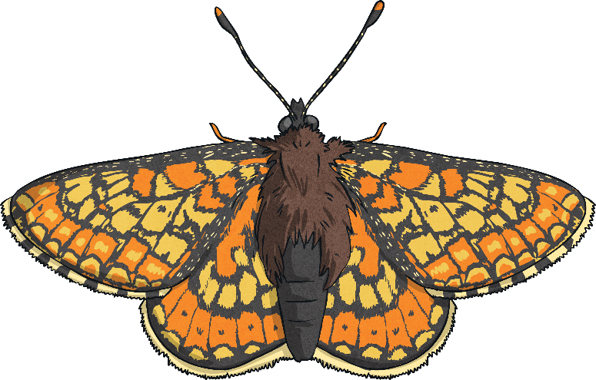
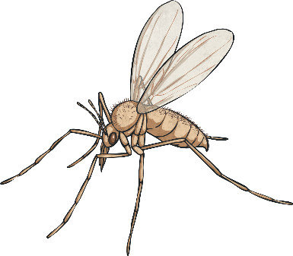
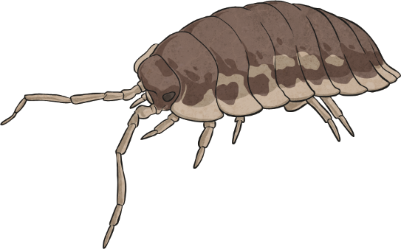
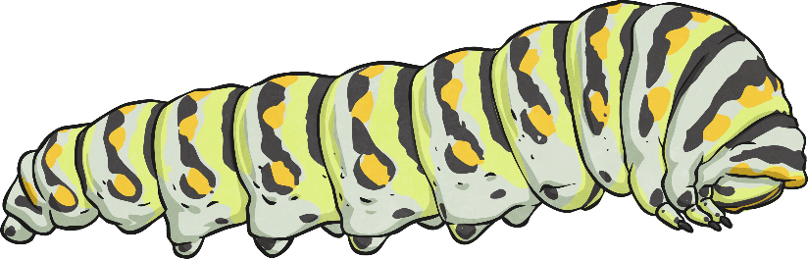
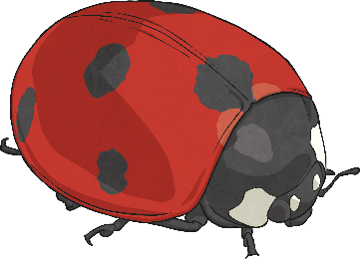
Insects
YOUR LEARNING TASKS:
Task 1:
Research the lifecycles of 2 different insects.
Explain the specific lifestyle of each insect.
Compare the lifecycles, what is the same and what is different?
Think how you can present your ideas.

Slide 12
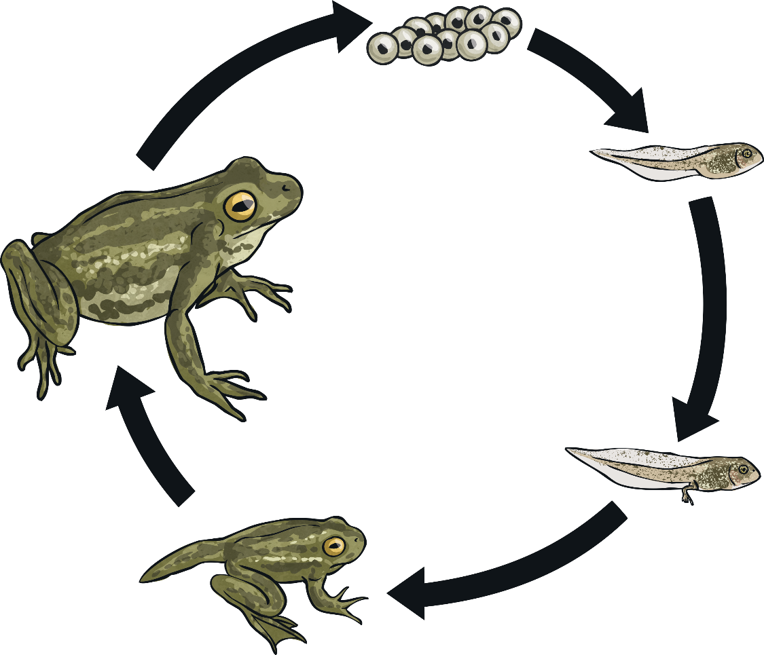
Amphibian
The lifecycle of a frog involves 5 main stages:
Task 2:
Present your learning about the life cycle of a frog (or a different amphibian) in one of these ways or in your own way:
Create a computer based presentation like PowerPoint
Use drama
Make a small book

