Slide 1

Pronouns
Let's learn about pronouns! Grade 2 English

Slide 2
What is a Pronoun?
A pronoun is a word that takes the place of a noun. Example: Instead of saying 'Maria is happy', we can say 'She is happy'.

Slide 3
Why Do We Use Pronouns?
We use pronouns to avoid repeating the same nouns again and again. Example: Tom is my friend. Tom likes to play. ➡ Tom is my friend. He likes to play.

Slide 4
Examples of Pronouns
Some common pronouns are: • I • You • He • She • It • We • They

Slide 5
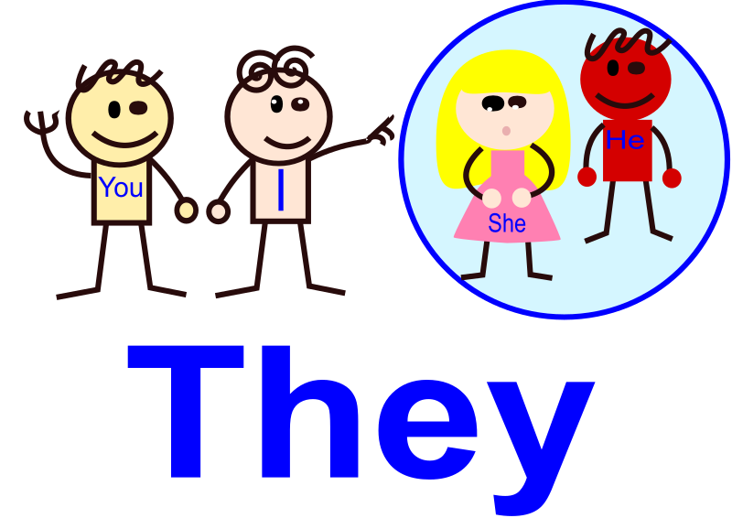
Pronouns for People
We use 'he' for boys and men. We use 'she' for girls and women. We use 'they' for more than one person. Examples: • John is tall. ➡ He is tall. • Mary is kind. ➡ She is kind. • John and Mary are friends. ➡ They are friends.

Slide 6

Pronouns

Slide 7
Pronouns for Things and Animals
We use 'it' for one animal or thing. We use 'they' for more than one animal or thing. Examples: • The cat is sleeping. ➡ It is sleeping. • The cats are playing. ➡ They are playing.

Slide 8
Pronouns for Yourself
We use 'I' when we talk about ourselves. We use 'we' when we talk about ourselves with others. Examples: • I am a student. • We are in Grade 2.

Slide 9
Let's Remember
• Pronouns replace nouns. • They make sentences shorter and easier. • Examples: I, he, she, it, we, they, you.

Slide 10
Thank You!
Now you know what pronouns are! Let's practice using them in class!

