Slide 1

Rhyming and Humorous Poems
Let's learn about fun and creative types of poems!
Unit 4
For Grade 2 English

Slide 2
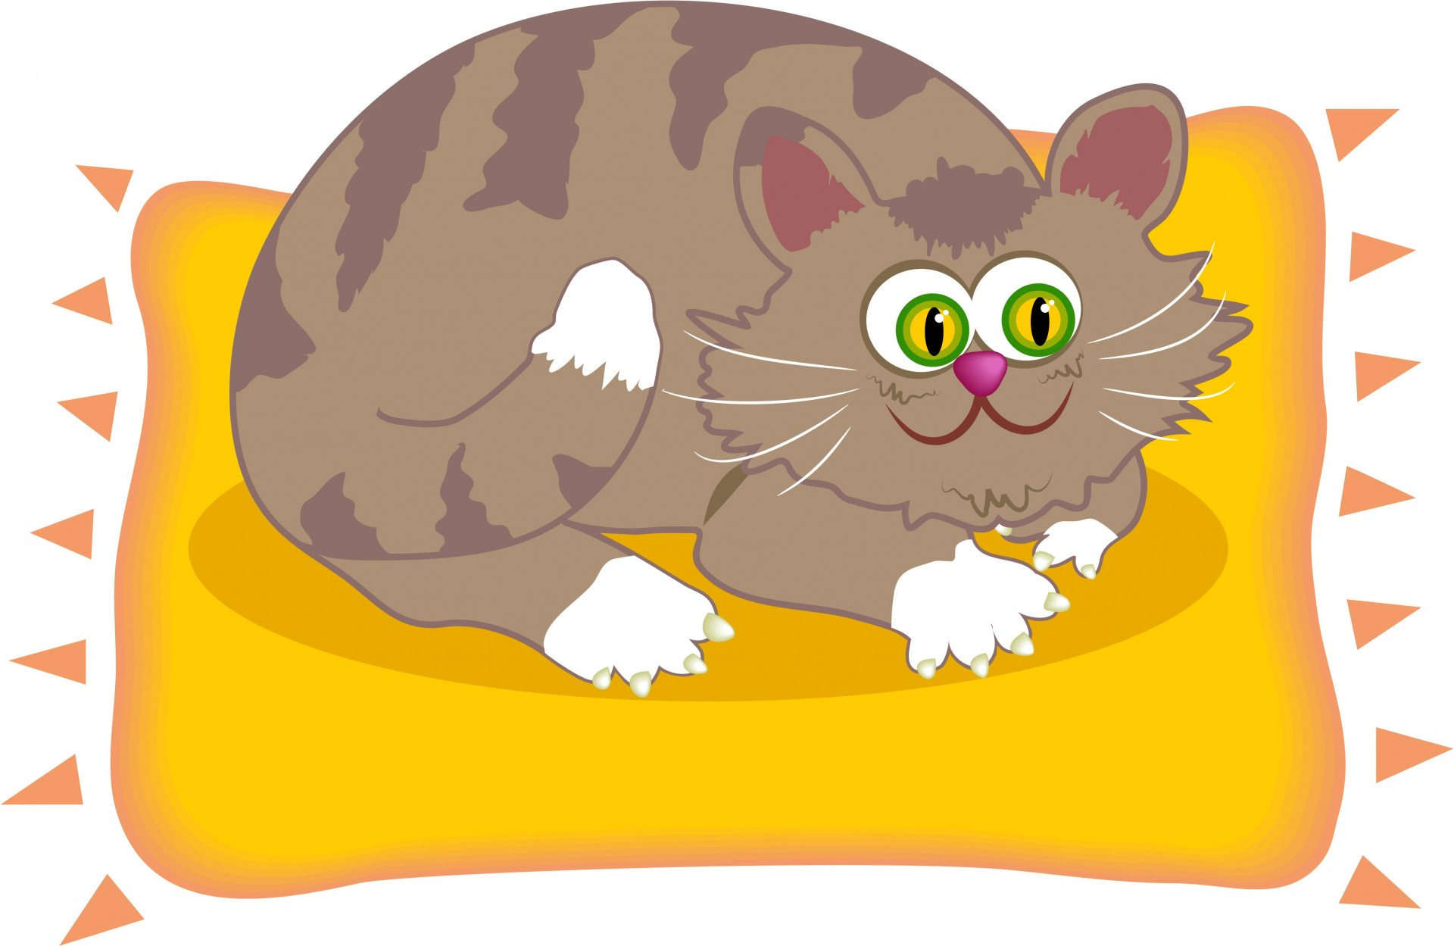
What is a Rhyming Poem?
A rhyming poem is a poem where words at the end of the lines sound the same. Example: The cat sat on the mat, Wearing a funny hat!

Slide 3
More Rhyming Examples
Rhyming words have the same ending sound. Examples: • Sun – Fun • Cake – Bake • Tree – Bee

Slide 4

Why Do We Use Rhymes?
Rhyming makes poems sound musical and fun! It helps us remember the poem easily. Rhymes can also make the poem playful and happy!

Slide 5

What is a Humorous Poem?
A humorous poem makes us laugh or smile. It can tell a silly story or use funny words. Example: My dog likes to chase his tail, He spins around just like a sail!
Humorous means: Funny ☺

Slide 6
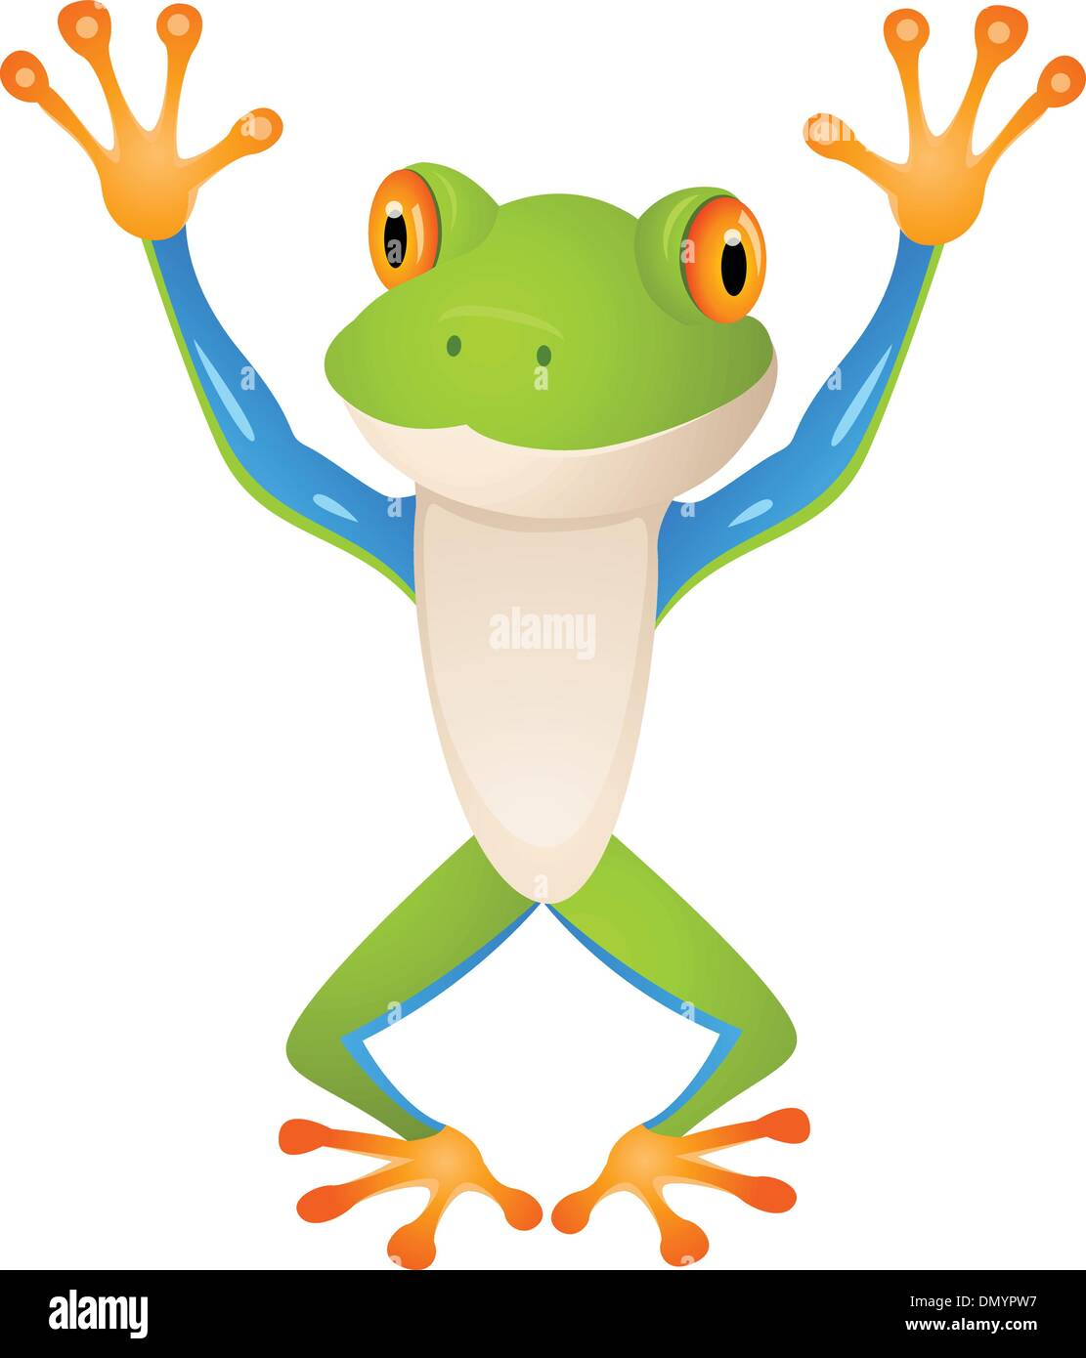
Funny Poem Example
There once was a frog named Lou, Who wanted to live in a shoe. He hopped in one night, And what a big fright! The shoe had a foot in it too!

Slide 7
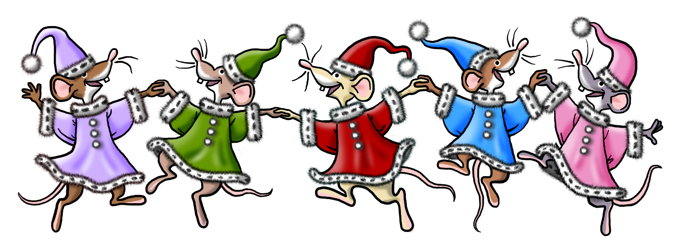
Rhyming + Humor Together!
Many funny poems also rhyme! That makes them even more fun to read. Example: I had a pet mouse, Who lived in my house, He squeaked for some cheese, Then ran up my blouse!

Slide 8
Let's Remember
• Rhyming poems have words that sound the same. • Humorous poems are funny and make us smile. • Both are fun to read and write!

Slide 9
Thank You!
Now you know about rhyming and humorous poems! Let's read some together in class!

