Slide 1
Science presentation
Made by Sophia madain

Slide 2
Mold attack
when airborne microscopic spores land on the food's moist surface and find the right conditions to thrive. These conditions include moisture, warmth, nutrients from the food, and oxygen. Once a spore takes root, it sends out thread-like structures called mycelia to absorb nutrients, breaking down the food and causing it to rot.

Slide 3
WHY DOES MOLD GROW ON FRUT VEGTEBLES CHEESE ETC
Mold grows because its spores find a damp, dark, and organic-rich surface to thrive on. The essential ingredients are moisture, an organic food source (like dust, wood, or wallpaper), oxygen, and a suitable temperature, typically .Common causes for indoor mold growth include water leaks, high humidity from showers or cooking, and poor ventilation.

Slide 4
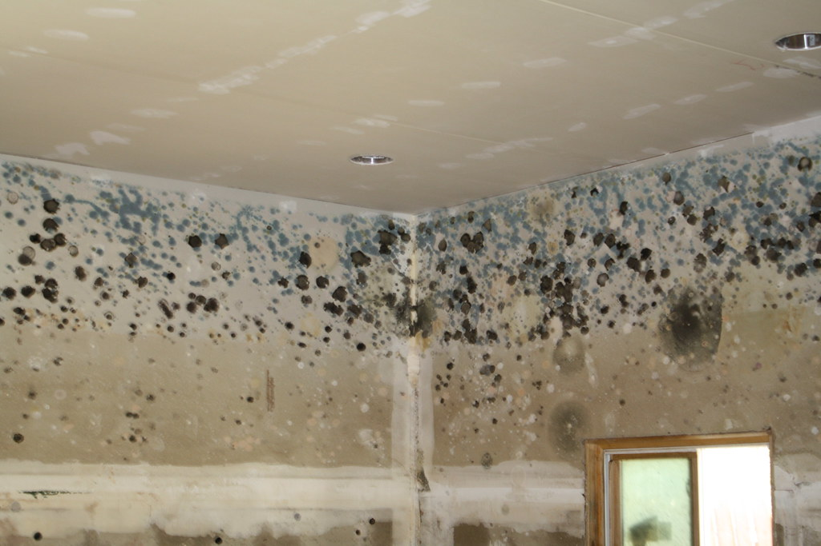
WHY DOES MOLD GROW IN YOUR HOUSE
Mold grows in houses because it needs moisture and organic material, which are readily available in most homes. Moisture enters through leaks from roofs, pipes, or windows, or from high humidity from daily activities like cooking, showering, or drying clothes indoors. This moisture provides the necessary conditions for the invisible mold spores, which are always in the air, to settle on surfaces and start to grow.
This Photo by Unknown Author is licensed under CC BY

Slide 5
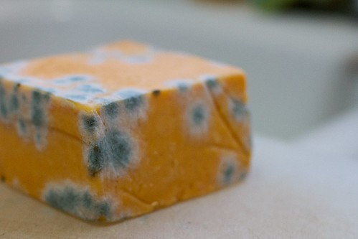
How does mold grow on cheese
mold is a type of fungus that thrives in warm and moist environments. When it comes to cheese, mold growth can occur due to a combination of factors. These include the presence of mold spores in the air, moisture content, temperature, and the type of cheese.
This Photo by Unknown Author is licensed under CC BY

Slide 6
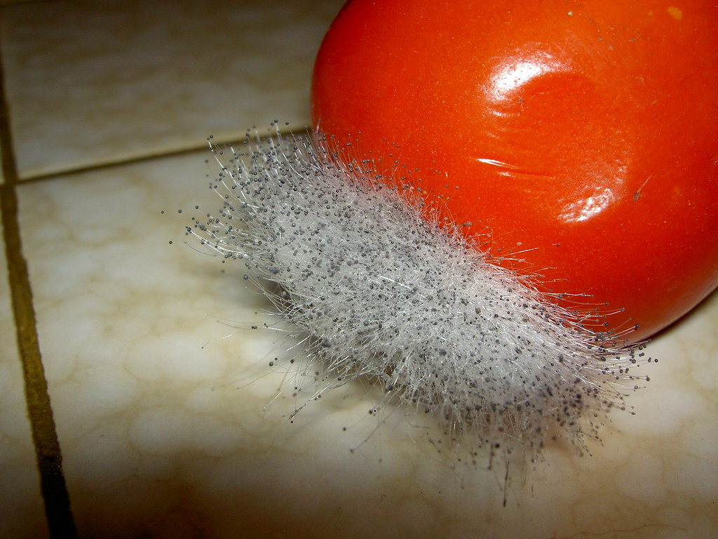
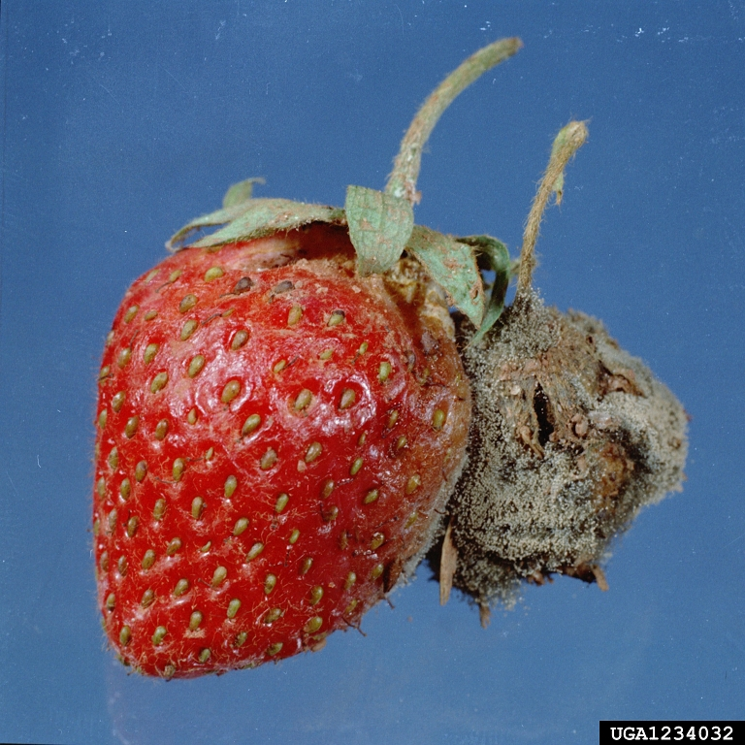
How does mold grow on fruits and VEGETABLE
mold grows on fruits and vegetables when tiny, airborne spores land on a damp surface with enough nutrients, oxygen, and the right temperature. The spores germinate, sending out root-like structures (hyphae) that penetrate the food, breaking it down and using it for energy. Damaged areas on the produce make them even more susceptible, as the protecti
This Photo by Unknown Author is licensed under CC BY-SA
This Photo by Unknown Author is licensed under CC BY

Slide 7
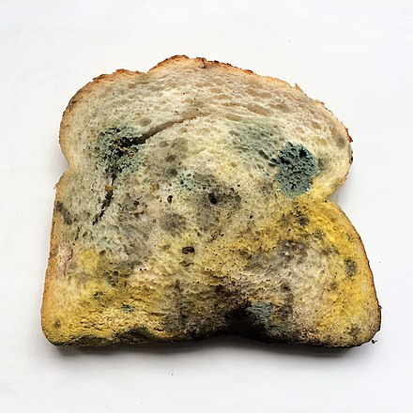
How does mold grow on bread
Mold grows on bread when airborne mold spores land on the bread and find suitable conditions, such as moisture, warmth, and a lack of sunlight, to germinate. Once the spores land, they send out root-like structures called hyphae that spread into the bread, and the mold begins to feed on the sugars, starches, and proteins. As the mold matures, it forms fruiting bodies that release new spores, starting the cycle over again.
This Photo by Unknown Author is licensed under CC BY-SA

Slide 8
Why is mold bad for you and your health
Mold is bad for you because it can cause allergic reactions, irritant symptoms, and, in some cases, infections or health problems from toxins (mycotoxins). Common symptoms include sneezing, a runny nose, watery eyes, and skin rashes. For people with asthma or other lung conditions, mold can trigger attacks. In individuals with weakened immune systems, mold can lead to serious infections.

Slide 9
CONDITIONS OF MOLD
Moisture: Mold cannot grow without water. Moisture from leaks, floods, high humidity, or condensation creates the damp conditions mold needs to spread.
Food source: Mold consumes organic materials. Common indoor food sources include wallpaper glue, paint, wood products, dust, and dead skin cells.
Oxygen: Mold needs oxygen to survive. While it's difficult to remove all oxygen, mold can grow even in low concentrations.
Temperature: Many molds grow best in temperatures between $60^\circ$F and $80^\circ$F, which are often the same temperatures humans find comfortable.

Slide 10
BIG QUESTION
WHICH FOOD GROWS MOLD THE FASTEST
Foods like cheese, cooked eggs, and dried fruits tend to mold the fastest because they have high moisture, fat, or nutrient content that provides ideal conditions for mold to grow. Berries and other fresh fruits and vegetables are also quick to mold, especially when damaged or stored improperly.

Slide 11


THANK YOU FOR LISTENING
This Photo by Unknown Author is licensed under CC BY-NC
This Photo by Unknown Author is licensed under CC BY-SA-NC
This Photo by Unknown Author is licensed under CC BY-SA-NC

