Slide 1
Why expiry dates matter
Done by : shereen

Slide 2
When food expires, you should immediately throw out anything that has passed its "use-by" date and be more cautious with food past its "best-before" date. For food with a "best-before" date, use your judgment: if it looks, smells, and tastes fine, it's often still safe to eat, but throw it if you have any doubts. You can also try freezing items to preserve them longer or donating unopened, non-perishable food to a local food bank.

Slide 3
Why are there expiry dates and why do they matter
Expiry dates matter because they indicate the time a product is guaranteed to be safe and effective, protecting against health risks from spoiled food or ineffective medications. They also ensure quality, as expired products can lose flavor, potency, and purity. Following expiry dates is crucial for food safety and the proper functioning of medicines and other products like disinfectants.

Slide 4
Why do foods have expiry dates
Foods have expiry dates to indicate their quality and safety over time. A "best before" date signifies the point at which the food may lose quality in taste, texture, or nutritional value, though it is often still safe to eat. A "use by" date is a safety warning for highly perishable foods like meat and dairy, and the product should not be consumed after this date.

Slide 5

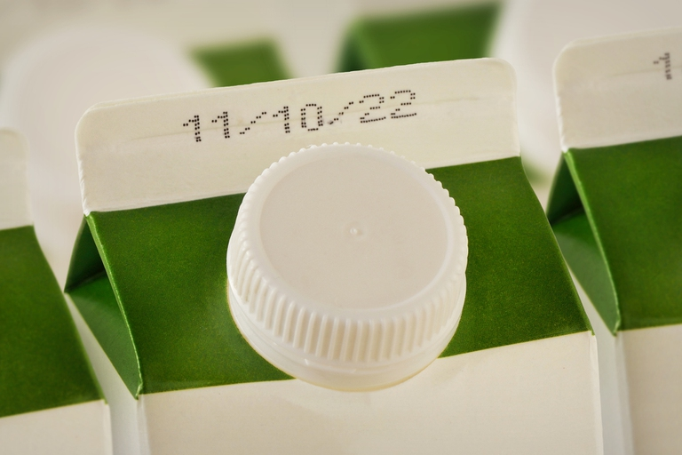
Pictures of expiry

Slide 6
What happens after food expires : After the expiration date, food may lose quality, have reduced nutritional value, or become unsafe to eat due to the growth of harmful bacteria like E. coli or Salmonella. Consuming expired food, especially perishable items, can lead to food poisoning with symptoms such as nausea, vomiting, and diarrhea. However, many shelf-stable and frozen foods are safe to eat long after the printed date, and it's important to use your senses to check for spoilage like mold

Slide 7
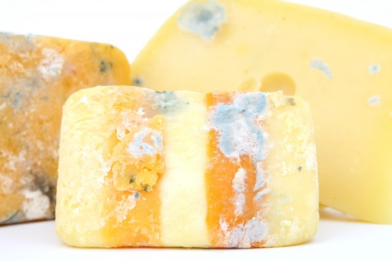
Why does food spoil over time :Food spoils over time due to the growth of microorganisms like bacteria, yeasts, and molds, as well as the activity of enzymes naturally present in the food. These agents break down the food, changing its texture, flavor, and odor, a process that is influenced by factors like temperature, moisture, air, and light.

