Slide 1
WHY EXPIRY DATES MATTER
DONE BY : SILA KHOURY

Slide 2
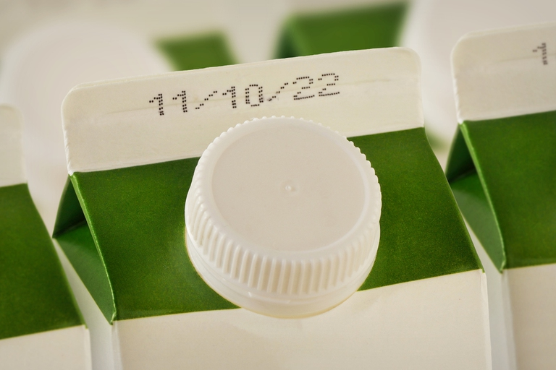
Why Foods Have Expiry dates ?
Foods have expiry dates to indicate both safety and quality. A "use-by" date is for safety and appears on perishable foods that go off quickly, meaning they should not be consumed after that date. A "best-before" or "best by" date relates to quality, indicating when a product may start to lose its freshness, flavor, or nutritional value, though it may still be safe to eat.
This Photo by Unknown Author is licensed under CC BY-NC-ND

Slide 3
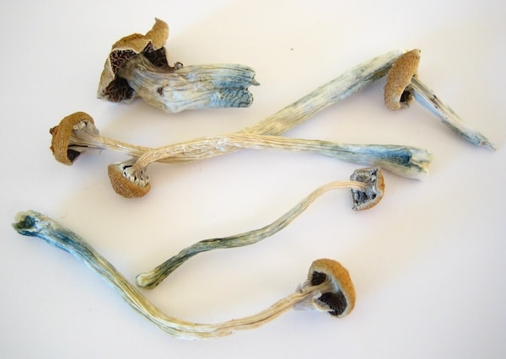
Can we eat expired food ?
No, you should not eat expired food because it can be unsafe and lead to food poisoning from harmful bacteria like E. coli or Salmonella. While some pantry items may last longer, perishable foods like fresh produce or dairy should be discarded after their expiration date to avoid health risks. Eating expired food can cause symptoms like nausea, vomiting, diarrhea, and fever.
This Photo by Unknown Author is licensed under CC BY-SA

Slide 4
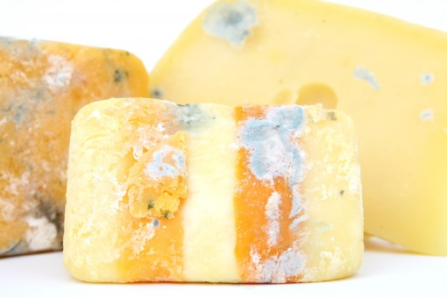
Why does food spoil over time ?
Food spoils due to the growth of microorganisms like bacteria, yeasts, and molds, as well as the action of enzymes naturally present in the food. Environmental factors such as moisture, temperature, oxygen, and light accelerate these processes, leading to undesirable changes in a food's texture, color, flavor, and safety.

Slide 5
What happens after they expire ?
After a product's expiration date, its quality and safety can degrade, leading to a loss of potency in medicines, spoilage in food, and potential health risks. While some items may still be safe to use, it is generally recommended to discard expired medications and exercise caution with expired food, using your senses to check for spoilage.

