Slide 1
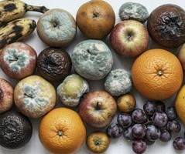
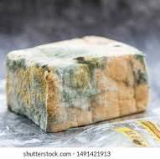
WHY EXPIRY DATES MATTER
DONE BY GHAZAL SAMAWI

Slide 2
WHY EXPIRY DATES MATTER
Expiration dates are important because they ensure the safety, quality, and effectiveness of products like food and medicine. Over time, food can develop harmful bacteria or lose nutritional value, and medications can lose their potency, making them ineffective or even harmful. Dates on products are a guide for when to consume, use, or discard them to prevent health risks and ensure the product performs as intended.

Slide 3
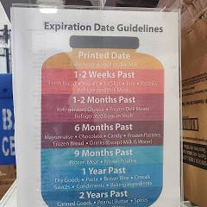
WHY DO FOOD SPOIL OVER TIME
After a product's expiration date, its quality and safety degrade over time. Food may become unsafe due to spoilage and bacterial growth, while medications can lose potency or become harmful, so it's best to use products before their "use by" date and dispose of them properly.
Food spoils over time due to a combination of microbiological growth, enzymatic reactions, and chemical processes like oxidation. Microorganisms such as bacteria, yeasts, and molds break down food, while natural enzymes cause changes in color, texture, and flavor. Environmental factors like temperature, oxygen, light, and moisture accelerate these processes, making food unsafe or unappealing to eat.

Slide 4
WHAT HAPPENS AFTER EXPIRY
How long you can eat food for past the written expiration ...After a product's expiration date, its quality and safety degrade over time. Food may become unsafe due to spoilage and bacterial growth, while medications can lose potency or become harmful, so it's best to use products before their "use by" date and dispose of them properly.

Slide 5
WHAT HAPPENS IF WE EAT EXPIRY FOOD
Eating expired food can lead to food poisoning due to harmful bacteria like Salmonella, Listeria, or E. coli, causing symptoms such as nausea, vomiting, diarrhea, fever, and abdominal pain. Other risks include mould toxicity and digestive issues, and for some foods like canned goods, there's an increased risk of exposure to harmful chemicals like BPA. The food's quality and nutritional value may also be lower.

Slide 6
thank you for listening
Done by ghzal samawi

