Slide 1

Mold attack!!
By:Joelle alrabadi

Slide 2
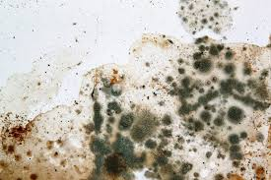
Facts about mold
Mold is a common fungus that is found everywhere, grows in moist areas, and reproduces via spores.

Slide 3

What mold does
It releases spores that trigger an immune response , causing allergic reactions like sneezing or a runny nose. For people with asthma, this can lead to asthma attacks, and in some cases, mold can also release irritants and toxins that can cause other health problems like skin rashes or, in rare instances, more severe respiratory issues.

Slide 4
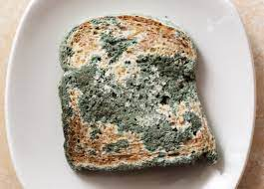
How mold grows on bread
Mold grows on bread when airborne fungal spores land on a favorable environment, such as a moist, warm slice. Once settled, the spores send out root-like structures called hyphae to absorb nutrients from the bread's sugars, starches, and proteins, while the visible fuzzy growth on top is the mold's fruiting body that releases new spores.

Slide 5
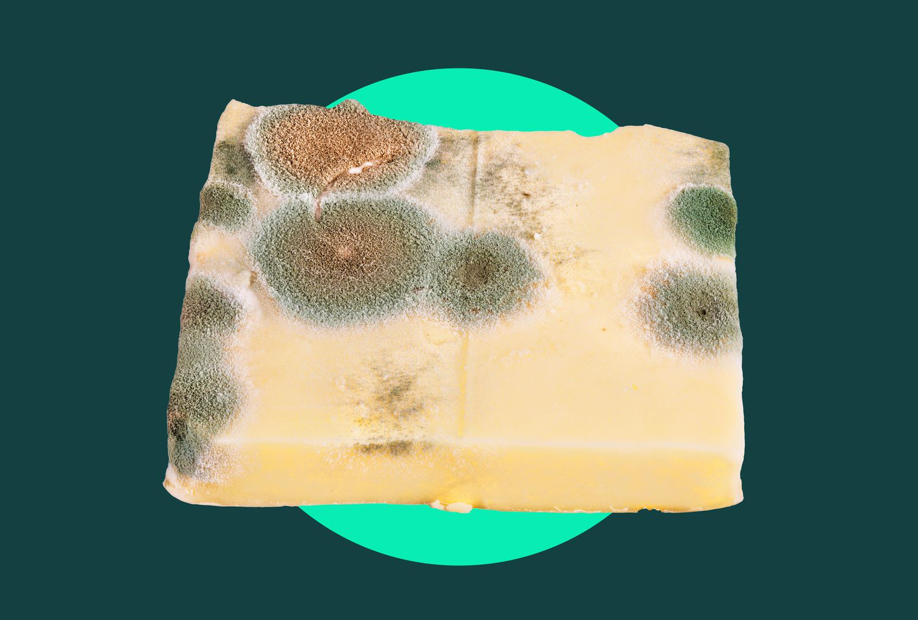
How mold grows on cheese
Mold grows on cheese when airborne spores land on it and find favorable conditions like moisture, warmth, and nutrients. Soft, high-moisture cheeses are more susceptible, while factors like high salt content, acidic pH, and lack of oxygen can inhibit mold growth. Proper storage in a breathable wrapper, rather than sealed plastic, and cool.

Slide 6
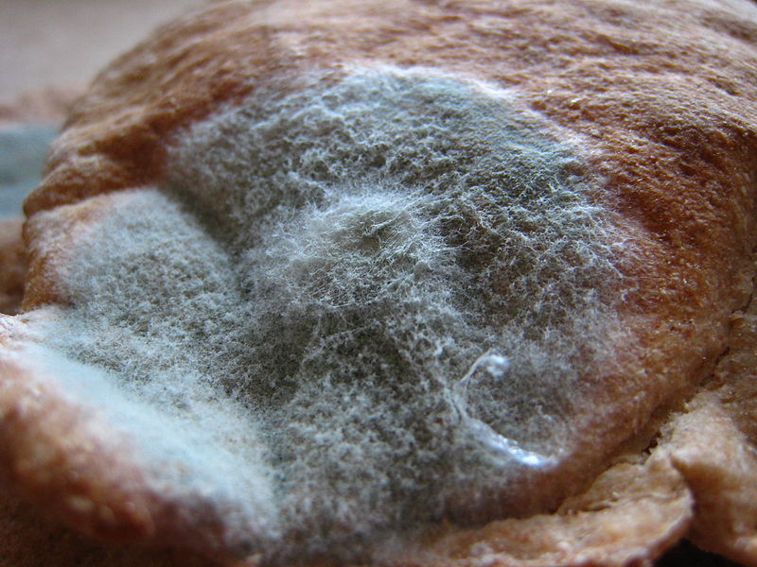
Big question!!!!
Which food grows mold the fastest?
Foods with high moisture content, especially those that are soft and damaged, grow mold the fastest. Examples include berries, tomatoes, and mushrooms, as well as soft cheeses, lunch meat, bread, and cooked grains and beans. Factors like warmth, darkness, and oxygen also accelerate mold growth.

Slide 7


