Slide 1
WHY EXPIRY DATES MATTER alma dorgham

Slide 2
Why expiry dates matter?
The importance of product expiry dates goes far beyond the food industry. While perhaps most evident on our supermarket shelves, “best before” and expiry dates serve a critical purpose in many different industries.
Whether you are a manufacturer, laboratory, or even a retailer, if your products have an expiration date, then it is essential to ensure that this date is accurate and reliable. For producers, expiry dates help ensure their products maintain the level of quality and effectiveness that they promise their customers.
While foodstuffs are perhaps the most obvious area where expiry dates are used, they are also used in many other industries, such as cosmetics, pharmaceuticals, and more. In the chemical industry, for example, using reagents that are past their expiry date could lead to inaccurate test results and, thus, unreliable products.

Slide 3
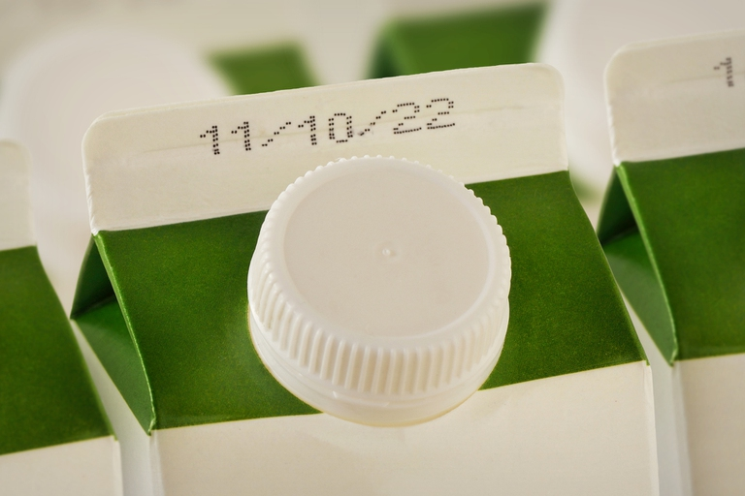
Expiry dates can be harmful because they indicate when a product, especially food and medication, may have degraded, become unsafe, or lost its effectiveness. Consuming expired products can lead to food poisoning from bacterial growth or, in the case of medications, cause serious health issues due to reduced potency or dangerous chemical changes. Vulnerable populations like the elderly, young children, and pregnant women are at higher risk of severe consequences from expired products.
This Photo by Unknown Author is licensed under CC BY-NC-ND

Slide 4
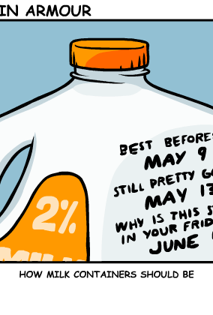
About expiry food
An expiry date is the last day a product is guaranteed to be safe, while a "best before" date refers to peak quality, not safety. Consuming products past their "use by" or "expiry" date can be risky and lead to food poisoning or loss of effectiveness. "Best before" products may still be safe to eat after the date if they have been properly stored, but their quality may decline.
This Photo by Unknown Author is licensed under CC BY-NC

Slide 5
Big question
ood spoils due to the growth of microorganisms like bacteria, mold, and yeast, and the action of naturally occurring enzymes within the food. These processes are accelerated by moisture, oxygen, and ideal temperatures (roughly
40∘F40 raised to the composed with power cap F
40∘𝐹
to
140∘F140 raised to the composed with power cap F
140∘𝐹
Why does food spoil over time

Slide 6
How does food spoil over time?
Food spoils due to the growth of microorganisms like bacteria, yeasts, and molds, and the activity of natural enzymes within the food itself. These processes break down the food, changing its taste, texture, and smell, and are influenced by factors like moisture, temperature, and oxygen.

Slide 7
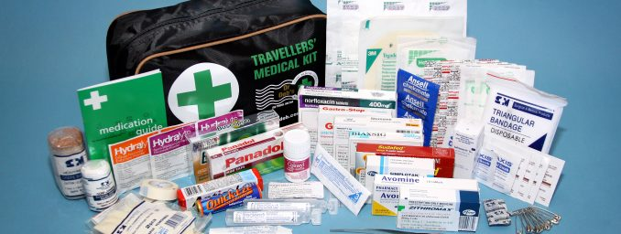
This Photo by Unknown Author is licensed under CC BY-ND

Slide 8
That’s all
Thank you

