Slide 1
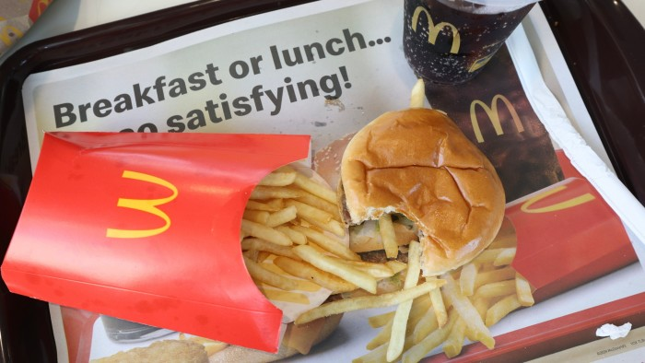
Food Spoilage
PRESENTATION BY AMIR AND NASER

Slide 2
Food Spoilage
PRESENTATION BY NASER AND AMIR
Food spoilage is the process whereby food becomes unsuitable to ingest by a person; it is a matter of food safety. Bacteria and various fungi are the causes of spoilage, and can create serious consequences for consumers, but there are preventive measures that can be taken. The precise cause of the process is due to many outside factors as a side-effect of the type of product it is, as well as how the product is packaged and stored.

Slide 3
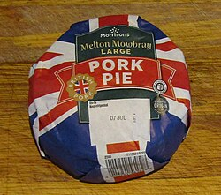
This is an image of a packaged food item, showing that the consumer should consume the product before this time in order to reduce chance of consuming spoiled food
Food spoilage is the process whereby food becomes unsuitable to ingest by a person; it is a matter of food safety. Bacteria and various fungi are the causes of spoilage, and can create serious consequences for consumers, but there are preventive measures that can be taken. The precise cause of the process is due to many outside factors as a side-effect of the type of product it is, as well as how the product is packaged and stored.

Slide 4
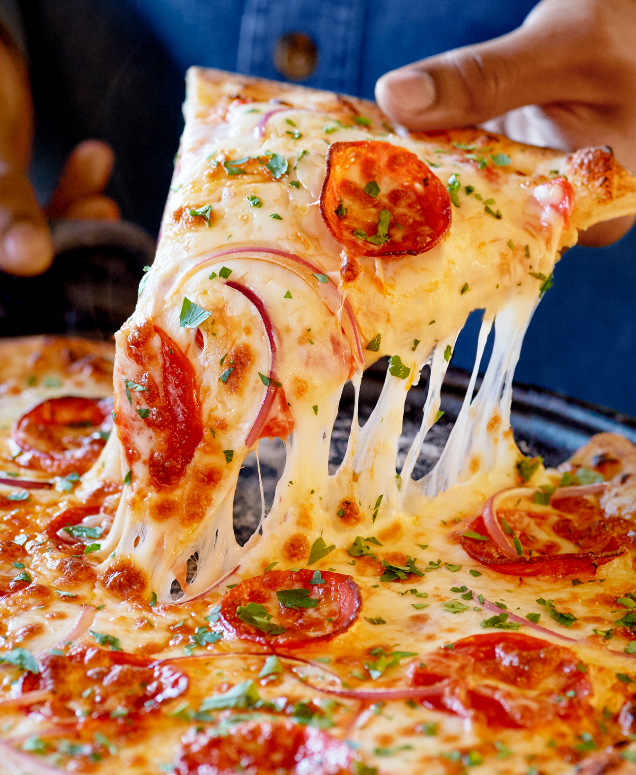
This is an image of a packaged food item, showing that the consumer should consume the product before this time in order to reduce chance of consuming spoiled food
Some bacteria are responsible for the spoilage of food. When bacteria breaks down the food, acids and other waste products are generated in the process.^{[2]} While the bacteria itself may or may not be harmful, the waste products may be unpleasant to taste or may even be harmful to one's health.^{[3]} There are many species of pathogenic bacteria that target different categories of food. For example, Clostridium botulinum spoils food such as meat and poultry, and Bacillus cereus, which spoils almost all type of food. When stored or subjected to unruly conditions, the organisms will begin to breed apace, releasing harmful toxins that can cause severe illness, even when cooked safely.^{[4]}

Slide 5
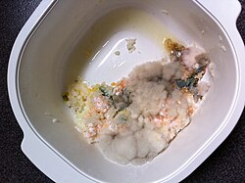
Fungi have been seen as a method of food spoilage, causing only an undesirable appearance to food, however, there has been significant evidence of various fungi being a cause of death. Fungi are caused by acidifying, fermenting, discoloring and disintegrating processes and can create fuzz, powder and slimes of many different colors, including black, white, red, brown and green.^{[5]}
Mold is a type of fungus, but the two terms are not reciprocal of each other; they have their own defining features and perform their own tasks.^{[6]} Very well known types of mold are Aspergillus and Penicillium, and, like regular fungi, create a fuzz, powder and slime of various colors.^{[1]}
Some bacteria are responsible for the spoilage of food. When bacteria breaks down the food, acids and other waste products are generated in the process.^{[2]} While the bacteria itself may or may not be harmful, the waste products may be unpleasant to taste or may even be harmful to one's health.^{[3]} There are many species of pathogenic bacteria that target different categories of food. For example, Clostridium botulinum spoils food such as meat and poultry, and Bacillus cereus, which spoils almost all type of food. When stored or subjected to unruly conditions, the organisms will begin to breed apace, releasing harmful toxins that can cause severe illness, even when cooked safely.^{[4]}

Slide 6
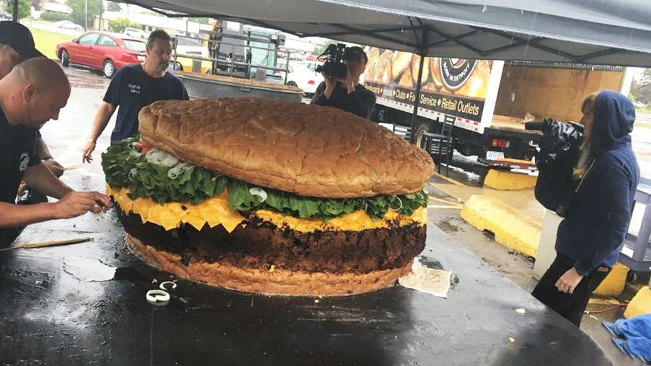
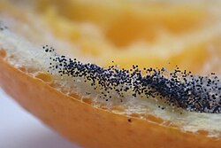
Yeast is also a type of fungus that grows vegetatively via single cells that either bud or divide by way of fission, allowing for yeast to multiply in liquid environments favoring the dissemination of unicellular microorganisms. Yeast forms mainly in liquid environments and anaerobic conditions, but being single celled, it oftentimes cannot spread on or into solid surfaces where other fungus flourish. Yeast also produces at a slower rate than bacteria, therefore being at a disadvantage in environments where bacteria are.^{[5]} Yeasts can be responsible for the decomposition of food with a high sugar content. The same effect is useful in the production of various types of food and beverages, such as bread, yogurt, cider, and alcoholic beverages.^{[7]}
Fungi have been seen as a method of food spoilage, causing only an undesirable appearance to food, however, there has been significant evidence of various fungi being a cause of death. Fungi are caused by acidifying, fermenting, discoloring and disintegrating processes and can create fuzz, powder and slimes of many different colors, including black, white, red, brown and green.^{[5]}
Mold is a type of fungus, but the two terms are not reciprocal of each other; they have their own defining features and perform their own tasks.^{[6]} Very well known types of mold are Aspergillus and Penicillium, and, like regular fungi, create a fuzz, powder and slime of various colors.^{[1]}

Slide 7
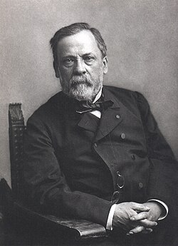
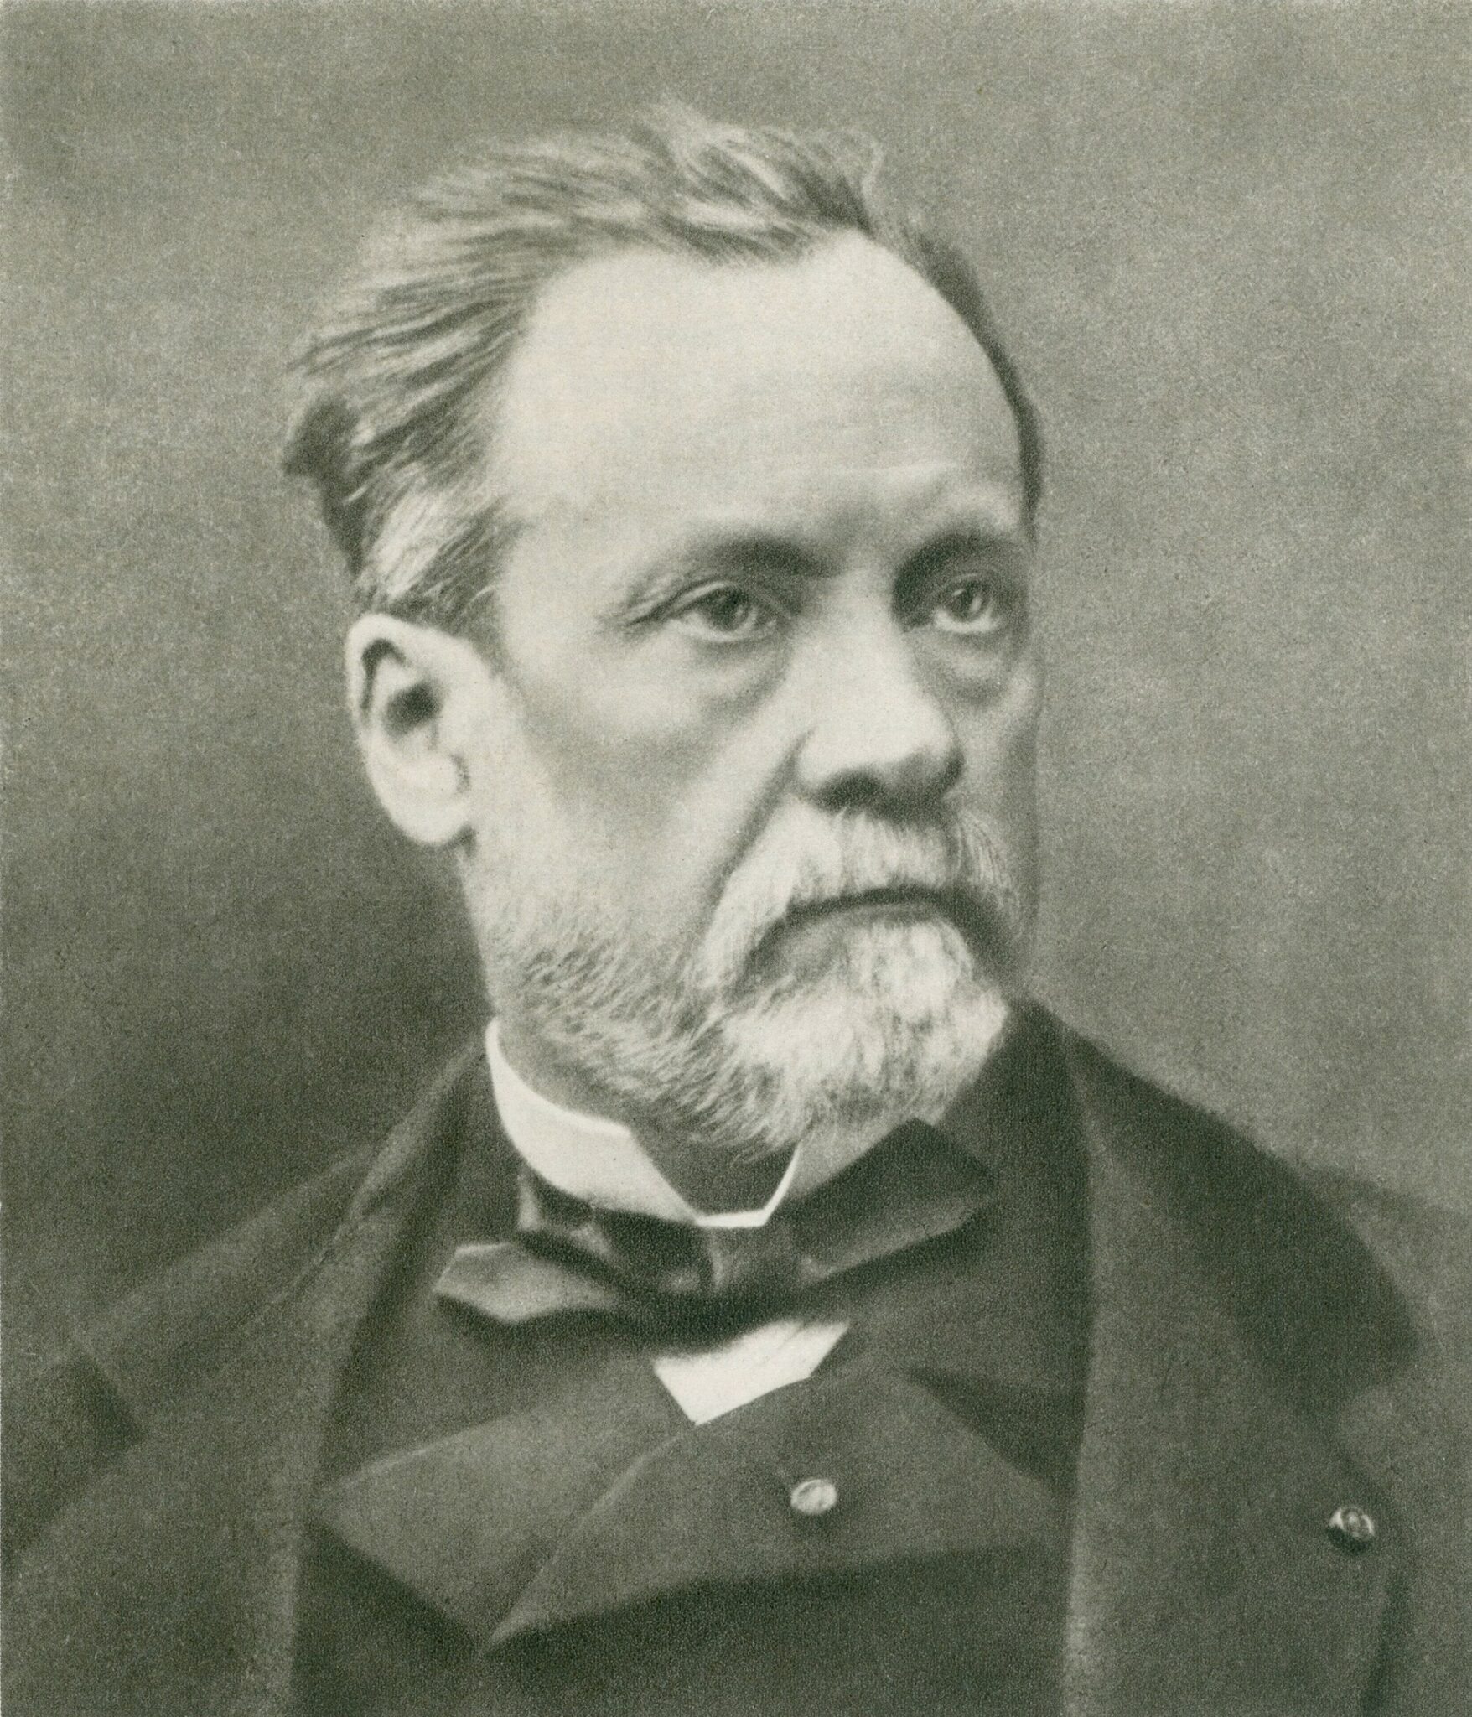
Yeast is also a type of fungus that grows vegetatively via single cells that either bud or divide by way of fission, allowing for yeast to multiply in liquid environments favoring the dissemination of unicellular microorganisms. Yeast forms mainly in liquid environments and anaerobic conditions, but being single celled, it oftentimes cannot spread on or into solid surfaces where other fungus flourish. Yeast also produces at a slower rate than bacteria, therefore being at a disadvantage in environments where bacteria are.^{[5]} Yeasts can be responsible for the decomposition of food with a high sugar content. The same effect is useful in the production of various types of food and beverages, such as bread, yogurt, cider, and alcoholic beverages.^{[7]}
The discovery that microorganisms cause food spoilage was made by Louis Pasteur in 1864, which linked spoilage to the growth of bacteria, molds, and yeasts. This understanding transformed food preservation by showing that spoilage is a biological process, not just a chemical one. The discovery helped develop preservation methods to kill or inhibit microbial growth.

Slide 8
Yeast is also a type of fungus that grows vegetatively via single cells that either bud or divide by way of fission, allowing for yeast to multiply in liquid environments favoring the dissemination of unicellular microorganisms. Yeast forms mainly in liquid environments and anaerobic conditions, but being single celled, it oftentimes cannot spread on or into solid surfaces where other fungus flourish. Yeast also produces at a slower rate than bacteria, therefore being at a disadvantage in environments where bacteria are.^{[5]} Yeasts can be responsible for the decomposition of food with a high sugar content. The same effect is useful in the production of various types of food and beverages, such as bread, yogurt, cider, and alcoholic beverages.^{[7]}
The discovery that microorganisms cause food spoilage was made by Louis Pasteur in 1864, which linked spoilage to the growth of bacteria, molds, and yeasts. This understanding transformed food preservation by showing that spoilage is a biological process, not just a chemical one. The discovery helped develop preservation methods to kill or inhibit microbial growth.
THE END

