Slide 1
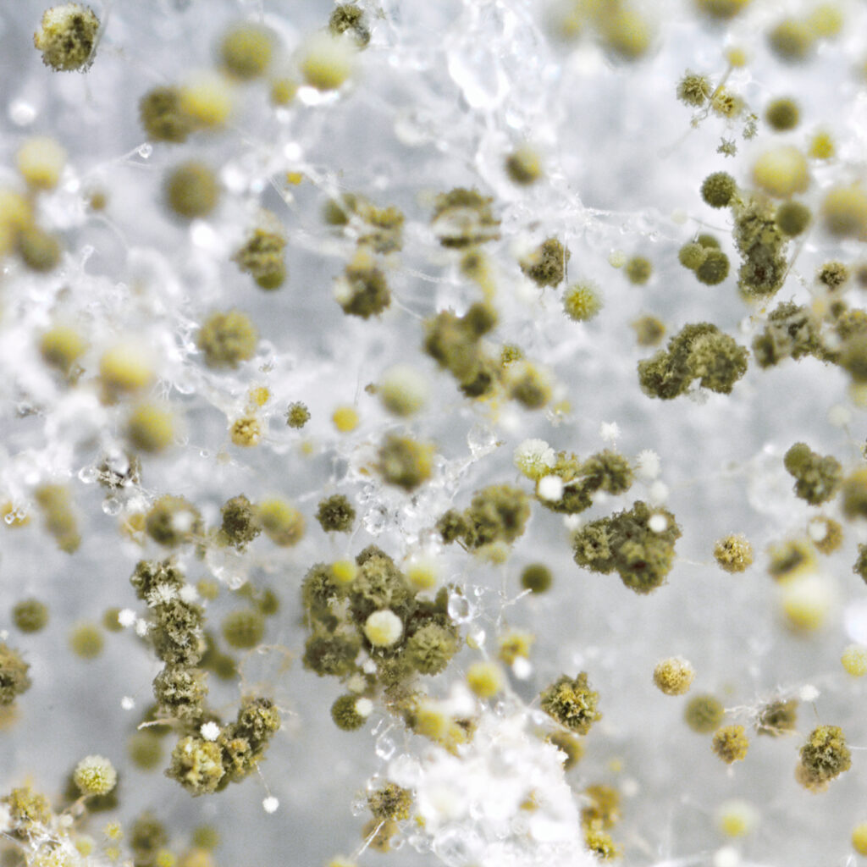
MOLD ATTACK
PRESENTED BY [ GEORGE MAKHAMREH]

Slide 2
Black mold.what is black mold?
Black mold is a type of fungus that looks dark green or black. There are many kinds of black mold, but when most people refer to it, they’re referring to Stachybotrys chartarum (S. chartarum). It grows and spreads on materials that contain a lot of cellulose, including paper products, wood products and drywall. Cellulose is a fiber in fruits, vegetables and other plants. It’s part of the cell wall.
Black mold needs warm temperatures and moisture to grow and spread. It commonly appears in damp or water-damaged areas of your home, such as basements, showers and windows.
For most people, black mold won’t make you very sick or kill you.

Slide 3
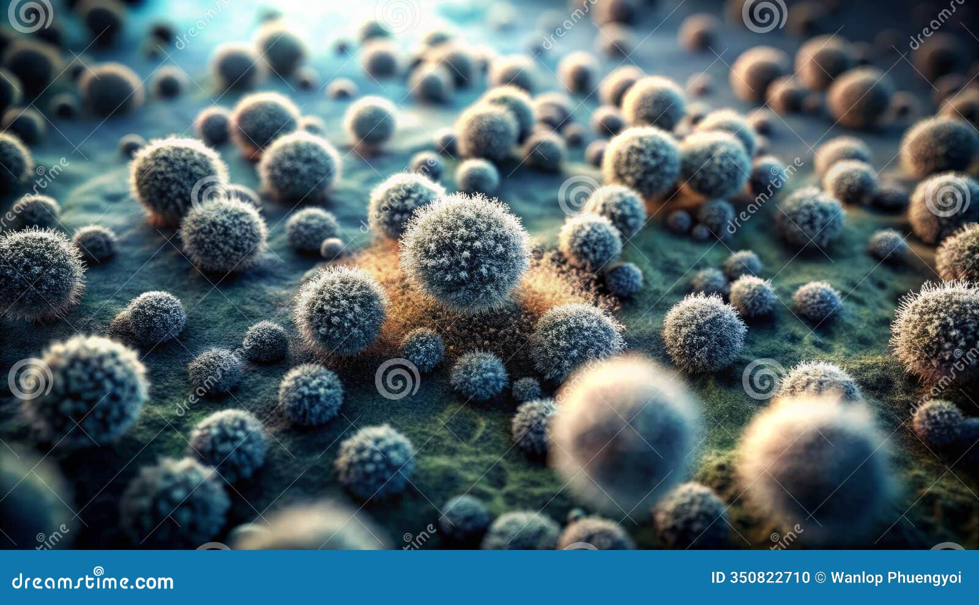
5 Facts about mold
It's estimated that approximately 47% of American homes have mold.
There are approximately 1.5 million types of mold.
Most mold is not dangerous to most humans but can pose some health risks to those with weakened immune systems.
Eliminating excess moisture is the key to preventing mold growth.

Slide 4
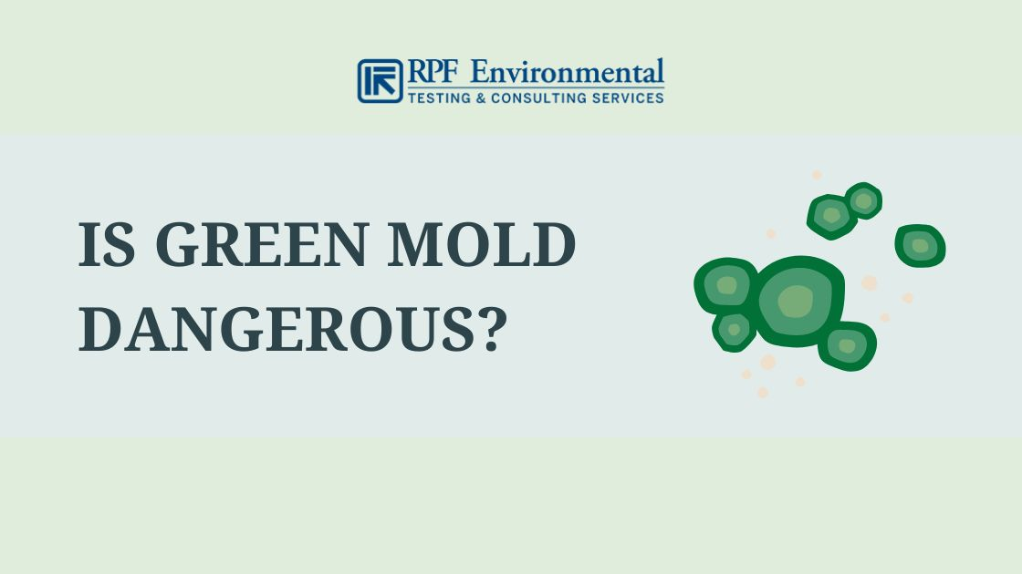
Is green mold dangerous
Yes, toxic species of green mold can cause difficulty breathing, watery eyes, swollen throat, coughing, and runny nose. They can even cause severe respiratory problems, cancer, and infections.

Slide 5
3 types of mold
Green mould. Green mould may be indicative of Cladosporium, Aspergillus or Penicillium mould. ...
White Mould. Likewise, white mould is often described as almost furry in look especially when found on damp wood. ...
Blue Mould. ...
Black Mould.

Slide 6


