Slide 1
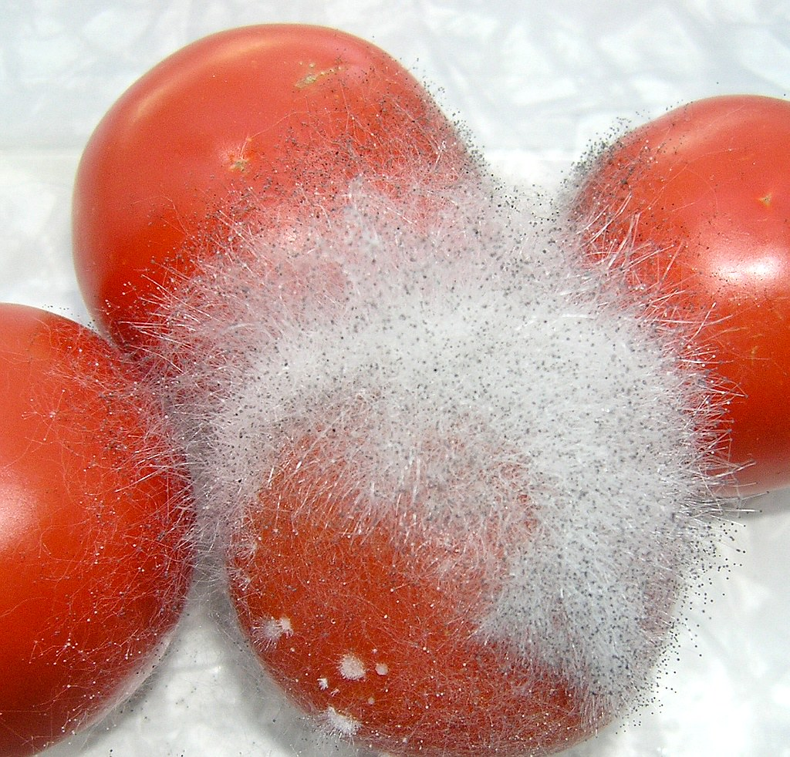
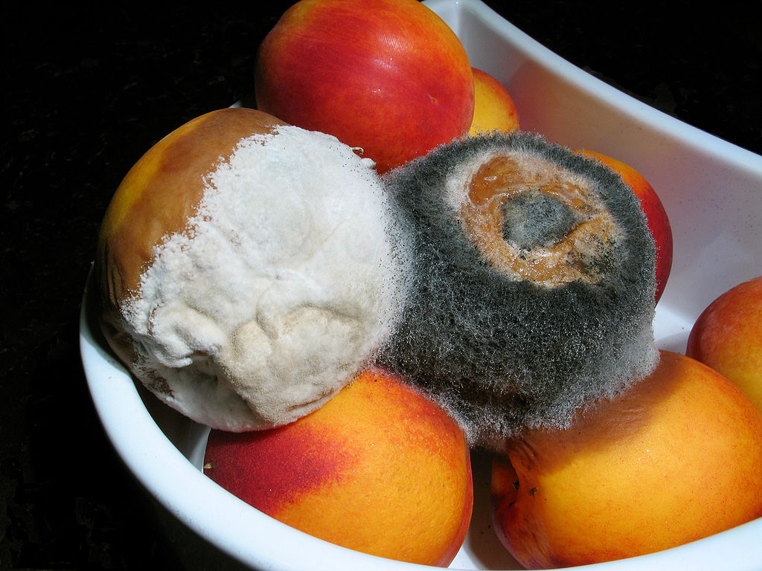
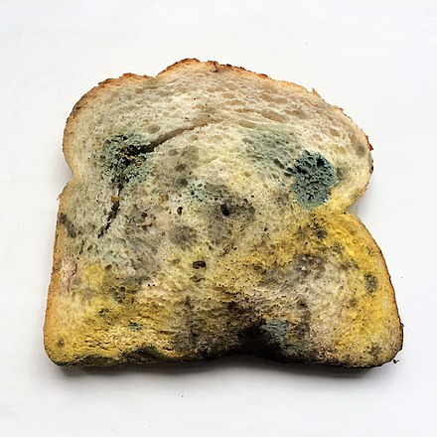

Mold Attack
is
Today im going to be talking about mold attack and how mold happenes and which fruit gets mold faster
This Photo by Unknown Author is licensed under CC BY-NC-ND
This Photo by Unknown Author is licensed under CC BY-SA
Notes:
1

Slide 2
The conditions that mold needs
Mold needs two conditions to grow on fruits bread and even hoses and they need moist and warm places

Slide 3
Here are some facts
Mold won’t grow if the conditions are not right. However, there are certain conditions that will facilitate a start to the mold growth problem and accelerate it. Moisture is the most important condition. Mold can start growing within 24 to 48 hours when moisture is present.

Slide 4
Here are the moisture levels
Mold thrives in areas with leaks, flooding, or humidity above 60%. Remember, the word is moisture and not water. Mold thrives when there is a slow and continuous presence of water. This allows the spores to settle in and start growing. During a flood, the water will take a while to dry up. During that drying stage, mold spores will settle around the moist areas and start growing.

Slide 5
This slide is about the tempreture for mold
Warm environments between 77°F and 86°F (25°C to 30°C) promote rapid mold growth. If it is too cold, mold cannot grow. That is because every living organism needs energy to grow. The spores will stay inert in very cold temperatures. Also, when it is too hot, the spores may not survive since it dries out the environment.
Below 77°F (25°C), mold growth will slow down. The higher you go past 86°F (30°C), mold growth starts to fail.

Slide 6
The fastest fruit to get mold faster
Berries, especially strawberries, are among the fastest-growing fruits for mold because they have high moisture, high sugar content, and a lack of protective skin. Other high-moisture fruits like peaches and plums also mold quickly, while harder fruits like apples last longer.

Slide 7
THANKS FOR WATCHING

